Slide 1
Introduction
Lecture 1b: Database Management Systems (DBS)
Dr Kemi Ademoye

Slide 2
Today’s Lecture
Historical Development of Databases
File-Based Systems
The Database and Database Management Systems (DBMSs)
Advantages and Disadvantages of DBMSs

Slide 3
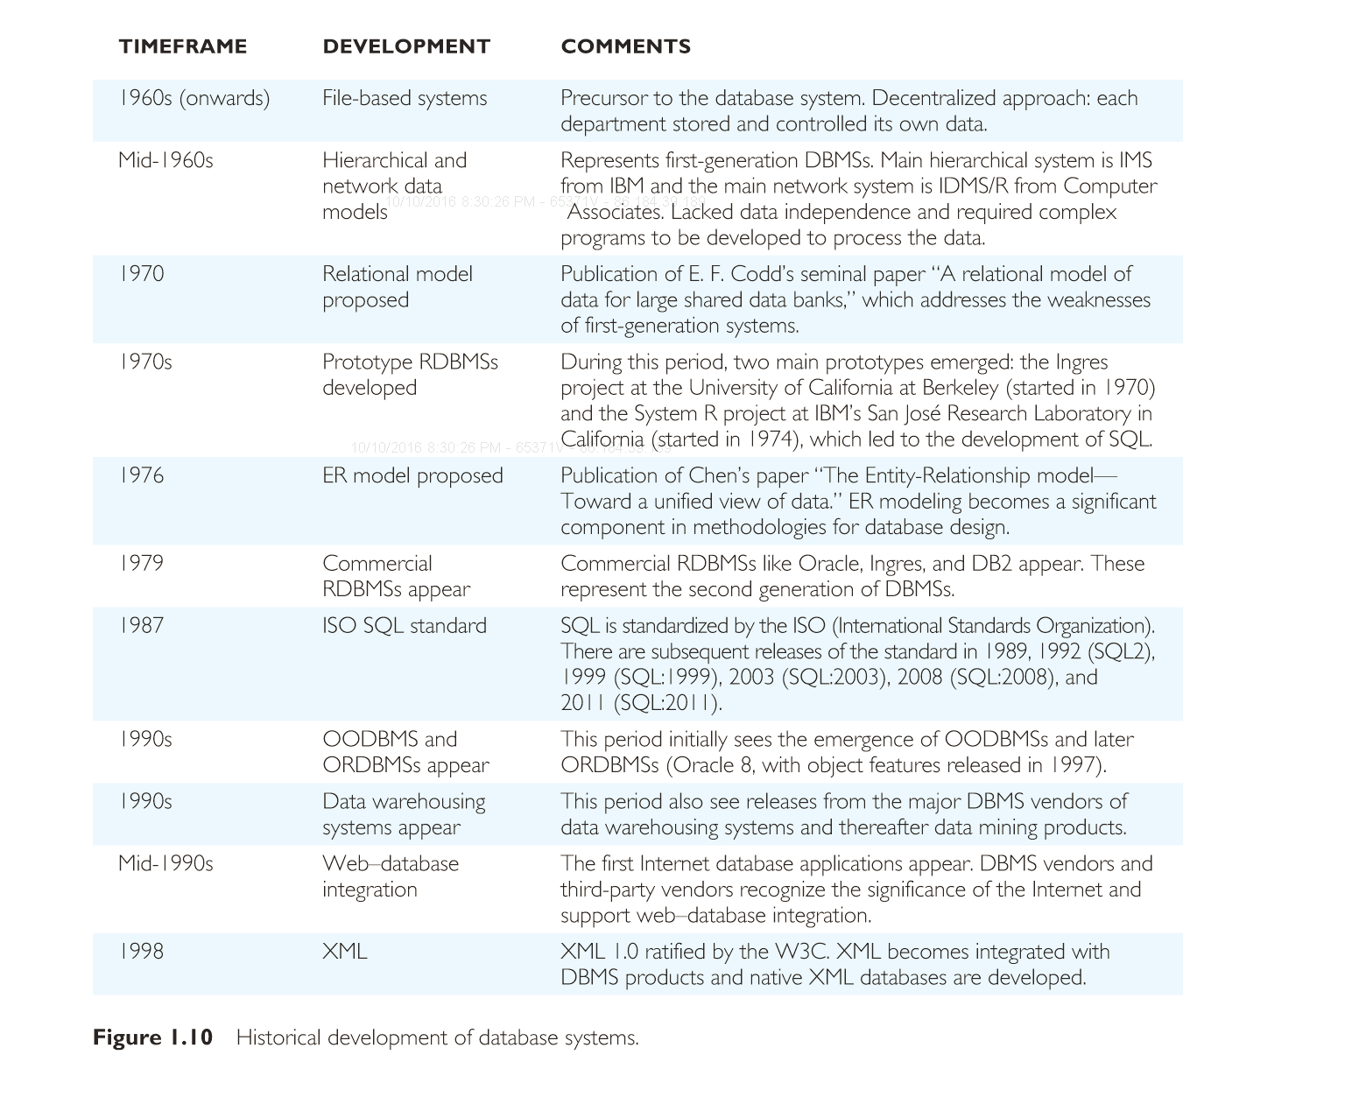
Historical Development of Databases
Notes:
Source: https://app.kortext.com/reader/draw?n=80118&l=76&w=1560&p=74

Slide 4
History of Databases Summarised
File-based Systems
1st Generation
  Hierarchical and network models
2nd Generation
  Relational model, proposed by E.F. Codd¹ in 1970
    Had strong theoretical foundation and addressed the disadvantages of former approaches.
    Led to introduction of a structured query language, SQL
3rd Generation
  Object-Relational
  Object-Oriented
Current
  Data Warehouses
  Big Data database technologies: NoSQL and NewSQL
Notes:
¹The relational model was introduced by E.F. Codd in 1970 in his paper, “A Relational Model of Data for Large Shared Data Banks”.

Slide 5
File-Based Systems
It is important to understand why database systems emerged.
Traditionally, there were file-based systems:
  Collection of application programs that perform services for the end users e.g. producing reports
  Each application program defined and managed its own:
    Data entry
    File maintenance
    Generation of a fixed set of reports
  The physical structure and storage of data files and records are all defined in the application’s code.
  The file-based approach is a decentralised approach!

Slide 6
Limitations of File-Based Approach
Separation and isolation of data
  Each program maintains its own set of data.
  Thus, users of one program may be unaware of potentially useful data held by other programs.
Duplication of data
  Same data is held by different programs.
  Wasted space and potentially different values and/or different formats for the same item.
  Duplication can lead to loss of data integrity.

Slide 7
Limitations of File-Based Approach
Sales and Contracts each have their own separate data and some of it is duplicated.
Sales Files
PropertyForRent (propertyNo, street, city, postcode, type, rooms, rent, ownerNo)
PrivateOwner (ownerNo, fName, lName, address, telNo)
Client (clientNo, fName, lName, address, telNo, prefType, maxRent)
Contracts Files
Lease (leaseNo, propertyNo, rent, paymentMethod, deposit, paid, rentStart, rentFinish)
PropertyForRent (propertyNo, street, city, postcode, rent)
Client (clientNo, fName, lName, address, telNo)

Slide 8
Limitations of File-Based Approach
Data dependence
  The file structure is defined in the program code, making changes to an existing structure difficult.
Incompatible file formats
  Structure of files are dependent on the application’s programming language.
  Application programs written in different languages cannot easily access each other’s files.

Slide 9
Limitations of File-Based Approach
Fixed queries or proliferation of application code
  Program’s are written for particular functions with fixed reports and queries - no support for ad hoc/dynamic queries.
  New requirements meant new application program code.

Slide 10
Limitations of File-Based Approach
In an Estate Management file-based application, different files may exist for: each property, each sale/rent, each buyer, each renter, and one for each member of staff.
Imagine trying to answer the following queries using all these separate files:
  What three-bedroom properties are available with a large garden and garage?
  What two-bed properties do you have for rent within three miles of the University?

Slide 11
Database Approach
All the limitations of the file-based approach can be attributed to two factors:
  The definition of the data was embedded in application programs, rather than being stored separately and independently.
  There is no control over access and manipulation of data beyond that imposed by application programs.
As a result, the Database and the Database Management System emerged.

Slide 12
Database Recap
A shared collection of logically, related data, and a description of this data, designed to meet the information needs of an organisation.
Consisting of:
  The System Catalog (aka the data dictionary or metadata) provides the description of the data to enable data independence.
  Logically, related data comprises entities, attributes and relationships of an organisation’s information.

Slide 13
Database
The database is also defined as a self-describing collection of integrated records because it stores:
  the organisation’s operational data,
  and also a description of this data.
It is this self-describing nature of databases that provides data independence, which file-based systems lacked.
More on data independence in the next lecture.

Slide 14
Database Management System (DBMS) Recap
A DBMS is software system that enables users to define, create, maintain and control access to the database.
  Access to the database is through the DBMS.
  It sits between application programs and the backend database.
  The DBMS is the software that interacts with users (individuals on workstations and users’ application programs) and the database.
Example DBMSs include Access, Oracle, MySQL, MS SQL Server, etc.

Slide 15
Advantages and Disadvantages of DBMSs
The DBMS has many advantages, but also some disadvantages.
The advantages and disadvantages are only listed on the following slides.
Please read the accompanying notes for explanations.
  The advantages and disadvantages highlight the differences between the file-based approach and database approach.
  The advantages further highlight why the database approach is better than the file-based approach.

Slide 16
Advantages of DBMSs
Control of data redundancy
Data consistency
More information from the same amount of data
Sharing of data
Improved data integrity
Improved security
Enforcement of standards
Economy of scale

Slide 17
Advantages of DBMSs
Balance conflicting requirements
Improved data accessibility and responsiveness
Increased productivity
Improved maintenance through data independence
Increased concurrency
Improved backup and recovery services

Slide 18
Disadvantages of DBMSs
Complexity
Size
Cost of DBMS
Additional hardware costs
Cost of conversion
Performance
Greater impact of a failure

Slide 19
Review Question
What are the two main problems of the file-based approach?
Consider a situation where Excel is used as “a database”. What problems may this pose?
Compare and contrast the file-based system to a database management system.

