Slide 1
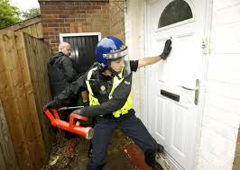

Powers of Search and Seizure

Slide 2
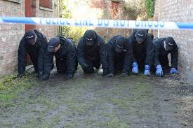
What is a Search?

Slide 3

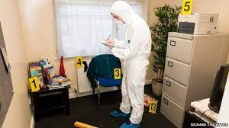
Searching a Premises
Premises must not be entered or searched nor property seized unless authorised by law and then only...
When it is necessary and a proportionate response in the circumstances

Slide 4

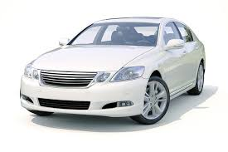
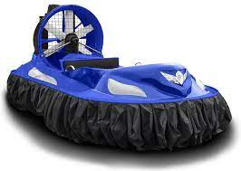



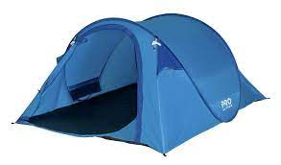
HAVVROT
What is a ‘PREMISES’?
Section 23 PACE 1984:
H
A
V
V
R
O
T

Slide 5
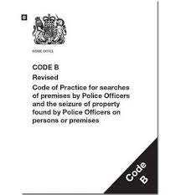
Powers of Entry, Search & Seizure without Warrant
PACE Section 17
Entry for purpose of arrest/recapture/Saving life & limb
PACE Section 32
Search of premises where arrested person is/has recently come from
PACE Section 18
Entry & search after arrest (triable either way or indictable only)

Slide 6
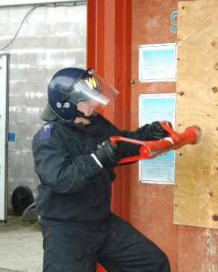
Section 17 P.A.C.E. (1984)
“reasonable grounds to believe”
Notes:
Section 17 Police and Criminal Evidence Act 1984
In order to exercise this power of entry under any of the circumstances, (stated below) you must have reasonable grounds to believe that the person whom you will arrest or recapture is on the premises that you want to enter.

Slide 7

Section 17 (1)(a) P.A.C.E (1984)
A Constable may enter & search any premises for the purpose of:
Executing a warrant of arrest or commitment

Slide 8

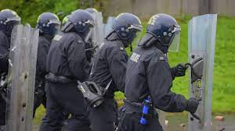
Section 17 P.A.C.E (1984)
Arresting a person for:
An Indictable Offence
An offence under S1 POA 1936

Slide 9


Section 17 P.A.C.E (1984)
S.4 Public Order Act 1986
S.6 to 8 or 10 of the Criminal Law Act 1967
S.76 Criminal Justice & Public Order Act 1994

Slide 10

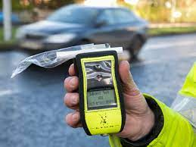
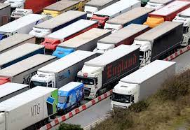
Section 17 P.A.C.E (1984)
S.163 Road Traffic Act 1988
163…STOP for me!!
S.4 Road Traffic Act 1988
S.27 Transport & Works Act 1992
Notes:
Section 163 of the Road Traffic Act 1988 relates to failure to stop when required to do so by a constable in uniform
Section 4 Road Traffic Act 1988 relates to driving under the influence of drink or drugs.
“To arrest a person who was driving, attempting to drive or in charge of a mechanically propelled vehicle on a road or public place, if the person is reasonably suspected to have been unfit through drink or drugs.”
Section 27 Transport & Works Act 1992 relates to offences involving drink or drugs in relation to transport system workers

Slide 11
Section 17 P.A.C.E (1984)
S.163 Road Traffic Act 1988
163…STOP for me!!
S.4 Road Traffic Act 1988
S.27 Transport & Works Act 1992
Notes:
Section 163 of the Road Traffic Act 1988 relates to failure to stop when required to do so by a constable in uniform
Section 4 Road Traffic Act 1988 relates to driving under the influence of drink or drugs.
“To arrest a person who was driving, attempting to drive or in charge of a mechanically propelled vehicle on a road or public place, if the person is reasonably suspected to have been unfit through drink or drugs.”
Section 27 Transport & Works Act 1992 relates to offences involving drink or drugs in relation to transport system workers

Slide 12

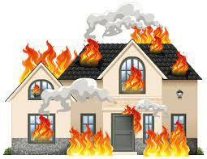
Section 17 P.A.C.E (1984)
Recapturing a person unlawfully at large & whom he is pursuing
Saving life & limb or preventing serious damage to property

Slide 13
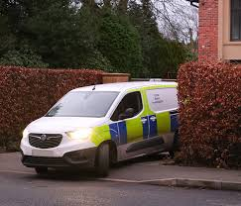
Section 32 P.A.C.E (1984)
“reasonable grounds for believing”

Slide 14
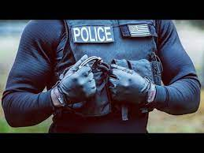
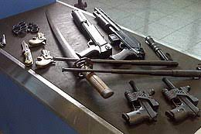
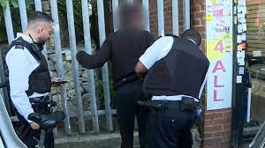
Section 32(1) P.A.C.E (1984)
JOG!!
A Constable may search any person who has been arrested at a place other than a police station
If they have reasonable grounds for believing that the arrested person may present
Danger to himself or others
Implement which he might use to escape
Evidence relating to an offence

Slide 15
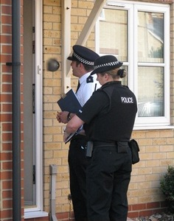
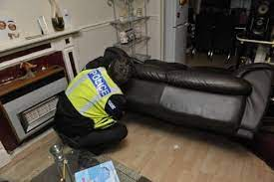
Section 32(2)(b) P.A.C.E (1984)
A Constable may enter & search a premises
In which a person was when arrested or immediately before he was arrested
For evidence relating to the offence for which he was arrested

Slide 16

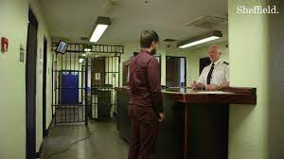

Section 18 P.A.C.E (1984)
“reasonable grounds for suspecting”

Slide 17

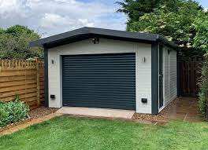
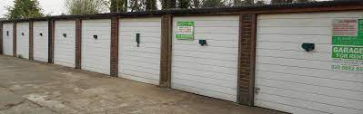
Section 18(1) P.A.C.E (1984)
A Constable may enter and search any premises occupied
Or controlled by a person under arrest for an indictable offence

Slide 18
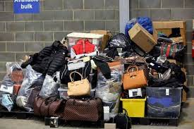

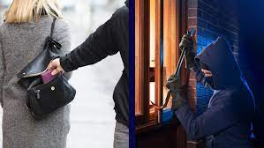
Section 18(1) P.A.C.E (1984)
If he has reasonable grounds for suspecting that there is on the premises evidence relating to that offence
Or another indictable offence which is connected with or similar to that offence

Slide 19
Section 18 P.A.C.E (1984)
An Inspectors authority will be required for all Section 18 searches unless
A constable may conduct a search before taking the person to a police station without obtaining an authorisation from an inspector if the presence of that person at a place is necessary for the effective investigation of the offence (S18(5))
In which situations could this happen?...

Slide 20
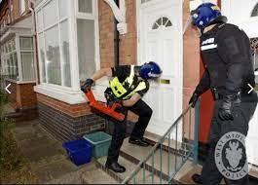

Consent
Gaining entry with consent
Premises may be searched (other than under a statutory power) with the written consent of a person entitled to grant entry
Gaining entry without consent
The occupier, or other person entitled to grant access to the premises is entitled to an explanation of the authority under which entry is sought & that occupier should be asked to grant access

Slide 21
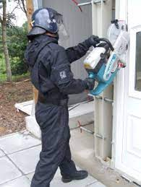
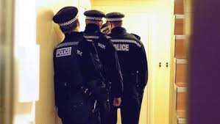
Reasonable Force
Necessity to use reasonable force to gain entry if
Refused Entry
Impossible to communicate
Unoccupied
Absent
Frustrate/ Endangerment
Section 117

Slide 22
Planning and Preparing a Search
Common H & S considerations
Do not eat, drink, smoke or touch your face whilst handling exhibits
All body fluid examples should be regarded as potentially infectious
Protect all cuts and grazes with waterproof dressings
Handle all items as little as possible
Considerations before conducting searches?
COMMUNICATION IS KEY!

Slide 23
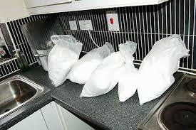

Section 19 P.A.C.E (1984)
General power to seize and retain property under certain circumstances.

Slide 24

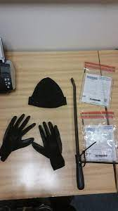
Section 19(2) P.A.C.E (1984)
A Constable who is lawfully on any premises may seize anything which is:
Covered by a warrant
Anything they have reasonable grounds for believing is evidence of an offence
Anything that has been obtained in consequence of the commission of an offence

Slide 25
Section 19 - Seizing
Necessary to seize it to prevent it being:
Concealed
Lost
Altered
Damaged
Destroyed
Section 22 of PACE 1984:
Seized property may be retained for specific reasons only.
Possible reasons for retention are that the property seized is:
For use as evidence in a trial (unless a photograph or copy would suffice)
Forensic examination
Further investigation
Establish the lawful owner.

Slide 26
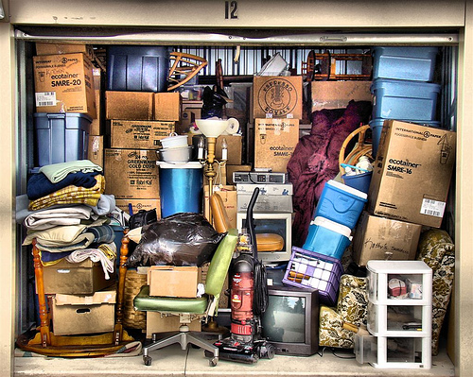
Criminal Justice and Police Act (2001)
Relates to the seizure of a large quantity of property
Or where it is not reasonably practicable to separate the legally seizable part from the rest, e.g. where the material is in a filing cabinet, and allows officers to sift through it at another place.
Seize and Sift

Slide 27

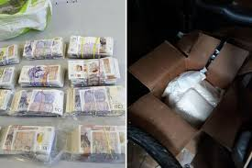
Record, Package and Store Evidence
Seize
Correctly package
Exhibit label
Exhibit number
Forensic Examination
Continuity signature
Evidence for court
EPNB entry/ statement

Slide 28
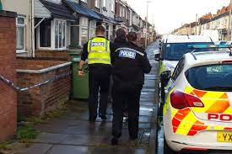
Question 1:
Rogers resides in a ground floor flat of a multi-storey house. He is wanted for an offence of burglary and one day officers arrest Rogers while he is leaving his flat. The officers believe that Rogers has stolen property from the burglary and hidden it in the building.
Which, if any, of the following rooms may be searched by the officers, in these circumstances?
A - Roger’s flat
B - The lounge and kitchen used by all the residents
C- Any room in the building
D - None, a warrant must be obtained.
Notes:
A, B, C or D?

Slide 29
Question 2:
You arrest John at his friend Peter’s house on suspicion of theft. Do you have the power to search Peter’s house before leaving for the police station?
A - Yes, with Peter’s permission
B - Yes, there is a power under Section 32 to search the house as John was in the premises when arrested.
C - No, the property is not owned or controlled by the suspect
D - Yes, if permission is given by an inspector.
Notes:
b

Slide 30
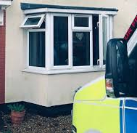
Question 3:
Before entering any premises under Section 17 PACE, you must seek the permission of an officer of the rank of inspector or above.
True or False?
Notes:
False

Slide 31

Question 6:
You have arrested SMITHERS on suspicion of theft of car stereos and have obtained a Section 18 PACE authority to search his lockup garage.
While conducting the search of the garage, you find five cameras which match the description of those stolen in a burglary two weeks previously.
Do you:
Seize the cameras under Section 19 PACE?
Seek permission from the duty inspector for authorisation to seize the cameras?
Return to the station and obtain a search warrant?
Arrest him on suspicion of burglary and seize the cameras under Section 32 of PACE?
Notes:
A

Slide 32
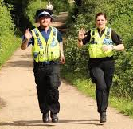
Question 7:
What Power of Entry can you use when recapturing an escaped prisoner whom you are pursuing?
S17 PACE
S18 PACE
S32 PACE
Common Law
Notes:
17

Slide 33
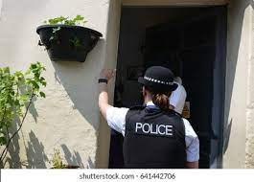
Question 9:
Section 32 of the Police and Criminal Evidence Act gives police officers the power to enter and search premises where a person was at the time of their arrest or immediately before if the offence for which he/she was arrested is an indictable offence.
Which of the following statements is true regarding this power?
This power only extends to a search for evidence of the offence for which they were arrested.
This power extends to a search for evidence of any offence.
This power extends to a search for evidence of the offence for which they were arrested as well as anything which they might use to injure themselves/others or assist their escape.
Notes:
True or False?

