Slide 1


Financial Training
16 January 2017
Kelly Small
Head of Funding and Information Unit
kelly.small@swansea.gov.uk 636689

Slide 3
Difficult Choices to be Faced
A challenging financial context
  For all authorities with public spending cuts & cost and service pressures
A great many issues to be managed each year – for example:
  Adult Services
  Child & Family Services
  Waste Management – WG recycling targets
How would you determine Swansea’s spending priorities?

Slide 5
Recent Developments
Focus beyond one year
Closer link between School Budget Forum and corporate budget process
Funding guarantee for schools?
  adds to pressures on non delegated education spending
  no guarantee for FY2017-2018
Local Government commitment to increase delegation rate
  What is best provided by schools, by Authority, regionally or nationally?
Online banking and direct debits

Slide 6
Key dates in the Council process
1 April – start of financial year
June – consideration of potential budget issues and pressures
July to September – review of current allocation of resources across services, spending needs an potential containment measures assessed
October to November – further consideration of broad budget choices and options
December – implications of Local Government Finance Settlement
January – further consideration of proposed budget options
February – Council Budget set and forward financial plans
March – School Budget Shares finalised
31 March – end of financial year

Slide 7
77% supports home to school transport, support for statement pupils, pupil referral units / EOTAS, or out of county places
50% relates to pension costs and insurance costs with remaining spending to meet core statutory duties of LA
Areas such employment training, community / adult education, and 6th form transport
Notes:
7

Slide 8
Local Management of Schools
Education Reform Act 1988
  Financial delegation to schools
    Day to day control over their own budgets
    Schools know best what they need
  Formula funding of budget shares
    Clear, simple and predictable
    Based on objective assessment of needs
    At least 70% linked to pupil numbers
  Funding follows pupils
  Delegated personnel powers for schools
    Appointments, suspension, dismissal etc.

Slide 9
Funding Formula
4 main elements originally (1990):
  Teaching staff element – pupil numbers
  Non-teaching staff element – pupil numbers
  Capitation element – pupil numbers
  Premises element – reckonable area of school
Designed for “best fit” with historical spending patterns within schools
Special Educational Needs element introduced in early 1990s

Slide 12
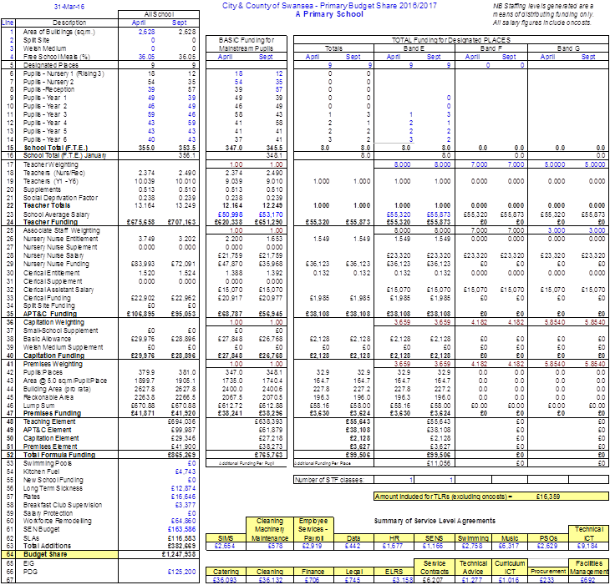

Slide 13
Changing the Formula
Can be changed after formal consultation process
  Finance Sub Groups/School Budget Forum
  Governing Bodies (usually by December)
  Included in formula from April

Slide 14
THE BUDGET SHARE IS NOT THE BUDGET !
The FUNDING FORMULA is the means of working out how much in total a school will have to spend in a financial year from the Council
  It simply allocates the available funding between schools
The BUDGET PLAN is the detailed spending plan of the school
  Reflecting specific needs and priorities
  A fundamental means of financial control

Slide 15
Governing Body
Most schools establish a Finance Committee (with agreed terms of reference)
Full Governing Body must agree on delegated spending powers for Headteacher and Chair of Governors
Finance Committee monitor school finances and report back to termly Full Governing Body meetings for approval
Ensuring value for money
The Full Governing Body must approve the following year’s balanced budget by 31st May each year
Discuss the audit report and action plan that is required every 3 years
Approve and minute that private funds have been audited each year
Send copies of all minutes to School Governor Unit

Slide 16
Why Budget ?
A budget is a means by which a school translates its strategic policies into financial terms – “a plan expressed in financial terms”
A schools annual budget & longer term financial projections should link and be consistent with the School Development Plan

Slide 17
Freedom & Accountability
Funding is delegated to schools at the start of the financial year according to the school funding formula & within the requirements of the “Scheme for the Financing of Schools”
Schools have considerable freedom in determining spending priorities – but spend must be on the education of the learners on roll at that school

Slide 18
Key Information Provided
School Budget Shares
  Indicative in early March
  Final by 31st March
2 Year Indicative School Budget Shares
  By 31st March
Section 52 Budget Statement
  By 31st March
Section 52 Budget Outturn
  By 30th July

Slide 20
Cost Behaviour

Slide 21
Approaches to Budgeting (1)
Incremental Budgeting
  Focus on marginal changes between years
  Current year’s budget as basis for the next year’s budget
Approach
  Establish base unavoidable expenditure
    Reflecting full year effects, increments, non-recurring items
  Allow for changes in price levels
  Reflect implications of developments and / or reduction measures
Most use in times of relative stability or of growth but looks to past spending patterns rather than future requirements of the school
Don’t get hung up on the pennies !

Slide 22
Approaches to Budgeting (2)
Zero Based Budgeting
  Producing a budget without any preconceived base
  Building up budget from a blank sheet from knowledge of planned objectives and activities
Approach
  Systematic review and justification of the funding and performance of current activities
  Justification of resources for new activities
  Determination & clarification of objectives
  Evaluation of alternative ways of achieving objectives
Reflects current rather than past activity and may be relevant for targeting department or capitation expenditure against objectives through a bidding process but highly complex and expensive process in time & other resources

Slide 23
Discussion Task
Consider how would go about determining your school spending plan for the coming year – what factors would you take into account ?

Slide 24
The Planning Process
Should include:
  A review of past activities, aims & objectives – Did we get it right?
  Definition & redefinition of aims & objectives – Are the aims still relevant?
  Development of the plan & associated budgets – How do we go forward?
Use – the School Development Plan
Ask – if we spend money on this, how will it impact on pupils? Don’t be afraid to ask questions!
Check – did the money we spent have the desired effect?
Benchmark – use the information provided by the School Funding Unit to compare your spend with that of other schools

Slide 25
Budget Setting
Schools cannot plan a deficit budget
  Budget can exceed budget share if the school has reserves which it plans to use
  Recovery plan with agreement of Head of Finance
Remember that significant changes in spending patterns tend to take place in September when a new staffing structure is in place, this will link in with you revising your budget at this time.

Slide 26
Preparing the School Budget
2 main areas to take into account
  Funding Available
    Budget Share
    Reserves from previous year
    Any retrospective adjustments for changes in pupil numbers
    Any external funds/income
  Planned gross expenditure

Slide 27
Factors to be considered
Budget plans should reflect current school needs rather than historic spending patterns but also be realistic, mindful of the resources available
Factors to consider include:
  Changes in pupil numbers – projections are provided by School Funding & Information Unit based on trends and Admission Numbers
  Curriculum requirements
  Staffing requirements
  Review of past performance
  Level of reserves brought forward
  Service Level Agreements
  Planned Improvements
  Other resource requirements
  Procurement/CPRs

Slide 28
Contract Value Bands
The value of a contract means the total estimated value of the contract over the full contract period (excluding VAT) including possible extensions of the contract.
A school must not split purchases or disaggregate spend in order to avoid the following contract value bands
If the goods or services are a regular requirement, consideration must be given to setting up a formal contract.
If the total contract spend with a single supplier is likely to exceed £5,000 in a year, then the procedures outlined in the Schools Procurement guide will apply.
School staff should in the first instance use historic spend data to determine whether a competitive procurement processes is required. The SIMS system will be able to provide this data.
Band | Value
A | Below £5,000
B | £5,001 - £75,000
C | £75,001-£1,000,000
D | Over £1,000,000

Slide 29
Use of existing corporate contracts
One of the first routes to take would be to see if there is already an existing corporate contract in place that could meet your need.
It is strongly recommended that wherever possible, you should make use of existing corporate contracts. Some of the advantages of using such contracts are:
  Agreed pricing
  Possibly no need to obtain further quotations
  Acceptable terms and conditions of contract
  Quality and safety checks will be built-in where needed, e.g. Health and Safety and DBS checks
  Safeguarding polices
  Appropriate insurance cover will be in place
  Supplier performance can be monitored and rectified by the Contract Manager
  Equality and sustainability issues will have been considered
Details of current corporate contracts are available from the Schools’ Procurement Helpdesk.

Slide 30
Making your own contracts
If an existing corporate contract does not meet your need then you will need to make your own contractual arrangements.
In order to comply with Contract Procedure Rules you will need to ensure then the required number of competitive written quotations/tenders are sought from appropriately qualified suppliers.
You must provide evidence of seeking the required number of quotes, written or emailed - not verbal.
Must comply with the principles of Open Competition, Transparency, Equity (Equality), and Proportionality
It is important that when ordering goods and services that the appropriate procurement process is followed, so as to avoid claims of unfairness and collusion by disappointed suppliers.
Competition requirements

Slide 31
Competition Requirements
Good , Works & Services
Band | Value | Competition Requirements
A | Below £5,000 | Not subject to procurement rules, but are subject to value for money considerations
B | £5,001 - £75,000 | At least 4 written quotations shall be sought from appropriate suppliers. School Staff shall decide the method by which proposed suppliers shall be identified.
C | £75,001-£1 million | Full tendering procedures apply. Open procurement exercise conducted via www.sell2wales.gov.uk
D | Over £1 million
Notes:
31

Slide 32
Making your own contracts
Where corporate contracts are not used then relevant checks of the suppliers will need to be undertaken.
The following checks will need to be undertaken, however this needs to be in proportion to what you are procuring and evidence kept:
  Track record – can the supplier prove that they can deliver?
  Relevant experience – has the supplier completed similar projects for other schools in the past?
  Capacity – does the supplier have the resources to complete the work?
  Financial stability (if appropriate) – does the supplier have an established pattern of turnover in recent years?
  DBS Policy – does the supplier have a DBS policy (if relevant to the procurement)?
  Safeguarding
  Health & Safety – does the supplier have a written health & safety policy (if relevant to the procurement)?
  Accreditations (if relevant)
  Appropriate insurance cover in place - it is recommended that a supplier has £5 million public liability and £5 million employers liability insurance cover (Professional Indemnity Insurance may also be required for certain contracts)

Slide 33
Record Keeping
Schools should retain tender or quote documents 6 years, after the end of the contract period.
Unsuccessful tender or quote documents should be retained for 12 months from award of contract, provided that there is no dispute regarding the award.
Notes:
33

Slide 34
Disposal of Assets
Where inventory items are considered to be surplus to requirements the School should initially circulate details of the items to other educational establishments and then to other Departments of the Council.
If the items are not required internally, disposal shall be by competitive tender, part exchange or public auction.
All disposals and transfers must be authorised by a certifying Headteacher in writing on an appropriate form (Annex 2 to Accounting Instruction 9)

Slide 35
Hospitality
What is reasonable?
a diary
a calendar
T shirt
golf balls
a pie and a pint
dinner
an overnight stop
box at the millennium stadium
a holiday
Notes:
35

Slide 36
Dispensations
A Dispensation may be granted where an urgent need to enter into contract is established.
  The criteria for an urgent need are:
  For protection of life or property;
  For the protection of the interests of the Council
  To comply with an statutory obligations of the council for which there is no provision in an existing contract
In exceptional circumstances it may be necessary to grant a retrospective dispensation e.g. where an urgent need to engage a supplier does not allow for prior approval. In these cases a retrospective application must be submitted within five working days.
Waiver
In exceptional circumstances the Monitoring Officer may waive a requirement of contract procedure rules in respect of an individual contract after considering a written report which will set out the factual background and justification for the request
Standard documentation available on staff net
Notes:
36

Slide 37
Single Supplier Tender Application
A single supplier tender procedure applies for purchases above £5,000 where a competitive process cannot be followed.
A Single Supplier Tender Application should only be used in exceptional circumstances. Such circumstances exist where:
  It can be explicitly evidenced that there is only a single supplier able to supply the required goods/services/works. Such applications must be accompanied by appropriate supporting evidence.
  Use of a specific supplier is required under national/EU legislation.
  In the case of a contract for goods or services, when the goods to be purchased are required as a partial replacement for, or in addition to, existing goods and when to purchase the goods from a supplier other than the supplier which supplied the existing goods would result in:
  Incompatibility between the existing goods and the goods to be purchased; or
  Disproportionate technical difficulties in the operation and maintenance of the existing goods.
Should none of the above circumstances apply to your request, it should be assumed that the request will be not be approved.
Headteachers are ultimately responsible for the Single Supplier Tender Applications they approve and for ensuring they are in accordance with the guidance set out in CPR.
Notes:
37

Slide 38
When should a Single Supplier Tender Application not be used?
As a retrospective application for the purchase of goods/services/works.
As loyalty to goods of a specific brand, source or manufacturing process.
Poor planning (i.e. not allowing enough time to procure).
To divide or separate contracts if the purpose or effect is to reduce the total value and/or amend or prevent the application of Contract Procedure Rules.
To facilitate urgent or time critical contracts.

Slide 39
Applying for Grants
External Funding Panel (EFP) - Oversight of the Council’s external funding opportunities
If external grant funding has specific award criteria, Governing Bodies and School Staff must ensure that those criteria are clearly met and that projects are managed in accordance with the external body’s requirements.
Contract Procedure Rules still apply when incurring expenditure under the grant.

Slide 40
Freedom of Information Act 2000
The Freedom of Information Act is all about the right of access to information held by public authorities.
Anyone has a right to ask a public authority for any information they hold.
Public authorities must respond promptly and within 20 working days (this can be extended where required to consider the public interest test).
Codes of Practice on FOI
Section 45 code - sometimes referred to as the “Access Code”–deals with how to handle requests for information including:
- Complaints procedures and impacts on public sector contracts.
Notes:
40

Slide 41
Things you would not do…..
Book £10k of hotel rooms for a conference to which nobody goes
Book a £1k holiday cottage for staff
Buy £30 a head meals for staff
Buy iPads for the staff via the school account to avoid the VAT
Buy a £400 leaving present for a head teacher

Slide 42
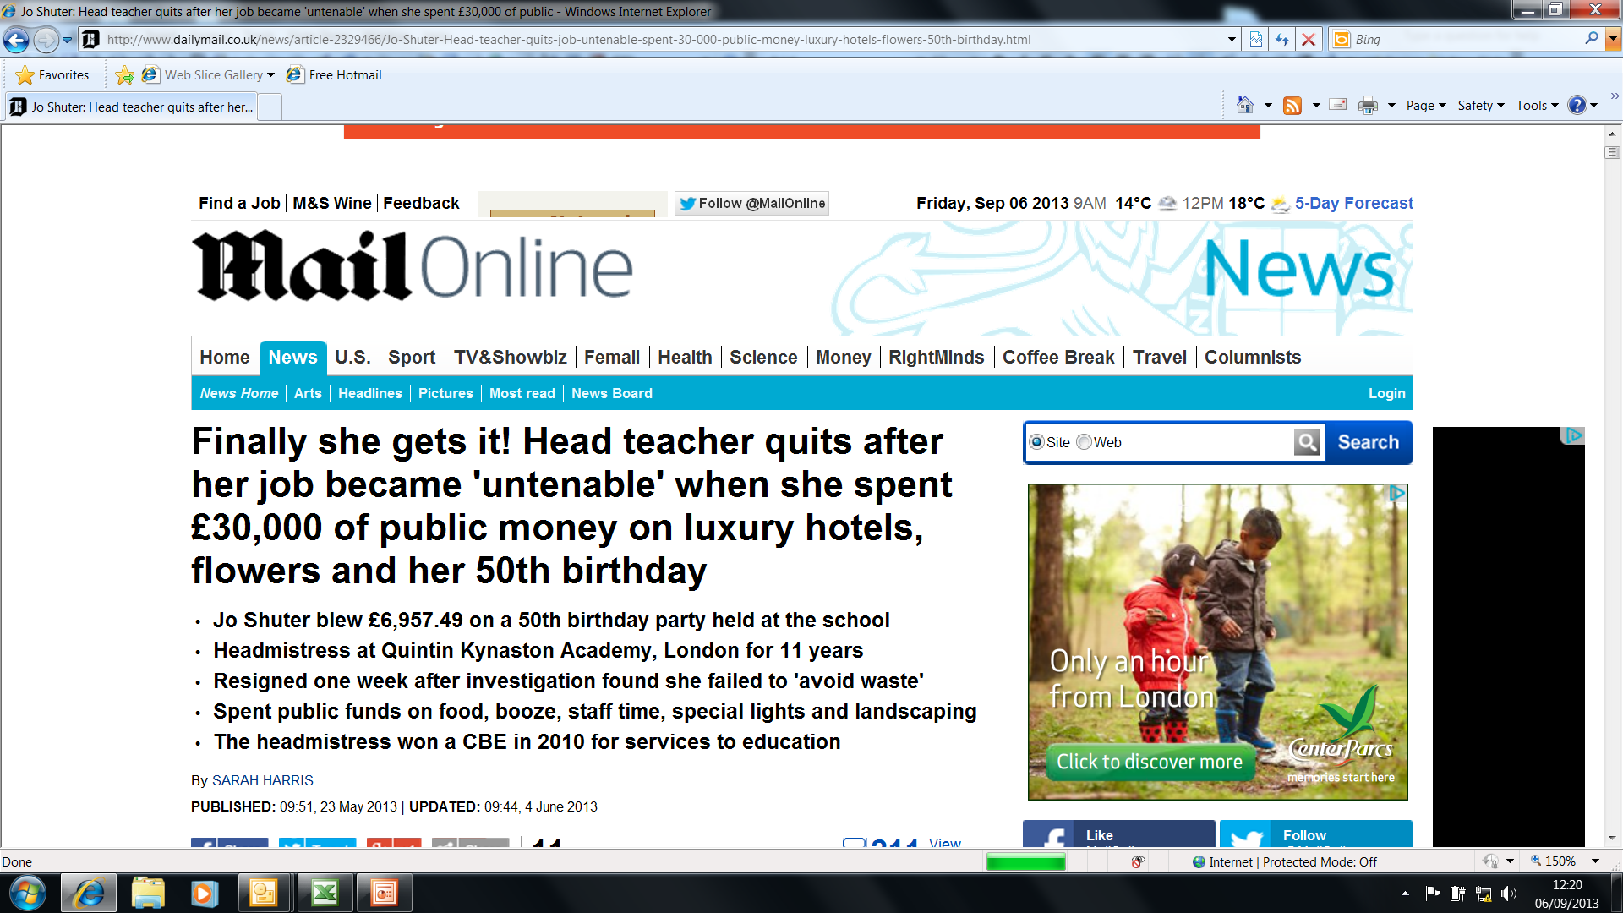
You do not want to be here

Slide 43
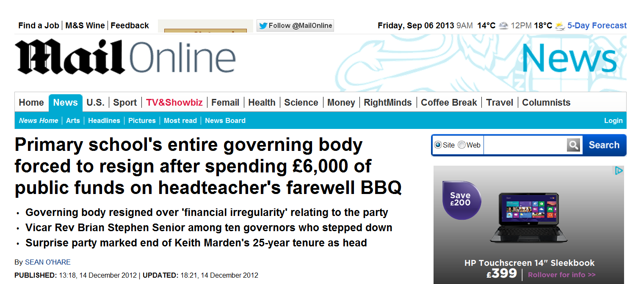
Or here

Slide 44
Planning the Budget
Identify and list costs which will have to be met each year
Look at options for staffing and their associated costs (taking account of incremental points / pay awards etc.)
Decide on staffing – it may not be possible to staff the school at the desired level
Decide on the level of capitation
Compare with available resources, including reserves and anticipated school income
  If any resources remain, decide what to spend them on from the School Development Plan
  If plans exceed resources available identify items which can be left out
Finalise the Budget

Slide 45
Role of Primary Support Officer/Accountancy Staff
Gathering information relevant to budget calculations & costing the elements of the School Development Plan
Assisting Headteacher to reconcile School Development Plan & the funding formula allocation
Assisting the Headteacher to present the budget plan to the Governing Body if required
In short - supporting the Headteacher but not responsible for setting the School Budget

Slide 47
Budget Monitoring
Why monitor ?
  To show what is going according to plan
  To show what is not going according to plan
  To show what is happening that was not planned for at all
  To initiate action if necessary
Monthly monitoring should be a standard procedure

Slide 48
Action to be taken
Spending in line with plan
  No action but continue monitoring
Where underspends are identified:
  Try to identify the cause
  If genuine:
    Include additional items in SDP with Governing Body approval, OR
    Do nothing & let underspend accumulate but be aware this will lead to an increase in your reserves.
Where overspends are identified:
  Try to determine cause & if possible take action to prevent further overspend
  Postpone spending on some other part of the SDP & transfer money from this budget heading to the overspend area (virement), OR
  Do nothing & be prepared to meet overspend at year end from school reserves

Slide 49
Year End
  Please note that any underspends on cost centres will automatically increase your reserves – you need to physically spend the money for it to be used! Budgeting for items and increasing budgets does not reduce your reserves!!
  Underspends are transferred to reserves held on behalf of the school by the Council or into school bank accounts – challenge if reserve is over £50k and 5% of budget share!
  Overspends will be met from the school’s reserves – if these are insufficient the shortfall will be taken off the following year’s budget share
  Must publish actual reserve figure – no virement between accounts!

Slide 50
VAT
Consistency is needed with regards to school proms, after school clubs, wrap around etc.
Schools need to EITHER use school fund or delegated budget to record income and expenditure for these activities.
You cannot pay invoices from the delegated account and receipt income into the school fund. All transactions need to be made through the same account.

Slide 51
VAT – Treatment
School Fund
  No VAT on income
  No VAT recovery on expenditure
Delegated Budget
  VAT on income
  VAT recovery on expenditure

Slide 52
VAT - Examples
School Meals
  Pupils – Non –business
  Staff / Visitors – Standard Rate 20%
School Photos Commission
  Paid into School Fund – No VAT
  Paid into Delegated budget – Standard Rate
School Uniform
  Primary Schools – All zero rated
  Secondary Schools – Size dependant

Slide 53
Good Practice
  Online banking is now available to view only and is a service we encourage schools to use. The facility will enable you to complete bank reconciliations quicker and therefore give more accurate projections when budget monitoring but it also highlights instances of fraud quicker.
  When making staffing appointments be mindful of the schools ISR and the funding implications of going above this.
  When employing your own family ensure that paperwork is signed independently by the staffing committee confirming the vacancy and endorsing references. Whilst not directly related to setting a budget it highlights the need to be transparent with public money.
  All staff must be paid via the payroll system not private accounts! This also includes travel and subsistence payments, petty cash should not be used to reimburse expenses.

Slide 54
Reserves
Regulations state that the local authority must challenge reserve levels that are more than 5% of the school’s budget share
The local authority also has powers to direct the governing body to spend reserves that are over £50,000 in primary schools and over £100,000 in secondary and special schools

Slide 55
Grants
Short to medium term allocations of funding
Must comply with terms and conditions for spend – grant paid back if not eligible spend
Usually involves having an expenditure plan and claim forms
Include grant spend in your SDP (part of the terms and conditions for EIG and PDG)

Slide 56
Roles & Responsibilities
Local Authority
  Sets the overall Delegated Schools Budget
  Allocates delegated budget through formula
Headteacher
  Day to day management of budget
  Operates within agreed limits/policies/procedures
Finance Committee (if established)
  Works closely with the Headteacher
  Regular, detailed monitoring of the budget
Governing Body
  Strategic view of budget
  Sets final budget

Slide 57
Support for Schools
Local Management of Schools is under the overall control of Brian Roles (Head of Service)
School Funding & Information Team (led by Kelly Small)
Primary Support Officers/ Accountancy Section
Procurement Team

Slide 58
Additional Useful Documents
Scheme for the Financing of Schools
  http://www.swansea.gov.uk/index.cfm?articleid=4738
Section 52 Budget Statement
  http://www.swansea.gov.uk/index.cfm?articleid=4736
Section 52 Outturn Statement
  http://www.swansea.gov.uk/index.cfm?articleid=4736
Accounting Instructions for Schools
    http://www.swansea.gov.uk/staffnet/accountinginstructionsforschools

Slide 59
Questions?

