Slide 1
Developing Relationships and Workplace Achievements
Student Name: Mihaiela Petreanu
Student ID: 2030622
Module leader: Nishi m Ramsurrun
Module Code: BMSW 5102-A1

Slide 2
TRAINING AND DEVELOPMENT NEEDS FOR AN HR OFFICER
tESCO plc.

Slide 3
OUTLINE
Tesco Plc.
Training & Development
Purpose, role and differences of training and development
KSB (Knowledge, Skills and Behaviour)
Personal Skills Audit & SWOT Analysis
Benefits to the organisation

Slide 4
Tesco Plc.
From market stall to the UK’s biggest supermarket
Leading multinational retailer with over 345,000 employees
Stores in 14 countries across Europe, Asia and North America
People team department
(Tesco, 2023)

Slide 5
Training and Development
Training
method of implanting staff with the necessary skills to allow them to perform a specific role.
building hard skills (i.e. speaking another language, degree, programming skills)
Development
focuses on psychology and soft skills (i.e. communication, leadership, teamwork)
development includes more levels of training
(CPD Courses, 2023)

Slide 6
Traditional v Modern
Traditional Training and Development
Costly
Logistical-complex
Process micro-managed by the company
Modern Training and Development
Used by proactive organisations
Uses distance-learning (online)
No travel / no classroom / no expense
(CPD Courses, 2023)

Slide 7
Purpose and role of training and development
Opportunities for staff to improve skills
Enhancement of employees performance / productivity
Improve company culture
Reduce employee turnover
Long term commitment of employees / employees engagement
(Maryville University, 2023)

Slide 8

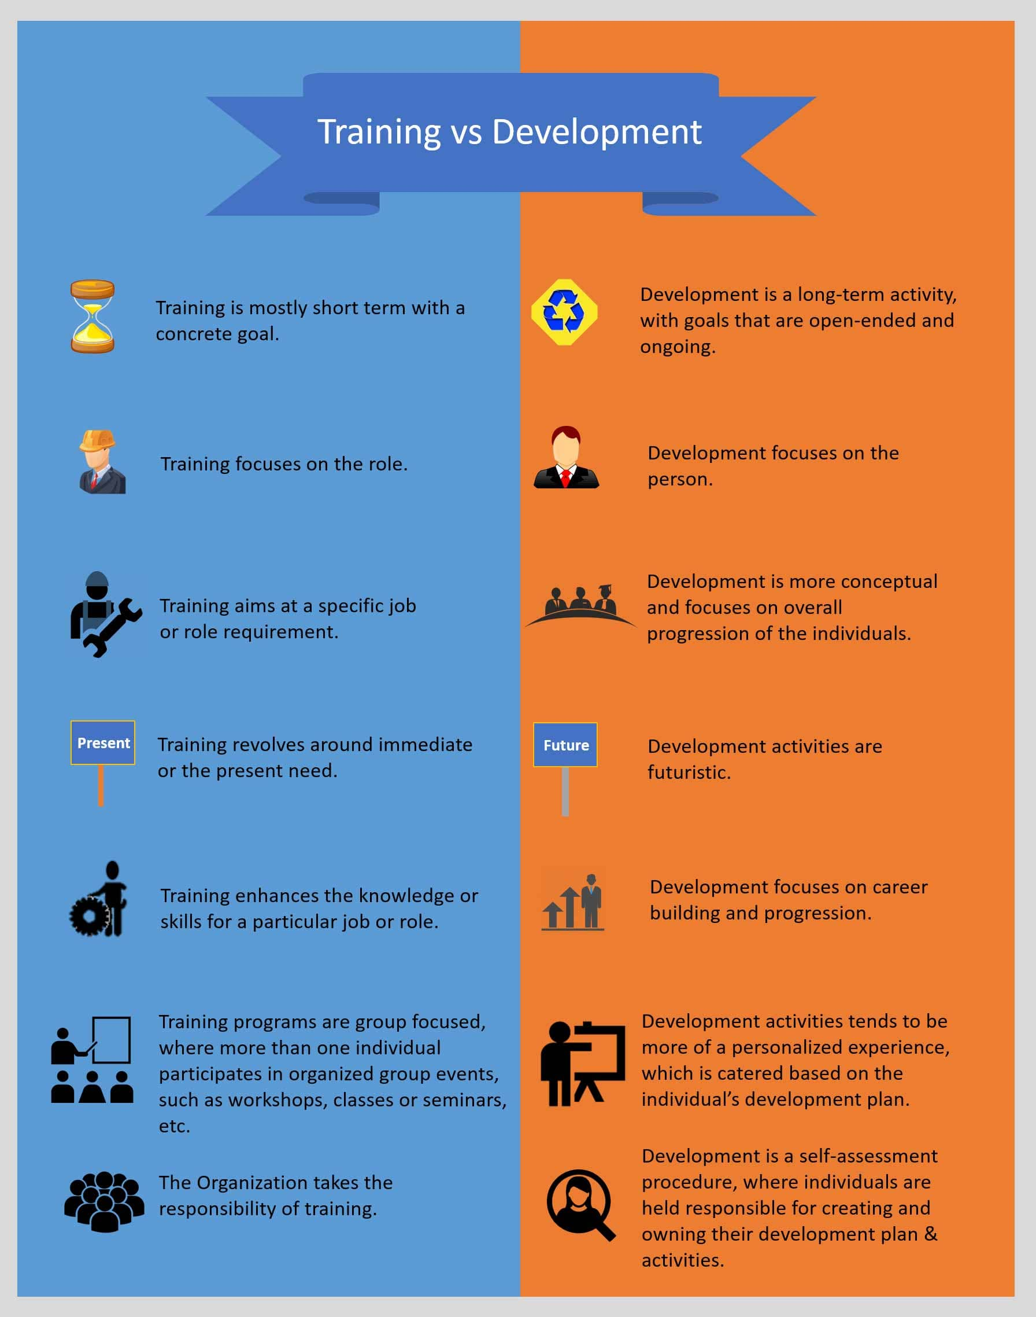



Differences training v development
(gyrus.com, 2016)

Slide 9
KSB
(knowledge, skills and behaviour)
KSB – core attributes one must have in order to be able to perform within the job of choice
High importance alongside studies and / or exams
Main assessment method used in EPA (end point assessments)
(kaplan, 2022)

Slide 10

Examples of KSB
Knowledge
Personnel and human resources
Administration and management
Law and government
Skills
Management of personnel resources
Judgement and decision making
negotiation
Behaviour
Mindset
Teamwork
Adaptability
(kaplan, 2022)

Slide 11
Personal skills audit (PSA) & SWOT Analysis
PSA
  Systematic assessment of skills and knowledge
  Proof of competence (existing and/or developing)
  Needs analysis: training or personal development
SWOT
  Planning tool which identifies strengths, weaknesses, opportunities and threats
  Framework for goal identification
  Created by Albert Humphrey over 50 years ago
(open.ac.uk, 2023)
Note: a personal skills audit as well as a personal SWOT to be found into the ANNEX of this presentation

Slide 12
Benefits to the organisation
Recruitment and training
Secure top talent
Offering a career rather than a job
Boosting employee's engagement / performance through developing trust / building relationships
Conflict management

Slide 13
References
cipd. (2021, 12 07). SWOT Analysis. Retrieved from CIPD - The professional body for HR and people development: https://www.cipd.co.uk/knowledge/strategy/organisational-development/swot-analysis-factsheet#gref
CPD Courses. (2023, 03 20). Training and Development in HRM. Retrieved from CPD Courses for Professional Development: https://www.cpdcourses.com/cpd-blog/training-and-development-in-hrm
gyrus.com. (2016, 05 17). The Difference between Training and Development. Retrieved from Gyrus Learning Management System LMS: https://www.gyrus.com/the-difference-between-training-and-development#:~:text=Training%20is%20mostly%20short%20term,overall%20progression%20of%20the%20individual.
kaplan. (2022, 09 29). Knowledge, Skills, and Behaviours - what do they mean for you? Retrieved from Kaplan.co.uk: https://kaplan.co.uk/insights/article-detail/insights/2022/09/29/knowledge-skills-and-behaviours-what-do-they-mean-for-you#:~:text=KSBs%20are%20the%20core%20attributes,you%20see%20in%20the%20workplace.
Maryville University. (2023, 03 21). Importance of Training and Development for Employees. Retrieved from Maryville University: https://online.maryville.edu/blog/importance-of-training-and-development/
open.ac.uk. (2023, 03 20). Skills audit and needs analysis. Retrieved from The Open University: https://www.open.ac.uk/students/research/content/skills-audit-and-needs-analysis#:~:text=A%20skills%20audit%20is%20a,for%20training%20or%20personal%20development.
Tesco. (2023, 03 19). About Us. Retrieved from Tesco Plc: https://www.tescoplc.com/about/

Slide 14
ANNEX 1 - SWOT
Strengths | Weaknesses
Conflict resolution Discretion Time management Perspective Empathetic | Self-criticism Public speaking Introverted Hesitant in asking questions
Opportunities | Threats
Public speaking classes Opportunities to learn from Tesco’s culture Developing corporate and business ethics | Continuously changing business environment Budget constraints Competitors to attract Tesco’s employees

Slide 15
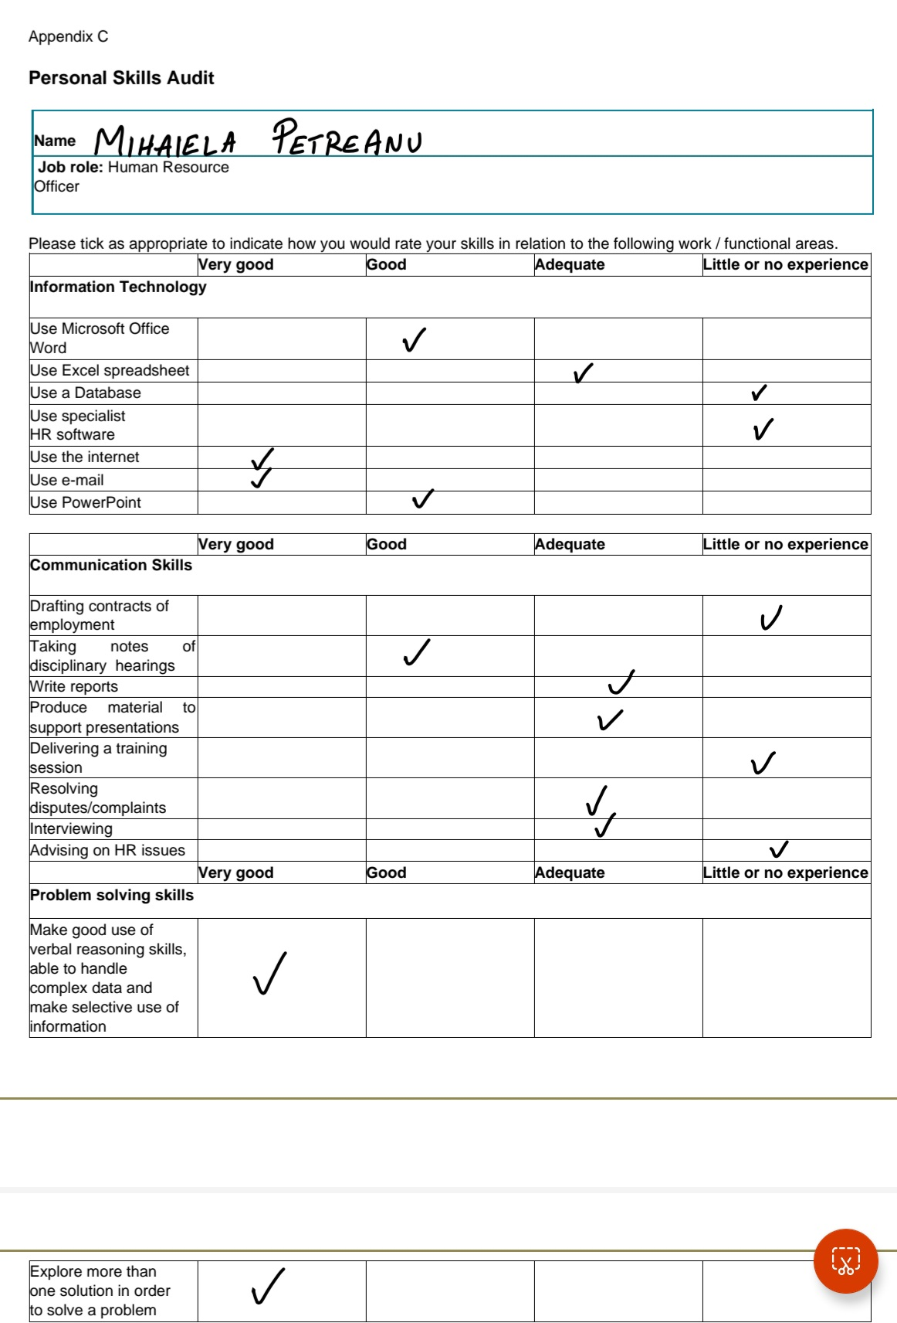
ANNEX 2 - PSA

Slide 16
Notes 1
Slide 4: Tesco Plc.
  Tesco plc. Has started in 1919 as a market stall in West London and has grown to become UK largest supermarket, employing over 345,000 people, expanded in 14 countries in over 3 continents. Looking into Tesco’s HRM, the company is proud to call its HR department, the “people team department”, putting its staff at the core of its business.
Slide 5: Training and development
  Training and development are key areas in HRM that must be treated as a priority for the benefit of the whole organisation. In this slide, it can be identified their definition and which area each of them is targeting according to CPD Courses, 2023.
Slide 6: Traditional v modern training and development
  As the world progresses and the business world is moving at a faster pace than ever before, companies had to find different approaches to the training and development which makes it more efficient, cost effective and less time consuming. Within this slide, it can be noticed some of the main differences between the traditional and the modern approach.
Slide 7: Purpose and role of training and development
  Employee training and development are mandatory to the success of the business as both the staff and the company will benefit from it; employees will develop new skill sets, new and stronger mindset which further, will help to enhance their productivity as well as the company culture and: “Corporate culture matters. How management chooses to treat its people impacts everything for better or for worse” Simon Sinek

Slide 17
Notes 2
Slide 8: Differences between training and development
  For a better and a more efficient implementation of training and development, we first have to understand what differences exists between them and which areas do they focus on.
  To be noted that the majority of people cannot identify the difference between training and development according to a survey conducted by Harvard Business Review in 2019.
Slide 9: KSB (knowledge, skills and behaviour
  One of the many but more often acronym one may come across in business, is KSB which stands for Knowledge, Skill and Behaviour and these relate to:
  Knowledge – refers to the “know-how”
  Skills – refers to the gathered knowledge expressed in a practical manner
  Behaviour – refers to the mindset of the employee

Slide 18
Notes 3
Slide 11: PSA and SWOT analysis
  PSA and SWOT are two highly important tools that can be used for corporate or personal growth; both will show the strong and weak points of a company or person as well as identifying new opportunities for growth, paying attention at the same time to what may stay between us and successful growth / development (threats).
Slide 12: Benefits to Tesco Plc.
  Within this slide, I have enlisted a series of benefits that I fully believe I can implement within Tesco Plc.
  My main focus will be on recruiting the right people, people with passion and drive, providing them with a career, rather and a job. A place where they will feel listened to and appreciated, which further, will help me in securing them for long term, which will also translate in great service to the customers, helping the company grow further.
  Focusing on staff wellbeing, understanding their reason of happiness or unhappiness, helping them through bad times, will help me avoid low morale which further will develop a great company culture and a family-like work environment.

