Slide 1
Gender development
ECES4008
Session 6 – Asynchronous Learning

Slide 2
Learning objectives
Explore theories of gender development
  Biological explanations
  Social learning approaches
  Cognitive approaches
  Psychoanalytical approaches

Slide 3
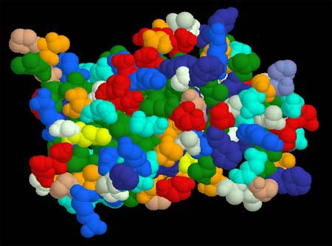
Biological Explanations
Assumes gender & sex are interrelated.
Differences between sexes are attributed to anatomical differences & action of hormones.
(Stress on internal factors/ Nature argument – ‘anatomy is destiny’.)

Slide 4
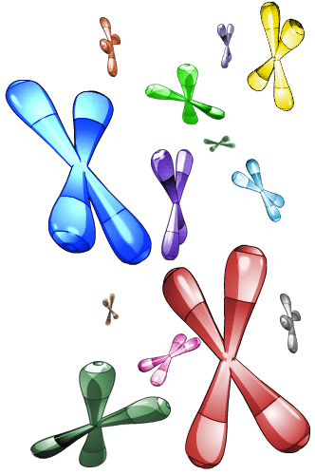
Typical Sex Chromosome Patterns
Chromosomes = biochemical units of heredity – have 46 matched into 23 pairs (each controls different area of development)
Pair 23 = control anatomical sex of person
Normal chromosome pattern =
  XX = female
  XY = male

Slide 5
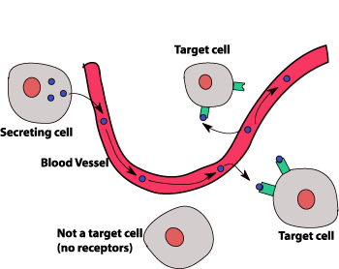

Influence of sex hormones (1)
Hormones = chemical substances in the glands (endocrine system)
Sex hormones = androgens (including testosterone), oestrogen, progesterone. Each are present in normal males & females but in differing amounts.
Evidence of effects of sex hormones supports biological explanation of gender development.

Slide 6
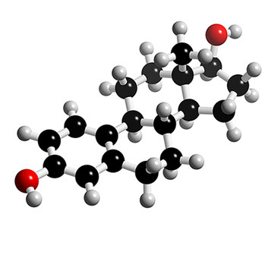

Influence of sex hormones (2)
Testosterone
Androgens = associated with male development
Testosterone = most important androgen. Leads to development of male external sexual organs. Acts on brain & pituitary system.
Effects – high levels are associated with aggression.

Slide 7
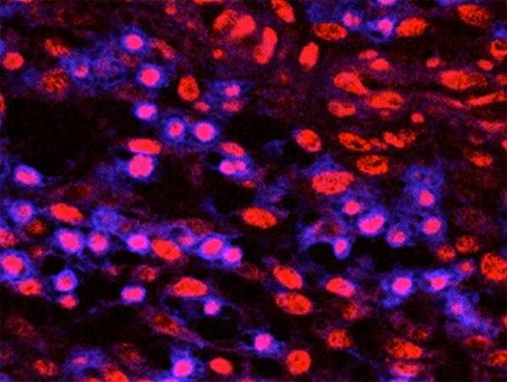

Influence of sex hormones (3)
Oestrogen
Oestrogen = responsible for controlling onset of menstruation & foetal development when pregnant. Important in females after puberty due to influence on menstrual cycle.
Behavioural Effects – in some women can lead to PMT/PMS. In some women can lead to aggression, anti-social behaviour, criminal acts (e.g. shoplifting – PMS has been used as defence in court cases)

Slide 8
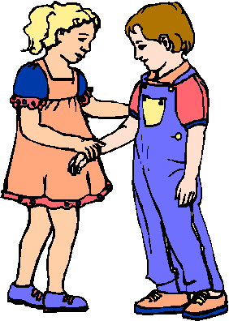
Social Learning Approach
Assumes behaviour is a product of environmental influences and is learned as a result of observation & modelling.
(Stress on external factors/ Nurture argument)
Children learn by observing what types of attitudes & behaviours are associated with their gender. If this behaviour is rewarded it is more likely to be repeated. Therefore their behaviour is shaped by those around them in a social context (opposite to biological approach)

Slide 9
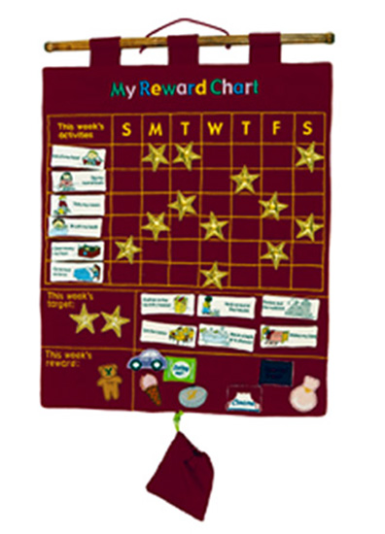
Social Learning Approach
Reinforcement
When behaviour becomes associated with a positive or negative response.
If the response to the behaviour is positive, it is more likely to be repeated (reinforcement). If the response is negative (e.g. punishment) it is less likely to be repeated.
Mischel (1966) – children learn sex-roles by being reinforced directly for doing sex-appropriate things & for imitating same sex role models.

Slide 10
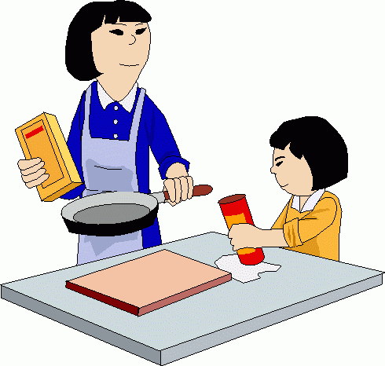
Social Learning Approach
Modelling
Modelling refers to behaviour which is observed (1), and having been observed can be repeated & imitated.
One person is the model (who provides the example), the other individual (e.g. the child) interprets the behaviour
Factors which increase chance of modelling are: appropriateness & relevance of model (e.g. same sex role model)

Slide 11
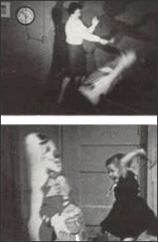
Social Learning Approach
Imitation e.g.Bandura et al (1963)
Copying behaviour = the quickest type of learning in humans and animals.
Behaviour is imitated as it is seen as rewarding – if reinforcement doesn’t happen, imitation usually ends.

Slide 12
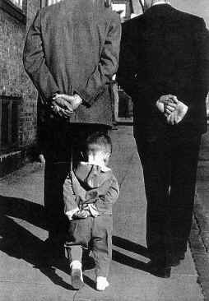
Social Learning Approach
Identification
Identification occurs with another person (the model), and involves taking on a range of observed behaviours, values, beliefs & attitudes of the person with whom you are identifying.
Attachment to specific models who possess qualities seen as rewarding. Important factor in choice of model is that the model has a quality the child would like to possess.

Slide 13
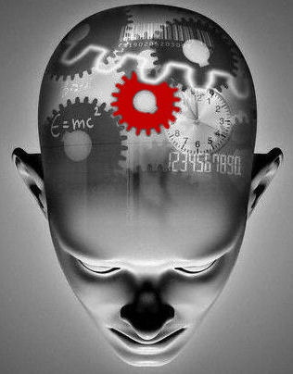
Cognitive Approach
Focus on internal mental world of child and how they react to external stimuli. How child actively constructs and understands gender.
(Stress on internal factors)
The child’s discovery that they are male or female causes them to identify with members of their own sex (SLT & psychoanalytic approaches argue this happens the other way round.)

Slide 14
Cognitive Approach - schemas
A schema is a mental structure which holds a collection of ideas and associations which guide behaviour.
A gender schema contains ideas about what is appropriate behaviour for males and females, this influences the individual’s behaviour.
Bem (1985) argues that children organise their ideas about gender as a result of their observations of their social world.
Gender divisions are culturally defined.

Slide 15
Cognitive Approach – Kohlberg’s Theory (1)
Gender Identity
Approx 2 years old
Knowledge that own gender is male or female (can answer question are you a boy or girl?)
Can label others male or female
Knowledge is fragile, child does not appreciate that gender = stable

Slide 16
Cognitive Approach – Kohlberg’s Theory (2)
Gender Stability
Approx 4-5 years old
Knowledge that own gender will remain constant throughout life (e.g. boys become men, girls become women – they will always be same sex)
Still relies on superficial features (e.g. hair length) to determine gender.

Slide 17
Cognitive Approach – Kohlberg’s Theory (3)
Gender Constancy
Approx 7 years old
Recognising that gender remains the same for everyone in spite of superficial changes/external appearances (e.g. clothes, hair, toys played with)
Understanding that biological sex does not change even if situation changes (e.g. a boy doesn’t become a girl if he wears a dress or plays with a doll)

Slide 18
http://www.youtube.com/watch?v=VZb2len6f18&feature=player_embedded

Slide 19

Psychoanalytic Approach
Assumes development of gender identity is linked to interpersonal relationships between child & parent.
The parent-child relationship forms the mould which stays with the child their whole life.
Parental relationship forms a prototype which remains with the person all of their life.
Assumes presence of the unconscious mind. (Internal & external factors)

Slide 20
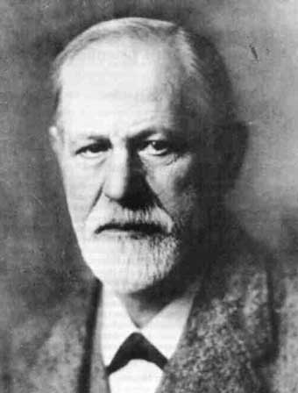
Psychoanalytic Approach
Freud’s Psychoanalytic Theory
Theory is linked to ideas surrounding infantile sexuality.
Stages of development in first 5 years – Oral stage (1st year), Anal stage (2nd-5th year), Phallic stage (5th & 6th year) – all linked to biological development.
Libido = sexual energy which motivates behaviour.

Slide 21
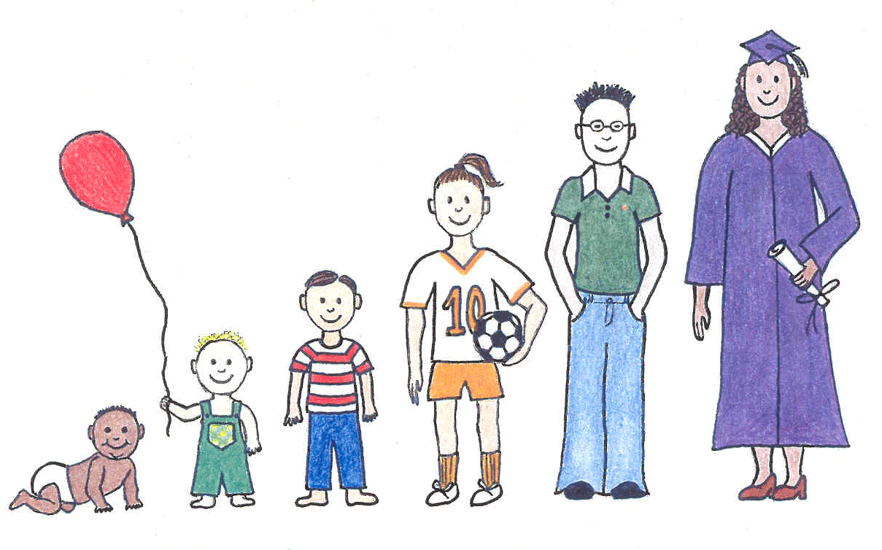
Psychoanalytic Approach
Freud’s Psychoanalytic Theory (2)
First 3 years of life child = bisexual.
The child’s relationship with the mother is crucial & intense, develops into auto-eroticism.
Phallic Stage – before this stage the child has no fixed gender identity (=flexible)
During this stage gender divisions occur which lead to males developing masculine behaviour & females developing feminine behaviour
This occurs due to Oedipus/Electra complexes

Slide 22
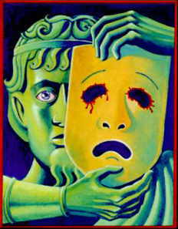
Psychoanalytic Approach
Oedipus Complex
Occurs during phallic stage in boys
Boy’s affection for mother becomes intensely sexual
Boy sees father as a rival who has the power to castrate him
Unconscious conflict - Boy is torn between love for mother & fear of father – resolves conflict by identifying with father.
Boy assumes masculine identity and looks to father as role model.

Slide 23
Psychoanalytic Approach
Electra Complex
Occurs during phallic stage in girls
Girl becomes aware of the male phallus and that she wants one (penis envy). Recognises phallus as symbol of power.
Unconscious conflict - Realises is powerless & mother is also – loathes mother for making her incomplete.
Resolves conflict by converting penis envy into penis baby project.
Having resolved her conflict she returns to pre-Electra relationship with mother, identifies herself as a woman with her mother as a role model.

Slide 24
References
Bandura, A., Ross, D. and Ross, S.A. (1963) imitation of film-mediated aggressive models. Journal of Abnormal and Social Psychology, 66, 3-11
Bem, S.L. (1985) Androgyny and gender schema theory: A conceptual and empirical integration. In T. B. Sondregger (Ed.), Nebraska Symposium on Motivation: Psychology and Gender, 1984. Lincoln: University of Nebraska Press.
Freud, S. (1962) Three essays on the theory of sexuality. New York: Basic Books
Kohlberg, L. (1966) A cognitive-developmental analysis of children's sex-role concepts and attitudes. In E. E. Maccoby (Ed.), The development of sex differences (pp. 82-173). Stanford, CA: Stanford University Press.
Mischel, W. (1966). A social learning view of sex differences in behavior. In E. E. Maccoby (Ed.), The development of sex differences (pp. 56–81). Stanford, CA: Stanford University Press.

Slide 25

Further reading
Read Section 1Chapter 1 – Gender Development
Available online via UWTSD Library
Also see Smidt, S. (2013)
The developing child in the 21st century a global perspective on child development

