Slide 1
Module Name : Signals and System
Module Code : ACDA4009
Topic : Revision 1

Slide 2
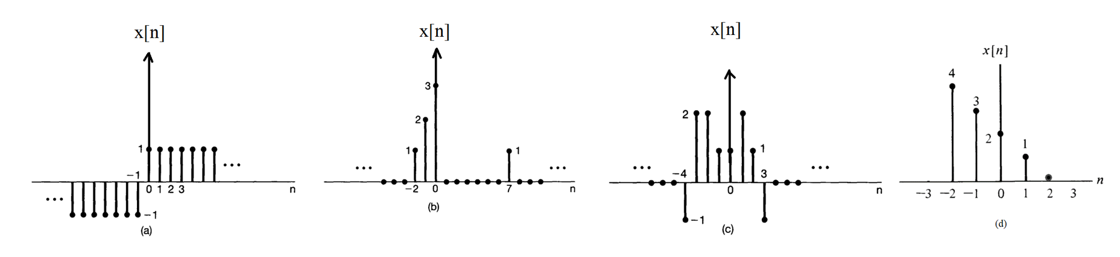
Revision 1
Exercise 1
ACDA4009 – Signals and System

Slide 3
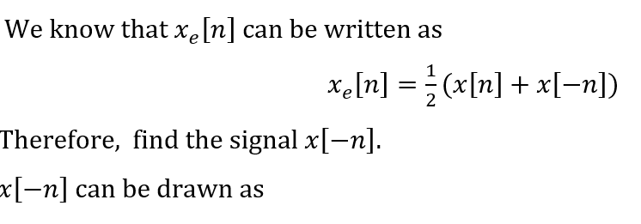
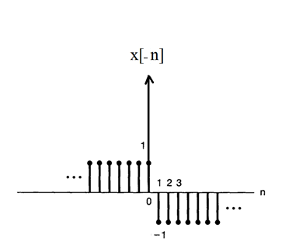
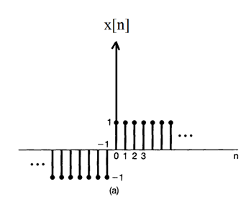
Revision 1
(a)
ACDA4009 – Signals and System

Slide 4
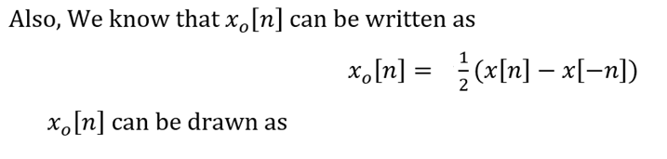
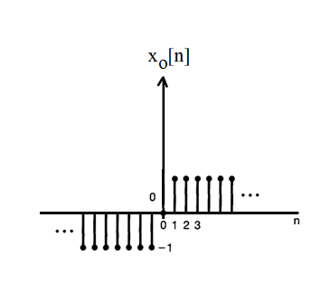
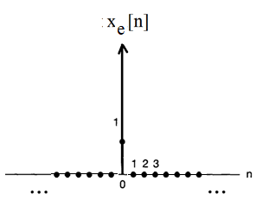
Revision 1
ACDA4009 – Signals and System

Slide 5
Revision 1
ACDA4009 – Signals and System

Slide 6
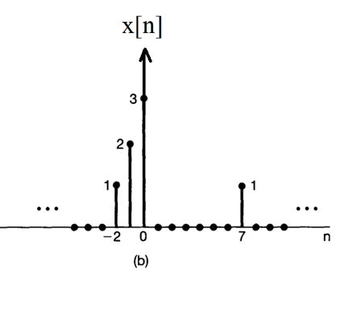
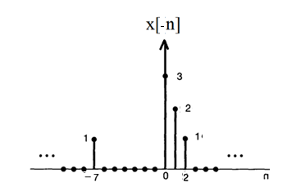
Revision 1
(b)
ACDA4009 – Signals and System

Slide 7
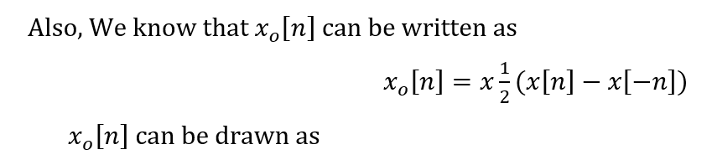
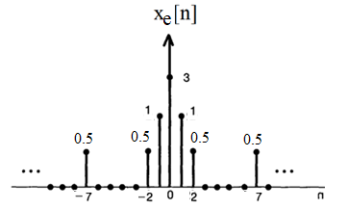
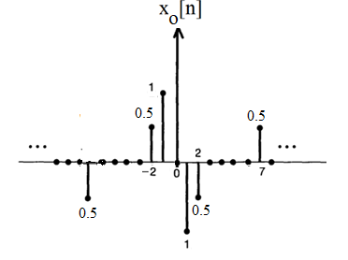
Revision 1
ACDA4009 – Signals and System

Slide 8
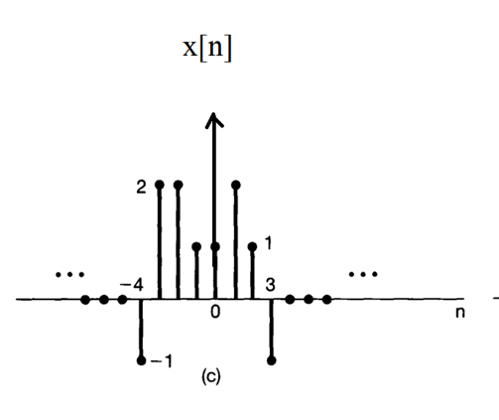
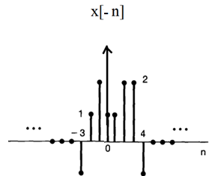
Revision 1
(c)
ACDA4009 – Signals and System

Slide 9
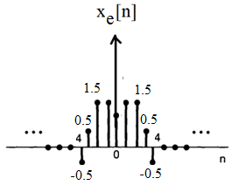
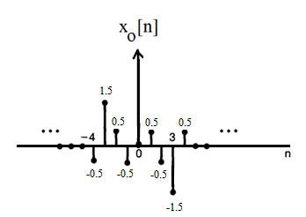
Revision 1
ACDA4009 – Signals and System

Slide 10
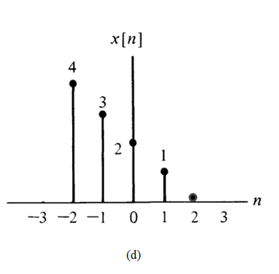
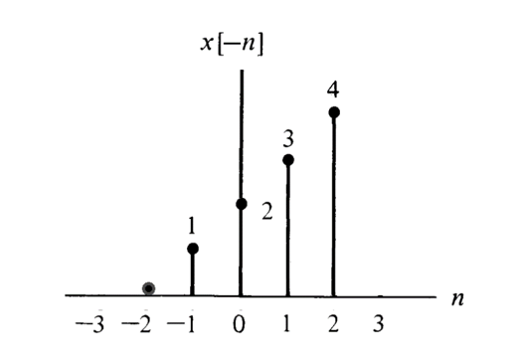
Revision 1
(d)
ACDA4009 – Signals and System

Slide 11
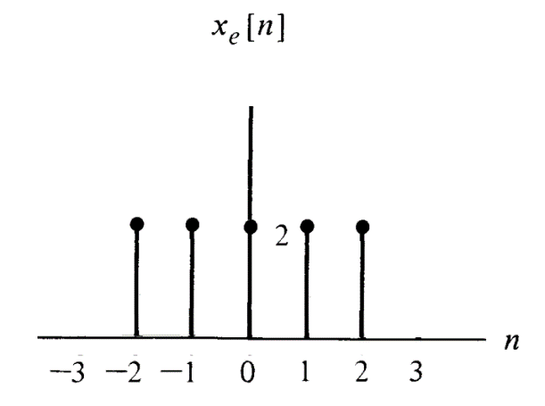
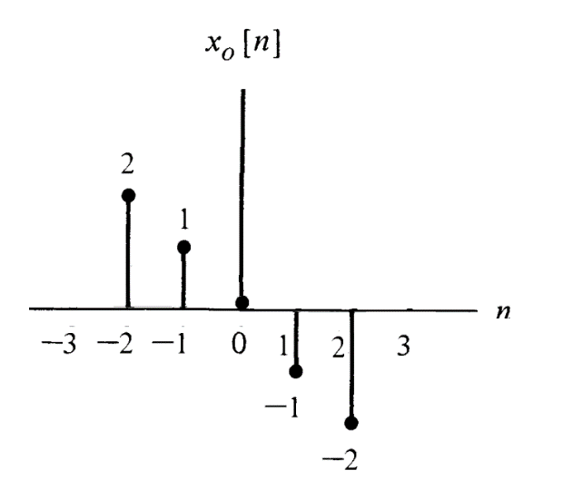
Revision 1
ACDA4009 – Signals and System

Slide 12
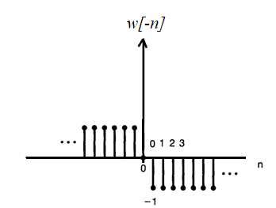
Revision 1
Exercise 2
a.
ACDA4009 – Signals and System

Slide 13
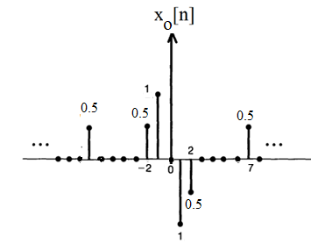
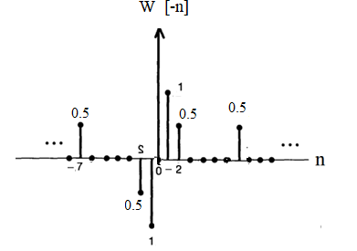
Revision 1
Exercise 2
b.
ACDA4009 – Signals and System

Slide 14
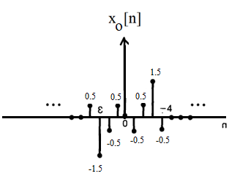
Revision 1
Exercise 2
c.
ACDA4009 – Signals and System

Slide 15

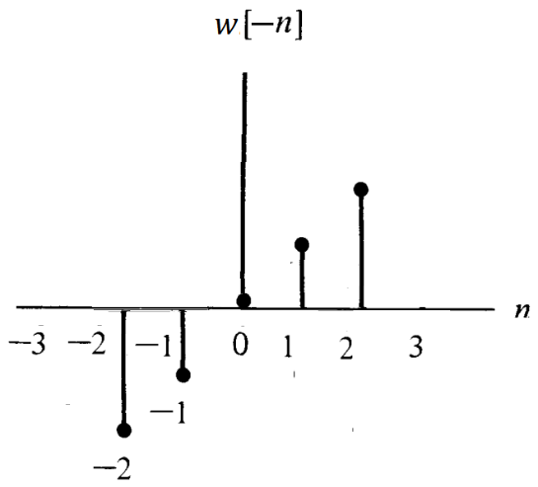
Revision 1
Exercise 2
d.
ACDA4009 – Signals and System

Slide 16
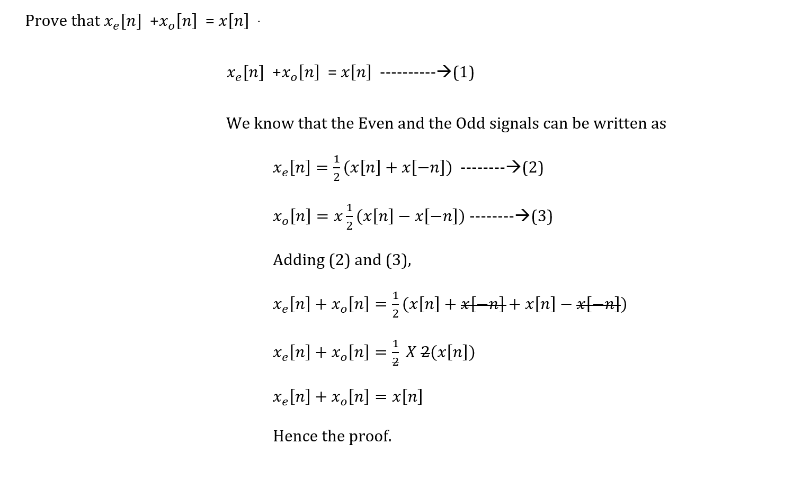
Revision 1
Exercise 3
ACDA4009 – Signals and System

Slide 17
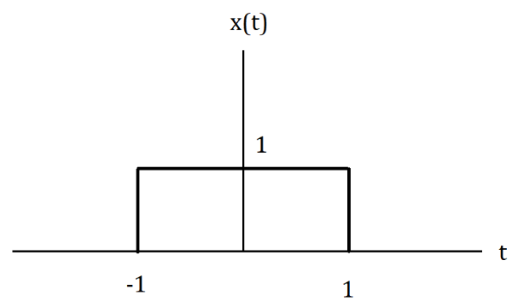
Revision 1
Exercise 4
Consider the rectangular pulse below
Illustrate the time shift and time variant representation for rectangular function y(t)=x(2t+3)
ACDA4009 – Signals and System

Slide 18
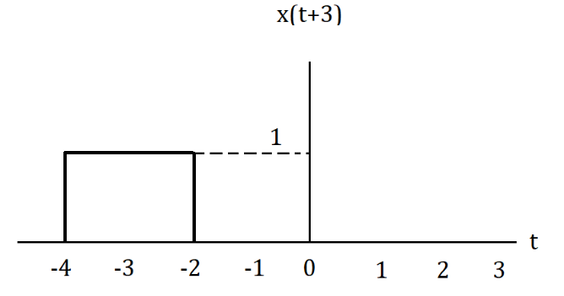
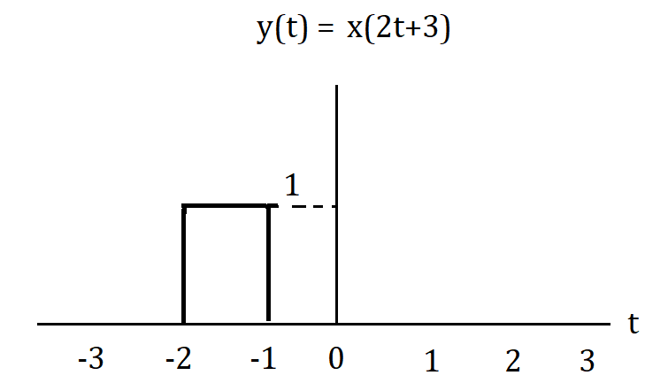
Revision 1
Exercise 4
y(t)=x(2t+3)
Time Shift Time Variant
ACDA4009 – Signals and System

Slide 19
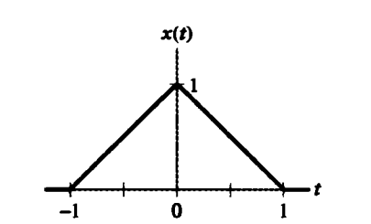
Revision 1
Exercise 5
For the triangular pulse x(t) shown below, sketch the time scaling for each of the following derived from x(t)
x(3t)
x(3t+2)
x(3t)+x(3t+2)
ACDA4009 – Signals and System

Slide 20
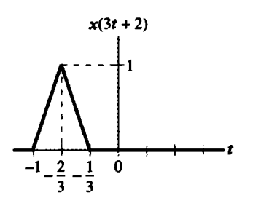
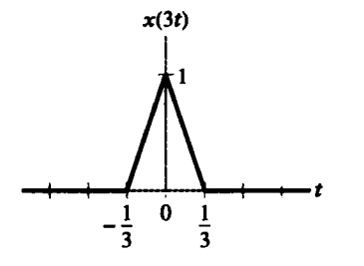
Revision 1
Exercise 5
x(3t) (b) x(3t+2)
ACDA4009 – Signals and System

Slide 21
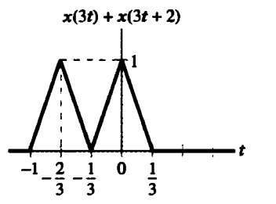
Revision 1
Exercise 5
(c) x(3t)+x(3t+2)
ACDA4009 – Signals and System

Slide 22
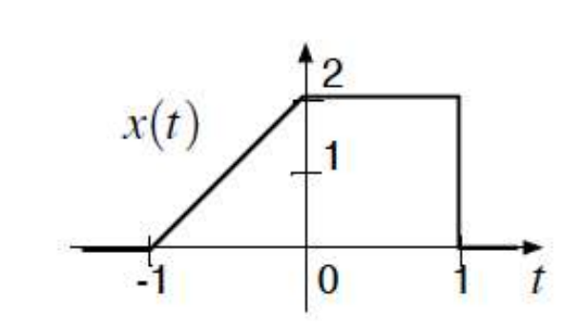
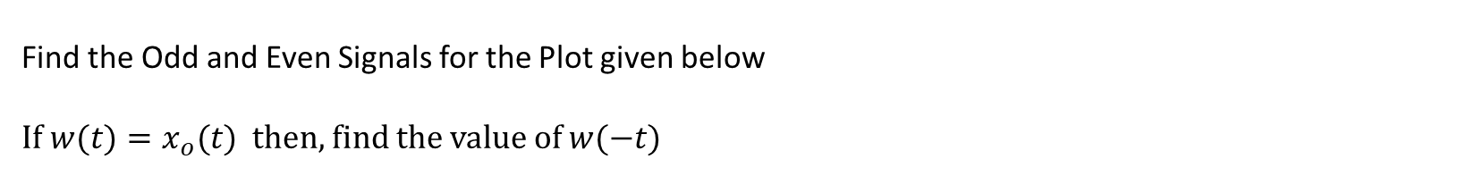
Revision 1
Exercise 6
Find the Odd and Even Signals for the Plot given below
If $w(t)=x_{o}(t)$ then, find the value of $w(−t)$
ACDA4009 – Signals and System

Slide 23
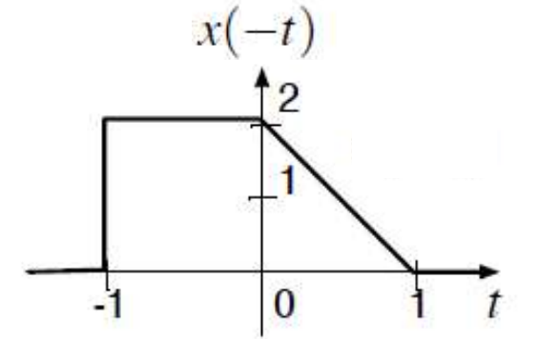
Revision 1
Exercise 6
ACDA4009 – Signals and System

Slide 24
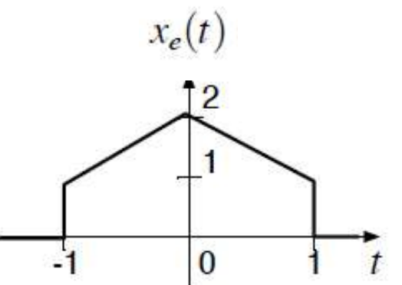
Revision 1
Exercise 6
ACDA4009 – Signals and System

Slide 25
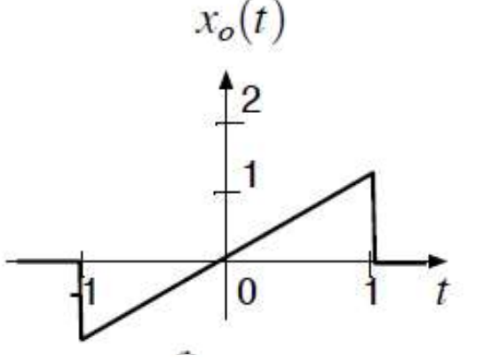
Revision 1
Exercise 6
ACDA4009 – Signals and System

Slide 26
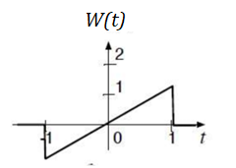
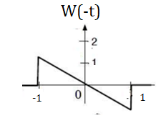
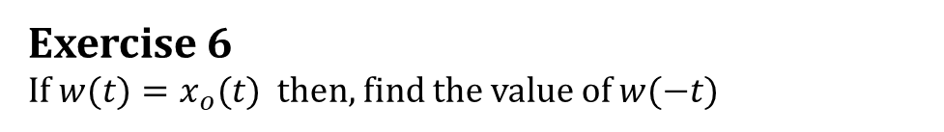
Revision 1
Exercise 6
If $w(t)=x_{o}(t)$ then, find the value of $w(−t)$
ACDA4009 – Signals and System

Slide 27
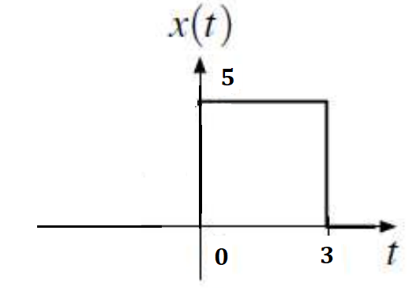
Exercise - Signals
Exercise 7
Calculate the Energy of the signal for the plot given below.
ACDA4009 – Signals and System

Slide 28
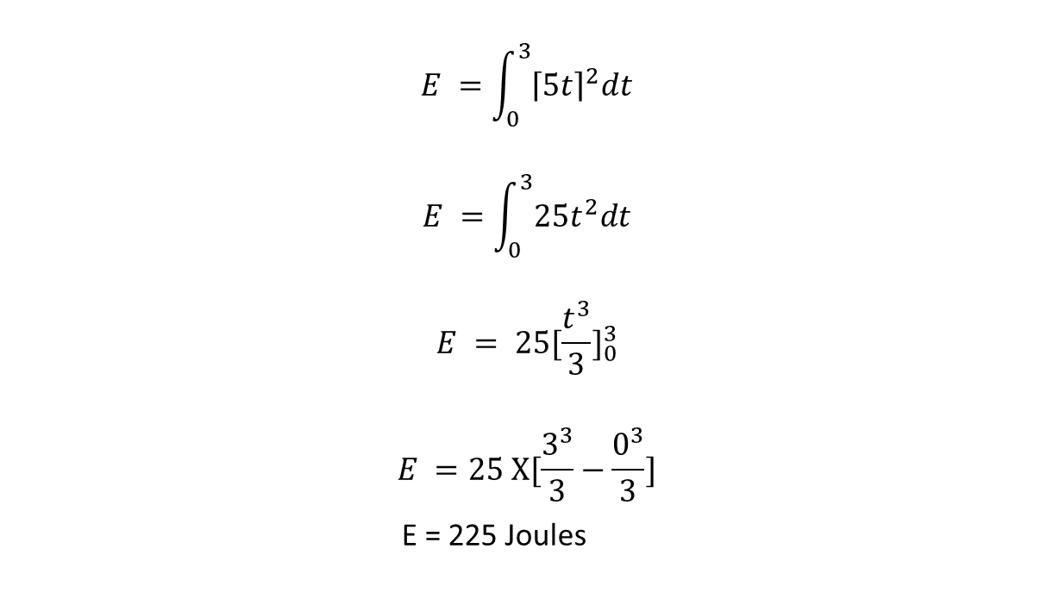

Exercise - Signals
Exercise 7
Calculate the Energy of the signal for the plot given below.
$$E =\int_{0}^{3}{{\left\lceil 5t\right\rceil }^{2}dt}$$
$$E =\int_{0}^{3}{25t^{2}dt}$$
$$E = {25[\frac{t^{3}}{3}]}_{0}^{3}$$
$$E =25 X[\frac{3^{3}}{3}−\frac{0^{3}}{3}]$$
E = 225 Joules
The Energy can be calculated using
$$E =\int_{−∝}^{∝}{{\left\lceil x\left(t\right)\right\rceil }^{2}dt}$$
ACDA4009 – Signals and System

Slide 29
Thank You

