Slide 1
How we use technology to collaborate at UWTSD
Kamil Kazimierz Lenczowski 2120445
Michaela Zawalana 2120150
Kristian Balog 2123604
Digital Skills and Research Methods (BMSW4003_BIRM)
Ngozi Ibeji

Slide 2


Introduction
Which digital tool is most commonly used for collaboration at UWTSD?​
Kamil Lenczowski

Slide 3
Rationale
A brainstorming session between our group
Searching on the internet
Literature
Feedback from other students
Analyses and reports
Kamil Lenczowski

Slide 4
Important keys
Digital media provides an unlimited number of learning sources.
Digital tools are used in pedagogy.
Digital tools that are free of charge and recommended for teaching.
Digital skills are required in many working places.
Nowadays, digital tools empower us to have a better chance to work and learn.
The use of technology can help students to be engaged and able to access school materials.
Kamil Lenczowski

Slide 5

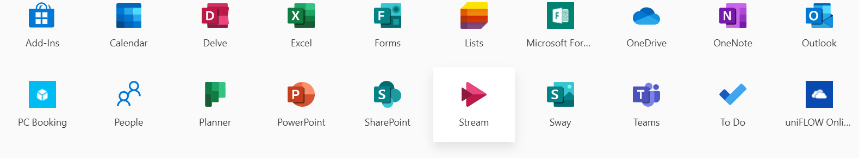
Tools use at University
Microsoft teams​
Outlook​
Hub app​
One drive​
365 apps​
Moodle​
Kamil Lenczowski

Slide 6








Popular tools
Kamil Lenczowski

Slide 7







Other popular and pivotal tools
Calendar
Excel
OneDrive
Power Point
Stream
Outlock
Kamil Lenczowski

Slide 8
Moodle
Moodle is the teaching and learning platform, available online.
Moodle is a tool which helps lectures in getting an education.
Moodle is much more modern practice to learn then a piece of paper and encourage us to learn.
Moodle is saving student's time.
Moodle is a handy platform.
Microsoft Word
Improving students writing skills.
It helps to develop our grammar skills.
Kamil Lenczowski

Slide 9
Microsoft teams
Using Microsoft teams will support the teaching and learning process, for example: during the pandemic or medical conditions
Collaborative learning
Microsoft Teams is a cloud app digital hub that brings conversations, meetings, files and all apps together
Recording class session, so you cannot miss any
OneDrive
OneDrive is a “cloud”
OneDrive allows users to access their files from a web browser after uploading them to cloud storage.
Users can keep the files private, share them with friends, or make the files public.
OneDrive files are backed up and so you don’t have to worry about that
It saves space on your device

Slide 10



METHODS
Hypothesis
Collecting data

Slide 11
QUESTIONS TAKEN
Rank these applications in order according to how frequently you use them to collaborate with
others.
How do you feel about using technology to collaborate?
Would you rather like to study with or without digital tools?
Do you feel confident to use technology to collaborate?
Which digital tools do you commonly use?
Do I need any more training?

Slide 12
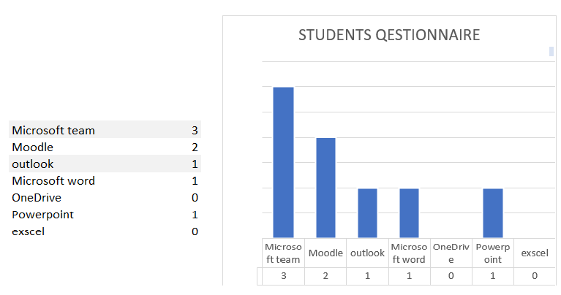
Week 3 beginning
Getting in groups
Planning and questioning
Collecting data and analyses
Discussions and conclusions

Slide 13



Reference
Rashid T, Asghar H M (2016) Technology use, self-directed learning, student engagement and academic performance: Examining the interrelations, Computers in Human Behavior, volume 63, Science Direct, available at: https://www.sciencedirect.com/science/article/abs/pii/S0747563216304204
Poston J, Apostel S, and Richardson K ( 2019) Using Microsoft Teams to Enhance Engagement and Learning with Any Class: It’s Fun and Easy, Bellarmine University available at: https://encompass.eku.edu/cgi/viewcontent.cgi?article=1005&context=pedagogicon
Gunawan, Agung (2009) TEACHING WRITING THROUGH MICROSOFT WORD IN IMPROVING STUDENTS’ WRITING SKILLS, available at: http://repository.upi.edu/9209/6/t_bing_0704794_chapter5.pdf
Erstad, Flewitt, R., Kummerling-Meibauer, B., & Pereira, I. S. P. (2020). The Routledge handbook of digital literacies in early childhood, available at: https://librarysearch.uwtsd.ac.uk/permalink/44WHELF_UWTSD/11c0l68/alma99100357058702421
Jesson, McNaughton, S., Rosedale, N., Zhu, T., & Cockle, V. (2018). A mixed-methods study to identify effective practices in the teaching of writing in a digital learning environment in low income schools. Computers and Education, available at: https://www.sciencedirect.com/science/article/abs/pii/S0360131517302622
Lopes A P (2011) Teaching with Moodle in higher education, P Porto, available at: http://hdl.handle.net/10400.22/622
                Kamil Lenczowski

