Slide 1

PRESENTING YOUR woRK
Developing Skills for Business Leadership

Slide 2


Professional v
Creative
Your presentation should effectively balance professionalism with creativity.
Choose a writing/speaking style that fits the mode of presentation but keep it professional – avoid slang and bad language.
Bring your scenarios to life with the addition of photographs, images and infographics.

Slide 3

consistency
What ever mode you choose to present your work it is important to be consistent. The completed portfolio should appear as one piece of work, not 4 different pieces. Though you can choose different modes it is best to stick with one delivery type to maintain consistency.
You could for example choose to do a blog with three blog posts and one vlog.
If you do choose to submit in document format don’t settle for a plain word document as this will not get you extra marks. Use platforms such as Canva (https://www.canva.com/join/nations-cheers-tightrope) to create colourful and professional looking documents and demonstrate enhanced IT skills.

Slide 4

Blogs
If you choose a blog then you can use any of the blog platforms available free online, I recommend WordPress but there are others.
Make the blog your own – include ‘about’ information and any relevant links to social media.
There are lots of excellent examples of blogs, here is a link to mine to give you some idea about layout: https://whytheworldwagstoday.wordpress.com/
The blog site should look professional and complete.
Vlogs can also be uploaded to these platforms.
Using these formats will help you to evidence enhanced IT skills and creativity.

Slide 5
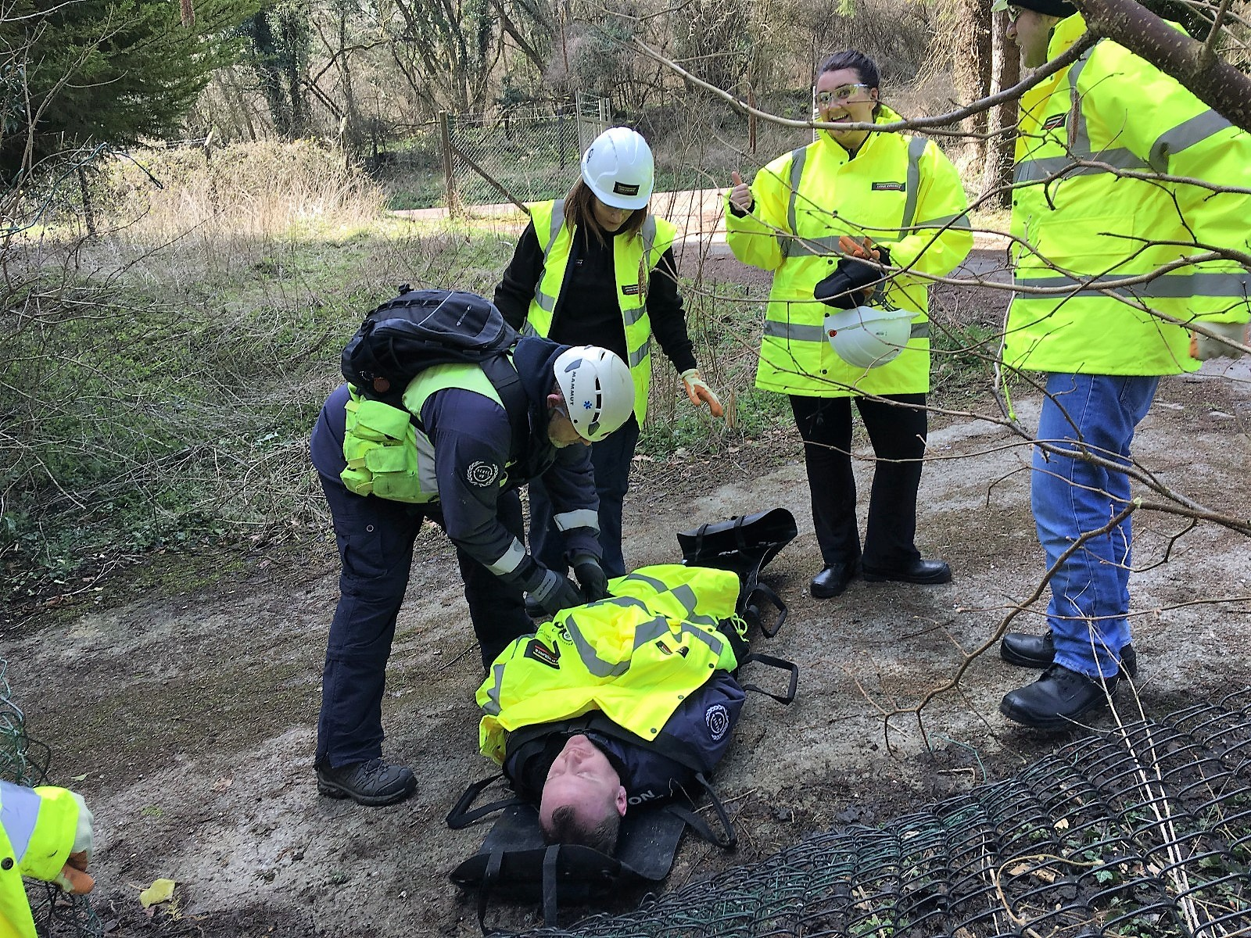
Make it about you
I have no idea what I am doing!!
Make sure your personality is reflected in the work. It should be clear this is about you. I should be able to recognise the work as yours even if you were not named.
Use pictures from your studies and work to bring the scenarios to life.
Remember you are telling a story about YOUR learning journey and this is unique to you.
Describe your emotions in each of the scenarios.
Me undertaking a leadership development event – April 2018

Slide 6
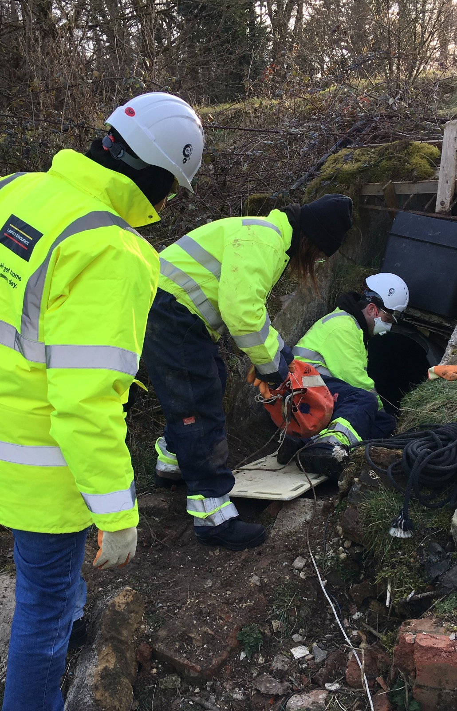
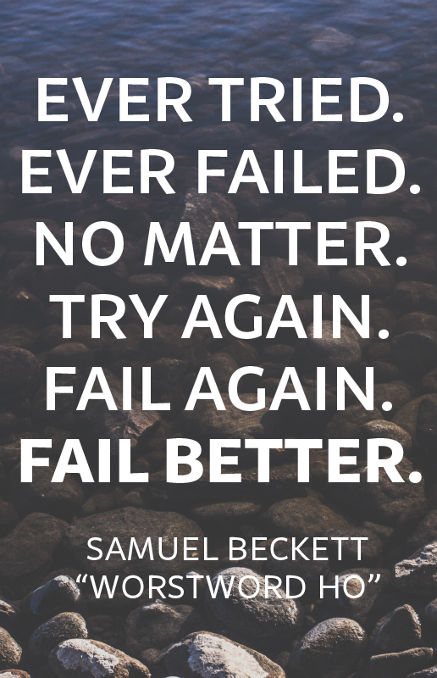
Massive Fail!
This hat was a mistake
Things sometimes go wrong and it’s good to acknowledge this as an important part of your learning journey.
Analyse what went wrong and what you would do differently next time.
Don’t be tempted to only talk about the positives, as this will not appear authentic. We all have challenges and these are good opportunities for learning.

Slide 7

referencing
Each scenario should be supported with reference to at least 8 sources of information. You should aim for more than this is you want higher marks.
Each scenario should have a separate reference list.
The sources should demonstrate a range of research, including books and journal articles.
If you are using blog format then you may use footnotes as this is more appropriate for a blog.
For video and podcasts you should refer to the author or article in the content.

Slide 8

Professional Development Plan
Click on the link to take you to a Canva presentation about how to complete your personal development plan using the CIPD template.
https://www.canva.com/design/DADwWsnM_zc/FeO9n45zNAQd7qyJkElY7Q/view?utm_content=DADwWsnM_zc&utm_campaign=designshare&utm_medium=link&utm_source=sharebutton

