Slide 1
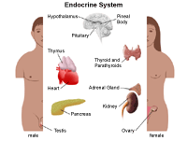
The endocrine system
Name: Saiqa Bibi
Student Id: 2020850
Module: Introduction to Physiology
Module Code: BMHP5003_BIRM
Lecturer: Muhammad Humza Saeed
The anatomy and physiology of the endocrine system is a network of organs and glands, physiology refers to the functions of these structures (Blanchard, S 2005).
The network of glands in the endocrine system are responsible for almost every cell, organ and body functions.
This includes growth, development, metabolism, reproduction, energy levels, and response to stress and mood (Hopkins, 2019.
If the endocrine system is not healthy, it can have many side effects such as weight gain, development of puberty and managing stress levels.
It can also control how hormones are released. (Brody, B 2021).
(John Hopkins 2019)

Slide 2
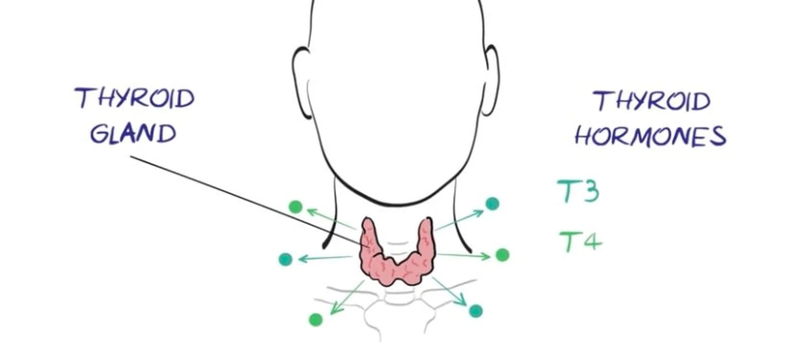
The Endocrine system and the thyroid gland
One of the integral parts of the endocrine system is the thyroid gland
The thyroid gland is made of two hormones, it is situated in the trachea on the base of the neck (Fogoros, N R, 2022)..
The normal functionality of the thyroid glands is it releases the hormone thyroxine (T4) and triiodothyronine (T3) into the bloodstream.
The thyroid gland requires iodine in order to produce the thyroid hormone. This is mainly from food and water, the thyroid gland then processes it into the thyroid hormones (Bonkovsky et al 2020)
The thyroxine contains four atoms of iodine and triiodothyronine contains three atoms of iodine and the secretion of these from the thyroid gland influence the functionality of the cells and tissues of the body.
British Thyroid Foundation, 2019

Slide 3
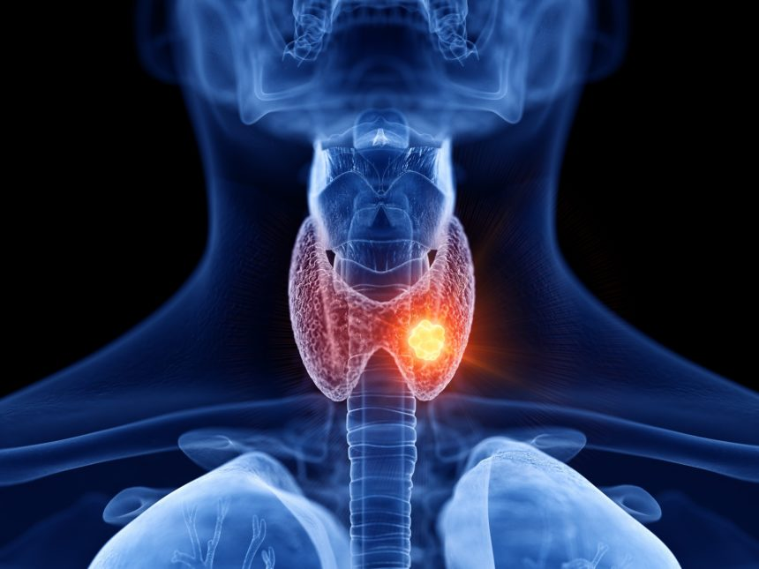
The disease.. Thyroid cancer
There are four main types of thyroid cancer.. Papillary carcinoma, Follicular carcinoma, medullary thyroid carcinoma and anaplastic thyroid carcinoma
The most common type is Papillary carcinoma which affects 8 out of 10 people, mainly women and under 40’s.
Symptoms of thyroid cancer can be swelling or a lump in the neck, difficulty breathing or swallowing, continuous cough without having a cold and pain in the neck which can go up to the ears (NHS 2020).
Thyroid cancer occurs when there's a change to the DNA within the thyroid cells, this causes them to grow uncontrollably and results in a lump being formed (NHS, 2020)
(Reddy V 2020)

Slide 4
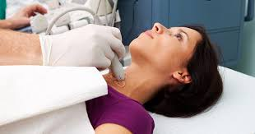
Care plan assessment
Referral to the endocrine specialist
Assess reports of pain and the intensity of pain via an ultrasound(Vera . M 2013)
Diagnosis to be confirmed via the ultrasound and full medical history check and physical exam
Thyroidectomy can be performed depending on severity of glands. This will completely remove the gland
Foundation of treatment to be discussed
Postoperative check ups to be done
Some patients may require calcium or vitamin D as a temporary measure to allow the glands time to recover and start to work effectively again
Heavy lifting to be avoided for roughly 3 weeks however general recovery is 3-5 working days post surgery
(NIDDK 2019)

Slide 5
References
Anatomy of the endocrine system. By John Hopkins Medicine | Year:2019 | Container: John Hopkins Medicine | URL: http://www.hopkinsmedicine.org/health/wellness-and-prevention/anatomy-of-the-endocrine-system
Brody, B. (2017). What Is the Endocrine System? [online] WebMD. Available at: https://www.webmd.com/diabetes/endocrine-system-facts.
British Thyroid Foundation (2019). Your thyroid gland. [online] British Thyroid Foundation. Available at: https://www.btf-thyroid.org/what-is-thyroid-disorder.
Blanchard, S. (2005). 3 - ANATOMY AND PHYSIOLOGY. [online] ScienceDirect. Available at: https://www.sciencedirect.com/science/article/pii/B9780122386626500057.
Hormonal and Metabolic Disorders. Herbert L. Bonkovsky, Sean R Rudnick. https://www.msdmanuals.com/home/hormonal-and-metabolic-disorders/porphyrias/porphyria-cutanea-tarda. 2020
How the Thyroid Gland Functions. Richard N Fogoros, Verywell health. https://www.verywellhealth.com/the-thyroid-gland-and-thyroid-hormones-4149834. 2022.
NHS Choices (2020). Overview - Thyroid cancer. [online] NHS. Available at: https://www.nhs.uk/conditions/thyroid-cancer/.
root (2020). Causes and Types of Thyroid Cancer - Dr.Vijay Anand Reddy. [online] Dr Vijay Anand Reddy. Available at: https://drvijayanandreddy.com/thyroid-cancer [Accessed 26 Jun. 2022]
. American Cancer Society (2015). Signs and Symptoms of Thyroid Cancer. [online] Cancer.org. Available at: https://www.cancer.org/cancer/thyroid-cancer/detection-diagnosis-staging/signs-symptoms.html
Vera, M., BSN and R.N. (2013). 5 Thyroidectomy Nursing Care Plans. [online] Nurseslabs. Available at: https://nurseslabs.com/5-thyroidectomy-nursing-care-plans/.
National Institute of Diabetes and Digestive and Kidney Diseases (2019). Thyroid Tests | NIDDK. [online] National Institute of Diabetes and Digestive and Kidney Diseases. Available at: https://www.niddk.nih.gov/health-information/diagnostic-tests/thyroid.

