Slide 1
LCBB5001
Entrepreneurship
Assessment 1 Support

Slide 2
LEARNING OUTCOMES
Upon the successful completion of this assessment, the student should be able to demonstrate the ability to:
Evaluate the theoretical knowledge of entrepreneurship
Explain entrepreneurship and enterprise with focus on their importance to the economy.

Slide 3
Requirements
50% of the final Grade
2000 words
Cover page
Introduction
Main body
Conclusion
Reference list

Slide 4
Question
Write an essay that evaluates an idea you have that then address the needs and problems of ourselves, others, and the broader community and world. What led you to choose this idea? Take into consideration your initial market research findings and make a case why you have decided to progress this solution in Assessment 2. (1,000 words)
You are expected to reflect on your personal development in your participation in this module by demonstrating the how the entrepreneurial skills and knowledge you have gained will ensure that your idea will create solutions to people’s problems and address people’s needs. (1,000 words)

Slide 5
Task 1
Write an essay that evaluates an idea you have that then address the needs and problems of ourselves, others, and the broader community and world.
What led you to choose this idea?
Take into consideration your initial market research findings and make a case why you have decided to progress this solution in Assessment 2. (1,000 words)

Slide 6
Essay Plan 1
Introduction – evaluates an idea you have that then address the needs and problems of ourselves, others, and the broader community and world. 250 words
Main body:
What led you to choose this idea – 200 words
Using evidence your initial market research findings – 400 words
Conclusion- Why you have decided to progress this solution in Assessment 2– 150 words

Slide 7
Task 2
Reflection on Module undertaken. You can use a reflective model.
You are expected to reflect on your personal development in your participation in this module by demonstrating the how the entrepreneurial skills and knowledge you have gained will ensure that your idea will create solutions to people’s problems and address people’s needs. (1,000 words)

Slide 8
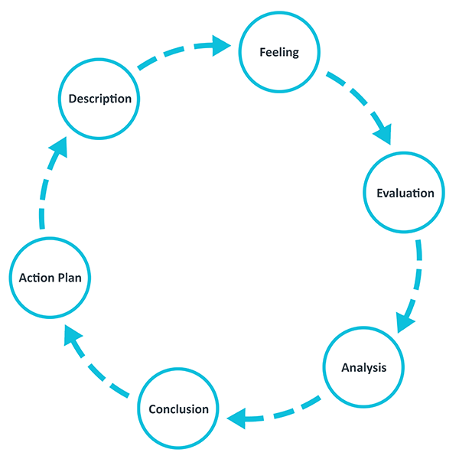
Essay Plan - Gibbs' Reflective Cycle

Slide 9
Essay Plan - 1
Description
Here you have a chance to describe the situation in detail. The main points to include here concern what happened. This situation is the Module you have undertaken.
Helpful questions:
What happened?
When and where did it happen?
Who was present?
What did you and the other people do?
What was the outcome of the situation?
Why were you there?
What did you want to happen?

Slide 10
Essay Plan - 2
Feelings
Here you can explore any feelings or thoughts that you had during the experience and how they may have impacted the experience.
Helpful questions:
What were you feeling during the situation? In undertaking this module
What were you feeling before and after the situation?
What do you think other people were feeling about the situation?
What do you think other people feel about the situation now?
What were you thinking during the situation?
What do you think about the situation now?

Slide 11
Essay Plan - 3
Evaluation
Here you have a chance to evaluate what worked and what didn’t work in the situation. Try to be as objective and honest as possible. To get the most out of your reflection focus on both the positive and the negative aspects of the situation, even if it was primarily one or the other.
Helpful questions:
What was good and bad about the experience?
What went well?
What didn’t go so well?
What did you and other people contribute to the situation (positively or negatively)?

Slide 12
Essay Plan - 4
Analysis
The analysis step is where you have a chance to make sense of what happened. Up until now you have focused on details around what happened in the situation. Now you have a chance to extract meaning from it. You want to target the different aspects that went well or poorly and ask yourself why. If you are looking to include academic literature, this is the natural place to include it.
Helpful questions:
Why did things go well?
Why didn’t it go well?
What sense can I make of the situation?
What knowledge – my own or others (for example academic literature) can help me understand the situation?

Slide 13
Essay Plan - 5
Conclusions
In this section you can make conclusions about what happened. This is where you summarise your learning and highlight what changes to your actions could improve the outcome in the future. It should be a natural response to the previous sections.
Helpful questions:
What did I learn from this situation?
How could this have been a more positive situation for everyone involved?
What skills do I need to develop for me to handle a situation like this better?
What else could I have done?

Slide 14
Essay Plan -6
Action plan
At this step you plan for what you would do differently in a similar or related situation in the future. It can also be extremely helpful to think about how you will help yourself to act differently – such that you don’t only plan what you will do differently, but also how you will make sure it happens. Sometimes just the realisation is enough, but other times reminders might be helpful.
Helpful questions:
If I had to do the same thing again, what would I do differently?
How will I develop the required skills I need?
How can I make sure that I can act differently next time?

Slide 15
Entrepreneurial traits and skills
Traits: Creative
Need for achievement
Self-confidence
Innovativeness
Stress tolerance
Need for autonomy
Proactive personality
Persuasive
Perseverance
Skills: Promoter and networker
Resource assembler/leverager
Self-starter
Decision making,
HR management,
Marketing,
Finance
Tenacious and Visionary
Market research
Source: Barringer and Ireland (2019)

Slide 16
Materials to use
Textbooks for basic understanding
Research Articles
Business/ entrepreneurship news from credible sources e.g., Beehurst, BBC, Forbes
Gibbs G (1988). Learning by Doing: A guide to teaching and learning methods. Further Education Unit. Oxford Polytechnic: Oxford.

