Slide 1



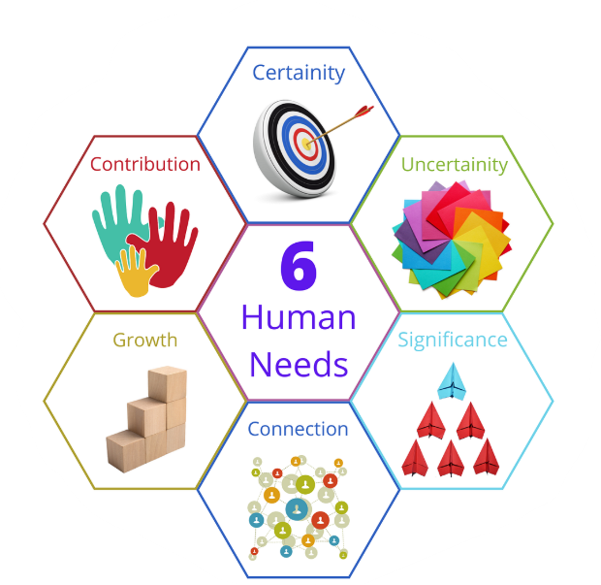
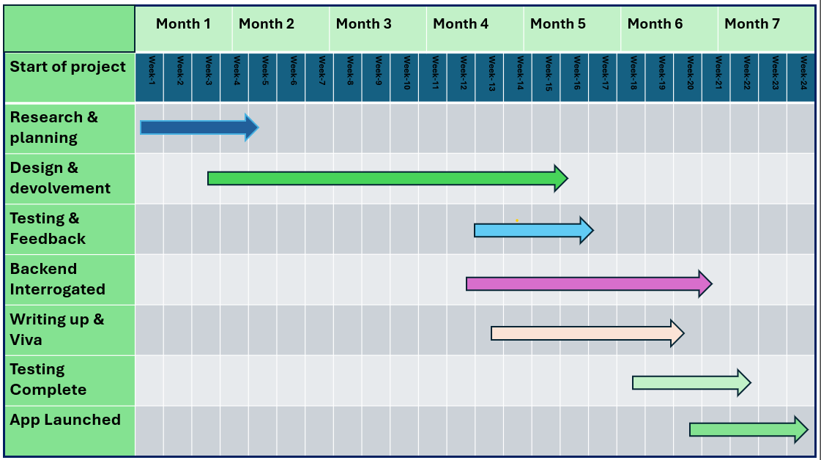
Introduction:
The Human in Need Charity App is expanding its reach beyond the UK to support people in crisis all over the world. Whether someone is facing poverty, displacement, or sudden hardship, the app offers a simple way to request urgent financial help or donate to those in need. It’s built to connect caring individuals and organizations with vulnerable people—no matter where they live. By focusing on small, impactful grants and fast support, the app makes it easier to respond to emergencies and everyday struggles across borders. It’s a global tool for local compassion.
Student Name: Masod Abas Karim
Student Number: 2227092
Assignment Code: ACCA6020_BIRM
Supervisour Name: Nouh Elmitwally
Watching Children in Need on the BBC really inspired me to create the Human in Needs app. Seeing how people came together to help kids and families going through tough times made me want to do something too. It showed me how even small donations can make a big difference. That feeling stuck with me and pushed me to build an app that could help people in need—not just here in the UK, but all over the world.
The Human in Needs Charity App is currently in the development stage, but the vision is clear and powerful. Inspired by programs like Children in Need, the goal is to build a simple, global platform that helps people facing urgent hardship get quick financial support. Whether it's someone struggling with poverty, displacement, or crisis, the app aims to connect them with caring donors and organizations. It’s still a work in progress, but every step brings it closer to making a real difference in people’s lives around the world.

