Slide 1
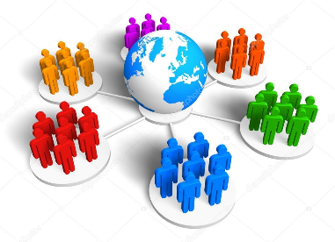
Communication and Communities in a Connected World (SJSS5001)
International Policies & Free Speech

Slide 2
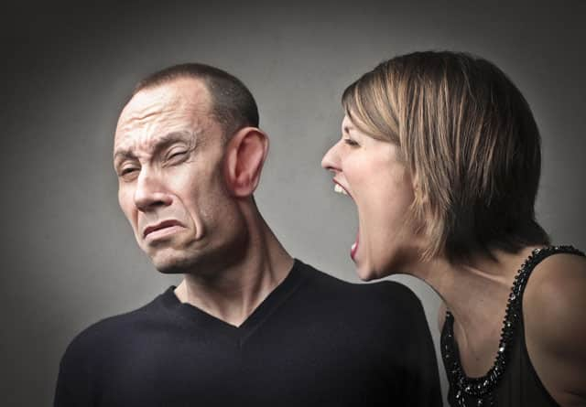
Do you have a Right to Communicate?

Slide 3
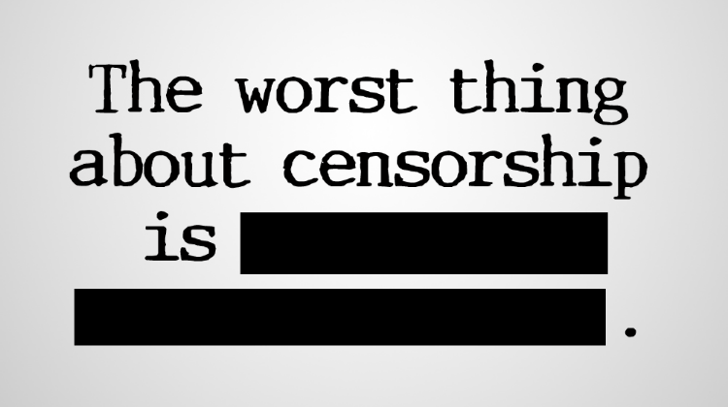
Declaration of Human Rights 1948
Article 19 of UNDHR:
Everyone has the right to freedom of opinion and expression; this right includes freedom to hold opinions without interference and to seek, receive and impart information and ideas through any media and regardless of frontiers.

Slide 4
However..
Resolutions on the right to communicate
At this time, there are no formal United Nations instruments directly on the right to communicate. However, there are a number of 'non-binding resolutions' that contribute to a common understanding of the right to communicate and, usually, propose a course of action.
For example, one of these resolutions is UNESCO Resolution 4.121: Right to Communicate, 1974
http://righttocommunicate.com/?q=human_rights

Slide 5
What examples are there of limits on free speech?
Hate Speech Laws
Blasphemy Laws
Wikileaks & Edward Snowden – Limits for Security (or PR?)
Westboro Baptist Church ( dubbed ‘The Most Hated Family in America’)
Radical / Extremist groups or political parties
Controversial speakers such as historian David Irving, ethicist Peter Singer
Controversial or provocative artistic works, e.g. The Satanic Verses by Salman Rushdie, Lolita by Vladimir Nabokov
Net Neutrality vs State censorship

Slide 6

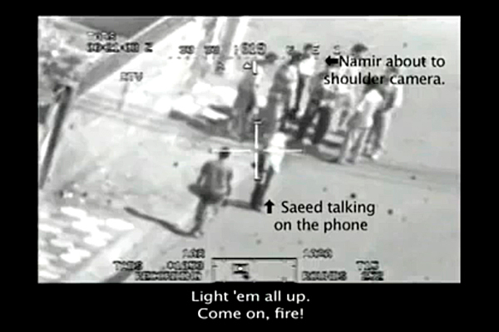
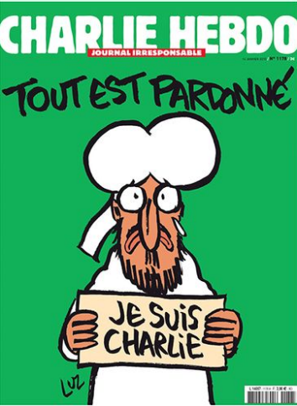
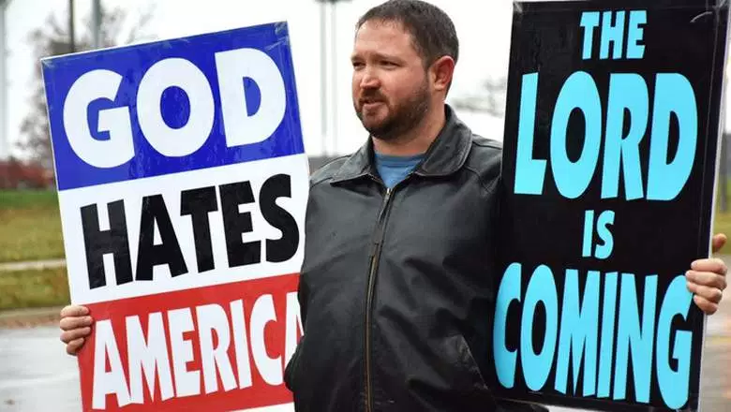
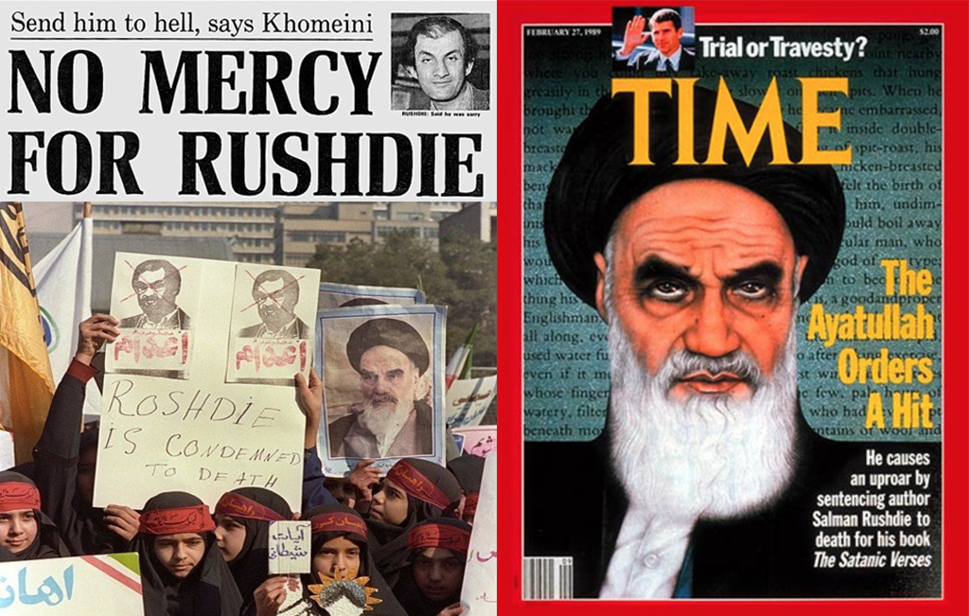
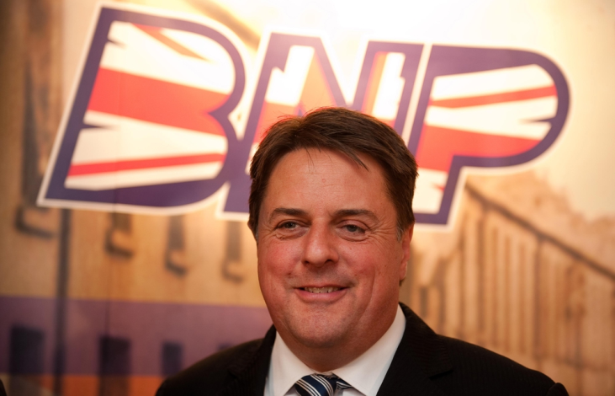
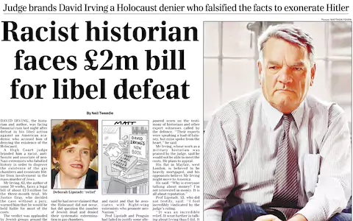

Slide 7
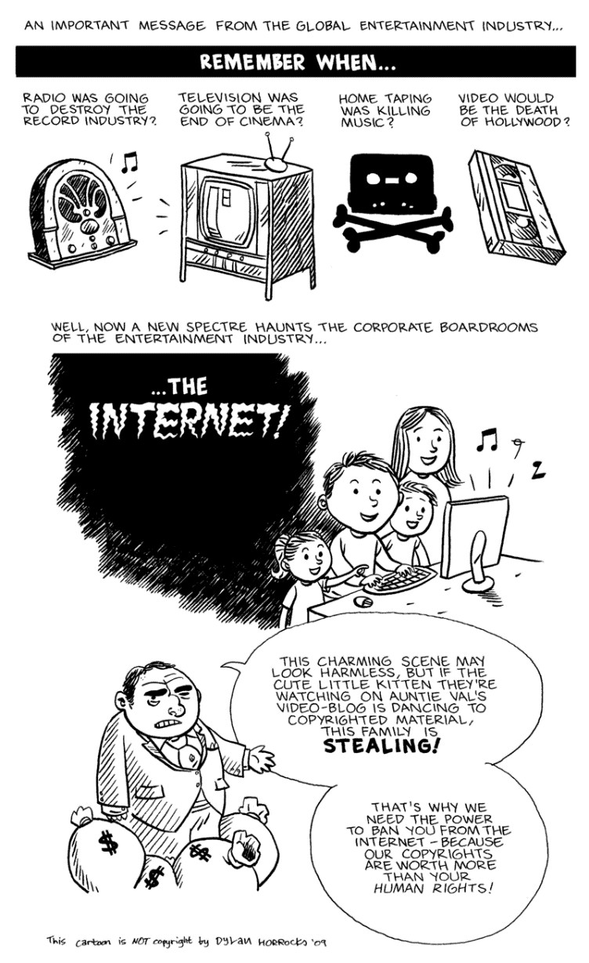

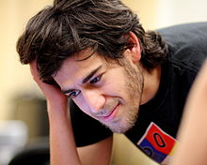


Net Neutrality & Global Surveillance
Aaron Swartz & the Open Access Movement http://www.capitalaspower.com/2019/12/the-legacy-of-aaron-swartz-the-fight-for-open-access/
Anonymous Hacker collective
NSA Prism Surveillance Programme
The Pirate Bay torrent website

Slide 8
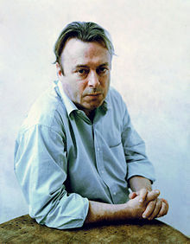
Who Decides What is Harmful?
‘Freedom of speech must include the right to offend’
Christopher Hitchens in debate on free speech, 2006
‘Bear in mind, ladies and gentlemen, that every time you violate or propose to violate the free speech of someone else, (...), you’re making a rod for own back. Because the other question raised (…) is simply this: who’s going to decide?
Do you know anyone — hands up — do you know anyone to whom you’d give this job? Does anyone have a nominee? You mean there’s no one in Canada good enough to decide what I can read? Or hear? I had no idea. But there’s a law that says there must be such a person. Or there’s a subsection of some piddling law that says it. Well, the hell with that law then. It’s inviting you to be liars and hypocrites and to deny what you evidently know already.’
http://blog.skepticallibertarian.com/2014/09/30/christopher-hitchens-freedom-of-speech-means-freedom-to-hate/
https://www.youtube.com/watch?v=7oCmhZ-1gGc

Slide 9
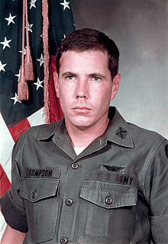
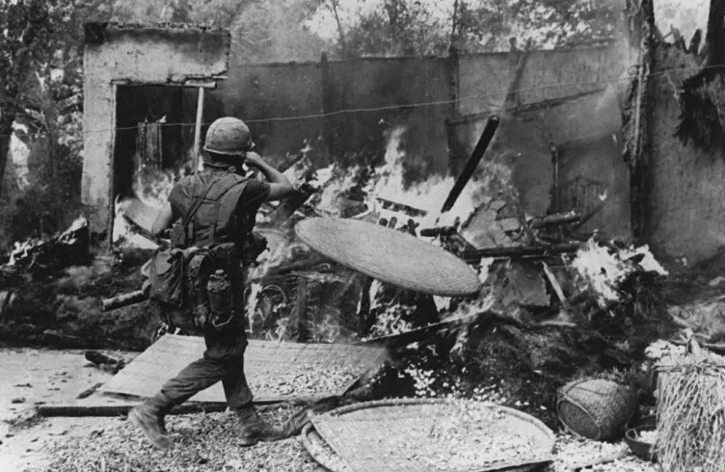
Case study: My Lai, Vietnam, 1968.
It took nearly a year for the story to break in the media. The army tried to discredit and fabricate reports about Thompson, considering him a traitor who was seen as undermining the war effort and endangering American lives.
Question: Should freedom of speech & press be as important during wartime or terrorism? Who decides what is ‘harmful?’
Hugh Thompson Jr.
25 years old at the time, prevented the killing of Vietnamese civilians.

Slide 10
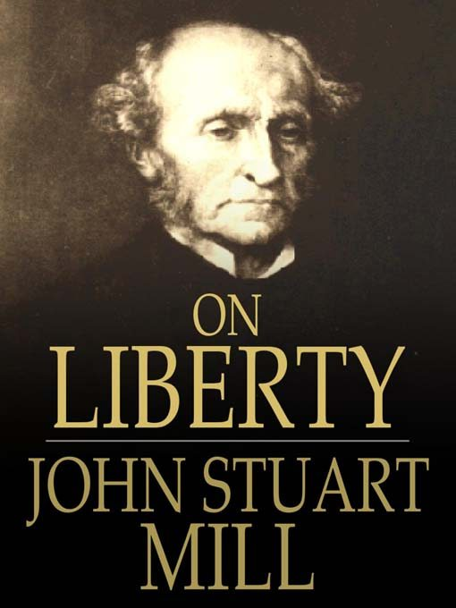
Who Decides what is Acceptable Speech in the Global Sphere?
https://plato.stanford.edu/entries/freedom-speech/
The Right to communicate is therefore particularly linked to:
Right to religious expression
The increasing spread of technology
Right to privacy
Right to fair trail
Democracy as a political system

Slide 11
Freedom of Speech
Freedom of speech is the right for an individual or community to express any opinions without censorship or restraint and without fear of retaliation or legal sanction.
This is not limited to “speech” specifically as it includes other forms of expression.
There is an ongoing debate about where to draw the line between freedom of speech and offensive comments.
In the age of social media, concerns have arisen over whether freedom of speech is causing more harm than it is good
(World Population Review 2020)

Slide 12
Freedom of Speech
Freedom of speech is a right preserved in the United Nations Universal Declaration of Human Rights and is granted formal recognition by the laws of most nations; however, the degree to which this right is upheld varies greatly from one country to another.
Researchers asked participants of 38 countries a series of five questions with answers ranging from 0-8. Zero representing the least support for freedom of expression and 8 representing the most supportive for freedom of expression. A median score was calculated for each country
(World Population Review 2020)

Slide 13
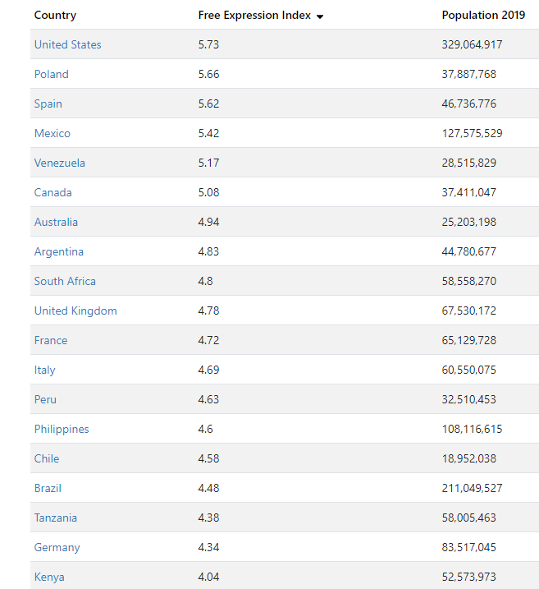
Countries With Freedom Of Speech 2020
(World Population Review 2020)

Slide 14
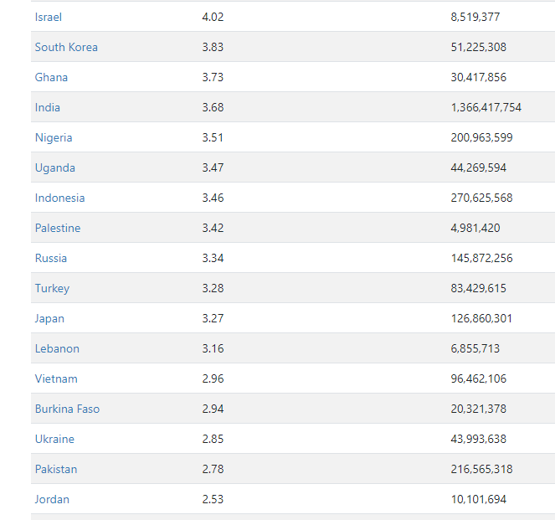
Countries With Freedom Of Speech 2020
(World Population Review 2020)

Slide 15
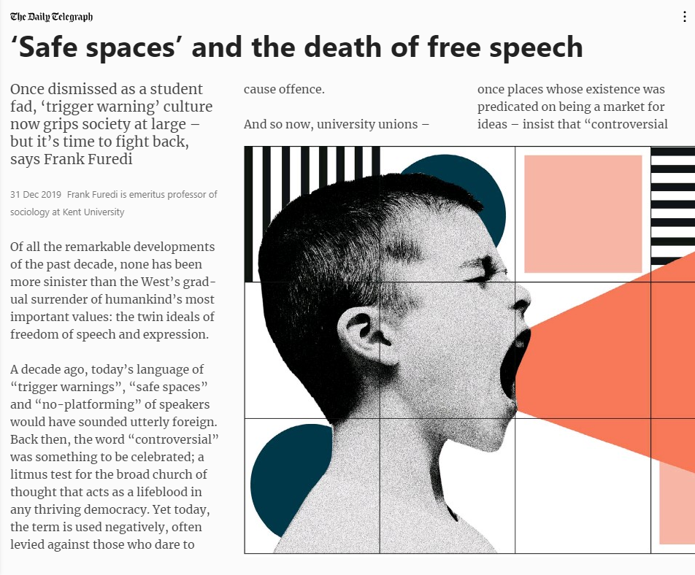
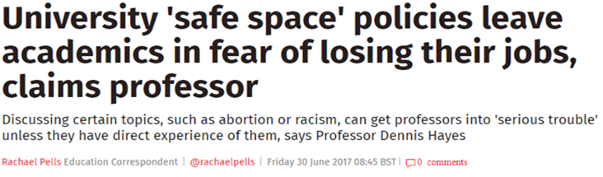
Who Decides what is Acceptable Speech in the Global Sphere?
European Court of Human Rights- Hate Speech
https://www.echr.coe.int/Documents/FS_Hate_speech_ENG.pdf
https://www.pressreader.com/search?query=safe%20spaces%20and%20the%20death%20of%20free%20speech&in=ALL&date=Anytime&hideSimilar=0&type=2&state=2

Slide 16
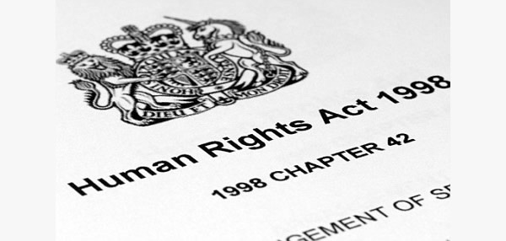
Human Rights Act 1998 UK
Freedom of expression – protected by Article 10 of the Human Rights Act – is fundamental to our democracy.
Free to hold opinions and ideas and share them with others without the State interfering.

Slide 17
Limitations on the Human Rights Act
Article 10 may be limited in certain circumstances. Any limitation must:
Be covered by law
Be necessary and proportionate
For one or more of the following aims:
  national security, territorial integrity or public safety
  preventing disorder or crime
  protecting health or morals
  protecting other people's reputation or rights
  preventing the disclosure of information received in confidence
  maintaining the authority and impartiality of the judiciary.

Slide 18
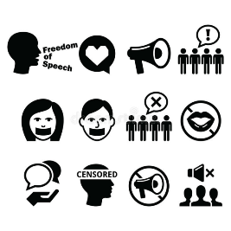
Right to Communicate / Communication Rights
Freedom requires access to resources. The full recognition of the right to communicate requires that the communication resources be available to meet the basic communication needs of everyone.
The right to communicate can be broken down into 3 parts; fundamental, inclusive and comprehensive.

Slide 19
Fundamental
In this multi-layer framework, the first layer differentiates the right to communicate from the other human rights included in the Universal Declaration of Human Rights.
The right to communicate is a fundamental and inclusive human right; it is both a
natural right of the human person and a
prerequisite for the exercise of the other human rights.
This fundamental right enriches the cultural heritage of humankind.

Slide 20
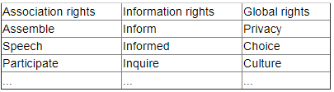
Inclusive
At the core of this fundamental right is the basic and universal claim that everyone has the right to communicate. Attached closely to this core and inseparable from it emerge three classes of specific communication rights: association rights, information rights, and global rights.

Slide 21
Comprehensive
The third layer of the right to communicate may be described as follows.
Everyone has the right to communicate; this fundamental human right includes but is not limited to the following specific communication rights:
a right to assemble, a right to speech, a right to participate and related association rights;
a right to inform, a right to be informed, a right to inquire and related information rights;
a right to privacy, a right to choose, a right to culture and related global rights

Slide 22
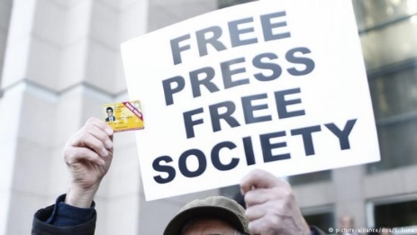
Freedom of Media
Accountable media is not necessarily free media.
Equal access to communication media implies inasmuch a negative duty, to not restrict access to media, as a positive duty, to assure pluralism and diversity. Therefore, when pluralism and diversity are not respected, or not fulfilled, not only has the right to equality been violated, but the right to freedom of expression has been violated as well.
Controlling news content, whether through the physical harassment of journalists covering protest movements or other sensitive news stories; restrictions on foreign reporters; tightened constraints on online news outlets and social media. Additionally, press freedom in a number of countries threatened by private owners.

Slide 23
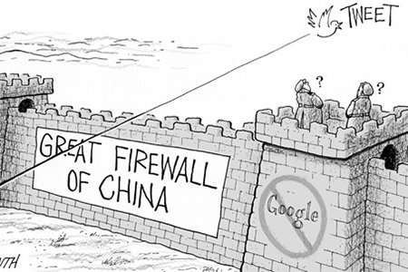
For example..
https://www.theguardian.com/world/2016/oct/05/ten-years-putin-press-kremlin-grip-russia-media-tightens

Slide 24

GreatFire.org & ‘Charlie Smith’
https://en.greatfire.org/

Slide 25
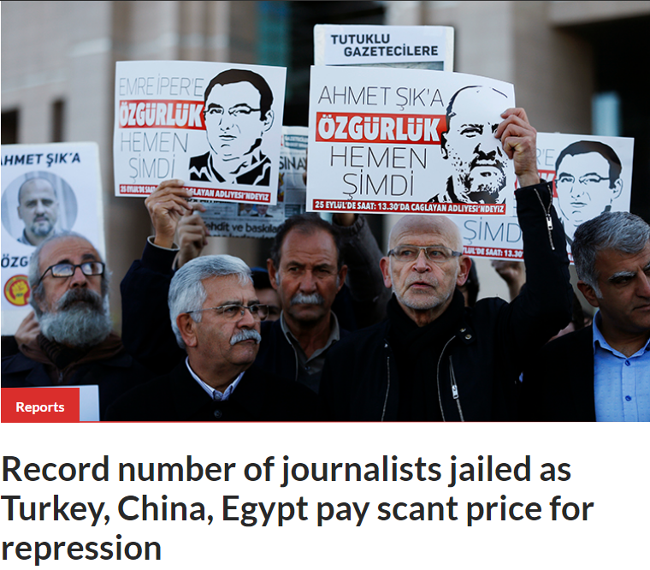
Committee for the Protection of Journalists
2017 was the worst year on record for journalists in detention, at 262 journalists jailed for their work.
https://cpj.org/reports/2017/12/journalists-prison-jail-record-number-turkey-china-egypt.php

Slide 26
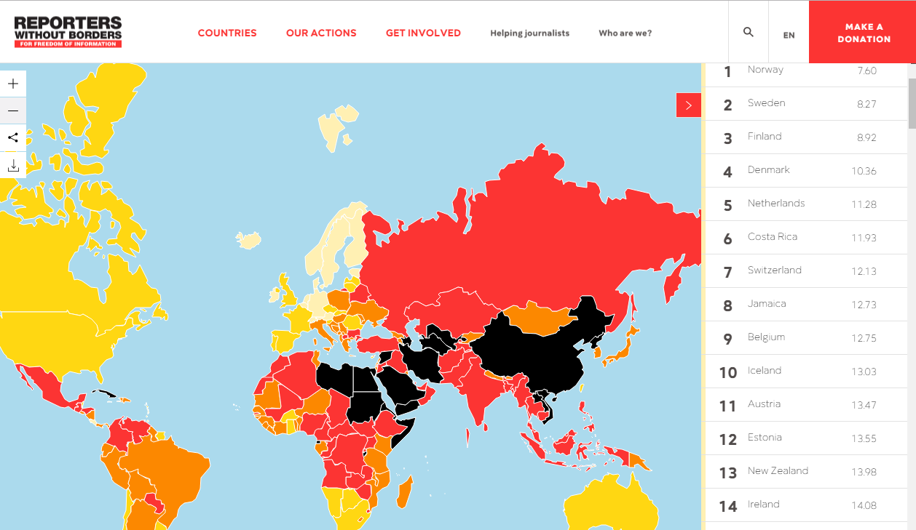
Reporters Without Borders
Press Freedom Index - https://rsf.org/en/ranking

Slide 27
Communication & Human Rights
‘Communications must be regarded as a fundamental tool for participation in local, national and international development plans. Such plans must take into account its economic dimensions because communication is strongly related to the access to electronic media, its social dimensions because of the means it provides to building citizenship, and political dimensions because it involves the participation of all.’
A. Fulya - Communication and human rights, 2014
https://ac.els-cdn.com/S1877042815010319/1-s2.0-S1877042815010319-main.pdf?_tid=e9c3aae2-17b4-11e8-a178-00000aacb360&acdnat=1519292822_1dfaa9a23084a8ccd4c982f71a4945c5

Slide 28
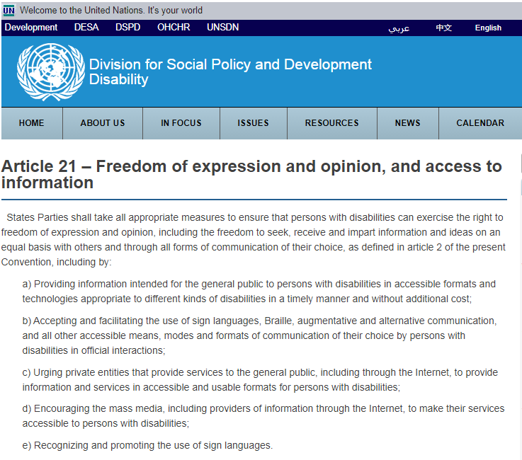
https://www.un.org/development/desa/disabilities/convention-on-the-rights-of-persons-with-disabilities/article-21-freedom-of-expression-and-opinion-and-access-to-information.html

Slide 29
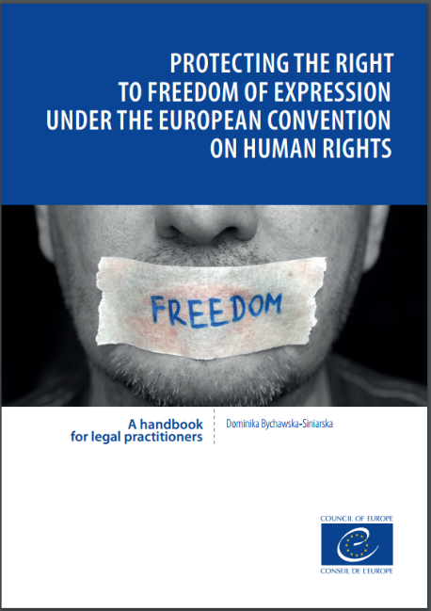
In Human Rights Law
Without a broad guarantee
of the right to freedom of expression protected by independent and impartial
courts, there is no free country, there is no democracy. This general proposition
is undeniable.’
https://rm.coe.int/handbook-freedom-of-expression-eng/1680732814

Slide 30

To conclude…
We must also consider that the right to communicate is only one very broad aspect of international communication. There are numerous other questions to consider, such as:
To what extent are people in more affluent countries able to exercise the right to communicate more than those in less affluent countries?
Is the right to communicate a fundamentally Western concept, and masks its ideological imperialism?
Who does / should police the issue of free speech? The UN? the European Convention? UK Government?
How does technology provide opportunities and new challenges for communication?
The problem of intellectual property: who owns material on the internet?

Slide 31
References
Bychawska-Siniarska, D. (2017). Protecting the Right to Freedom of Expression Under the European Convention on Human Rights. Council of Europe.
Committee to Protect Journalists. (2017, December 13). Record number of journalists jailed as Turkey, China, Egypt pay scant price for repression. Retrieved March 05, 2018, from Committee to Protect Journalists: https://cpj.org/reports/2017/12/journalists-prison-jail-record-number-turkey-china-egypt.php
Fulya Sen, A. (2015, Febuary 12). Communication and Human Rights. Procedia - Social and Behavioural Sciences, 174, 2813-2817.
Oppenheim, M. (2018, March 03). China bans George Orwell's Animal Farm and letter 'N' as censors bolster Xi Jinping's plan to keep power indefinitely. The Independent.
The Skeptical Libertarian. (2014, September 30). Christopher Hitchens: “Freedom of speech means freedom to hate.”. Retrieved March 04, 2018, from The Skeptical Libertarian: http://blog.skepticallibertarian.com/2014/09/30/christopher-hitchens-freedom-of-speech-means-freedom-to-hate/
Van Mill, D. (2017). Freedom of Speech. Retrieved March 05, 2018, from Stanford Encyclopedia of Philosophy: https://plato.stanford.edu/entries/freedom-speech/
Walker, S. (2016, October 05). The murder that killed free media in Russia. The Guardian.
YouTube. (2012, July 25). Christopher Hitchens - Freedom of expression must include the license to offend [2006]. Retrieved March 05, 2018, from YouTube: https://www.youtube.com/watch?v=7oCmhZ-1gGc

