Slide 1

Strategic and Agile Business ManagementBMMB7027D
Strategic Change
Daniela Hellyer
December 2024

Slide 2

Strategic change
We will explore:
  Types of Change
  Change Management

Slide 3

Strategic change
  Change is constant – forced upon from outside the organisation or initiated from within
  Definition of strategy: ‘…to take an organisation from where it currently is, to where it wants to be…’ which inherently calls for change
  An organisation’s strategic environment changes constantly
  Successful strategic change initiatives require:
    strong and continual communication
    clear explanation of reasons for change
    swift pace of change processes

Slide 4

Two characteristics of change
There are two central characteristics of change:
  Speed or Pace of the change
  Degree or Extent of the change
Ranging across a spectrum…
  Speed or pace can be:
    incremental on the slow end
    “big bang” fast-paced change
  Degree or extent can be:
    realigning (more measured degree)
    transformational (e.g. extensive shift in culture)

Slide 5

types of strategic change
Key is to identify type of change and how to best integrate it into your strategic management process and planning
Change can be very complex and is highly context-dependent.
Balogun & Hope Hailey (2008) developed a model that incorporates that complexity and context-dependency:
By combining the two characteristics of Speed and Degree, a matrix can be formed depicting four key types of change
Type of Change Description
Evolution High degree of change that takes effect over a slower pace
Revolution High degree of change taking effect at a fast pace
Adaption More modest degree of change taking place at a slow pace
Reconstruction More modest degree of change taking place at a fast pace

Slide 6
Balogun & Hope Hailey’s model of types of strategic change
Big
Small
Extent of Change
Transformation
Realignment
Evolution:
Transformational change implemented gradually through interrelated initiatives;
likely to be proactive change undertaken in anticipation of the need for future change
Adaption:
Change undertaken to realign how the organisation operates, implemented in a series of steps
Slow
Incremental
Speed of Change
Revolution:
Transformational change occurs via simultaneous initiatives on many fronts;
more likely to be forced and reactive because of the changing competitive conditions that the organisation is facing
Reconstruction:
Change undertaken to realign how the organisation operates, with many initiatives implemented simultaneously;
often forced and reactive because of a changing competitive context
Big Bang
Fast

Slide 7

change management
Change within an organisation can be very challenging
The source of challenges may be both internal and external in nature
It needs to be managed
Strong and adaptable leadership is essential for change to be successful

Slide 8
Robert katz’s
Three skill model of leadership
Technical Skill | Human Skill or 'People Skills' | Conceptual Skill
Proficiency in a specific task or area of work Most important at lower and middle levels of management Less important at senior management levels | Knowledge and proficiency in the ability to work with people Selfawareness: adapting their own ideas incorporating good themes from those of others Creating an atmosphere of trust Empowering people Motivating others Effective communication Important at all levels of management: Lower, Middle and Senior | Working with ideas and concepts Creating visions, strategic plans and setting direction Cognitive, business, and strategic skills Most important for top managers
  Successful leadership consists of particular skills
  The Three Skill Approach or Model was developed by Robert Katz:
    It suggests three groups of leadership skills
    The balance of those three skills changes, depending on the level of leadership

Slide 9

Change management process – five key steps
Watch this video and take notes:
  What are the key messages that you take away from this?
  We will discuss this together after the video.
https://youtu.be/wxVgd8h1svU?si=Q8IrwlibRUJuMtRz

Slide 10
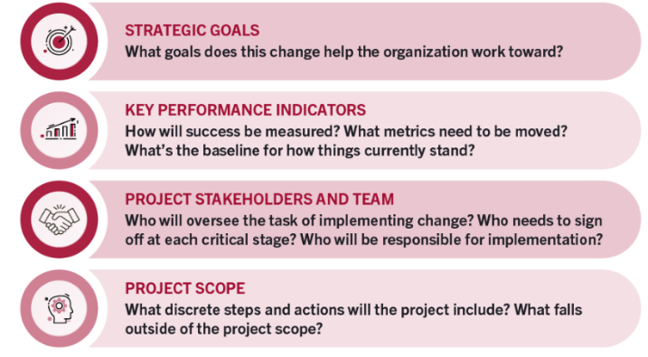
Change management process – five key steps
Four elements of effective plans for change
Preparing the organisation for change
Craft a vision and plan for change
Implement the changes
Embed changes within company culture and practices
Review progress and analyse results

Slide 11
Sources of Resistance to change
Source of Resistance | Description
Employee Self-Interest | Change may be perceived as taking away something of value from an employee—an office space, or a prominent intra company position
Misunderstanding | Employees may widely misunderstand change, and those misperceptions may lead them to feel the change is more threatening
Lack of Trust | In organisations where there is deep mistrust between management and employees, prescriptions for change may further stress that lack of trust
Low Tolerance for Change | Specific departments may be less receptive to change (e.g. accounting department may be less tolerant than an innovative R&D department)
Different Assessments of Change | Change may be viewed as valuable to management and stakeholders' individual interests but may be perceived as providing little value to employees
Question: can you think of any examples that you have experienced, either as an employee or a manager?

Slide 12

tell a compelling story to inspire your organisation! a case study
Watch this video and take notes:
  What are the key messages that you take away from this?
  We will discuss this together after the video.
https://youtu.be/4FlP1-5WMyo?si=9BS-gbk9X1ihyPNx

Slide 13

overcoming resistance to change
There are five main management tactics for overcoming resistance to change:
  Communication & Education
  Participation & Involvement
  Facilitation & Support
  Manipulation
  Coercion

Slide 14

Communication & education
Often underestimated
Managers often fail to anticipate and prepare responses to the proposed change's inevitable answers or questions
It may be beneficial to communicate to employees in multiple layers
Deliver the cornerstone message of the strategy with a presentation to the entire office as a whole
Follow up with divisional meetings to address more specific aspects of change
Provide opportunity for one-on-one meetings with employees to answer specific questions they may have
Communicate a message to key mid-level managers and leaders to enable synchronised and prompt response to employee questions
Any examples?

Slide 15

Participation & involvement
Managers can offer employees opportunities to play a critical role in the strategic roll-out
Generates acceptance and excitement
For instance:
  Appoint a divisional or departmental liaison for each group that can oversee the implementation of the division-specific strategy pieces
  This informal and temporary appointment may instil a level of pride in the key employee, and that pride may permeate their division
Any examples?

Slide 16

Facilitation & support
Include support mechanisms to ease growing pains that may engender resistance to the new strategy
  Example: if a company is changing an essential aspect of its production workflow and replacing it with technology, it may want to provide ample training and support for employees in learning the new system
Any examples?

Slide 17

Manipulation
Only to be utilised in limited circumstances
Can be an effective mode for pushing change forward
Includes selectively conveying information to engender a particular response
However, if the means of manipulation are discovered, they may ultimately engender more resistance and a lack of trust!
Also: involve a recognised leader (or famous individual) to participate in the strategic plan roll-out to get them to lead their followers along the strategic direction
Any examples?

Slide 18

coercion
Undertaking explicit or implicit means to force employees to carry out the strategic change
Includes threats, firings, or demotions or transfers
Most dangerous strategy to employ – leads to distinctive resistance, pushback and sabotage!
Should be used only in select circumstances (e.g. in an emergency or extremely time-sensitive crises)
Any examples?

Slide 19

Change management – implementation challenges
Deloitte conducted a technology adoption survey with Forbes Insights to understand what differentiates successful implementations from less successful implementations…
Watch this video and take notes:
  What are the key messages that you take away from this?
  We will discuss this together after the video.
https://youtu.be/sXN6Sz4-QUw?si=1dL9qcKW0DOUvF72

Slide 20
A very effective summary video on Change management
Watch this video and take notes:
  What are the key messages that you take away from this?
  We will discuss this together after the video.
https://youtu.be/k69i_yAhEcQ?si=HZ9WdL8eSzQH_HIU

Slide 21

This concludes our lectures

