Slide 1

Welcome to the
Research in Context
Introduction
Today
Assessment Specification
The Weekly Plan
Library
Questions - Pick one question from six choices
Essay Formats
Reading Lists

Slide 2

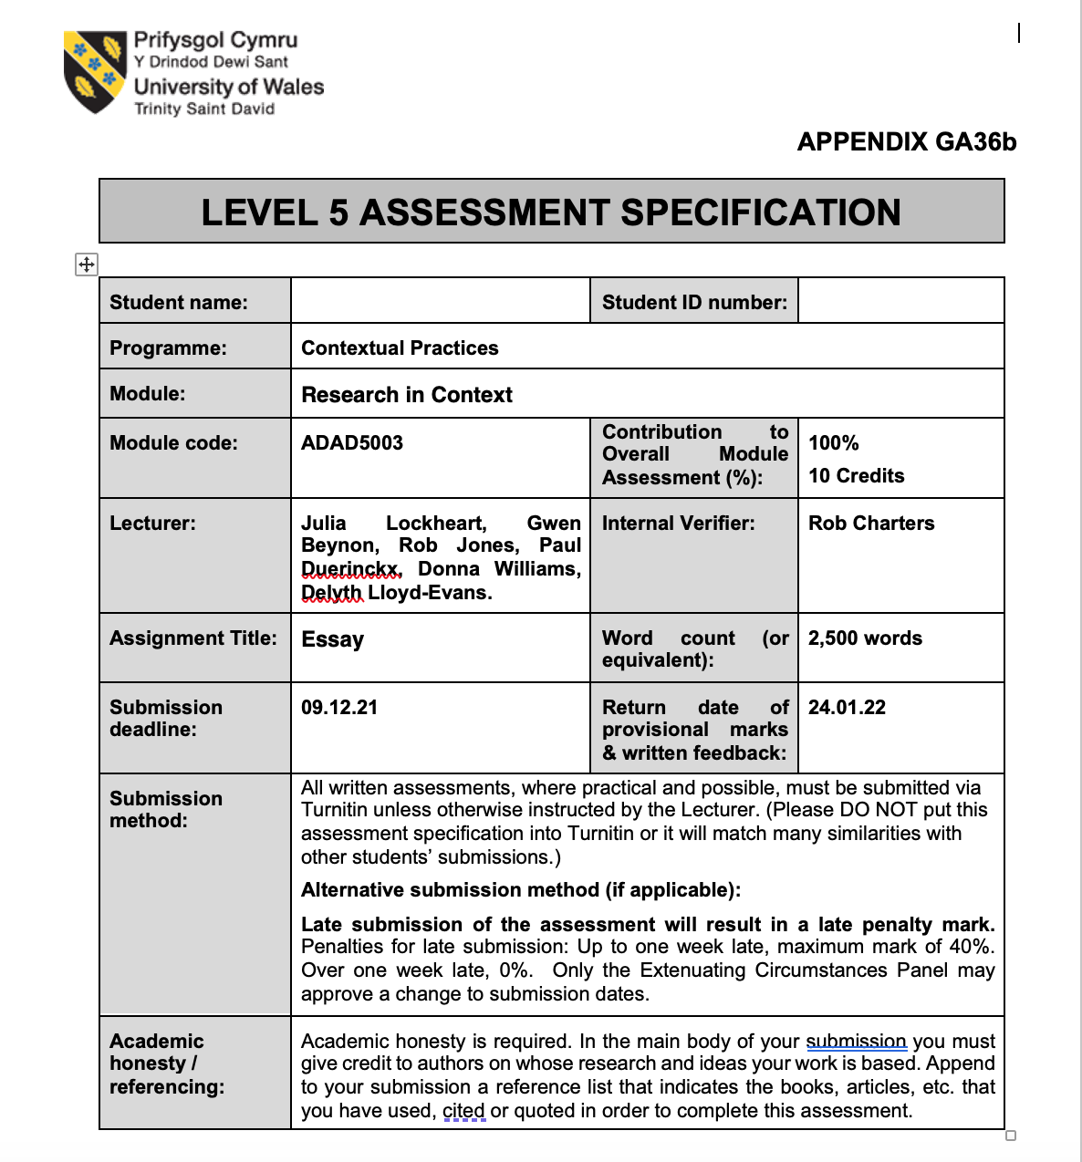
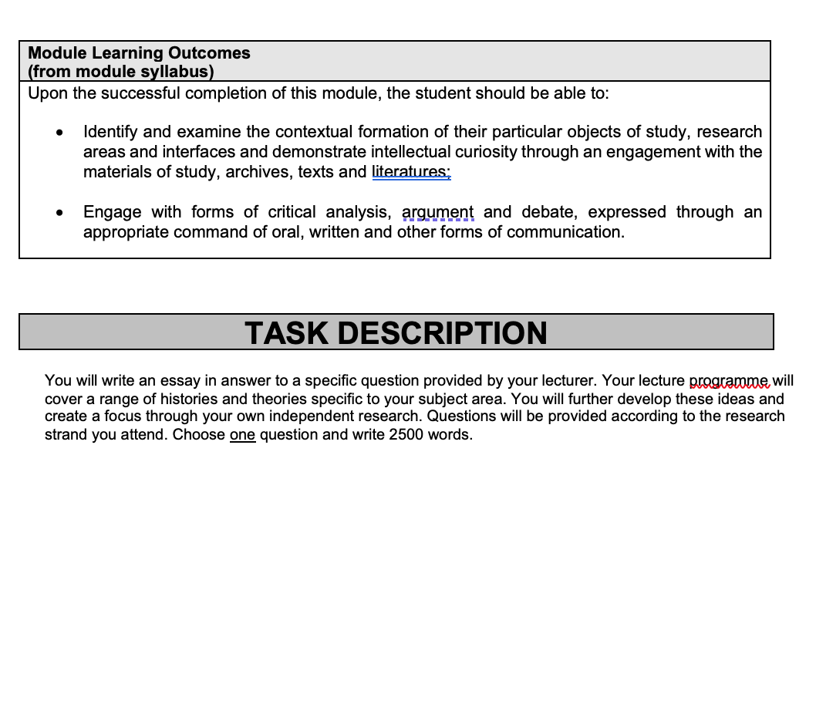
Assessment Specification.

Slide 3
Learning Outcomes
Identify and examine the contextual formation of their particular objects of study, research areas and interfaces and demonstrate intellectual curiosity through an engagement with the materials of study, archives, texts and literatures;
Engage with forms of critical analysis, argument and debate, expressed through an appropriate command of oral, written and other forms of communication.

Slide 4
How do we assess?
Research 25%
RESEARCH 25%
Assemble a substantial bibliography, recognizing both established viewpoints and contemporary thinking on your question of choice.
Identify key practitioners and recognized changemakers, whether widely known or more marginal.
Show evidence of an understanding of social, cultural and technological factors that may have shaped the visual artefacts under discussion.

Slide 5
How do we assess?
Subject Knowledge 25%
SUBJECT KNOWLEDGE 25%
Present an engaging written output that demonstrates knowledge and understanding of, and curiosity about, your subject.
Deploy effective visual examples to further elucidate your written output.
Consider divergent viewpoints and reflect upon these to both support and challenge your argument.

Slide 6
How do we assess?
Critical Engagement 25%
CRITICAL ENGAGEMENT 25%
Deploy your research to formulate a convincing structure for your essay.
Critically evaluate and analyse the relevant theoretical and practice-based discourses.
Explicitly outline and justify the solutions, insights and understanding that have come from your research.

Slide 7
How do we assess?
Professional 25%
ACADEMIC CONVENTION/PROFESSIONAL PRACTICE 25%
Present your text with attention to the conventions of language and grammar within a coherent system of paragraphing.
Apply Harvard referencing conventions accurately and consistently with regard to quotations and visual imagery.
Deploy an appropriate page layout to effectively communicate your content.

Slide 8
What’s it all about?
The Research in Context module (ADAD5003) is designed to help students to explore interests, artists, designers and themes within, or associated with their practice, as a preparation for an ongoing engagement with the contextualization of their work.
Bear in mind that in order to contain your argument within the format of a 2,500-word essay and avoid superficial coverage, you should be highly selective
in your choice of examples and concentrate on
critical analysis.
(Critical analysis - Analysing critically means looking at your findings or research and asking yourself, ‘What do I think about this?' Then go one step further and ask, ‘What is making me think that?’ Then one step further, ‘What conclusions can I conclude from this?’).

Slide 9
Essay Questions
Choose ONE essay question from the following 6 questions:
Question 1: When will advertising embrace diversity, gender and race equality, and start reflecting the real world? Critically discuss and respond.
(Delivered by Martin Bush)
Question 2: Can Graphic Design really save your life?
Explore the association of wellbeing and personal growth in Design in your discussion. (Delivered by Donna Williams)
Question 3: Investigate the digital graphic design revolution of the mid 1980s. Discuss the work of 3 designers who embraced this new technology to challenge the past and define the future. (Delivered by Phil Thomas)

Slide 10
More questions to choose from
Question 4: Why is Information Design important? Explore how Information Design helps to shape the world around us as well as our understanding of it. (Delivered by Gavin Kirby)
Question 5: From the FUTURE WORLD research strand lectures, choose a theme, movement, or selection of artists or designers that relate to your practice or interests, and construct a 2,500-word essay. Critically assess primary themes, key writers, and relevant practitioners. (A general question that covers all lectures)
Question 6: With an emphasis on Welsh language, Culture or Identity chose a theme or focus on creative practitioners relevant to your field of study and critically analyse your choices. This essay can be presented in Welsh or in English in discussion with your tutor. (Delivered by Gwen Beynon)

Slide 11
Deadline
Word Count 2,500
Essay hand-in
10am on Friday
2 December 2022 on Turnitin

Slide 12
The Library
Emily Hywel
Emily.hywel@uwtsd.ac.uk
Please use the Harvard Referencing
Library link which is on moodle.
studyskillsdistance@uwtsd.ac.uk

Slide 13
The lectures for GD & CA
6 Oct. 22
Week 1 - 06/10/22 An introduction with Donna
13 Oct. 22
Week 2 - 13/10/22 - Phil Thomas - The digital graphic design revolution of the mid 1980s. Past Present and Future
20 Oct. 22
Week 3 -20/10/22 - Donna Williams - The association of wellbeing and personal growth within Visual Communication
27 Oct. 22
Week 4 - 27/10/22 - Gavin Kirby - The importance of Information Design

Slide 14
The lectures for GD & CA
3 Nov. 22
Week 5
03/11/22 Gwen Beynon - Welsh language, Culture or Identity in Art and Design
10 Nov. 22
Week 6
10/11/22 Martin Bush - Embracing diversity, gender and race equality in Advertising.
17 Nov. 22
Week 7
17/11/22 (Book in one to one Tutorials with Donna)
Thursday online
18 Nov. 22
Week 7
18/11/22 (Book in one to one Tutorials with Donna)
Friday online

Slide 15
The lectures for GD & CA
24 Nov. 22
Week 8
24/11/22 (Book in one to one Tutorials with Donna)
Thursday online
25 Nov. 22
Week 8
25/11/22 (Book in one to one Tutorials with Donna)
Friday online
2 Dec. 22
Deadline is
10am on Friday 2 December on Turnitin

Slide 16
Essay Format
An Introduction
The Body
The Conclusion

Slide 17
Essay Format
Introduction
Thesis Statement
Body
Conclusion

Slide 18
Introduction
First part of an essay
Try to capture the reader’s attention
Introduction Format
1. Attention getter
2. State your problem
3. Bridge or transition sentences
4. Thesis statement (always at the end)

Slide 19
Ways to Start Your Introduction
Strategy
  Provide some interesting background about the topic in the form of a general statement
  Use a thought-provoking quotation
  Ask a question about your topic
  State a surprising fact or a puzzling statement
  Start with a short story
Examples
  Today’s gnome owners become tomorrow’s leaders.
  Gnomes are creatures to be loved, not feared!”
  Dr. S. Rosner
  Why don’t many people like gnomes?
  In 1693, the first gnome was brought to America.
  Little Susie looked out her window, only to see her precious gnome, Willard, was being stolen….

Slide 20
Ways to Start Your Introduction
Strategy
  State a common misconception
  Describe a problem
  Give an analogy
  Show how the topic is related to the reader’s experience
Examples
  People don’t learn bad habits from gnomes.
  Everyone knows what a problem gnome-napping has become in our society.
  Gnomes are just like children.
  Most people know how difficult it is to take care of garden gnomes.

Slide 21
The Parts of a Thesis Statement
Topic
Opinion
3 Reasons

Slide 22
The Functions of a Thesis Statement
To announce the topic to the reader
To reflect a judgment about the topic
To provide the reader with a blueprint
of what is to come in the paper

Slide 23
Example of an Introduction
Example
  Gnome-Phobia in America
  1. In 2004, the Gnome Liberation Front (GLF) was created. This group of people believes that gnomes should be free, not prisoners of their owner’s garden. 2. The GLF has now begun gnome-napping, the act of stealing gnomes and “freeing them” in the wilderness; however, the law is unwilling to do anything. 3. Many police state that the gnomes are not a serious enough offense to deal with and that they have larger crimes to deal with. This is not acceptable. The law should be taking the gnome-napping more seriously because people are committing a crime. 4. Gnome-napping is stealing personal property, and is illegal, morally wrong, and disrespectful.
1. Attention getter
2. State your problem.
3. Bridge or transition sentences
4. Thesis statement
**NOTE: This doesn’t mean your intro is 4 sentences long. It just has 4 parts.

Slide 24
The Body
The body is a set of paragraphs that develop the idea expressed in the thesis statement.
    Make a list of main ideas that support the thesis statement. Each main idea becomes the main idea sentence for a body paragraph.
    Arrange the main ideas in logical order (time, place, importance)
    Plan out each body paragraph by listing major details that support each main idea
    Order the details within each paragraph in a logical way. Each body paragraph may end with a concluding sentence.

Slide 25
Examples of essay outline
Thesis Statement
Gnome-napping is stealing personal property, and is illegal, morally wrong, and disrespectful.
Body Paragraph 1
Topic Sentence: Gnome-napping is stealing someone’s personal property, and stealing is illegal.
Main Points: 1.
2.
3.
Body Paragraph 2
Topic Sentence: It is morally wrong to take anyone’s property, whether it is a gnome or a car.
Main Points: 1.
2.
3.
Body Paragraph 3
Topic Sentence: The GLF is incredibly disrespectful because they take items that don’t belong them.
Main Points: 1.
2.
3.

Slide 26

The Writing Stage
After planning and arranging your main ideas and major details, begin writing your body paragraphs.
The number of paragraphs depends on the topic’s complexity, inclusiveness, and your purpose for writing.
Usually a short essay contains 3 to 5 body paragraphs, plus an introduction and conclusion
Remember to use signal words to make smooth transitions between sentences and paragraphs.

Slide 27
Signal/Transition words
For examples: For example, for instance, to illustrate
For organization or chronological order: The six steps are…, next, finally first, secondly, third
For additional points: Furthermore, in addition, also, moreover
For opposing ideas: On the other hand, in contrast, although, however
For similar ideas: Likewise, similarly, in comparison

Slide 28
Signs / Transition words
For exceptions: However, nevertheless, but, yet, still
For emphasis: Above all, finally, more importantly
For understanding: In other words, in essence, briefly
For summarizing: In conclusion, to sum up, for these reasons, in a nutshell

Slide 29
Conclusion
Leave the reader thinking about your topic. Leave an impression on them!
No new information in conclusion
Be sure to recap your ideas
Should follow logically from the body of the essay
Restate your thesis statement in different words
You might want to have your reader do something after reading (“call to action” – Example: Go write your MP about this problem.)

Slide 30
Reading List
Module Code | ADAD5003
Module Title | Research in Context
Classification | Reading List entry | Electronic*
Essential | Creswell, J. W. (2013) Qualitative inquiry & research design: choosing among five approaches. London: Sage | ☐
Essential | Pink, Sarah (2013) Doing visual ethnography. Los Angeles: Sage | ☐
Essential | Silverman, D. (2011) Qualitative research: issues of theory, method and practice. London: Sage | ☐
Further | Davies, C & M. Parrinder (2010) Limited Language: Rewriting Design-Responding to a feedback culture. Berlin: Berkhäuser. | ☐
Further | Cooper, K. & R. E. White. (2012) Qualitative research in the post-modern era: contexts of qualitative research. Dordrecht: Springer | ☐
Further | Schneider, J. & M. Stickdorn. (2011) This is service design thinking: basics, tools, cases. Hoboken: Wiley | ☐
Further | Art Review Journal | ☐
Further | Textile Design Research and Practice Journal | ☐
Further | Craft Research Journal | ☐
Further | The Journal of Writing in Creative Practice | ☒
As we go through each speaker extra resources will be added.
Here is the reading list so far for this module

