Slide 1
Sport school program
By Amir Joubara

Slide 2
History of Llangatwg school
My sport program
Funding of the program
Promotion of the program
Partner

Slide 3
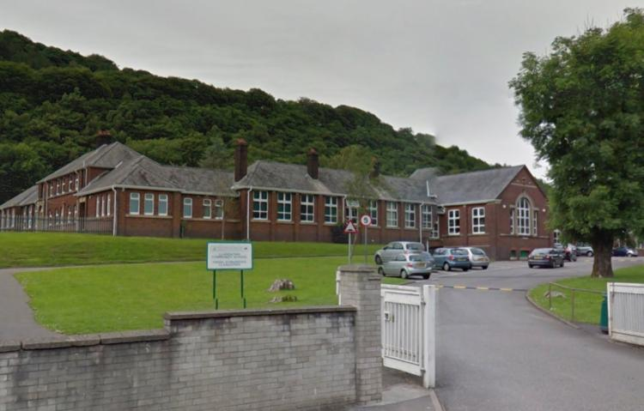
Information about Llangatwg school

Slide 4
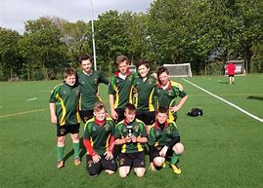
My sport program
My sport programme it will be about football, the programme it will take place in the Llangatwg school community. I will create two teams mix (male-female).
One team under 11 .
one team under 8 .
What I will teach?
How many sessions a week?
- An assistant coach will be required

Slide 5
What do I teach them
Basic football skills such as:-
Warm up- cool down
Passing –shooting
Dribbling – Heading
Small side game
- An assistant coach will be required

Slide 6
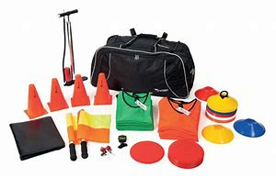
Equipment required for the session
-what type of equipment do I need for the session?
-footballs -Air pump-whistles.
-cones – bibs –water bottles- goals post
-first aid kit
Emergency cell phone

Slide 7
Funding of the program
How do I will get the fund? I will apply for the fund from community chest
What is the community chest ?
Who can apply ?
How to apply?
Is the fund still available ?
What do I need the fund for?

Slide 8
Promotion of the program
How do I will promote the programme?
There is two type of the promotions:-
-Cost ( TV, Radio, Local magazine, news paper, flyers. )
-No cost :- Social media ( Facebook, twitter, YouTube, snapchat , Instagram . )
Taster
- WhatsApp group to post time for the sessions or any changes to keep the parents update.

Slide 9

Partner
What is EYST ?
What the project offers?
Official website link
eyst.org.uk/project.php?s=bme-sport-cymru

Slide 10
THANKS

