Slide 1
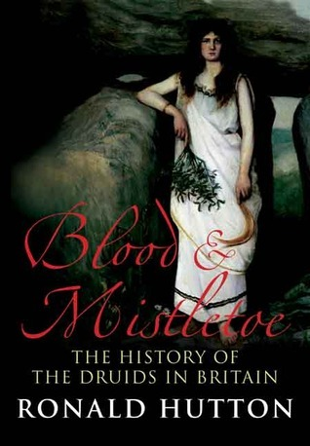
Summary & Evaluation
Chapter 3
“The Druids Take Over”
(Image 1)
Natasha Joanne Davies
October 2022

Slide 2
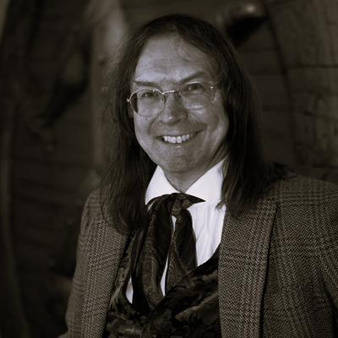
RONALD HUTTON
‘A leading authority on history of the British Isles in the sixteenth and seventeenth centuries, on ancient and medieval paganism and magic, and on the global context of witchcraft beliefs. Also the leading historian of the ritual year in Britain and of modern paganism. He is a member of the “Medieval and Early Modern Cluster” at Bristol’ (bristol.ac.uk)
141 research outputs
14 books
Hutton's contribution to the field of historical academia is extensive, persuasive and formidable; he has introduced alternative ideas when considering history
As well as the academic study and research ,Hutton has successfully reached out to the “lay person” with his books ,encouraging and sharing his passion of history to anyone who has an interest
This book is the result of Hutton’s research over 7 years and the 2nd outcome of his project-the 1st outcome being his published book “The Druids” (Hutton,2011. Blood & Mistletoe, p.xi)
Hutton describes Blood & Mistletoe ‘as the heavyweight of the two, and the main published outcome of the research project’ (ibid)
Image 2

Slide 3
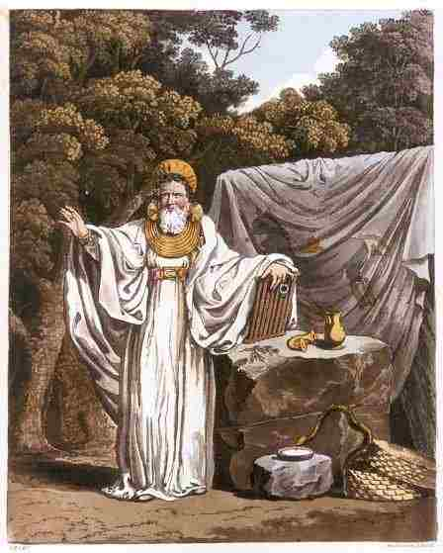
CHAPTER 3
“THE DRUIDS TAKE OVER”
Image 3
The preceding chapters explore and evaluate former representations of Iron Age druids and examines scholars interpretations and perceptions of who the druids were
Chapter 3 focuses on history requiring the ‘right person’ to change the often predisposed national imagery of history in order to gain further insights into the past
Within this chapter Hutton argues the person who made this change was William Stukeley (18th century English antiquarian, physician and Anglican clergyman)
Hutton incorporates vast quantities of scholarly opinions and resources to validate his claims that Stukeley pioneered the Druids marginality within British and Welsh culture to that of a pronounced cult

Slide 4


KEY POINTS CHAPTER 3
Chapter 3 sits well within the framework of the whole book as a history of scholarship, rather than as prose pertaining to Druid history
William Stukeley was the forerunner of modern archaeology which augmented his theory that prehistoric sites such as Stonehenge and Avebury were temples built by the Druids (Hutton,2011., Blood & Mistletoe, p86)
Stukeley’s views of the ancient Druids as nature priests, inspired by ancient Egyptians and early Druids, promoted the cult to the public conscience as worthy ancestors devoted to God
Through his work, Stukeley resurrected the Druids from a national imagined obscure, barbaric cult into a more civilised, intelligent comprehension
Hutton reminds us that documented history is very often written with a bias towards the authors cultural standing and position within society
Chapter 3 “The Druids Take Over” is pivotal in providing an understanding of how and when Druids began to secure their role in the British imagination

Slide 5
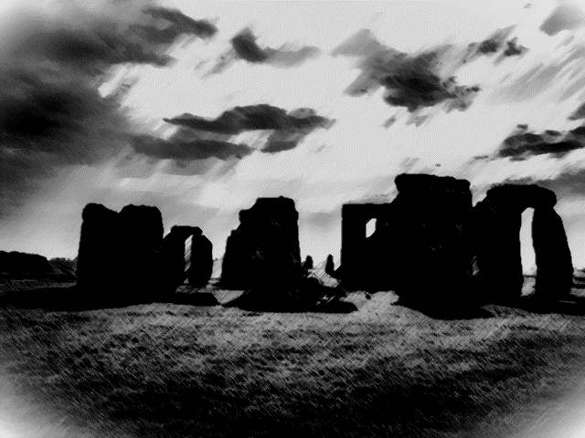

MY VIEWS
Surprised at the difference between the title and content of the book
Sparing knowledge of Druidism made the work a little hard to comprehend as quite an academic piece of literature
Readers of history text, whether academic or lay person, would bode well to consider the reasons why the text was written, who for and when – ulterior motives are often applied!!
I found Chapter 3 fascinating in providing examples of it was, and why it is, we see the things the way we do. In this instance the “Taking Over by Druids” into the public conscience of the British public

Slide 6
REFERENCES
Hutton, R. (2011 ) Blood & Mistletoe The History of The Druids in Britain. New Haven & London: Yale University Press
BIBLIOGRAPHY
Aldhouse-Green, M. (2010) ‘Ronald Hutton. Blood & mistletoe: the history of the Druids in Britain. xiv+492 pages. 2009. London: Yale University Press; Antiquity, 84(323), pp. 270–271. [Accessed online 28.9.2022]
Carey, J. (2010) ‘Blood and Mistletoe: The History of the Druids in Britain’, American Historical Review. Oxford: University of Chicago Press, pp. 281–282. [Accessed online 28.9.2022]
White, E. (2014) On New and Alternative Religions: An Interview with Professor Ronald Hutton [Accessed online 30.9.2022]
ILLUSTRATIONS
Image 1. Personal photo
Image 2. Professor Ronald Sutton (https://www.bristol.ac.uk) [Accessed online 27.9.2022]
Image 3. Imaginative illustration of “An Arch Druid in His Judicial Habit”., S R Meyrick & C H Smith. ‘The Costume of the Original Inhabitants of the British Islands’. (1815). [ Accessed online at wikimedia.org 2022]

