Slide 1
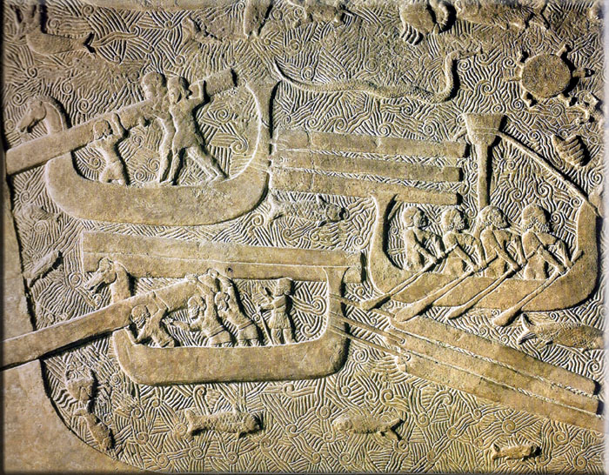
Pharaohs, Phoenicians & Peoples of the Sea
Early Phoenician Expansion

Slide 2
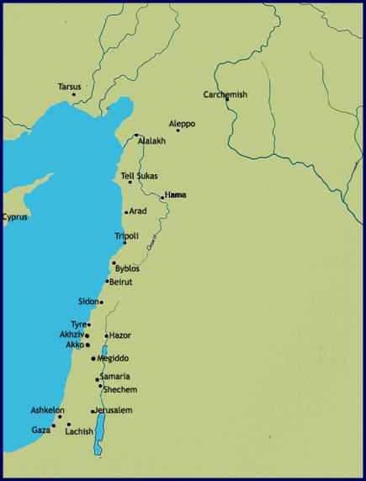
Who were the Phoenicians?
Iron Age descendants of the Canaanite population of Levant
Essentially central Levant:
  Philistines & Israelites to south
  Neo-Hittite kingdoms to north
Main centres:
  Sidon, Byblos, Tyre
  Punic inscriptions
    “man of Sidon”
Naturally look west - geography

Slide 3

Why Phoenician Expansion?
Maritime activity linked to rise of Assyria
  10th century: 1st incursions by Tiglath Pileser I
  8th century: Phoenicians pay tribute to Tiglath Pileser III
  7th century: Phoenicia is Assyrian province, under Sennacherib & Esarhaddon
Escaping Assyrians & seeking raw materials for tribute to Assyrians

Slide 4
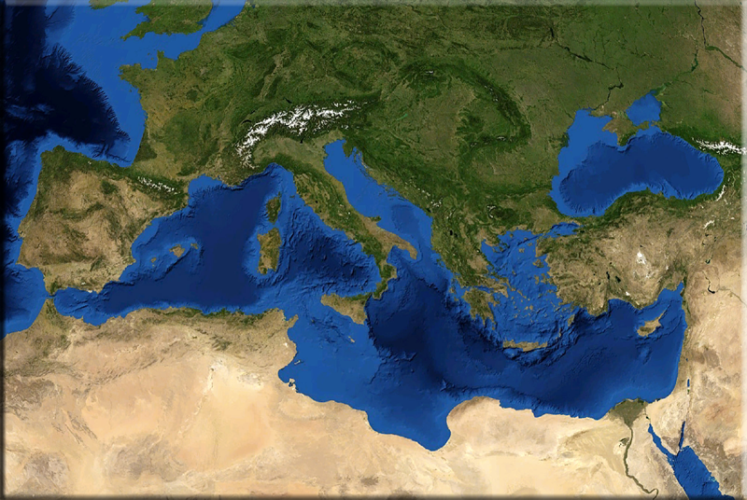
Phoenician Expansion
Phenomenon is marked by:
  Spread of Phoenician pottery
  Appearance of local orientalising traditions in art in west
Impetus for trade:
  Raw materials, especially metals
  Assyrian demand for finished goods as tribute
Initial trading contact in East Mediterranean: 11^{th-}10th centuries
Colonisation phase: Beginning in 9th century

Slide 5
Phoenician Expansion
Moscati (1982) identifies two phases:
Pre-colonial phase: 11th-9th century BC
  Surveying sea routes & studying sea conditions
  Locating sources of raw minerals
  Identifying potential markets
  Fragmentary archaeological record
Colonial phase: 8th century BC
  Establishment of colonies in central & west Mediterranean

Slide 6
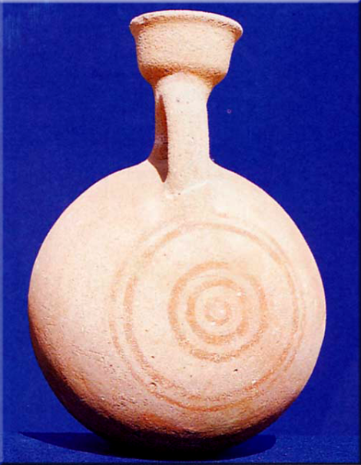
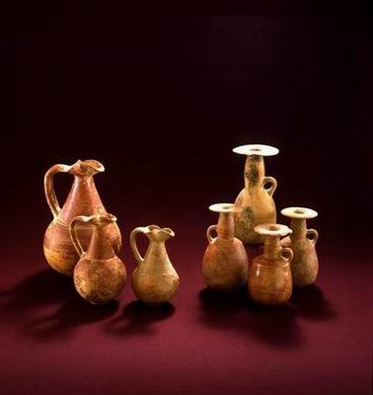
Pottery
Development of distinctive Phoenician style:
11th century BC Bichrome style
  Globular jugs & neck-ridge jugs
  Oils & perfumes
  Breakdown of trade with Aegean led to gap in market?
9th century: Red Slip pitchers & mushroom lipped jugs

Slide 7
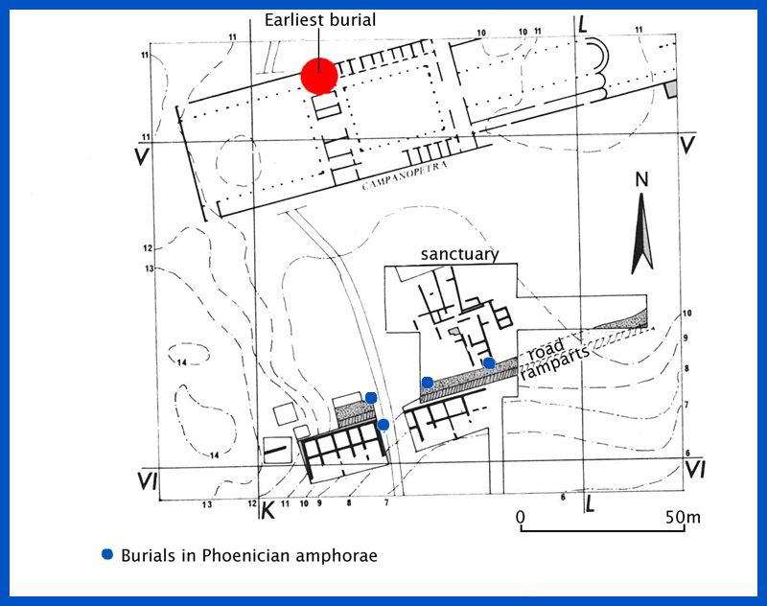
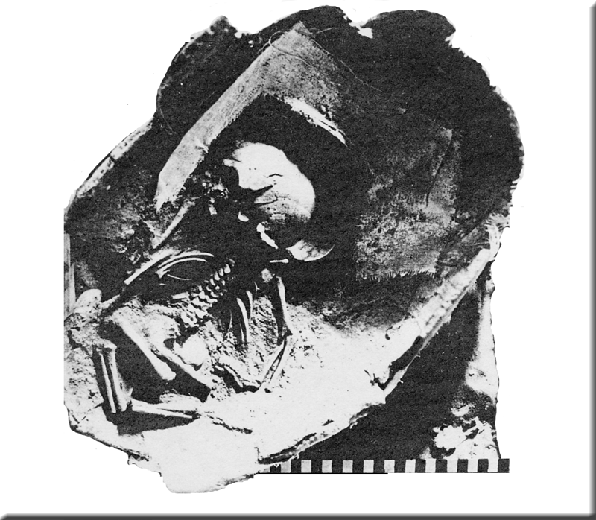
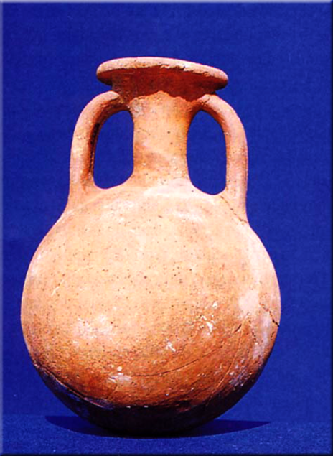
Cyprus
11th-10th century horizon of Phoenician imports in tomb groups:
  Containers of highly prized commodities
Palaepaphos Skales stands out as the focus of Phoenician activity
Colonisation or trade?
  Phoenician child burials at Kition & Salamis

Slide 8
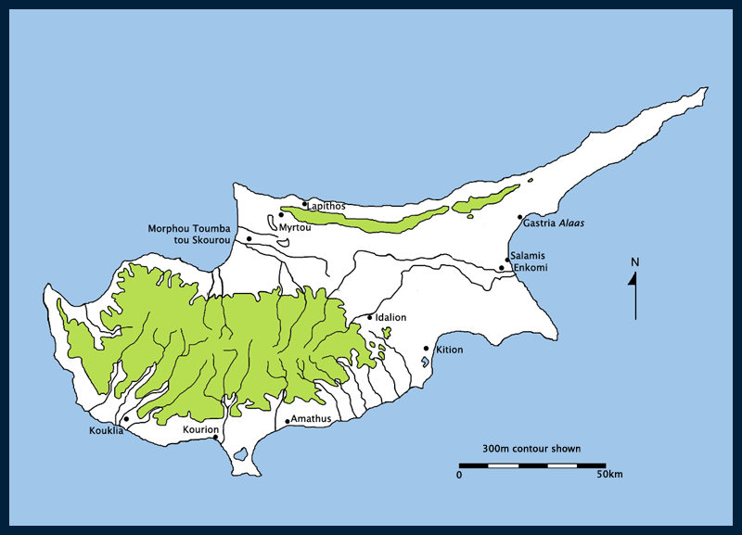
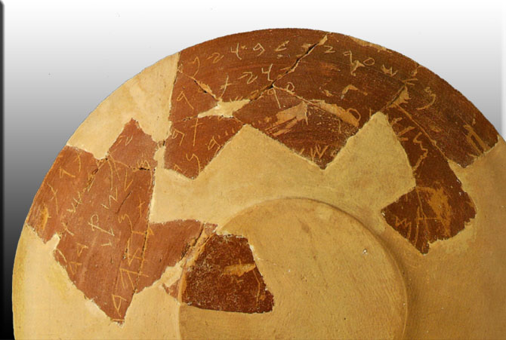
Phoenician Colonies
Identified at Kition & Amathus
Kition: Phoenician colony established in 9th century
  Phoenician temple built over LBA temples
  Numerous Phoenician inscriptions from 9th century
  Kittim = first landfall after Tyre

Slide 9
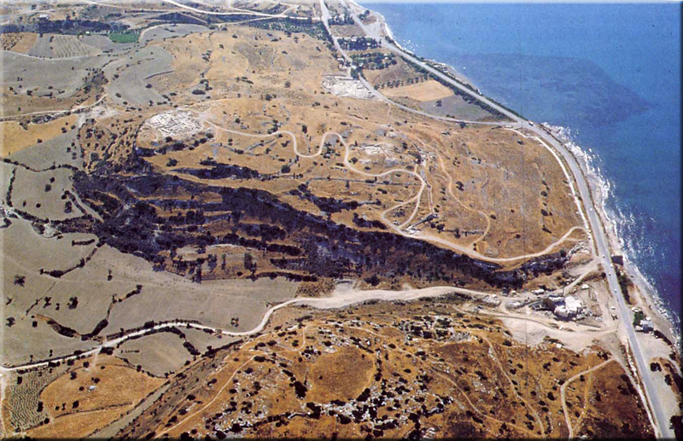
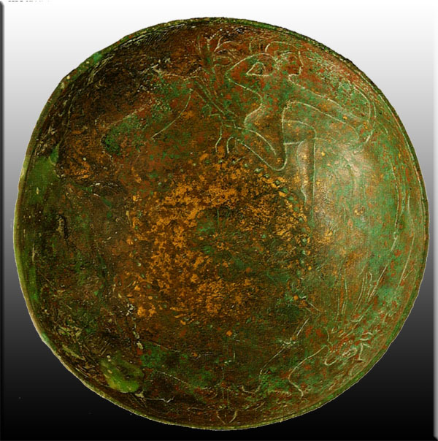
Phoenician Colonies?
Amathus: city kingdom established in 11th century
8th century: evidence for Phoenician settlers
  Phoenician inscriptions
  Tophet: cemetery set aside for cremations of infants?
Phoenician luxuries increasingly common in tombs from 9th & 8th centuries

Slide 10
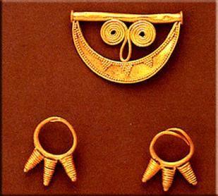
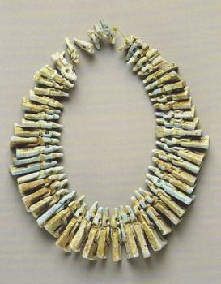
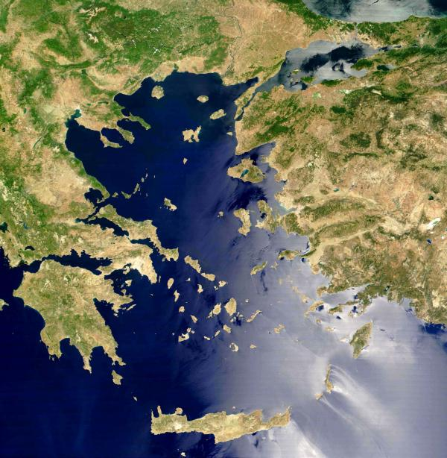
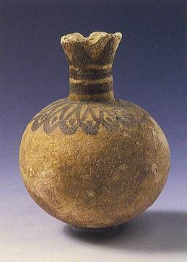
Aegean
Early Phoenician contact focuses on Euboea, Crete & Athens
  Occasional oriental trinkets found in tombs between 10th & 8th centuries BC
Euboea (Lefkandi):
  Gold trinkets, faience objects etc.

Slide 11
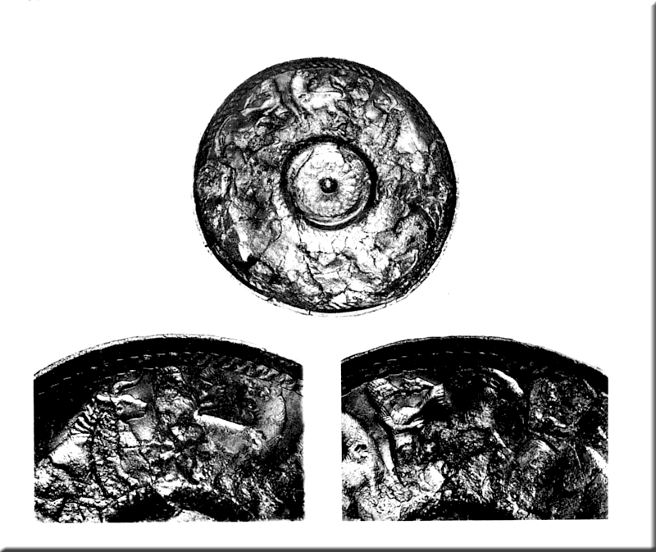
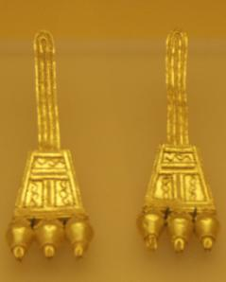
Aegean
Athens: occasional oriental objects found in 9th century tombs
  Kerameikos: bronze bowl
  Areopagus: ivory, glass, faience & gold trinkets

Slide 12
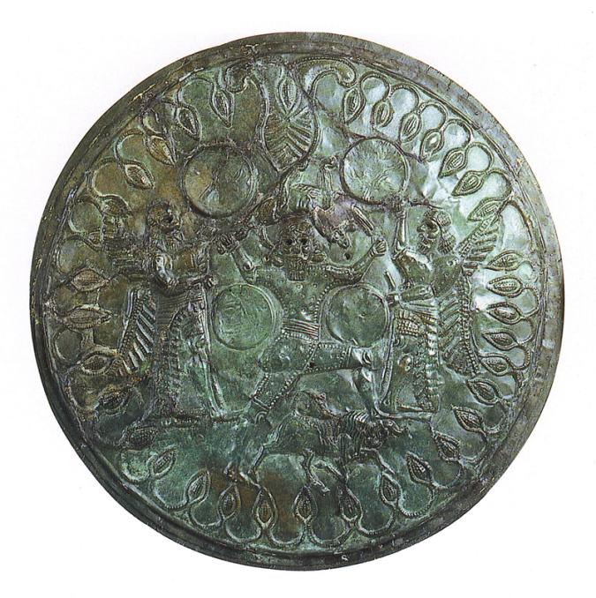
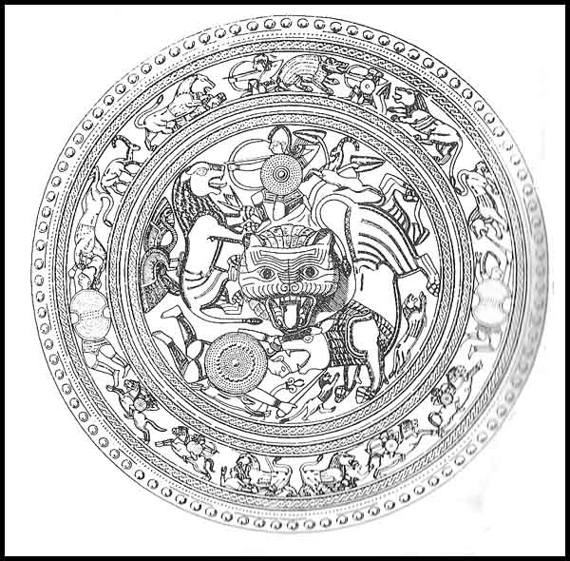
Crete
Phoenician contacts evident at two main sites from 9th century:
  Knossos
  Kommos
Luxury Phoenician objects in tombs at Knossos
Phoenician influence over craft production:
  Shields from Idaean Cave (8th century)

Slide 13
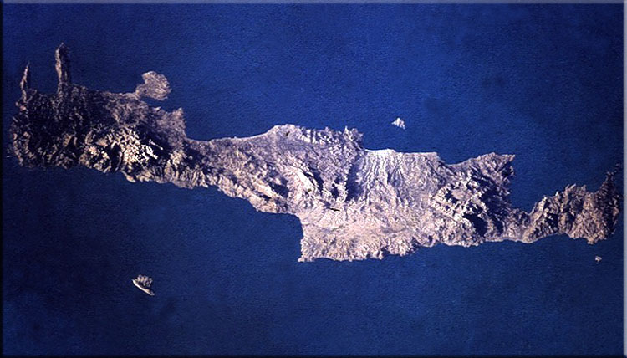
Crete
Crete: primary transit point in Phoenician route west
Focus of metals trade?
  Iron ore deposits: first source to west of Phoenicia
  Early iron metallurgy on island

Slide 14
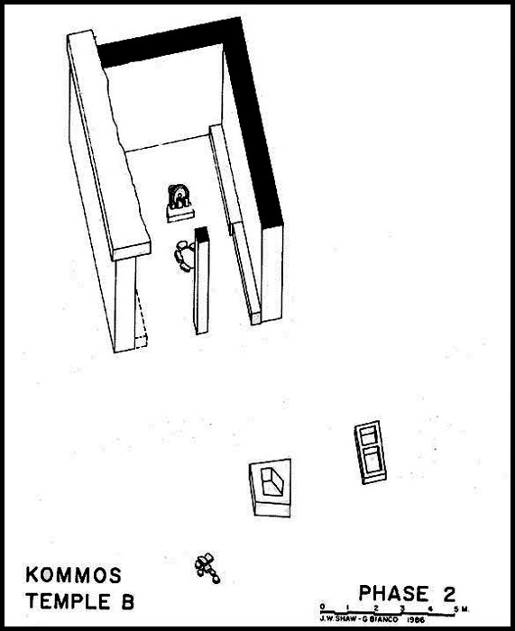
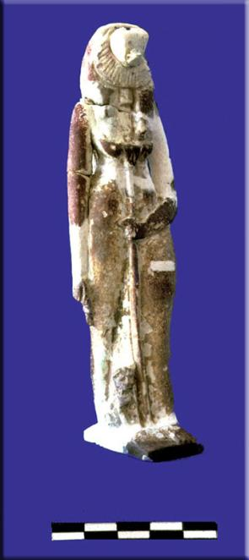
Kommos, Crete
8th century: strong evidence for a Phoenician presence at the site
Temple B: 800-600 BC
  Tripillar shrine associated with two Egyptianising faience statuettes
  Sekhmet & Nefertu
  Close parallels with LBA cult in Levant & Punic cult in East

Slide 15
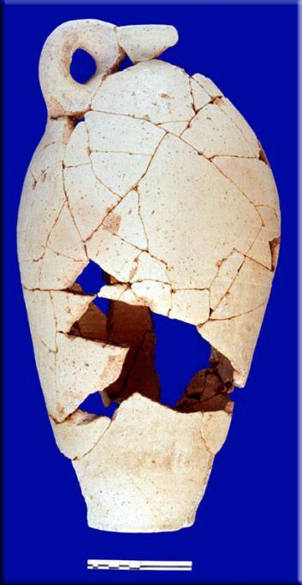
Kommos, Crete
Large quantities of Phoenician pottery associated with Temple B
Established by Phoenician sailors at a watering stop on route west?

Slide 16
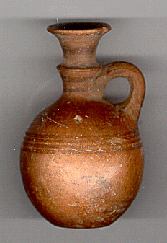
Perfume Factories
9th century Kos: local imitations of Phoenician perfume bottles
Filling gap in local market:
  Distinctive shape & finish served to advertise contents
Coldstream: establishment of perfume factories at Kos, operated by Phoenicians

Slide 17
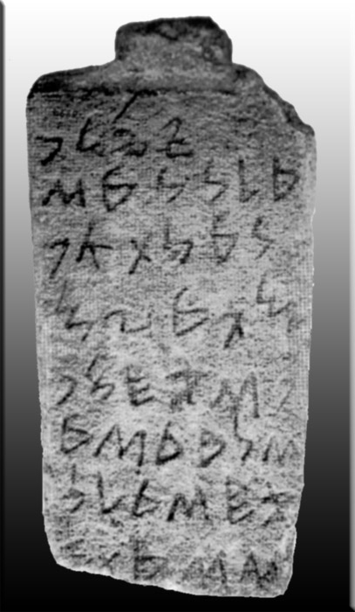
Nora Stela
Phoenician expansion to Sardinia dates to 9th century
Nora Stela: most ancient Phoenician find in the west
  Epigraphically c.830-825 BC
  Commemorates building of a temple dedicated to Pmy on the island of Sardinia (b šrdn)
  Associated with the arrival of first Phoenicians in Nora
Phoenician interest in Sardinia: iron & lead resources

Slide 18
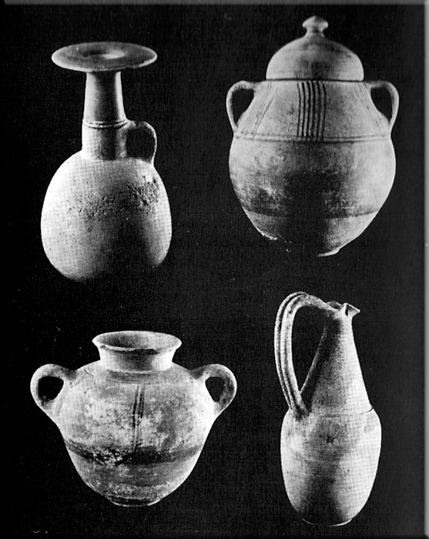
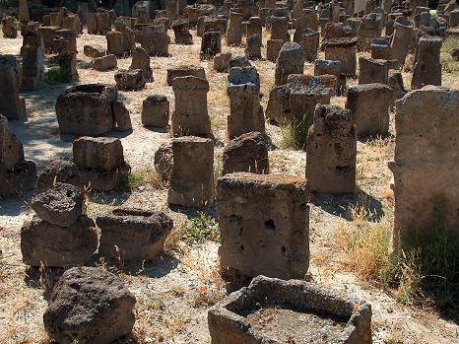
Carthage
Located on small peninsula on north coast of Africa, to control shipping routes in central Mediterranean
Founded in 8th century by aristocratic families from Tyre
  Late 8th century: three cemeteries & tophet at Salammbô
  No traces of the city prior to 4th century BC

Slide 19
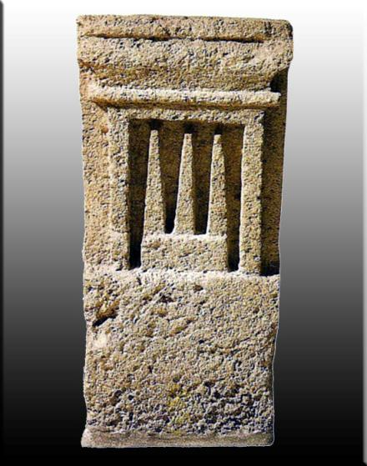
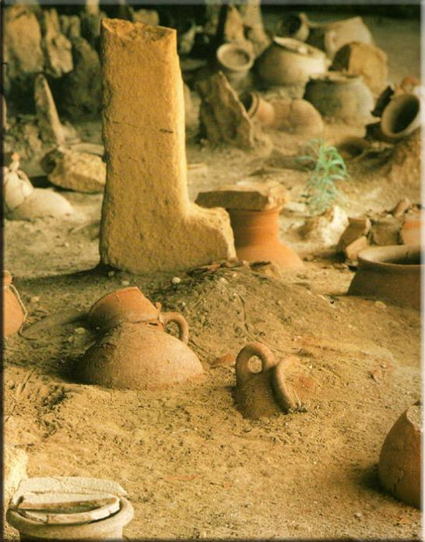
The Tophet
Most characteristic cultural signature of Phoenician expansion west
  Sacred open-air enclosure on edge of colonial settlements
  Molk sacrifice: of the firstborn in honour of Ba’al, predominantly new-born (up to 3years)
  Cremation urns sealed with stone stela dedicated to Tanit
Might sacrifice animals (sheep, goat)
Inscriptions: mlk’dm (human) or mlk’mr (substitution of sheep)

Slide 20
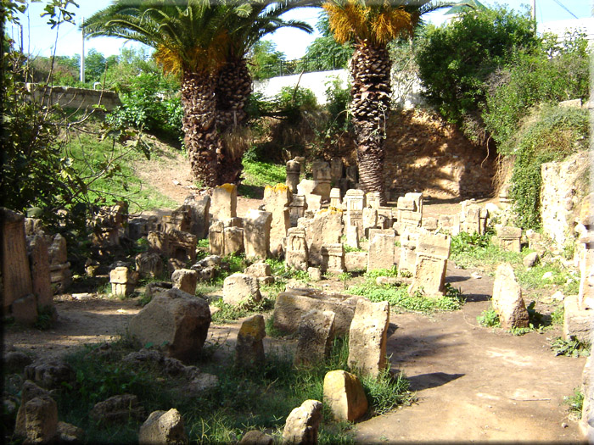
Tophet
Tophets amongst the earliest Phoenician remains in the west
Sacrifice of the firstborn of elite identified with concept of citizenship:
  legitimising rights of community?
Was there regular, institutionalised sacrifice, or were these simply infant cemeteries?

Slide 21
Summary
Key Phoenician interest was metal resources
Initial expansion to Cyprus & Aegean in 10th & 9th centuries BC
Earliest Phoenician activity at Sardinia as early as 9th century
Archaeology: main phase of expansion in west Mediterranean dates to 8th century BC
Establishment of Punic culture:
  Characteristics include tophets

