Slide 1

Student Name: Masoud Latifi
Student number:2232810
Lecture Name: Parees Ahmed
Module Name: Health, Wellbeing and Sustainable Development.
Presentation Title:
Component 1: Presentation
This Photo by Unknown Author is licensed under CC BY-NC-ND

Slide 2



INTRODUCTION
This presentation will explore:
The concepts of Health and Wellbeing (WHO, 1948; UN, 2015).
The Sustainable Development Goal 3 ‘Good Health and Well-being’ (UN, 2015).
The integration among Health, Well-being and Sustainable development (SDG Goal 3. UN, 2015).
Factors that influence the service and delivery (theorical and policy frameworks).
A UK-based case study that implements the SDG, Goal 3.
Promotion of equity and access.
(UN, 2015)
(UN, 2015)
(GOV. UK, 2023)

Slide 3

DEFINITIONS AND KEY CONCEPTS
Constitution of the World Health Organization, 1948
TO PROMOTE AND PROTECT HEALTH:
17 Sustainable Development Goals (UN, 2015)
SDG GOAL 3. GOOD HEALTH AND WELL-BEING: TO ENSURE
A STATE OF
W
E
L
L
B
E
I
N
G
HEALTHY LIVES
C
O
M
P
L
E
T
E
SUBJECTIVE
AND PROMOTE
physical
WELL-BEING
mental
FOR ALL AT ALL AGES
social
OBJECTIVE
CRITICAL POINTS:
only predictable, not measurable (Costanza et al., 2016);
consumption levels, increasing population and inequalities (Henderson, Loreau, 2023)
NOT MERELY THE ABSENCE OF DISEASE OR INFIRMITY
CRITICAL POINTS:
idealistic definition,
dynamic process,
productive lifestyle.
‘’Shared blueprint for peace and prosperity for people and the planet’’ (UN, 2015)

Slide 4
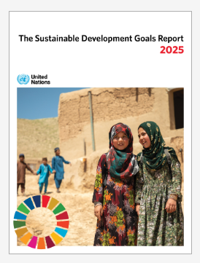
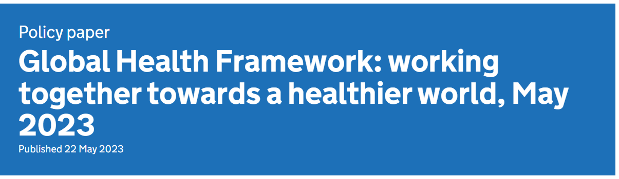


INTEGRATION
Maternal and child health.
Infectious diseases (HIV, malaria, tubercolosis…)
Non-communicable diseases.
Substance abuse.
Sexual and reproductive health-care services.
Universal health coverage.
Hazardous chemical and pollution.
3 Pillars of sustainability:
- Social
- Environmental
- Economic
HEALTH WELLBEING
SUSTAINABILITY
(UN, 2025)
Focus on interpendencies between SDGs (Nunes et al., 2016)
INTEGRATION AND INTEGRATIVE FRAMEWORKS
(GOV. UK)
National Vaccination campaigns
‘Stay Strong. Get Vaccinated Maternity Campaign’
(20 Sept. 2025- 31March 2026)
“to make it as easy as possible for people” (NHS, 2025)

Slide 5


THEORIES
BIOPSYCHOSOCIAL MODEL (Engel, 1977) CRITICAL POINTS: Preferences in prioritisation of factors Not scientific (Ghaemi, 2018) |  | Medical support Psychological support Social support (alternative to Biomedical model)
ECOLOGICAL MODEL (Dubos, 1965) CRITICAL POINTS: Prevalence of group Ecological fallacy (Sedgwick, 2014) |  | Prevention programs Access to health and social care services
HOLISTIC MODEL (Huber, 2011) CRITICAL POINTS: Distraction from most important health issues (Ernst, 2007) |  | Person-centred approach
BIOLOGICAL FACTORS
PSYCHOLOGICAL FACTORS
SOCIALOGICAL FACTORS
MULTI-LEVEL ENVIRONMENT
MENTAL
PHYSICAL
7 core dimensions
WELLBEING
SPIRITUAL

Slide 6







POLICY AND GOVERNANCE
Health in All Policies (HiAP)
International Health Regulations (2005)
Guidelines
Long-term Plan (2019)
Improvement Health and Social care
Positivist methodologies, quantitative data collection, age inequalities (Fearon et al., 2018)
Practical action, technology, improved services, joined up care, partnership
Long «what», short «How» (Stein, T., 2025)
International frameworks
Health for All Policies (Scott, G. et al., 2022)
Difficult implementation Countries policies (Bartolini, 2021)
2030 Agenda for Sustainable Development (2015)
SDG 3 Good Health and Well-being
Reduction health inequalities
Continual review ; localism (Goldblatt, 2016)
Support / Link to general or specific targets (one or more) of SDG 3.
Role of Independent sector health care providers (The Kings’Fund, 2023)
Marmot, T. et al. (2010) Fair society, healthy lives: The Marmot Review
Health and Care Act (2022)
Public Health England Strategy 2020 to 2025 (2019)
Tobacco and Related Product Regulations (2016)
Equality Act (2010)
Mental Health Act (1983)
(DHSC) Public Health Outcomes Framework (PHOF) (2012 and updates)
Marmot, T. et al. (2020) Health equity in England: The Marmot Review 10 years on (2020)

Slide 7
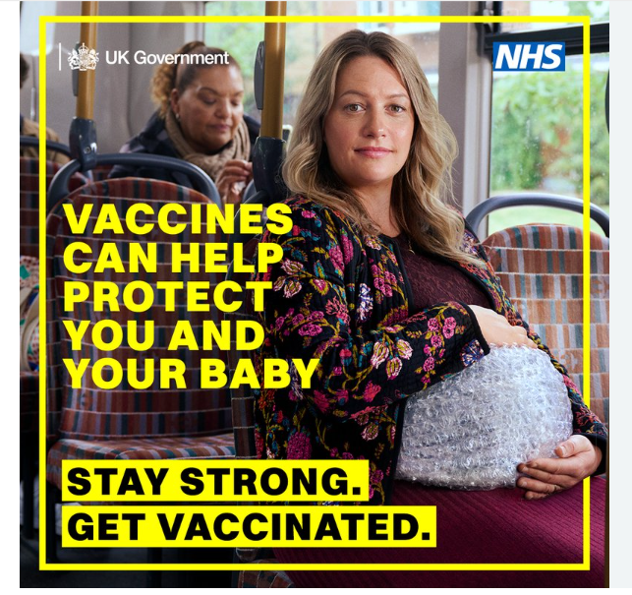
A UK– BASED CASE STUDY: THE MATERNAL VACCINATION PROGRAMME (Sept. 2025- March 2026)
‘Stay Strong. Get Vaccinated Maternity Campaign’
Promoted by:
UK Government, Department of Health and Social Care (DHSC)
National Health Service (NHS)
Stakeholders
HEALTH:
flu, RSV, whooping cough
Health Belief Model (HBM)
SUSTAINABILITY:
3 pillars:
Social: information, promotion and protection
Environmental: medical waste
Economical: vaccination plan and goals (NHS, 2025)
WELLBEING:
SDG. GOAL 3:
Maternal health
Child health

Slide 8
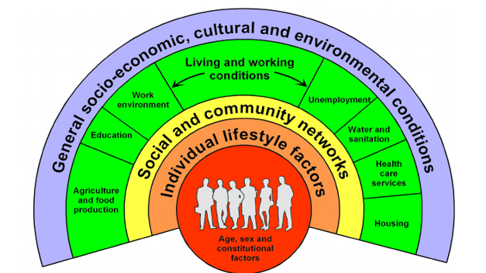


EQUITY AND ACCESS
INEQUALITIES IN HEALTH: CAUSES
Dahlgren and Whitehead (1991)
WHO (2023)
Marmot, M. (2010; 2020)
Social indicators
Demografic indicators
Social Determinans of Health
(SDH)
RAINBOW MODEL
BARRIERS, INEQUALITIES IN ACCESS AND IN QUALITY CARE
POLICIES / INITIATIVES:
ACTION ON CAUSES: (Marmot, M. , 2010, 2020)
ANALYSIS INDICATORS: DHSC, Public Health Outcomes Framework (PHOF) (2012 and updates)
GUIDANCE: NICE Guidelines;
STRATEGY: NHS Long-term Plan (2019)
RECOMMENDATION:
Continuous data updating (indicators).
Focus on effective action on causes rather process targets (policy, initiatives).
Stakeholder partnership.
Dissemination, staff training.
Awareness campaigns (media, community)

Slide 9
CONCLUSIONS
In the 17 Sustainable Development Goals (SDG), the concepts of Health and Wellbeing are addressed to «all people at all ages» (UN, 2015) and are linked to the concept of Sustainability.
The three key aspect are integrated in the SDG Goal 3 ‘Good Health and Well-being’ and influence the national policies about Health and Social care.
In practice, service and delivery are affected by models (Biopsychological model, Ecological Model and Holistic Model) with different outcomes.
By the political point of view, the implementation of the SDG Goal 3 in the international and national policy and governance requires improvement.
For example, the current ‘Maternal Vaccination Campaign and Programme’ (Sept. 2025-March 2026) follows the SDG Goal 3, and highlights the integration among Health, Wellbeing and Sustainability. It tries to overcome the people’s resistance (Health Belief Model), providing information and making vaccination as easy as possibile.
However, barriers and inequalities (Dahlgren and Whitehead, 1991; Marmot, M. 2010; 2020 and WHO, 2023) still limit the concrete achievement of equity in the access and in the quality care (SDG Goal 3, 2015).

Slide 10
REFERENCES
Bartolini, G. (2021) ‘The failure of ‘core capacities’ under the who international health regulations’, International and Comparative Law Quarterly, 2021;70(1):233-250. doi:10.1017/S0020589320000470. Available at: https://www.cambridge.org/core/journals/international-and-comparative-law-quarterly/article/failure-of-core-capacities-under-the-who-international-health-regulations/D00B890119F5145D8E41731F3D912744 (Accessed:10 October 2025).
Costanza, R. et al. (2016) ‘Modelling and measuring sustainable wellbeing in connection with the UN Sustainable Development Goals’, Ecological Economics, 130 (October 2016), pp. 350-355. https://doi.org/10.1016/j.ecolecon.2016.07.009
Department of Health and Social Care (2025) ‘Stay Strong Get Vaccinated Maternity Campaign’, Campaigns. Available at: https://campaignresources.dhsc.gov.uk/campaigns/vaccinations/stay-strong-get-vaccinated/ (Accessed:10 October 2025).
Department of Health & Social Care (2023) Policy paper ‘Global Health Framework: working together towards a healthier world, May 2023’, Health in developing countries. Available at: https://www.gov.uk/government/publications/global-health-framework-working-together-towards-a-healthier-world/global-health-framework-working-together-towards-a-healthier-world-may-2023 (Accessed:10 October 2025)
Department of Health and Social Care (2022). Health and Care Act (2022). Available at: https://www.gov.uk/government/collections/health-and-care-act-2022 (Accessed:10 October 2025).
Department of Health and Social Care (2013, 2025). Public Health Outcomes Framework (PHOF). Available at: https://www.gov.uk/government/collections/public-health-outcomes-framework(Accessed:10 October 2025).

Slide 11
Fearon, D. et al. (2018) ‘A philosophical critique of the UK’s National Institute for Health and Care Excellence guideline ‘Palliative care for adults: strong opioids for pain relief’’, British Journal of Pain 12(3). https://doi.org/10.1177/2049463717753021
Ernst, E. (2007) ‘Holistic health care?’, Br J Gen Pract. 2007 Feb 1;57(535):162–163. Available at: https://pmc.ncbi.nlm.nih.gov/articles/PMC2034187/ (Accessed:10 October 2025).
Goldblatt, P. (2016) ‘Moving forward monitoring of the social determinants of health in a country: lessons from England 5 years after the Marmot Review’, Glob Health Action, 2016 Feb 25;9:10.3402/gha.v9.29627. doi: 10.3402/gha.v9.29627
Gov.UK (2019) Public Health England Strategy 2020 to 2025. Available at: https://www.gov.uk/government/publications/phe-strategy-2020-to-2025 (Accessed:10 October 2025).
Gov. UK (2016) Tobacco and Related Product Regulations (2016). Available at: https://www.legislation.gov.uk/uksi/2016/507/contents (Accessed:10 October 2025).
Gov. UK (2010) Equality Act (2010). Available at: https://www.legislation.gov.uk/ukpga/2010/15/contents (Accessed:10 October 2025).
Gov. UK (1983) Mental Health Act (1983). Available at: https://www.legislation.gov.uk/ukpga/1983/20/contents (Accessed:10 October 2025).
Greer, S. et al. (2022) ‘From Health in All Policies to Health for All Policies’, Lancet Public Health (7). Available at: https://www.thelancet.com/pdfs/journals/lanpub/PIIS2468-2667(22)00155-4.pdf (Accessed:10 October 2025).

Slide 12
Henderson, K., Loreau M. (2023) ‘A model of Sustainable Development Goals: Challenges and opportunities in promoting human well-being and environmental sustainability’. Available at: https://www.sciencedirect.com/science/article/abs/pii/S0304380022002654 (Accessed:10 October 2025)
Marmot, T. et al. (2010) Fair society, healthy lives: The Marmot Review. Available at: https://www.gov.uk/research-for-development-outputs/fair-society-healthy-lives-the-marmot-review-strategic-review-of-health-inequalities-in-england-post-2010 (Accessed:10 October 2025)
Marmot, T. et al. (2020) Health equity in England: The Marmot Review 10 years on (2020). Available at:ww.health.org.uk/sites/default/files/upload/publications/2020/Health%20Equity%20in%20England_The%20Marmot%20Review%2010%20Years%20On_full%20report.pdf (Accessed:10 October 2025).
National Health Service – NHS (2025) ‘NHS kicks off flu and COVID jabs to ‘winter-proof’ vulnerable’, News, 1 October. Available at: https://www.england.nhs.uk/2025/10/nhs-kicks-off-flu-and-covid-jabs-to-winter-proof-vulnerable/ (Accessed:10 October 2025).
National Health Service – NHS (2019) Long-term plan. Available at: https://webarchive.nationalarchives.gov.uk/ukgwa/20230418155402/https:/www.longtermplan.nhs.uk/publication/nhs-long-term-plan/ (Accessed:10 October 2025).
Nassir Ghaemi, S. (2018) ‘The rise and fall of the biopsychosocial model’. The British Journal of Psychiatry (195;1). Available at: https://www.cambridge.org/core/journals/the-british-journal-of-psychiatry/article/rise-and-fall-of-the-biopsychosocial-model/A31DAA3BED6569F6080A1DF2C1D15A64(Accessed:10 October 2025)
Nunes A. R. et al. (2016) ‘The importance of an integrating framework for achieving the Sustainable Development Goals: the example of health and well-being’, BMJ Global Health, 2016;1:e000068. https://doi.org/10.1136/bmjgh-2016-000068

Slide 13
Office for National Statistics (2025) ‘Goal 3 - Good Health and Well-Being - U.K. Indicators For The Sustainable Development Goals’. Available at: https://sdgdata.gov.uk/3/ (Accessed:10 October 2025).
Sedgwick, P. (2014) ‘Ecological studies: advantages and disadvantages’. The BMJ 348(may02 4):g2979. Available at: https://www.researchgate.net/publication/264904899_Ecological_studies_Advantages_and_disadvantages (Accessed:10 October 2025).
Stein, T. (2025) ‘NHS plan is long on the ‘what’ and short on the ‘how’’, Financial Times (4 Jul.). Available at: https://www.ft.com/content/eeff0ce1-7f9e-44e1-957f-9e201448ee0b (Accessed:10 October 2025).
The King’sFund (2023) ‘Independent health care and the NHS’. Available at: https://assets.kingsfund.org.uk/f/256914/x/5e4aed4284/independent_health_care_and_nhs_2023.pdf (Accessed:10 October 2025).
UK Health Security Agency (2025) ‘National vaccination campaign to protect newborns this winter’, Press release, 22 September. Available at: https://www.gov.uk/government/news/national-vaccination-campaign-to-protect-newborns-this-winter (Accessed:10 October 2025).
United Nations (2015) ‘Sustainable Development Goals’. Available at: https://sdgs.un.org/goals (Accessed: 9 October 2025).
United Nations (2015) ‘Goals: 3 Ensure healthy lives and promote well-being for all at all ages’. Available at: https://sdgs.un.org/goals/goal3 (Accessed:10 October 2025).
United Nations (2025) The Sustainable Development Goals Report 2025. Available at: https://unstats.un.org/sdgs/report/2025/(Accessed:10 October 2025).
United Nations (2025) ‘Health and Population’. Available at: https://sdgs.un.org/topics/health-and-population(Accessed:10 October 2025).
World Health Organization WHO (1948) ‘Constitution’. Available at: https://www.who.int/about/governance/constitution (Accessed:10 October 2025).
World Health Organization WHO (2005) International Health Regulations. Available at: https://www.who.int/publications/i/item/9789241580496(Accessed:11 October 2025).
World Health Organization WHO, Health in All Policies (HiAP). Available at: https://www.who.int/activities/promoting-health-in-all-policies-and-intersectoral-action-capacities (Accessed:11 October 2025).

