Slide 1
Why is psychology important when working as a
Personal Assistant working with adults with disabilities
Presentation on
Student ID-2123016
Student Name-Margarita Chaparova
Notes:
Hello everyone. Welcome to today's presentation on Why is psychology important when working as a Personal Assistant working with adults with disabilities.

Slide 2
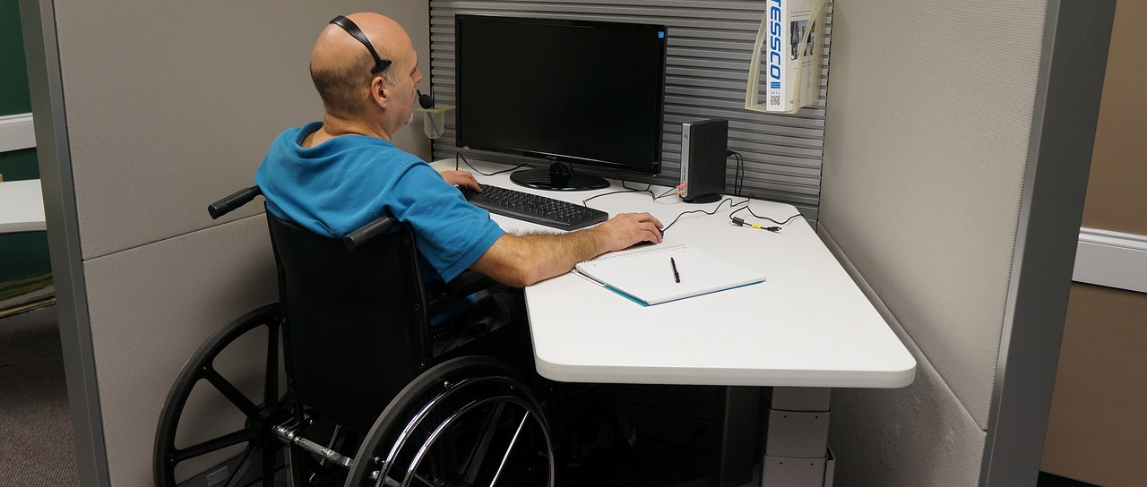
Overview of adults with disabilities
An adult (18+) who has a physical or mental impairment due to a condition such as a developmental disorder, organic brain trauma, or mental disorder, or who suffers from one or more limitations in physical or mental functioning that prevent the person from engaging in many aspects of daily life (Law Insider, 2022).
Notes:
According to Law Insider A person with a disability is defined as an adult (18+) who has a physical or mental impairment due to a condition such as a developmental disorder, organic brain trauma, or mental disorder, or who suffers from one or more limitations in physical or mental functioning that prevent the person from engaging in many aspects of daily life.

Slide 3

Analysis of the Job Role:
Personal Assistant working with adults with disabilities
Assistance in day to day activities
The disabled person has the freedom to choose
The tasks and the psychological connections vary on different types of personal assistants. (Being a personal assistant, 2022)
Notes:
An Article called Being a personal assistant from skillsforce care says that personal assistance is assistance provided by a person to a disabled individual in completing routine tasks. The disabled individual has the right to select the method and provider of assistance. An assistant can assist a person in getting through the day without having to worry about time-consuming errands. These duties include keeping oneself clean and well-fed, looking presentable, moving about, and interacting with others. These errands can take place anywhere, including at home, the office, a trip to the store, or a friend's house. The tasks and the psychological connections vary for different types of personal assistants.

Slide 4
Types of Personal assistants for the people with disabilities
The staff PA
The Staff PA lives are distinct from that of the disabled individual. They comply with the regulation. and offers no recommendations.
The Professional PA
The Professional PA has distinct responsibilities and roles. Infrequently do professional relationships involve social activities outside of work hours. Professionals can collaborate closely without knowing about one another's personal lives. (Snow, 2017)
The Colleague PA
The third type of PA relationship involves a colleague PA. Colleagues work for the disabled individual's independence. They collaborate as teammates, and their abilities vary.
The Paid friend PA
Paid friend PA places a premium on social and emotional PA relationships. Companionship is equally as crucial as tasks. Important is a friendly, relaxed atmosphere.
The Family PA
The Family PA prioritizes more profound aspects of the PA relationship, such as the client's well-being and future aspirations, and ensuring that the relationship lasts longer than others. (Snow, 2017)
Notes:
Judith Snow describes the types of PA’s very well on a article.
The Staff PA lives are distinct from that of the disabled individual. They comply with the regulation. and offers no recommendations.
The Professional PA has distinct responsibilities and roles. Infrequently do professional relationships involve social activities outside of work hours. Professionals can collaborate closely without knowing about one another's personal lives.
The third type of PA relationship involves a colleague PA. Colleagues work for the disabled individual's independence. They collaborate as teammates, and their abilities vary.
Paid friend PA places a premium on social and emotional PA relationships. Companionship is equally as crucial as tasks. Important is a friendly, relaxed atmosphere.
The Family PA prioritizes more profound aspects of the PA relationship, such as the client's well-being and future aspirations, and ensuring that the relationship lasts longer than others.

Slide 5
Psychological factors of Diabled people and PA’s
Disabled People
PA’s
Disables people are in vulnerable state in different scenarios
They have unmatched intimacy with the PA’s
They shouldn’t grow emotional dependency towards the PA’s (Weyder et al.,2015).
The tasks can be too intimate or too mundane
The PA’s can feel to controlled
Their own life can suffer
Notes:
Weyder et al talks about the Psychological factors of Disabled people and PA’s. Personal assistant encounters are close relationships. In some cases, a person with a disability may be especially weak and vulnerable. Long periods of time are spent together, and personal topics may be discussed. None of this typically occurs between people who are not romantically involved with one another. So it is crucial to keep borders and avoid becoming too mentally dependent on the PA. The duties of a personal assistant (PA) can range from the personal to the mundane. They could feel like they're being controlled excessively.

Slide 6
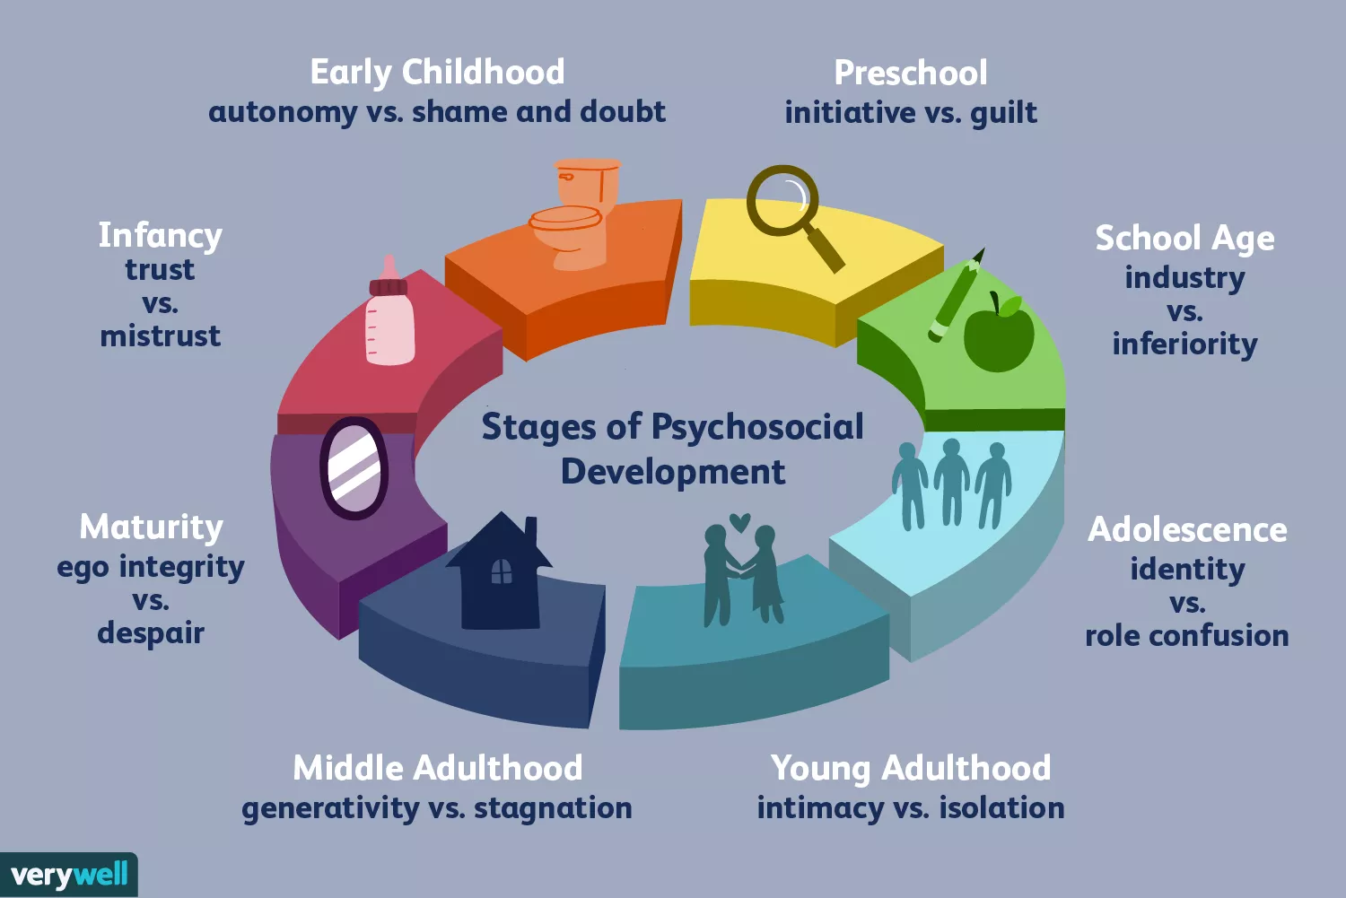
Erikson’s Theory
We become better people through interaction with others. Taking on new challenges is part of expanding horizons, and these experiences can help or hinder maturation (Verywell Mind, 2022).
Figure: Erikson's Stages of Development (Verywell Mind, 2022)
Notes:
According to Erikson, we become better people through interaction with others. Taking on new challenges is part of expanding horizons, and these experiences can help or hinder maturation.

Slide 7
Application of Erikson’s Theory while assisting adults with disabilities
A deeper understanding of the needs and collaborate with them to find solutions.
Help them in an active routine.
Handling information with caution is important. Integrity according to the law and ethical norms is also essential. Personal assistants must handle client information with extreme caution (NursingAnswers, 2022).
Notes:
On the basis of Erikson's theory, PA’s can develop an understanding of the clients' issues and collaborate with them to find solutions. Without the proper assistance, disabled individuals are much less likely to adhere to routines that are vital to their lives.
Integrity according to the law and ethical norms is also essential. Personal assistants must handle client information with extreme caution. NursingAnswers.net goes in depth in this topic.

Slide 8
Application of psychology for the Disabled people
The analysis of the disabled people’s emotional needs according to the type of assistance.
Giving them confidence in day to day activities by being the backbone to their activities as much as possible is crucial (CDC, 2018).
Communication with other people involved in their lives to understand their emotional needs better.
Keeping the boundaries and not letting them being emotionally dependent on the PA’s
Notes:
The analysis of the disabled people’s emotional needs should be done continuously according to the type of assistance. PA’s should give them confidence in day to day activities by being the backbone to their activities as much as possible. PA’s should ommunicate with other people involved in their employer lives to understand their emotional needs better. Keeping the boundaries and not letting them being emotionally dependent on the PA’s is important as this can become harmful for the disabled people.

Slide 9
Application of psychology for the PA themselves for better services
Setting ground rules for addressing issues at the outset
Clear communication if asked to do unpleasant jobs. This stops problems from snowballing
Getting help and advice from union (if they're members) or peer support groups (CDC, 2018).
Notes:
According to Centre for disease control and prevention, Problems will arise in any workplace, so the PA and employer must establish ground rules for addressing them at the outset.
PAs should talk to their employers if they're asked to do unpleasant jobs. This stops problems from snowballing
Instead of letting problems fester, PAs should address them immediately. They can also seek help from their union (if they're members) or peer support groups.

Slide 10
References
Being a personal assistant. (2022). [online] Available at: https://www.skillsforcare.org.uk/Employing-your-own-care-and-support/Resources/Working-as-a-PA/1.-What-is-a-PA/Being-a-personal-assistant/Being-a-personal-assistant.pdf.
CDC (2018). Adults with Disabilities. [online] Centers for Disease Control and Prevention. Available at: https://www.cdc.gov/vitalsigns/disabilities/index.html.
Greater Manchester Coalition of Disabled People. (2017). What is Personal Assistance? [online] Available at: https://gmcdp.com/what-personal-assistance [Accessed 10 Oct. 2022].
Law Insider. (2022). Disabled adult Definition. [online] Available at: https://www.lawinsider.com/dictionary/disabled-adult#:~:text=Disabled%20adult%20means%20a%20person [Accessed 10 Oct. 2022].
Misra, S., Orslene, L.E. and Walls, R.T. (2007). Personal Assistance Services (PAS) for Workers with Disabilities: Views and Experiences of Rehabilitation Service Providers. Disability Studies Quarterly, 27(3). doi:10.18061/dsq.v27i3.31.
NursingAnswers.net. (2022). Application of Erikson’s Psychosocial Development Theory in Patient Care Plan. [online] Available at: https://nursinganswers.net/essays/application-of-eriksons-psychosocial-development-theory-in-patient-care-plan.php.
Snow, J. (2017). Personal Assistance: What It Is and What It Is Not – Judith Snow. inclusion. 1 Feb.
Verywell Mind. (2022). Understanding Erikson’s Stages of Psychosocial Development. [online] Available at: https://www.verywellmind.com/erik-eriksons-stages-of-psychosocial-development-2795740#:~:text=According%20to%20Erikson%2C%20our%20ego.
Wyder, M., Bland, R., Blythe, A., Matarasso, B., & Crompton, D. (2015). Therapeutic relationships and involuntary treatment orders: Service users’ interactions with health-care professionals on the ward. International Journal of Mental Health Nursing, 24(2), 181-189.

