Slide 1
Enterprise and Entrepreneurship LCLM4006
RETAILEDGE CONSULTANCY BUSINESS

Slide 2
BUSINESS OVERVIEW
The three specialist consulting packages offered by RetailEdge are Employee Engagement Audit (£3,500), Operational Efficiency Review (£5,000), and Implementation Support Programme (£8 000-15,000) (Burns, 2016).
The business is in the form of a sole trader first, and then on to the limited company status after six months of consecutive monthly income of more than £8,000 (Bridge and O'Neill, 2012).
The founder is the direct retail management experience of Tesco, Marks & Spencer, and Primark, and qualifications in Business Studies, organisational behaviour (Barrow et al., 2018).
The professional indemnity insurance will cover up to 1 million pounds, and the public liability insurance will cover 2 million pounds when making visits to clients, which costs 720 pounds per year (British Business Bank, 2021).
Notes:
The proposed solution, RetailEdge Consultancy, fits an ongoing crisis of employee engagement in the UK retail sector, in which the current engagement rate reaches 36% (CIPD, 2023). The three-level service model offers the ability to be flexible to the various client budgets and requirements. Being a sole trader at the establishment level reduces the administrative load but gives a complete control of the operations (Bridge and O'Neill, 2012). The founder has relevant experience in the retail sector coupled with an academic degree which gives credibility to his advice on SME retailers. Insurance policy safeguards the company and the business clients in the event of consulting work.

Slide 3
ENVIRONMENTAL ANALYSIS - POLITICAL & ECONOMIC
Employment rights Bill 2024 will introduce an enhanced level of worker protections such as predictable schedules and the right to day-one unfair dismissal which will generate a need to seek compliance consultancy (UK Parliament, 2024).
The retail sector is the largest contributor to the annual turnover of UK economy with a total of 471 billion, and through the employment of 3.1 million people, SME retailers make up 68% of all retail enterprises (ONS, 2024).
Demand in the efficiency and cost-cutting measures was caused by the average retail operating margins decreasing to 3.2% in 2023, having a decline in 2019 to 4.1% (Retail Economics, 2024).
The labour expenses constitute 52 percent of the retail operating expenses, so enhancing the workforce productivity is a financially important factor in the profitability of the clients (BDO, 2023).
Notes:
The consulting opportunity is influenced by political factors. The new employment law means that the retailers are forced to change the practice of management, and this demands expert advice urgently (UK Parliament, 2024). Value proposition is pushed by economic pressures. Brexit is still having a labour effect where retailers are unable to attract and keep customer-facing employees (British Retail Consortium, 2023). The retail industry is large in size and this offers a huge market to address. The studies indicate that 10 percent increase in employee engagement will save the turnover expenses by approximately 1800 pound per employee per year (CIPD, 2022), which is an evident payback period on consulting services.

Slide 4
ENVIRONMENTAL ANALYSIS - SOCIAL & TECHNOLOGICAL
In the UK retail sector, the turnover is averaged at 38 per annum, which costs businesses around £4,000 per employee leaving the business, including the costs of hiring, training, and loss of productivity (People Management, 2023).
The employees of generation Z pay attention to the frequency of feedback, the ability to communicate openly, and the visibility of career growth, and new management strategies are necessary (Deloitte, 2024).
Advanced workforce management strategies can be achieved through cloud-based scheduling systems, mobile communication systems and performance analytical systems (Sharma and Jhamb, 2020).
Most SME retailers do not have the skills to utilize information provided the point-of-sale systems, inventory databases, and labour management software (Wamba et al., 2015).
Notes:
The urgent need to use consulting services is produced by social factors. The retention issue in the staff becomes even more critical throughout the industry, as the turnover rates are devastating the profits (People Management, 2023). The pandemic altered the expectations of the working population dramatically, and now workers prefer flexible work and significant work (McKinsey, 2023). The new management tools are offered by technological advances. Online platforms change workforce management by enhancing their scheduling, communication, and analytics (Sharma and Jhamb, 2020). There is a technology discrepancy between what systems provide and what is being used by retailers that is a consulting opportunity. Well-trained and engaged employees provide excellent customer experiences (Institute of Customer Service, 2024).

Slide 5
ENVIRONMENTAL ANALYSIS - ENVIRONMENTAL & LEGAL
The government of the UK has made it mandatory that it must achieve net-zero emissions by 2050 which entails retailers modifying their logistics, facilities management, and product sourcing habits (Climate Change Act 2008)
Retailers have been under pressure to minimize environmental impact by being energy efficient, minimizing waste and implementing sustainable sourcing policies (Jones et al., 2020).
The complexity of employment laws such as National Minimum Wage laws, Working Time Regulations and Equality Act requirements causes SME retailers difficulties in complying with these laws (ACAS, 2024).
Health and Safety at Work Act of 1974 demands that employers provide the safety of the staff by conducting risk assessment, training, and system to handle incidents (HSE, 2023).
Notes:
The issue of environment affects the retail business and participation of employees. Sustainability programs will not be effective without proper staff communication and training (Jones et al., 2020). Second-hand market and repair service are examples of the principles of the circular economy that will necessitate new business models that demand new workforce skills (Kirchherr et al., 2017). Consulting opportunities exist because of legal reasons. The complexity of employment law requires a high level of management to prevent the introduction of fines and the establishment of negative media coverage (ACAS, 2024). The management of employee information is regulated by data protection rules of UK GDPR (ICO, 2023). Consultants assist retailers to maneuver around these requirements in a consistent fashion and minimize the compliance risk and enhance operational effectiveness.

Slide 6
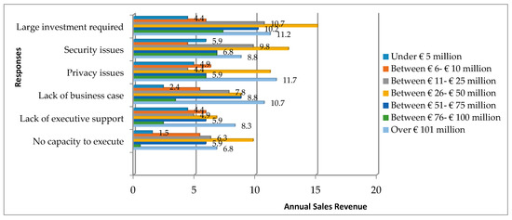
TARGET MARKET SEGMENTATION
Independent retailers who have a workforce of between 20 and 100 people, annual revenue of between £1 million and 15 million, have resources to invest in consultancy are the primary targets (Burns, 2016).
The regional retail chains that have five to fifteen stores facing growth issues such as poor operational standards are considered secondary targets (Bridge and O'Neill, 2012).
The tertiary targets include franchise operation, where franchisees strike a balance between the corporate needs and local operating reality (Barrow et al., 2018).
The geographic focus is on South West England which includes retailers within a 90 minutes drive to Bath to reduce travelling expenses and facilitate the ability of having a face to face relationship.
Notes:
In market segmentation, resources are prioritized on potential customers who are high. Primary targets have enough funds to spend on consulting services and do not have in-house HR or operational excellence capabilities (Burns, 2016). Studies indicate that the mid-sized retailers have specific challenges to keep culture and engagement during the expansion stages (Bridge and O'Neill, 2012). The regional focus strategy minimizes the operation expenses as it develops concentrated market presence. Word-of-mouth marketing is successful in limited geographical business networks. The aspects of franchise operations are a particular area of consulting requirements related to performance management and staff development in balancing the corporate requirements with the local realities (Barrow et al., 2018).

Slide 7
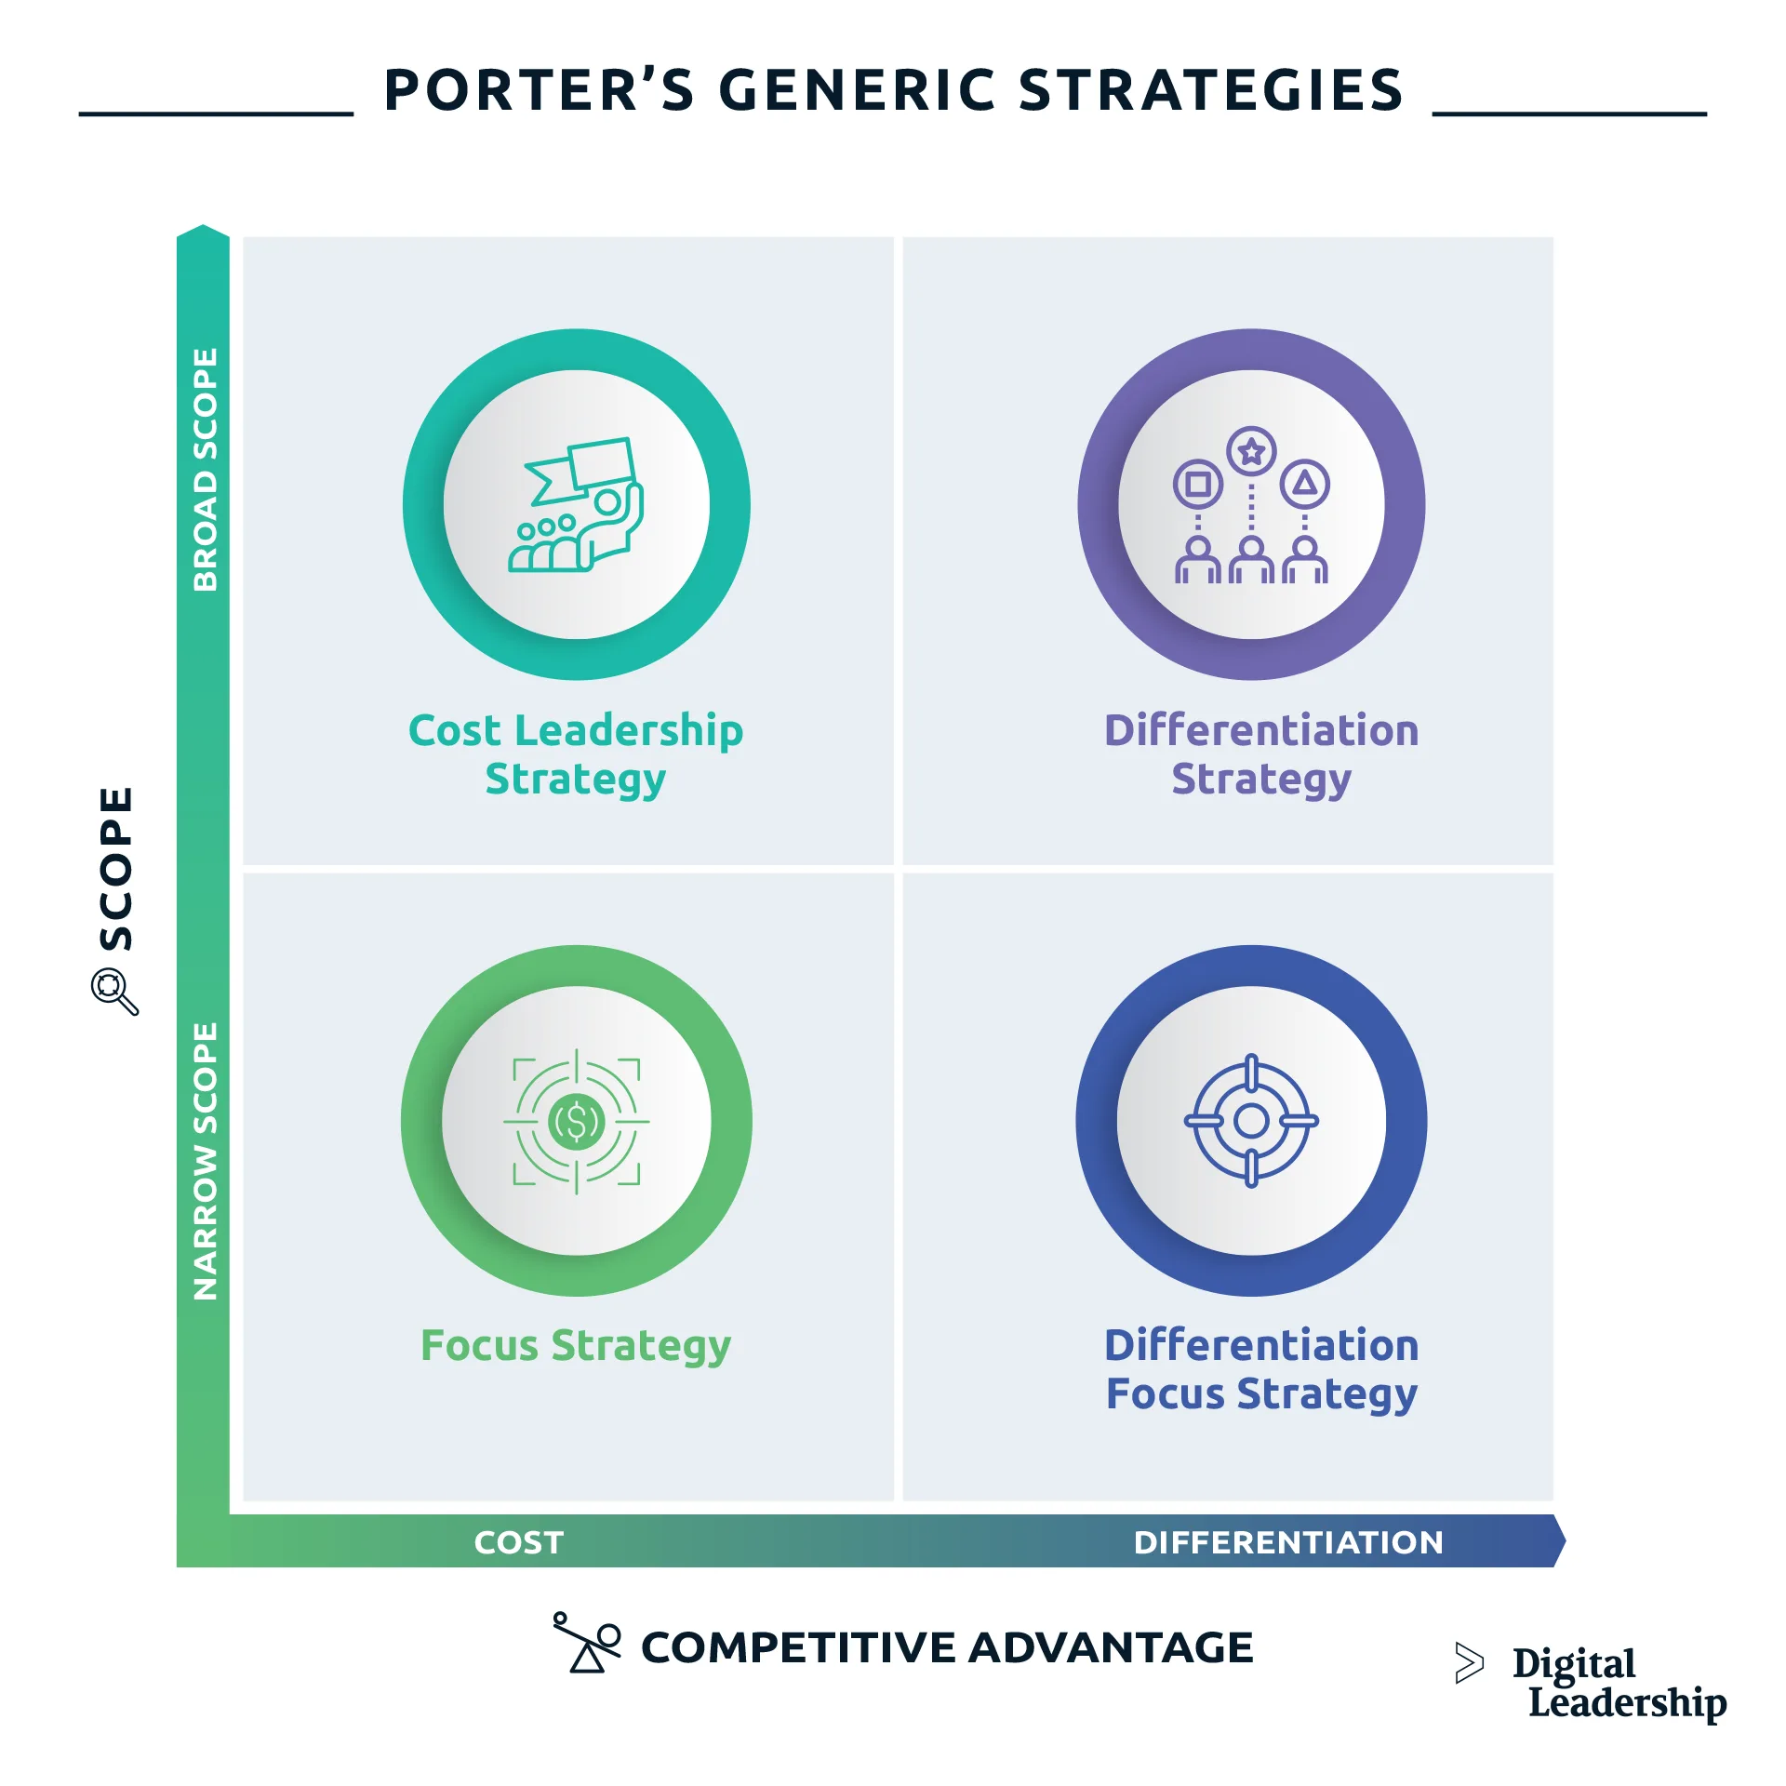
POSITIONING STRATEGY
RetailEdge gains a competitive edge over generic HR consultants due to its practical retail experience that adds credibility that the founder of the organisation has a management background with large retailers (Ries and Trout, 2001).
Professional consultancy is affordable to smaller retailers with the fees being set 30 percent lower than the established consultancies to penetrate the SME marketplace (Porter, 1985).
Implementation focus is what distinguishes RetailEdge and report-only consulting models whereby the model does not just offer advice but actually provides hands-on implementation support (Maister, 1993).
Brand messaging focuses on evidence-based recommendations, practical implementation support, and performance improvements that could be measured on all marketing communications.
Notes:
Competitive advantage is created by effective positioning. The direct retail management experience of the founder also offers relevant insights and credibility in giving advice to the clients (Ries and Trout, 2001). Other rival companies usually focus on larger companies with their fee system, and SME retailer is not adequately served by these companies. Premeditated underpricing relative to the existing consultancies creates the capacity to enter as well as make profits (Porter, 1985). The implementation support has practical outputs and establishes long-term relationships with clients. Clients are given practical support in the implementation of the recommendation instead of reading reports on their own (Maister, 1993). Complimentary messaging in all channel enhances positioning and creation of brand recognition in target markets.

Slide 8
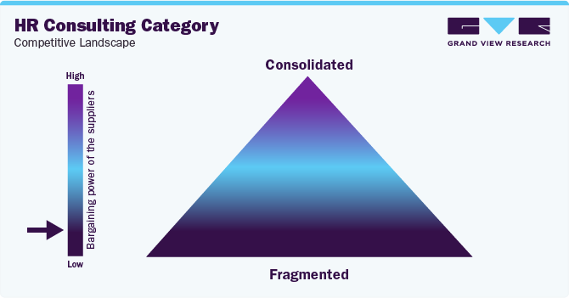
DIGITAL MARKETING TACTICS
The business site will have the detailed service descriptions, examples of case studies, pricing policy, and provide free downloadable guides that would allow capturing contact information of visitors (Chaffey and Ellis-Chadwick, 2019).
The search engine optimisation focuses on certain keyword phrases such as retail management consultant South West and improve retail employee engagement (Kingsnorth, 2019).
The main and key channel is LinkedIn, where regular posts are made with retail management knowledge, research-based posts, and client success stories (Quesenberry, 2020).
The high-purpose keywords, such as the retail staff turnover solutions, are used in Google Ads campaigns with the monthly advertising spend of £300, which may be modified depending on the conversion results.
Notes:
Digital marketing offers a low cost of customer acquisition. The main online resource is the website, and there is a section called resources, where the free guides on the topics of retail management are provided (Chaffey and Ellis-Chadwick, 2019). Blog posts on content marketing will also be discussing the frequent retailer issues, which develop organic search presence (Kingsnorth, 2019). LinkedIn is the social channel being used as the main channel since the business decision-makers are already using the platform. The founder develops the professional circle through participating in the groups of retail business owners and taking part in the discussions related to it (Quesenberry, 2020). Paid advertisement focuses on retailers who are actively seeking solutions and providing qualified leads at an effective pace. The marketing via email fosters the prospects via quarterly newsletters.

Slide 9
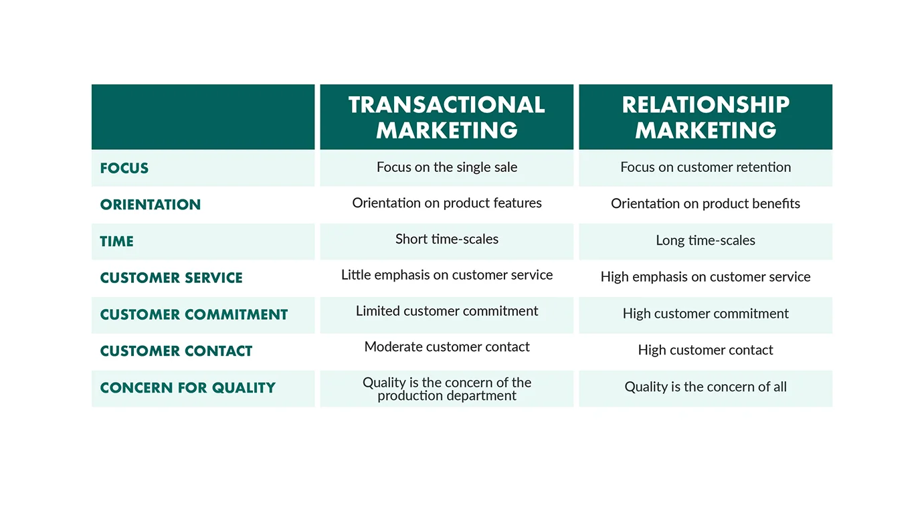
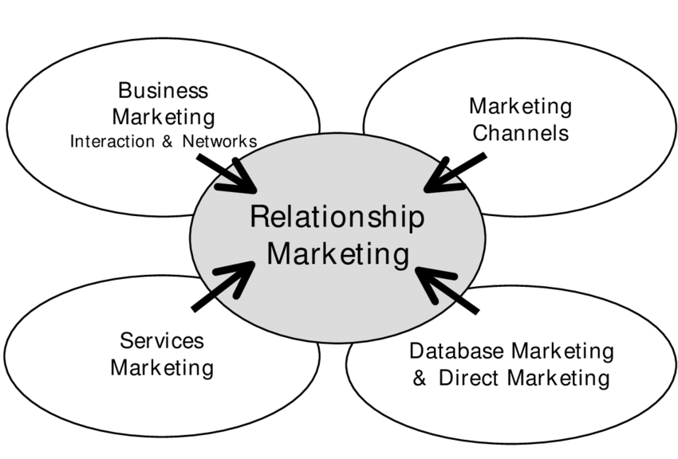
DIRECT & RELATIONSHIP MARKETING
Federation of small business, Chamber of Commerce events, and retail specific groups are part of business networking that yields referrals and direct enquiries (Barrow et al., 2018).
Thought leadership is created by speaking engagements in business events where the presenters talk about issues such as Reducing Retail Staff Turnover by Better Management.
Referral channels are producted by the partnership development with retail accountants, commercial property agents and point-of-sale system suppliers.
Business reviews continue relationships with clients quarterly, and referral incentive programmes are used to reward clients who bring new business on board at 10 percent credit (Reichheld and Sasser, 1990)
Notes:
Direct marketing develops the client base by use of personal relations. All the networking activities provide referrals and enquiries because they create visibility in the target markets (Barrow et al., 2018). Pr presentations make the founder an authority figure and the event organisers appreciate pragmatic content by the experienced practitioners. The partnership development establishes referral systems to the professionals who meet the retailers with operational problems. The retention of clients is given the same importance as customer acquisition. Studies have proven that repeat customers produce 67 percent more profit margins in professional services (Reichheld and Sasser, 1990). Social proof with client testimonials and the case studies will record the definite challenges and achieved results (Kotler et al., 2017).

Slide 10
FUNDING REQUIREMENTS
The initial capital outlay of the business is the total startup capital of £12,500 to fund initial operational costs, marketing investments, and the first three months working capital (Burns, 2016).
The founder contributed personal savings in the form of £7,500 and the British Business Bank Start Up Loan programme will provide the rest of the sum of £5,000 with a 6% yearly interest (British Business Bank, 2024).
The professional services amount to £1,200, marketing and branding amounts to £2,800, technology and equipment amount to £1,650 and office supplies amount to 380 in the first month.
The personal draws within the first three months are covered by the working capital available of 3,500, and research has indicated that new consulting business take three to six months before the firm can produce positive cash flow (Burns, 2016).
Notes:
The balance of financial prudence and sufficient resources to enter the market efficiently is created through funding structure (Burns, 2016). The individual investment is an indicator of financial well-being to the prospective investors and lenders in the future (Barrow et al., 2018). The Start Up Loan programme is focused on service companies with growth potential and its terms to repayment range between one to five years with monthly payments of about 97 dollars keeping the cash flow manageable with an impact (British Business Bank, 2024). The initial month costs are equivalent to £10,500 and the remaining 2000 (as a buffer) will be regarded as the cost of financial safety. Travel costs include the allocation of meeting clients and networking to the tune of £970. Monthly operating expenses are fixed at about £1,100 once it has been set up.

Slide 11
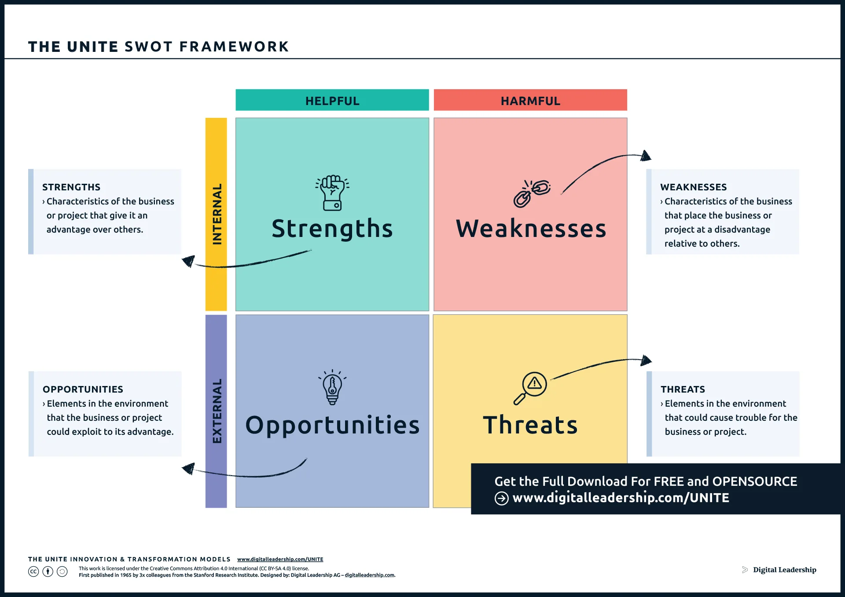
REVENUE PROJECTIONS & BREAKEVEN
The first month is devoted to business establishment and prospecting of clients where no revenues will be gained during the first month.
The second and third months will focus on single client projects with a monthly revenue of about 3,500 to represent the time and resources to create awareness of the product and transform the potential customers (Maister, 1993).
Since the fourth month, the business is planned to produce two projects at once every month, bringing in revenue ranging between £7,000 and 10,000 as a result of good execution of marketing strategies and client referrals.
Breakeven will be reached at a point where monthly revenue is always above 2,000 pounds and above, including personal drawings, and fixed costs, and the financial forecasts show the achievement of breakeven during month four.
Notes:
The market entry is realistic as reflected in revenue projections. Conservative first-quarter estimates do admit that time is needed to create market awareness and transform prospects into clients. It has been found that in most cases, professional services businesses can be able to boast of having a sustainable inflow of clients after six months of active marketing (Maister, 1993). Insurance, software subscriptions, accounting services, virtual assistant support and marketing costs are all fixed monthly operating costs. Variable expenses such as travel and fees paid to associate consultants increase with the amount of revenue. The increase of profitability is associated with the increase of revenue since the fixed costs do not change. Within the initial 18 months, the business will use the profits to invest in expanding marketing and developing capacity.

Slide 12
References
ACAS (2024) Employment law for small businesses. Available at: https://www.acas.org.uk (Accessed: 10 November 2025).
Barrow, C., Barrow, P. and Brown, R. (2018) The business plan workbook. 9th edn. London: Kogan Page.
BDO (2023) Retail insights report 2023. London: BDO LLP.
Bridge, S. and O'Neill, K. (2012) Understanding enterprise: entrepreneurship and small business. 4th edn. Basingstoke: Palgrave Macmillan.
British Business Bank (2021) Small business finance markets 2021. Sheffield: British Business Bank.
British Business Bank (2024) Start Up Loans programme guide. Available at: https://www.startuploans.co.uk (Accessed: 10 November 2025).
British Retail Consortium (2023) Retail workforce report. London: BRC.
Burns, P. (2016) Entrepreneurship and small business. 4th edn. Basingstoke: Palgrave.
Chaffey, D. and Ellis-Chadwick, F. (2019) Digital marketing. 7th edn. Harlow: Pearson.
CIPD (2022) Employee turnover and retention report. London: Chartered Institute of Personnel and Development.
CIPD (2023) UK working lives survey. London: Chartered Institute of Personnel and Development.
Climate Change Act 2008. London: HMSO.
Deloitte (2024) Global Gen Z and Millennial Survey. London: Deloitte Touche Tohmatsu Limited.
Gallup (2020) State of the global workplace report. Washington DC: Gallup Inc.
HSE (2023) Health and safety in retail. Available at: https://www.hse.gov.uk (Accessed: 10 November 2025).
ICO (2023) Guide to UK GDPR. Wilmslow: Information Commissioner's Office.
Institute of Customer Service (2024) UK Customer Satisfaction Index. London: Institute of Customer Service.
Jones, P., Comfort, D. and Hillier, D. (2020) Sustainability in the global shop window. International Journal of Retail & Distribution Management, 39(4), pp. 256-271.
Kingsnorth, S. (2019) Digital marketing strategy. 2nd edn. London: Kogan Page.
Kirchherr, J., Reike, D. and Hekkert, M. (2017) Conceptualizing the circular economy. Resources, Conservation and Recycling, 127, pp. 221-232.
Kotler, P., Armstrong, G., Harris, L.C. and He, H. (2017) Principles of marketing. 7th European edn. Harlow: Pearson.
Maister, D.H. (1993) Managing the professional service firm. New York: Free Press.
McKinsey (2023) The future of work after COVID-19. McKinsey Global Institute Report. New York: McKinsey & Company.
ONS (2024) Retail sales statistical bulletin. Newport: Office for National Statistics.
People Management (2023) Retention and turnover survey. London: CIPD.
Porter, M.E. (1985) Competitive advantage. New York: Free Press.
Quesenberry, K.A. (2020) Social media strategy. 2nd edn. London: Rowman & Littlefield.
Reichheld, F.F. and Sasser, W.E. (1990) Zero defections: quality comes to services. Harvard Business Review, 68(5), pp. 105-111.
Retail Economics (2024) Retail margins analysis. London: Retail Economics Ltd.
Ries, A. and Trout, J. (2001) Positioning: the battle for your mind. New York: McGraw-Hill.
Sharma, A. and Jhamb, D. (2020) Changing consumer behaviours towards online shopping. Academy of Marketing Studies Journal, 24(3), pp. 1-10.
UK Parliament (2024) Employment Rights Bill 2024. London: HMSO.
Wamba, S.F., Akter, S., Edwards, A., Chopin, G. and Gnanzou, D. (2015) How big data improve retail operations. Production Planning & Control, 26(4), pp. 270-275.

