Slide 1




Contemporary issues and professional role (CIPR)
Postgraduate Certificate in Education (PCET)
Marlene Roderick

Slide 2

Aim of the presentation
To describe a contemporary issue that will impact upon post compulsory education and training sectors.

Slide 3

Objectives
Explore what does contemporary issues in post compulsory education means.
Investigate a contemporary issue in Education and how it impacts on the post compulsory education and training sector.

Slide 4
What does contemporary issues in education mean?
According to Enosi (2011), contemporary issues in education refers to the challenges that are relevant to the modern world.
This is the impact of modern changes in education, science, economic, social, government, technology, Health and environment.
CIPR, can be diverse, in relation to impact, cause, magnitude, relevancy and/or any other dynamic.
(Enosi, 2011).

Slide 5
Examples of contemporary issues in Education (1/2) (Megginson & Whitaker, 2007)
Government policies and spending
What impact will Brexit have on the education system and the hiring of foreign teachers?
Technology and education
Should the use of technology be a right for every student?
Should universities have e-assessments, learning analytics, game and video-based education and blended learning.
Could AI replace teaching?
Assessment and attainment
Should students have assessments as well as exams?
School reform
What are your views on all schools becoming academies?
Are curriculum/class sizes/school funding being reformed correctly?
GDPR
How to make sure student’s personal information is kept safe.

Slide 6
Examples of contemporary issues in Education (2/2) (Megginson & Whitaker, 2007)
Health and human development
How can we better support students' mental health?
Are we too quick to stigmatize students?
Education and the curriculum
How important are music, the arts and drama education in secondary schools?
How much early years education should be provided for free?
Is the curriculum staying relevant?
Wellbeing
The need to manage students wellbeing.
Staffing issues
Do staff have the skills to deliver education through the changes?
Is there diversity in teaching?
Financial
Do universities put profit before education?
Is a weak GBP making the UK a more attractive opportunity for foreign students?
Student controls removal in 2015/2016 impacting universities?

Slide 7
The fourth industrial revolution
The first revolution used water and steam power to mechanize production.
The second revolution used electricity to build mass production.
The third used IT and electronics to automate the production line.
The fourth industrial revolution is the merging of the third at an unprecedented rate and is seen to blur the lines between, biological, digital and physical arenas (Schwab, 2016).
This has an impact on all areas of life. Especially on training and education…

Slide 8
Technology in education. The advantages… (1/2)
There are distinct advantages to the use of technology in the classroom. Here are some of the benefits associated with using technology in post compulsory education.
More access to information.
Way we can learn has morphed
  Videos,
  Books,
  Images,
  Audio,
  Podcasts/blogs
More opportunities to collaborate.
Shift from “Sage on the stage” to a “Guide on the side”

Slide 9
Technology in education. The advantages… (2/2)
Can be used adjunct, blended or wholly online.
Flexible
Students can focus on learning and not writing the information down.
Easier for governing bodies to check and monitor work (by using Turnitin).
Can work out cheaper (especially with the adoption of student’s Bringing your own devices (BYOD).
Lecturers have more tools to enable learning from pre-recorded lectures, to apps like Microsoft teams and Kahoot.com

Slide 10
Technology is a good thing then?
In the main yes. It empowers learners to have access to information to enable independent learning.
As technology has become immersed in learning then it prepares learners for the technology-based competitive world of the future.
Technology has removed barriers for learners with special needs and made it easier to teach those students.

Slide 11
Disadvantages of Technology in Post Compulsory education.
Laziness – This can be applied to students, lecturers and universities. Students have access to information to solve a problem and no longer have to use deep thinking to resolve an issue (Kasparov, 2017). Lecturers can become too dependant on proofing software and not on the marking. Universities can become complacent in the technology they are using.
Dependence – Students and lecturers become too dependant on technology for learning. Students therefore struggle with simple tasks like writing on paper or debating subjects. Lecturers can waste time & effort on trying to implement technology instead of just delivering a class.

Slide 12
Disadvantages of Technology in Post Compulsory education.
Discrimination – Technology is not something that everyone has even in todays society. It can also be discriminatory against people from different cultures, backgrounds, social status, age, sex and ethnicity (Elting, 2019).
Lecturers competence in new or emerging technology. There is a need for lecturers to be kept up to date on leveraging new and emerging technology as a resource. In streams where technology is at the forefront, this may be easier. However, in subjects like nursing or health and social studies this may be more difficult as there are other focal points to keep up to date on.

Slide 13
Disadvantages of Technology in Post Compulsory education.
Cost- Although some argue that the effectiveness of technology far outweighs the cost, there is an increasing burden on universities and students to keep up-to-date with the latest technologies.
Addiction to technology – This can interfere with student’s studying, be it in the classroom or at home. According to the report “Technology Addiction: Concern, Controversy, and Finding Balance”, over half of teens are addicted to their mobile devices and seventy two percent of teens and young adults feel the need to reply to their texts, social-networking messages and other notifications straight away (Robb, 2016).
Poor collaboration: All post educational suppliers work in siloes and do not share information across areas. This leads to stifled growth (Jisc, 2019).

Slide 14
Disadvantages of Technology in Post Compulsory education
Cheating – Students now have more opportunities to cheat, quicker and without much effort. The emergence of “CheatTech” is becoming a global issue worldwide. From the simplistic mobile phone to fingerprint replication and smart glasses this is evolving faster than it can be traced (Chandler, 2019).
Fake news – With the abundance of information available on the internet. It is becoming harder and harder to know what is reliable information and what is not. According to New York Magazine, less than 60% of web traffic today is actually human-based searches or content interaction (Miller, 2020). This means that even bona fide research through the internet can be skewered.

Slide 15
Digital 2030 - A strategic framework for post-16 digital learning in Wales
“Our National Mission for education in Wales is to raise standards and ensure that learners of all ages, abilities and backgrounds are equipped with the skills they need to succeed in their work and throughout their lives” (Welsh Government, 2019)
This date of 2030 is to align with the ‘towards 2030’ Hazelkorn review and signals a recognition that technological innovation are pulling the workplace and education at an unprecedented pace (Scheider & Bakhshi, 2017). The skills needed to function, evolve and exploit this technology are needed to keep up with the pace of change and this can only be achieved by sound, immersive learning (Davies, 2019).

Slide 16
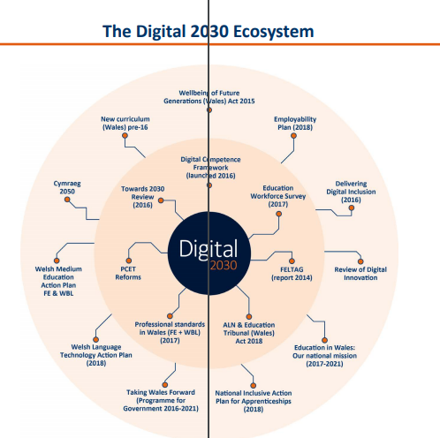
This is a strategic framework of digital 2030. Work started on this back in 2014 and will continue up to 2030 for post-16 digital skills (Jisc, 2019).

Slide 17
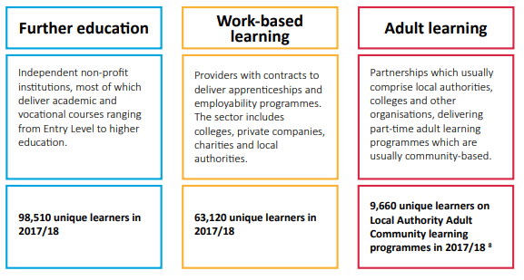
Who does the digital 2030 affect.
FE
WBL
AL

Slide 18
Major impact of digital 2030 on higher education?
According to the report for higher education governance in Wales the following challenges were highlighted:
Its aim is to maximise the effectiveness of its finances under the guise of budgetary pressures.
The need to maintain academic and research excellence in an environment of changing demographic, student demand and rising expectations;
The need to address issues of institutional size and capacity, particularly in the face of increasing global and UK competitiveness;
The need to invest in, and continuously improve upon, the student experience and opportunities for learner employability;
The need to build a culture of innovation, dynamism and continuous improvement if the sector is to maximize its potential contribution to economic growth and social improvement (McCormick, 2011).

Slide 19
How does this impact PCET
The adoption of a centralised strategic framework and vision enables a clearer and harmonious technological direction for all post compulsory education and training to follow. Specifically it enables PCET to have sufficient support to continually evolve and improve.
It should enable greater awareness and buying power of new technology to improve efficiency.
It gives a clearer continuum for learners and teachers to adhere to.
Transparency on investment and support needs

Slide 20
Technology addiction & Digital 2030
There wasn’t anything specifically around the increase in addiction in the post education learner group. This was left to the Wellbeing of Future Generations (Wales) Act 2015. This act states that lecturers should:
Educate about the over-use of technology.
Use lecture room management tools to aid the use of digital distractions whilst in lectures.
Ensure the content of the lecture is engaging and immersive.
Offer support. From lecturers or other bodies within the university.
(Welsh Government, 2017)

Slide 21
References
Chandler, S., 2019. How Technology Is Being Used By Students To Cheat On Tests. [Online]
Available at: https://www.forbes.com/sites/simonchandler/2019/09/11/how-technology-is-being-used-by-students-to-cheat-on-tests/#4d64bea5384f
[Accessed 04 May 2020].
Davies, S., 2019. Member stories: moving towards Education 4.0. [Online]
Available at: https://www.jisc.ac.uk/blog/member-stories-towards-higher-education-40-15-jan-2019
[Accessed 03 May 2020].
Elting, L., 2019. The Problem Behind the Problem: Why Technology Perpetuates Bias. [Online]
Available at: https://www.forbes.com/sites/lizelting/2019/06/20/the-problem-behind-the-problem-why-technology-perpetuates-bias/
[Accessed 04 May 2020].
Enosi, S., 2011. Contemporary issues in Education. [Online]
Available at: https://oer.avu.org/handle/123456789/152
[Accessed 02 05 2020].
Jisc, 2019. 2030 vision for education in Wales. [Online]
Available at: https://www.jisc.ac.uk/news/2030-vision-for-education-in-wales-04-jul-2019#
[Accessed 05 May 2020].
Kasparov, G., 2017. Deep Thinking: Where Machine Intelligence Ends and Human Creativity Begins. London: John Murray .

Slide 22
References
McCormick, J., 2011. Achievement and accountability: Report of the independent review of higher education governance in Wales, Cardiff: Welsh Assembly Government, Department for Children, Education, Lifelong Learning and Skills.
Megginson, D. & Whitaker, V., 2007. Continuing Professional Development. 2nd ed. London: CIPD.
Miller, K., 2020. 22 Advantages and Disadvantages of Technology in Education. [Online]
Available at: https://futureofworking.com/10-advantages-and-disadvantages-of-technology-in-education/
[Accessed 03 May 2020].
Moon, J. A., 2000. Reflection in Learning and Professional Development: Theory and Practice. Abingdon: Routledge.
Robb, M., 2016. What Educators Need to Know About Technology Addiction. [Online]
Available at: https://www.commonsense.org/education/articles/what-educators-need-to-know-about-technology-addiction
[Accessed 04 May 2020].
Scheider, P. & Bakhshi, H., 2017. The Future of Skills: Employment in 2030. [Online]
Available at: https://www.nesta.org.uk/report/the-future-of-skills-employment-in-2030/
[Accessed 04 May 2020].
Schwab, K., 2016. The Fourth Industrial Revolution: what it means, how to respond. [Online]
Available at: https://www.weforum.org/agenda/2016/01/the-fourth-industrial-revolution-what-it-means-and-how-to-respond/
[Accessed 05 May 2020].
[Online]
Available at: https://www.wcva.org.uk/media/5636168/the_goals_of_the_wellbeing_of_future_generations__wales__act_2015.pdf
[Accessed 01 May 2018].
Welsh Government, 2019. A strategic framework for post-16 digital learning in Wales, Cardiff: Welsh Government.

