Slide 1
Effective team working and communication.
Effective communication when supporting families and patients in hospital.
Names & student numbers: Hanad(2018607), Nisa(2025737) , Iunia (2027536) and Crystal (2028055)
Module code: BMSW4002
Lectures name: Suzannah Ogwu

Slide 2
Introduction
This presentation will be used as a training and development tool with new staff working at a local children’s hospital to support families throughout their treatments.
In this presentation the discussion includes the channels of communication that can be used.
Types of barriers that can prevent effective communication.
The impact of communication on staff and patients.
The theories relating to model of communication.

Slide 3

Theories relating to models of communication

Slide 4

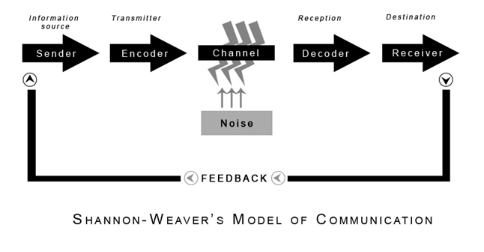
Shannon Weaver communication model
The Shannon–Weaver communication model has been named the "mother of all models.“
The word is used by social scientists to refer to an integrated model that incorporates the notions of information source, message, transmitter, signal, channel, noise, receiver, information destination, likelihood of error, encoding, decoding, information rate, and channel capacity.
However, some argue that the term is deceptive, claiming that Shannon created the most important concepts on his own.
CommunicationTheory.org, 2010
The Nurse manager in-charge from Rainbow Children's Hospital, identified the problem that the parents of children had is miscommunication, and she took action to resolve that problem, to train the staff members in communication skills.

Slide 5
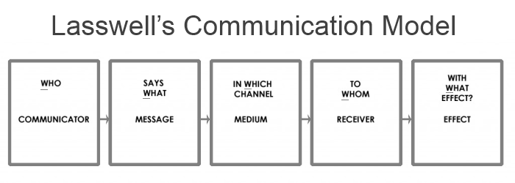
Lasswell communication model
Lasswell's model of communication characterises a communication act by specifying who said it, what was said, how it was said, to whom it was said, and with what impact it was stated.
Many communication and public relations specialists describe it as "one of the first and most important communication models."
In 1948, while teaching at Yale Law School, American political scientist and communication theorist Harold Lasswell devised the concept.

Slide 6
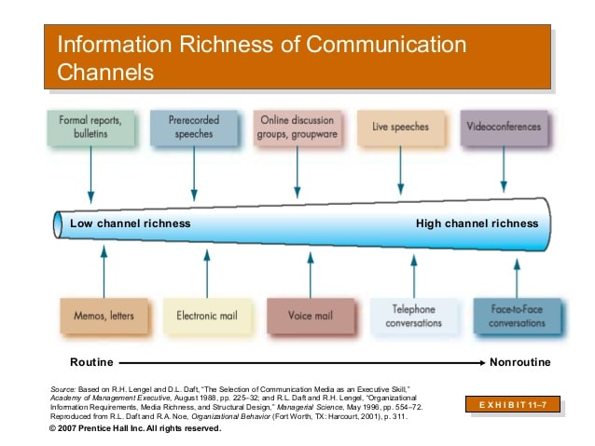
The channel of communication that can be used to improve communication
Lancaster (2021) implies Communication channel are the approach for individuals in an environment to communicate.
Here are three channels of transmission that staff can operate whilst working at the Rainbow children’s hospital to assist families during the course of their treatment. These matters are all interaction that function exceptionally well.
Keiling (2021) refers that there are several channels in communication such as:
Microelectronic Communications Channels
Face-to-Face or Individual Communication
Written Technique of Communication

Slide 7


Microelectronic Communications Channels
Sharon K. (2002) refers Microelectronic communication channels consist of
Internet
Mail/ Email
Social media
Conference on teams and zoom
These programs are established on electronic communication channels.
Staff working at the Rainbow children’s hospital will be competent to operate these ways as it helps them to interact with families to support them all through their treatment giving them one to one conversation on email regarding their situation, development, and any follow up schedules.
This is greatest way to convey with patient's family and maintain them involved with updates.
This communication channel allows you to have group meeting such as group meeting on teams or zoom. This channel is not personal but this method of communication is available, simple, and specialized.

Slide 8


Face to face or individual communication
Coach (2021) Face-to-face or individual communication is excessive channels of interaction that can be used within an organisation.
This interaction is beneficial for staff who are employed at the Rainbow children’s hospital as it shows physical presence.
This is the credible channel to apply for sensitive communication because it allows interaction among staff and patient to clarify doubts.
The manner and attitude of the colleague’s tone and facial languages reassures families as they can relate that information as the staff predicts.
In addition, this supports staff member to assess whether the families have determined their communication as scheduled and question or respond to any worries or doubts.

Slide 9

Written technique of communication
Harappa (2021) indicates Written technique of communication involves
Policies and procedures
Important Memos
Examination notes
Letters
Announcements, warnings, and advertisement
It is essential that staff working at a Rainbow children’s Hospital use written technique of interaction as is a permanent process of communication. It is valuable when data are needed or required, this provides legitimate documents, records, and references if necessary. Staff will be making use of this channel while completing examination notes or writing letters, important memos, or announcements for loved one e.g., family during their treatment.

Slide 10
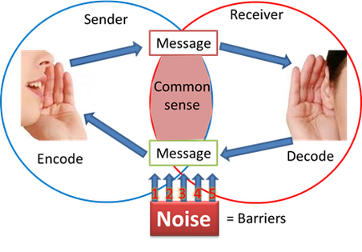
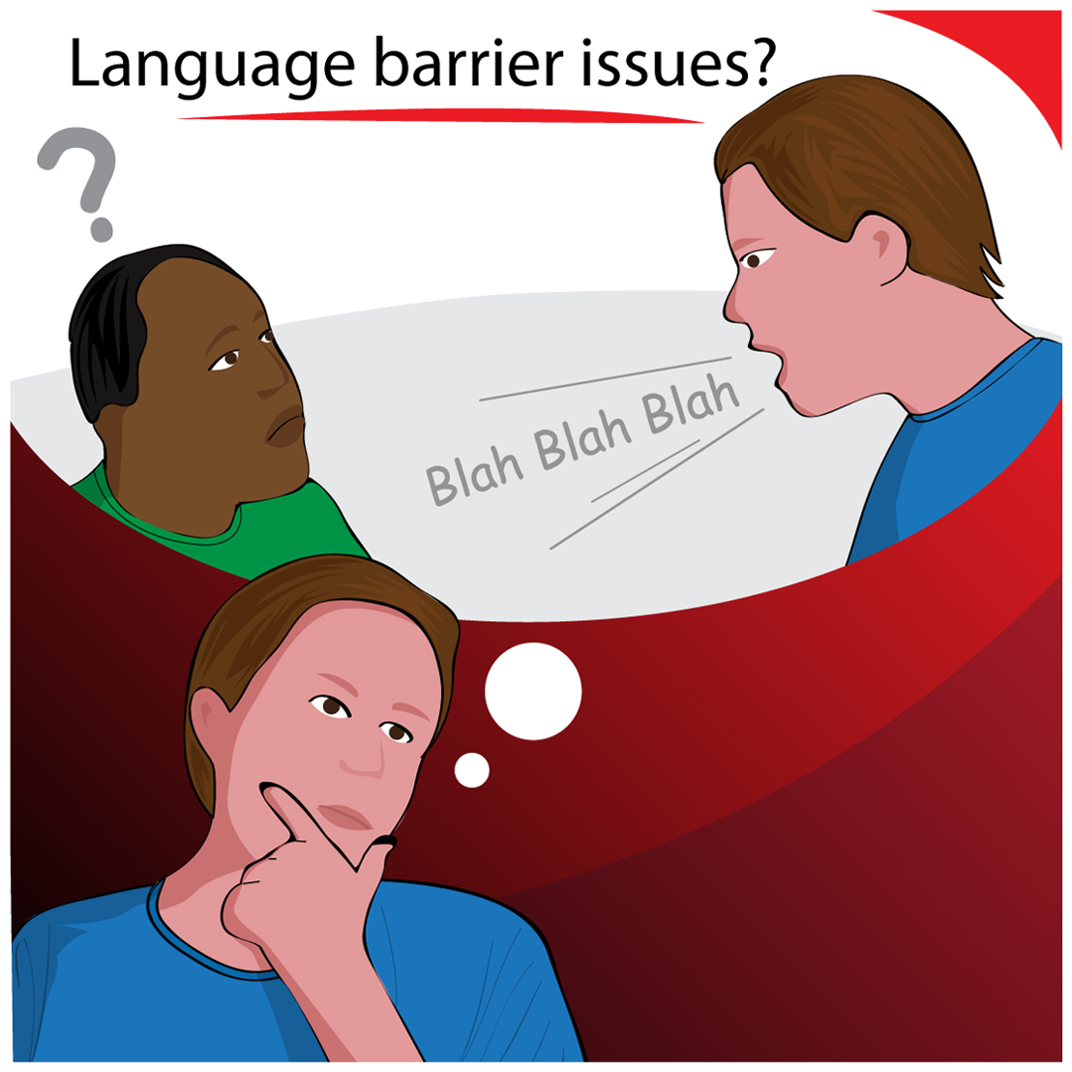
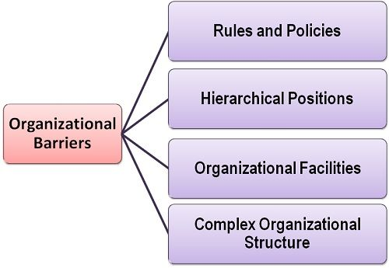
Barriers that can prevent effective communication
Gardner (2020) suggests There are many barriers that can prevent effective communication such as
Noise
Language barrier
Organisational barrier
Personal barrier
Cultural barrier
But all these barriers have channels to follow to help the receiver to receive the message.

Slide 11
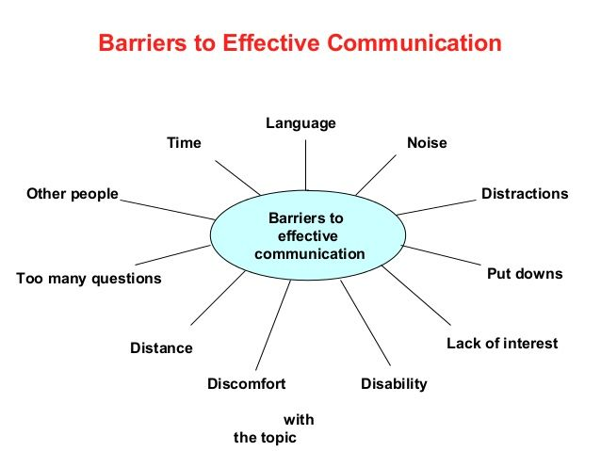
Barriers that can prevent effective communication.
Customer satisfaction and retention : After several complaints from Rainbow children’s Hospital, customer satisfaction should be improved on with better communication, positive influences have a positive impact on customer satisfaction loyalty.
Knowledge sharing : One of the main goals Rainbow children’s Hospital needs to achieve is by investing internal communications to better the knowledge sharing amongst their employees.
Barriers of Attitude- Rainbow children’s hospital need to ensure all staff have a positive attitude at work as this can inhibits the communication from staff to families as they may not look or sound approachable which then can lead to further problems in the setting.

Slide 12
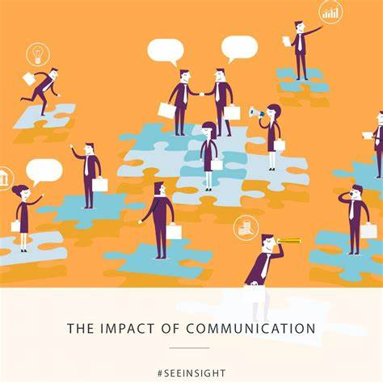
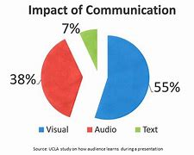
The Impact of effective communication on the staff and patients
Tod (2021) states
Positive impact of effective communications are:
Increased confidence
Better efficiency
Employee engagement
Greater work environment
Stronger management
Better Customer service
Greater care for patients
Built rapport
Better trust
Stronger relationship between staff and patients

Slide 13


The impact effective communication on the staff and patients
Negative impact of effective communications are:
Lower productivity
Conflict
Damaged morale
Stress
Increased turnover
Bad customer service
More prone to mistakes
Unhappy patients
No trust in care
Bad rapport
Poor care

Slide 14
Conclusion
Overall, throughout this presentation, we have recognised communication is not just about speaking or talking it is combination of tone and body language.
We have identified there are various of types of ways of communication, the positive and negative barriers that can affect communication and explained how these ways will affect and benefit Rainbow Children’s hospital.
Communication is keyway to relay information; Rainbow Children’s hospital can efficiently use tone of voice and body language to deliver their message across.
Furthermore, we have discussed a few models of communication which are theoretical models that are applied to simplify the human communication process.

Slide 15
References
Coach, B (2021) What is Face to Face Communication? Characteristics (Web) Available at: What is Face to Face Communication? Characteristics (bizcommunicationcoach.com) (Accessed: 31/10/21)
CommunicationTheory.org., (2010). Shannon and Weaver Model Of Communication. Communication Theory. Retrieved on Dec. 2 2013 from: http://communicationtheory.org/shannon-and-weaver-model-of-communication/
Erik Hollnagel and David D. Woods (2005). Joint Cognitive Systems: Foundations of Cognitive Systems Engineering. Boca Raton, : Taylor & Francis.
Gardner, J (2020) Alert Solutions, Inc.: Overcoming Language Barriers for More Effective Contact Tracing.
"Global communications : opportunities for trade and aid" U.S. Congress, Office of Technology Assessment. (1995). (OTA-ITC-642nd ed.). U.S. Government Printing Office.

Slide 16
References:
Harappa (2021) Effective Written Communication Skills (Web) Available at: Written Communication – Types of Written Communication - Harappa Education (Accessed: 31/10/21
Jump up to:ª ^{b} "Rant in the defense of Shannon's contribution: the father of the digital age", YouTube video, Martin Hilbert, Prof. UC Davis (2015)
Muth, R., Finley, M. and Muth, M. (1990) Harold D. Lasswell: An Annotated Bibliography. New Haven: New Haven Press.
Keiling,H (2021). 4 Types of Communication and How to Improve Them (Web) Available at: 4 Types of Communication and How to Improve Them | Indeed.com (Accessed: 31/10/21)
Lancaster, A (2021). Why is Communication Important? (Web) Available at: Why is Communication Important? | Life and Career Benefits - Mallory (Accessed: 31/10/21)

Slide 17
References
RAHMANJMC, Febryary 9, (2015). Lasswell's Model Of Communication. Communication Models. From: https://rahmanjmc.wordpress.com/2015/02/09/lasswells-model-of-communcation/
Sharon K. (2002) electronic communication (Web) Available at: Electronic Communication - an overview | ScienceDirect Topics (Accessed: 31/10/21)
Shoemaker, P., Tankard Jr, J. and Lasorsa, D. (2004) How to Build Social Science Theories. Thousand Oaks: Sage
Steve, T (2021) positive and negative communication (Web) Available at: Positive and Negative Communication in the Workplace – Open Sourced Workplace (Accessed: 16/11/21)
Smarp (2020) TOP 12 COMMUNICAION BARRIERS AND HOT TO TACKLE THEM (Web) Top 13 Communication Barriers and How to Tackle Them (smarp.com) Available at: (Accessed: 20/11/21)

Slide 18
Nisa
Teamwork Evaluation | Team responses.
Who was in your team? | In my team there is Hanad, Crystal, Lunia and myself (Nisa Azad)
What were the key strengths of your team? | I think the key strength of our team is functioning all together as a group and assisting each other when required and sharing the tasks out fairly. In my opinion I think our team is very devoted too.
What were the challenges that you overcame as a team? | One of the challenges we had to overcome as a team is that the team members had to send the work 4 days before the due date as I as a team leader could not put the work together on certain days due to work commitments.
What would you do differently if you worked as a team again? | What I think we should do different is the team should stay in campus the whole time rather than going online halfway through as it was harder to communicate and work as a team which was quite complex.
How would you rate your team working? Out of 10? | 8 out of 10 we gave ideas to each other, we established on what part we are going to do in the presentation without no differences and significantly we operated as a team.

Slide 19
Crystal
Teamwork Evaluation | Team responses.
Who was in your team? | Lunia, Nisa, Hanad, Myself (Crystal)
What were the key strengths of your team? | The key strengths of my team is that everyone was communicating effectively with the group presentation
What were the challenges that you overcame as a team? | The challenges I overcame was doing my part on my own and hoping the group will agree with my point of views.
What would you do differently if you worked as a team again? | I would arrange for everyone to come together and discuss the teamwork progress in person.
How would you rate your team working? Out of 10? | 9

Slide 20
Iunia
Teamwork Evaluation | Team responses.
Who was in your team? | Me, Nisa, Crystal and Hanad.
What were the key strengths of your team? | Determination and punctuality.
What were the challenges that you overcame as a team? | We did not have any challenges.
What would you do differently if you worked as a team again? | Nothing really, we are a really good team, we know how to communicate with one anotherm
How would you rate your team working? Out of 10? | 10, for sure.

Slide 21
Hanad
Teamwork Evaluation | Team responses.
Who was in your team? | Crystal (2028055) Lunia (2027536) Nisa (2028055) Hanad (2018607)
What were the key strengths of your team? | Communication
What were the challenges that you overcame as a team? | Some of us were working from home and others on campus
What would you do differently if you worked as a team again? | Be at the same place at the same time
How would you rate your team working? Out of 10? | 8

