Slide 1
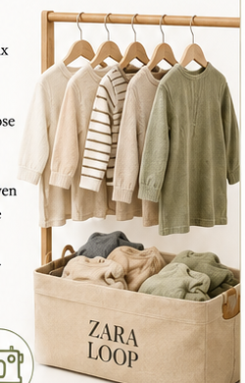
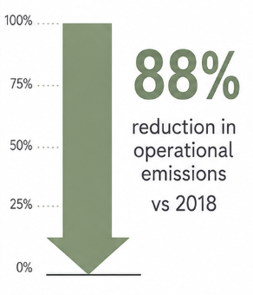
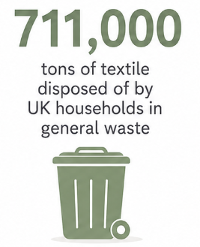
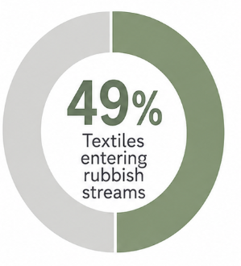
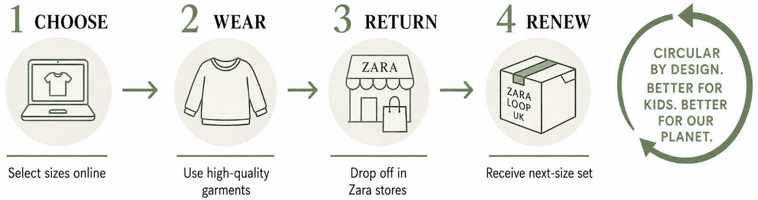
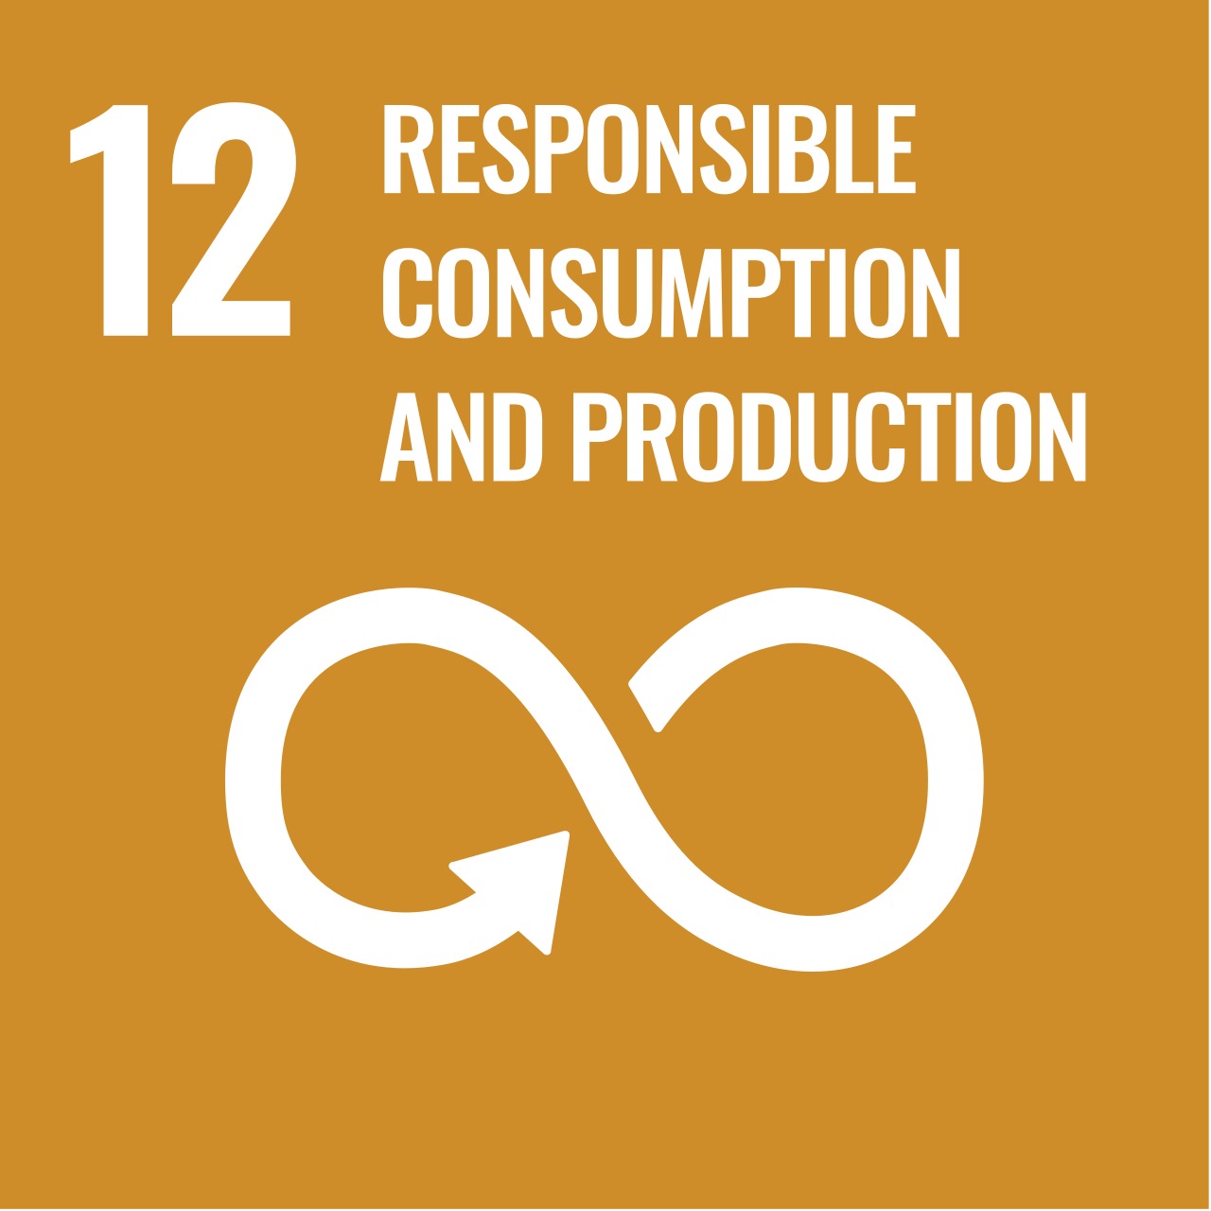
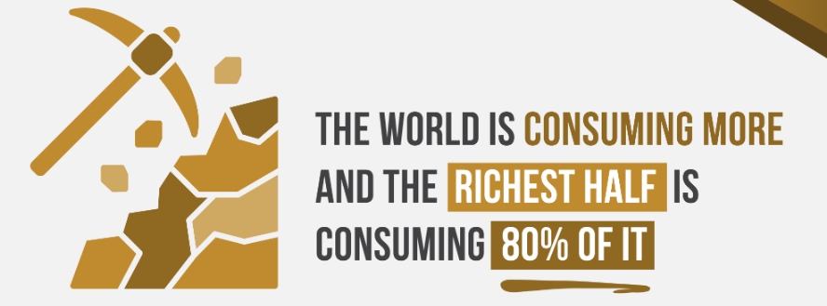
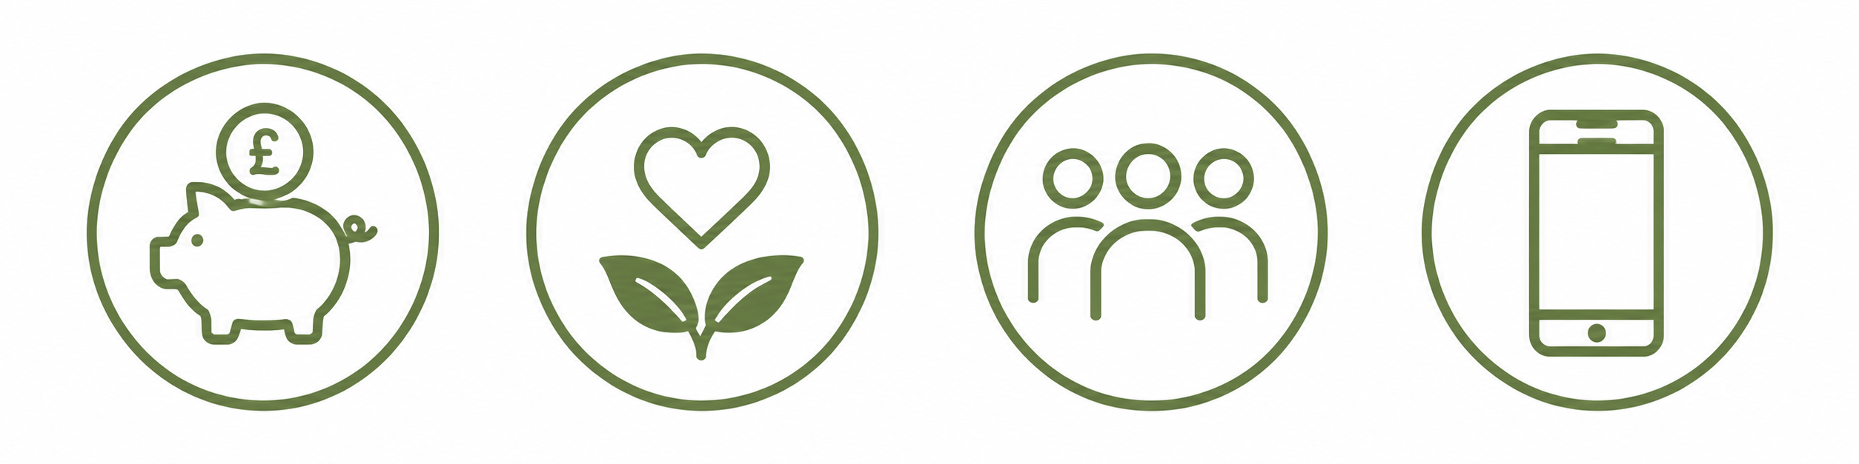
ZARA LOOP UK: CHILDREN’S CLOTHING SUBSCRIPTION
•
Wear. Return. Renew.
Student Name: Ankitaben Shaileshkumar Thakor
Student ID: 2541590
1
Brand and Sustainability Need
2
The Extension
Zara has the capacity to transition UK childrenswear to circular access. Inditex has cut operational emissions by 88 compared to 2018, but longer usage is required to cut impacts on value-chain (Inditex, 2025). The UK households disposed of 711,000 tons of textile in general waste, and 49% of the textiles found their way into the rubbish streams (WRAP, 2024).
Zara Loop UK would offer parents six long-lasting and durable children’s clothes in the age of 0-8 under subscription. Customers would choose sizes online and when the item outgrew them, they would drop off used items on Zara stores and be given the next size. Used clothes would be checked, mended and reused again and then the fiber would be recycled.
3
Why Customers Will Choose It
4
Sustainability and Growth
Rental saves on frequent buying and storing and retains designs. Willingness to rent online clothes is affected by green value, familiarity, social representation and innovativeness (Dovalienė and Salciute, 2024). A study that analyzes the almost 200 European fashion businesses designates rental, repair and resale as circular strategies (D’Itria and Aus, 2023). Sustainable fashion awareness and purchase intention can be enhanced by digital access (Vassalo et al., 2024).
The model promotes SDG 12 by reusing, repairing and taking back and generating recurring revenue (SDGS, 2026). Thus, Zara Loop turns the cycles of wearing of short children into quantifiable environmental and commercial value.
Circular access • repair and reuse • store take-back • recurring revenue
▤
Reference List
D’Itria, E. and Aus, R. (2023) ‘Circular fashion: evolving practices in a changing industry’, Sustainability: Science, Practice and Policy, 19(1), article 2220592. Available at: https://doi.org/10.1080/15487733.2023.2220592 (Accessed: 2 August 2026).
Dovalienė, A. and Salciute, L. (2024) ‘An investigation of circular fashion: antecedents of consumer willingness to rent clothes online’, Sustainability, 16(9), article 3862. Available at: https://www.mdpi.com/2071-1050/16/9/3862/pdf (Accessed: 2 August 2026).
Inditex (2025) Sustainability Report 2024. Arteixo: Industria de Diseño Textil, S.A. Available at: https://www.inditex.com/itxcomweb/api/media/d6d06b5c-4a2f-431d-915f-ce8ca9e95181/Sustainabilityreport2024.pdf (Accessed: 2 August 2026).
SDGS (2026) SDG 12: Ensure sustainable consumption and production patterns. SDGS. Available at: https://sdgs.un.org/goals/goal12 (Accessed: 2 August 2026).
Vassalo, A.L., Marques, C.G., Simões, J.T., Fernandes, M.M. and Domingos, S. (2024) ‘Sustainability in the fashion industry in relation to consumption in a digital age’, Sustainability, 16(13), article 5303. Available at: https://www.mdpi.com/2071-1050/16/13/5303/pdf (Accessed: 2 August 2026).
WRAP (2024) Textiles Market Situation Report 2024. Banbury: Waste and Resources Action Programme. Available at: https://www.wrap.ngo/resources/report/textiles-market-situation-report-2024 (Accessed: 2 August 2026).

