Slide 1

Harvard Referencing:
The why, when and how
Lisa Ellis
Academic Liaison Librarian

Slide 2
Aims...
1
What is referencing?
5
Hints and Tips
2
Plagiarism
6
Cite Them Right
3
Creating in-text citations
7
Further resources and help
4
Creating your reference list

Slide 3

What is referencing?
Why is it important to
acknowledge the sources you use in your
assignments?

Slide 4

Why we use referencing …
And lend credibility to our arguments
The intellectual work of others
Which ideas belong to others by attribution
Plagiarism
Breadth of reading
Notes:
Quick recap on why referencing is so important.

Slide 5

Why should you reference?
Authors
To see their work acknowledged.
To increase their academic reputation and possible funding for further research in the subject area. This could be you!
Academic community
To standardise references, making it easier to find resources and conduct peer review.
Correct referencing is an accepted characteristic of the academic community worldwide, the basis of trusted research.

Slide 6
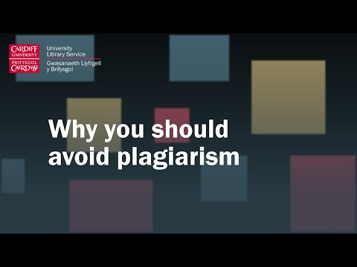
Video
Notes:
A video from a Cardiff University lecturer on why you shouldn’t plagiarise.

Slide 7
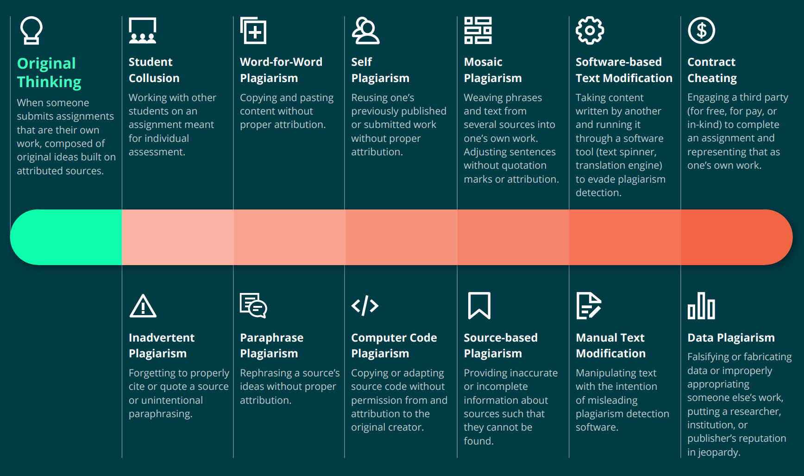
Notes:
Turnitin Plagiarism Instructor guide - Plagiarism Spectrum 2.0 | Turnitin
Student Collusion
Asking somebody you know to write all or part of your assignment
Allowing another student to submit your work as their own
Jointly completing an individual assignment with another person and then each submitting identical or similar pieces of work
Working with another student to jointly plan an assignment e.g. structure, main arguments and sources, even if you then individually write up the assignment.

Slide 8






Research Process
Making notes as you read, linking perspectives, critically analysing viewpoints and writing in your own words.
Recording as you read, produces original written work with ideas built on correctly referenced sources.
Exploring ideas, information and research from different sources
Notes:
Read widely and assimilate information from different sources, such as lectures, moodle, web, books, journals, tv, newspapers and more.
Take notes as you go along, making sure to highlight any quotes, paraphrasing, where you got the idea / words/ information from.
Focus on ideas not quoting or paraphrasing. Keep asking yourself, How do you know this information? Whose idea is it? Attribute the information.
Note taking is a skill that is necessary to develop to become a good scholar.
Draw your own conclusions based on your understanding of the evidence and information you have found and reference and acknowledge your sources, also known as attribution.
Repeat to yourself as you are writing How do I know this? Where did I read this? This will help you avoid plagiarism.

Slide 9
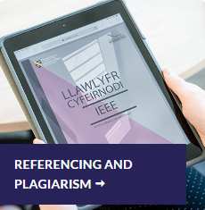
Harvard Referencing Style
There are many different styles of referencing.
You must follow UWTSD's handbook of Harvard Referencing, which currently follows the 12th edition of Cite Them Right.
The Cite Them Right book and database are available through the library.
Further support is found via the library infoskills page and Moodle.
Notes:
So we know why, but how do we reference in UWTSD?
Consistency is key!

Slide 10
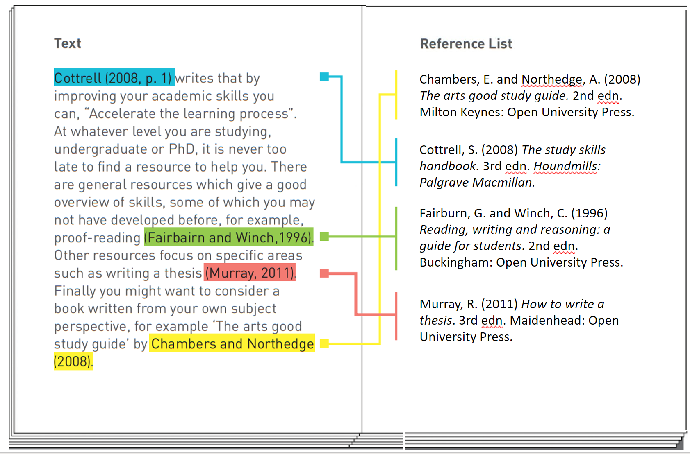
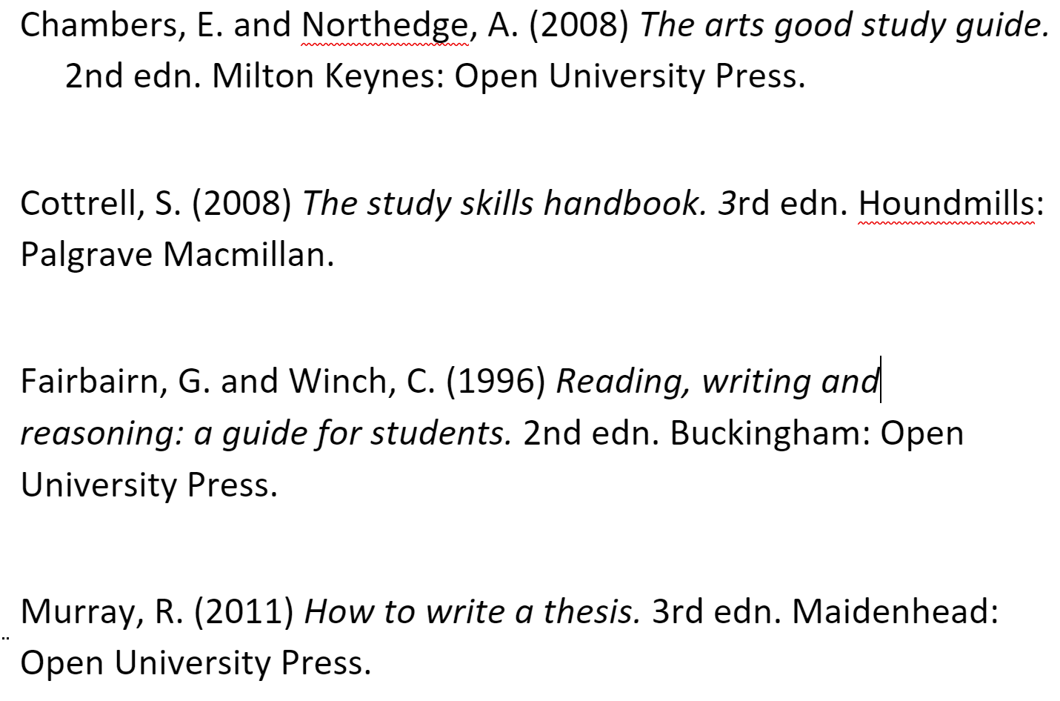
2 parts to Harvard Referencing:
1. In-text citation
2. Full reference list
This work is licensed and adapted under a Creative Commons Attribution 4.0 International License. Attribution: Leeds Beckett University Library.

Slide 11

Citations
Every idea you use from your reading must be acknowledged with an in-text citation and a reference.
This includes, but not limited to:
Direct quotes
Paraphrased material
Summarising
Images, tables, graphs
Lecture notes / PowerPoints from Moodle
Notes:
One of the key purposes of referencing is to acknowledge the role that the work of others has played in developing your ideas.
This means that you must include a citation every time you use an idea that you got from someone else – not just when you quote directly. That includes images, tables, graphs etc. if they’re not your own work.
Good note taking skills are important. You must record the information as you go along and highlight which words are exact quotes and which are paraphrased.

Slide 12
1. In-text citation
Goes into the body of your writing (at the point you refer to the source you have read) and includes:
Author(s) or editor(s) family name / surname
Year of publication
Page number(s) (if quoting or using a specific part of a work)
Notes:
If you are using the author's name in your sentence, you only need the date and page number in brackets. Note the full stop comes after the citation if at the end of a sentence.

Slide 13

Examples
1 author
(Stark, 2016, p.5)
2 or 3 authors
(Wayne, Banner, and Kent, 2012, p.54)
4 or more authors
(Rogers et al., 2014, p.37)

Slide 14
Parenthetical In-text citation
Author's Surname, Year & page number (if required) in brackets
  Scotland is taking a radical approach to tackling knife crime by treating it as a public health issue (Roberts, 2019).
The sentence is focusing on the information. The author is not relevant.
Easy to include multiple sources.
Example: (Roberts, 2019; Blake, 2020; Cornish, 2020)
Notes:
If you are using the author's name in your sentence, you only need the date and page number in brackets. Note the full stop comes after the citation if at the end of a sentence.

Slide 15
Narrative In-text citation
Author's Surname, Year & page number (if required) in brackets
  According to Roberts (2019) Scotland is taking a radical approach to tackling knife crime by treating it as a public health issue.
Used when describing views or opinions, as focus is on author.
Difficult to include multiple opinions and sources.
Overuse can disrupt the flow of your writing.
Notes:
If you are using the author's name in your sentence, you only need the date and page number in brackets. Note the full stop comes after the citation if at the end of a sentence.

Slide 16

Quotations
Avoid excessive quotations:
They can disrupt the style and flow of your writing
They form part of your word count
They do not show your understanding of your reading

Slide 17
Direct (short) Quotes
Use "quotation marks"
Integrate into your writing
Show page number if available
Example: When writing assignments, the “aim should always be to reference reliable sources of information” (Pears and Shields, 2016, p. 2).
If no pagination details available, use the information you have, such as loc, %, chapter/page/paragraph
Examples: (Thomas, 2020, 72%), (Fellows, 2021, ch. 4, para. 12).
Notes:
Don’t just drop a quote into your writing – integrate it into your own sentences. Highlight use of two authors, connected by ‘and’

Slide 18
Direct (short) Quotes
Example 1: When writing assignments, the “aim should always be to reference reliable sources of information” (Pears and Shields, 2016, p. 2).
Use "quotation marks"
Show page number if available
Example 2: According to Pears and Shields (2016, p. 2) when writing assignments, the “aim should always be to reference reliable sources of information”.
Notes:
Don’t just drop a quote into your writing – integrate it into your own sentences. Highlight use of two authors, connected by ‘and’

Slide 19
Long Quotations
Longer quotations are generally classed as a quote longer than 30 words.
They are written as a separate paragraph and indented from the main text.
Quotation marks are not required.
Note: Excessive use of quotes does not show your tutor you understand what you have read.

Slide 20
Paraphrasing
Your interpretation of someone else's ideas.
Should be a re-statement of the original text in your own words.
It is NOT simply changing some words or sentences around.
Organising and writing the ideas you have read in your own words shows your understanding of the original material and strongly supports your argument.
Godfrey, J. (2018) How to use your reading in your essays. 3rd edn. London: Palgrave.

Slide 21
Re-cap:
In-text citation
This work is licensed and adapted under a Creative Commons Attribution 4.0 International License. Attribution: Leeds Beckett University Library.

Slide 22

Questions?

Slide 23
When NOT to cite...
Common knowledge
Not all ideas belong to others
Facts, dates, events generally known in a particular subject.
Ask yourself:
Did I know this before I started this course?
Did this idea come from me, or from something I have heard, read, discussed?
If in doubt – CITE!
Notes:
Did I know this before I started this course?
Did this idea come from me or something I have read?
Ig in doubt – cite it!

Slide 24
Stop and think ...
What details do you think we need to include in our full reference list?

Slide 25
2. Creating a reference list
Arrange alphabetically by author’s surname - or by title if no author
List all sources cited in your writing
Format each reference according to the type of resource cited.
Include the following:
Who (author)
When (date)
What (title)
Where (location)

Slide 26
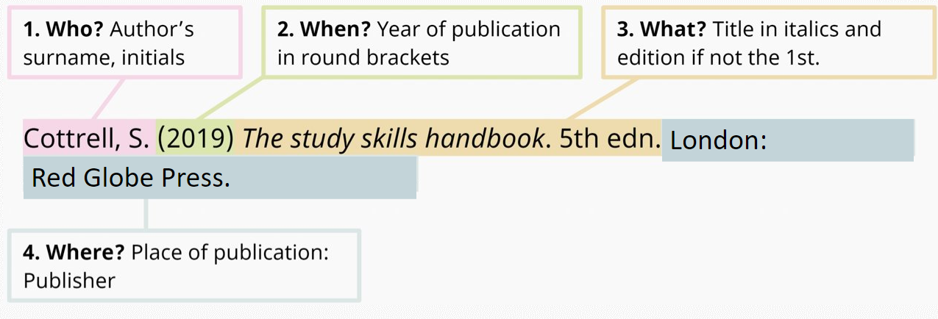
Reference List: book

Slide 27
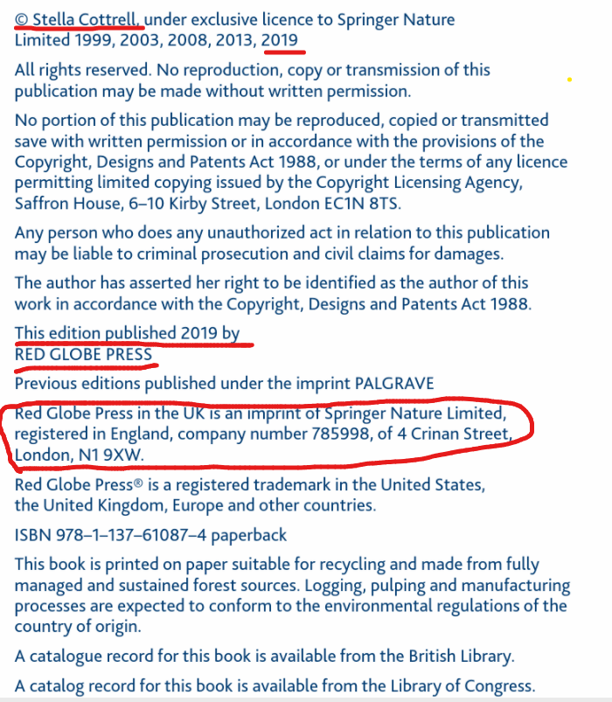
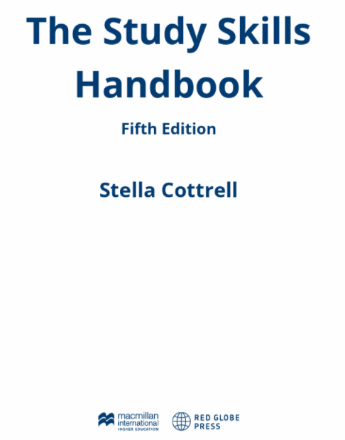
Where to find the information...
Title
Edition
Date
Author ​
Place of Publication (publisher's address).
Publisher

Slide 28
Web page
Who? Author's surname and initials
When? Date in round brackets
What? Title of webpage in italics
Holford, A. (2022) Student loans: would a graduate tax be a better option? Available at: https://theconversation.com/student-loans-would-a-graduate-tax-be-a-better-option-179253 (Accessed: 26 May 2022).
Where? URL and date accessed (in round brackets).
N.B. It is the title of the webpage, not the name of the website

Slide 29

Webpage
The Conversation

Slide 30
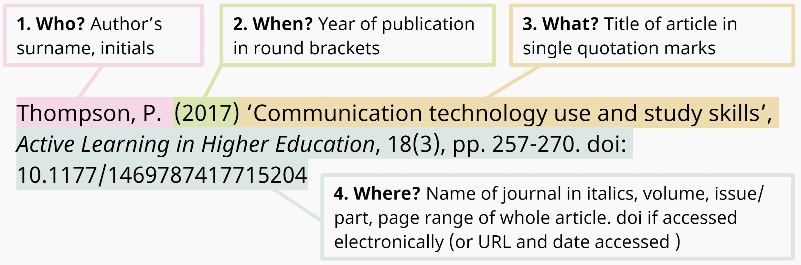
Reference List: journal article
Available at:
Available at: doi.org/

Slide 31
Reference List: journal article
Surname, Initial. (Year of publication) 'Title of article', Title of Journal, Issue information, Page reference. Available at: DOI / URL (Accessed date).
Pascoe, K.M., Waterhouse-Bradley, B. and McGinn, T. (2021) 'Systematic literature searching in social work: a practical guide with database appraisal', Research on Social Work Practice, 31(5), pp. 541-551. Available at: https://doi.org/10.1177/1049731520986857
In-Text Citation:
(Pascoe, Waterhouse-Bradley and McGuinn, 2021)

Slide 32
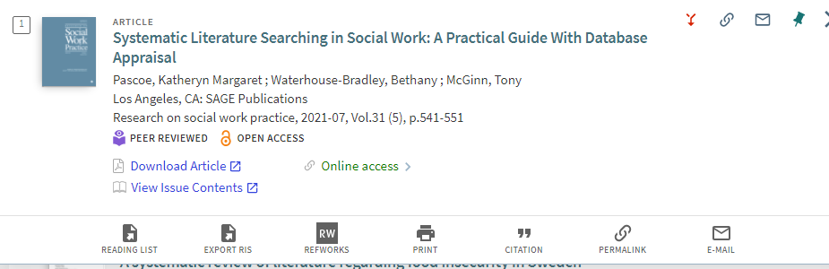
Finding the information
Article title
Authors
Journal title
Date & issue information

Slide 33
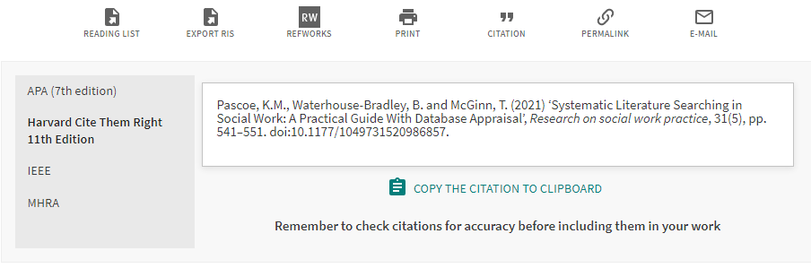
Citation

Slide 34
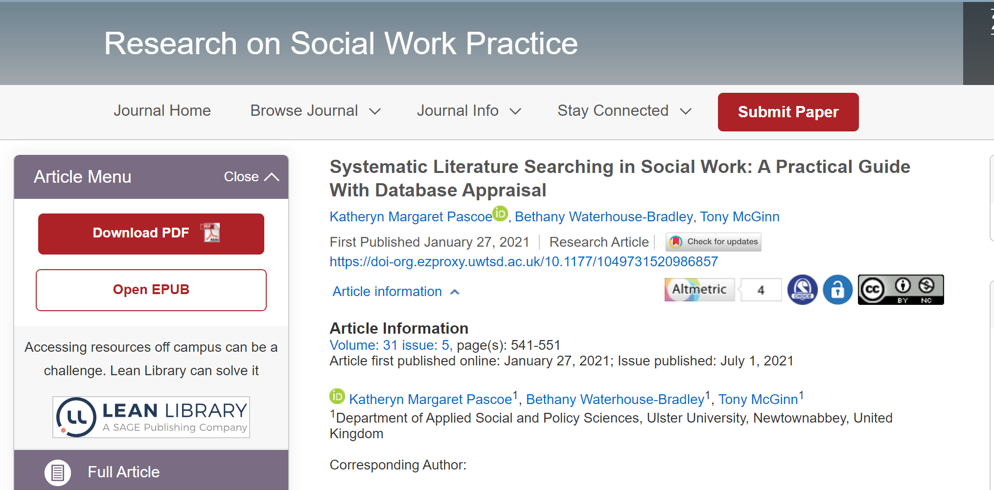
Finding the Information

Slide 35
Streamed Content
Title of episode (in single quotation marks) if known; if not, use series title
Year of original broadcast (in round brackets)
Title of series/season (in italics)
Series/season and episode numbers, or day month (if available)
Production company
Available at: Name of streaming service / link to homepage site (if available)
(Accessed: date)
Example:
'Papa' (2022) Stranger Things, season 4, episode 8. Netflix. Available at: https://www.netflix.com/gb/title/80057281 (Accessed: 20 Oct 2022).

Slide 36
Reference List Example
Cottrell, S. (2019) The study skills handbook. 5th edn. London: Red Globe Press
Holford, A. (2022) Student loans: would a graduate tax be a better option? Available at: https://theconversation.com/student-loans-would-a-graduate-tax-be-a-better-option-179253 (Accessed: 26 May 2022).
‘Papa’(2022) Stranger Things, season 4, episode 8. Netflix. Available at: https://www.netflix.com/gb/title/80057281 (Accessed: 20 Oct 2022).
Pascoe, K.M., Waterhouse-Bradley, B., and McGinn, T. (2021) 'Systematic literature searching in social work: a practical guide with database appraisal’, Research on Social Work Practice, 31(5), pp. 541–551. Available at: doi:10.1177/1049731520986857
Thompson, P. (2017) 'Communication technology use and study skills', Active Learning in Higher Education, 18(3), pp. 257-270. Available at: doi: 10.1177/1469787417715204
N.B. Alphabetical Order

Slide 37
Re-cap of what it looks like...
1. In-text citation
2. Full reference list
This work is licensed and adapted under a Creative Commons Attribution 4.0 International License. Attribution: Leeds Beckett University Library.

Slide 38
How to cite...
No date available:
Consider if you really want to include this in your work, (refer back to CRAAP test).If you decide to use it, include (no date).
No author:
Use corporate author e.g. BBC, NHS, CIPD or title (e.g. Health of the nation, 2011).
Multiple publications, same author in different years:
List chronologically.

Slide 39
Secondary Referencing
Always try to locate, read and cite the original (primary) source wherever possible.
This will avoid the need to secondary reference. Your interpretation may differ to the (secondary) author whose article you are reading.
If this is not possible, you must only include the source you have actually read in your reference list.
You must however include both authors in your in-text citation and use the words, 'quoted in', or 'cited in' depending if the (secondary) author is directly quoting or summarising.
Examples
Kent (2017, quoted in Banner, 2019, p.86) provides an excellent survey...
Stark's views on genetics (2019, cited in Rogers, 2020) support the idea that...
N.B. Only Banner and Rogers will be in your reference list if you secondary reference.

Slide 40
Question?
What about the same author, same year?
How would we differentiate between 2 sources in our in-text citation?

Slide 41
Same author, same year
To cite multiple works by the same author in the same year, use lower-case letters after the publication date in your in-text citations. This applies to any type of source including books, journal articles, tweets etc.
In-text-citation examples:
Research has previously focused on whether high-density housing, in city centres, is one solution to mitigate against homelessness (Wilmot, 2020a). However, further intense research, concluded that high-density, city centre housing is not the answer (Wilmot, 2020b).
Reference list:
Wilmot M. (2020a) Inclusion: when will we have a home for life? Dublin: Pearson.
Wilmot M. (2020b) Solutions and barriers to homelessness. Dublin: Pearson.
Adapted from: https://libguides.ucd.ie/harvardstyle/sameauthosameyear

Slide 42
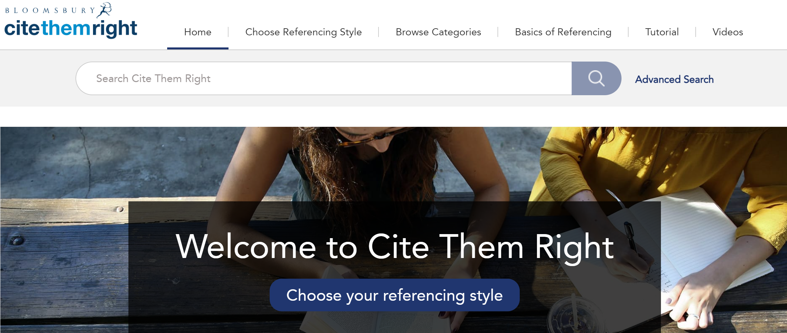
Cite Them Right Database
LINK

Slide 43

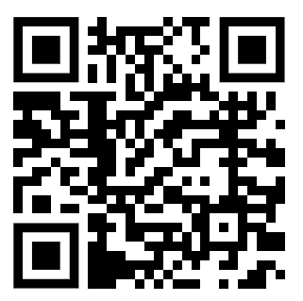
Further support
Available through the Library infoskills webpage.
Hosted on Moodle
New resources being added throughout the year.

Slide 44
Questions?

Slide 45

Top Tips
Bring together what you have discovered through your research, form your own opinions on what you have read, and write in your own words.
Give yourself enough time. Referencing takes longer than you think!
Ask for help if you need it.

Slide 46

Tips to improve your referencing
When used properly, references strengthen and enhance your work.
Understand the basics before you begin.
Keep a record of all sources as you use them.
Be consistent in the records you keep and in the way you reference. Use your collections in your online resource lists, Word, or MS One Note to help you a record.
Check your references before submitting your assignment.
Notes:
Cite them Right, p. 26

Slide 47
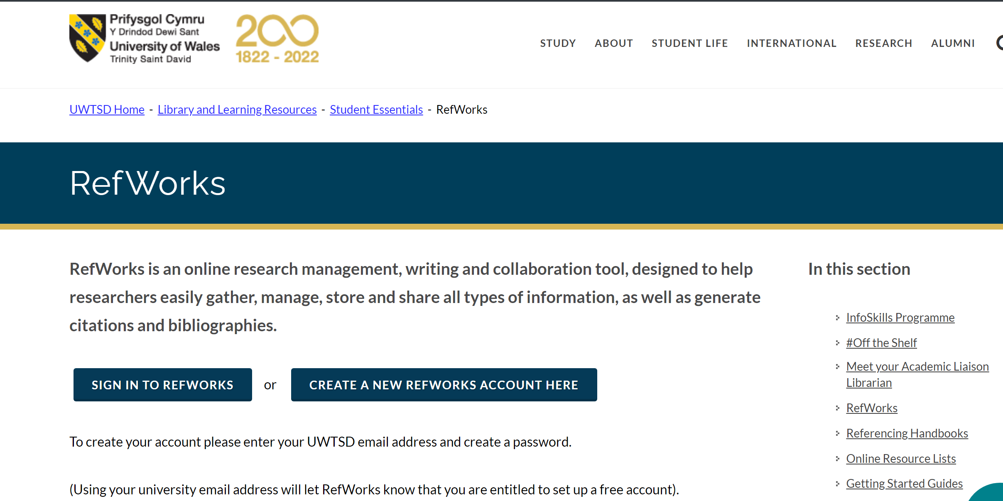
Citation Manager Tools
You must sign up through the library webpage to register for a FREE account.
Navigate to Student Essentials.
Click on Refworks
Create your account using your University email.
Sign in and create your profile.
Using a tool such as this is personal choice

Slide 48


YouTube
Getting started with RefWorks Playlist
Advanced RefWorks Playlist

Slide 49

When creating a reference ...
Find an example which matches your source and follow the format.
If you cannot find an exact match, choose the example most like it and amend it (Remember to include: Who, When, What, Where).
By putting together the different parts an elements, you can construct a citation and reference for any type of work.
Be consistent in your style and presentation

Slide 50
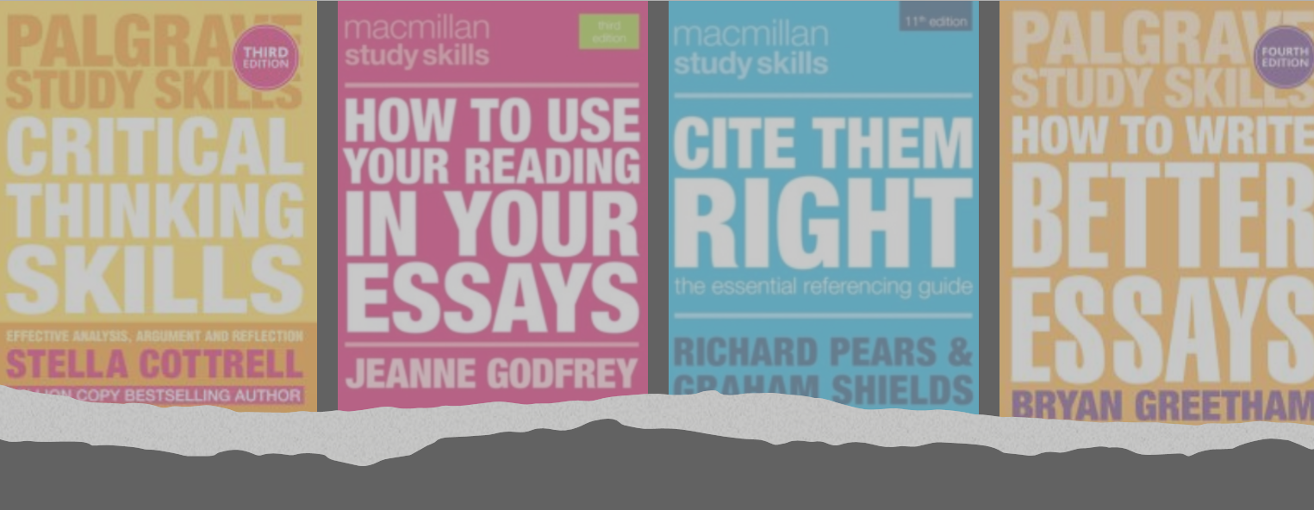
Useful Resources
Critical Thinking
Use Reading In Your Essays
Cite Them Right
Write Better Essays
Notes:
Don't forget study support through the HWB pages.

Slide 51
Online Resource List
Study skills & Referencing Online Resource List
A list of useful resources to help you with your studying and referencing

Slide 52

Contact
Lisa Ellis
IMH Academic Liaison Librarian
Email: l.ellis@uwtsd.ac.uk

