Slide 1
LCBB4012
Academic Skills (ACS)
Coherence, and Cohesion

Slide 2
Aims
To understand what coherence and cohesion is in writing
To recognise the importance of linking devices in academic writing
To learn new linking devices and practice using such devices in your own writing

Slide 3
Discuss with a partner
What do you think “coherence” means? How about “cohesion”? Have you heard these words before? Have you heard of them in relation to writing?

Slide 4
Coherence and Cohesion
Coherence means that your writing is easy to understand because all the ideas are connected and flow logically from one to the next. Think of it as making sure your writing is clear and makes sense as a whole.
Cohesion refers to the way you link sentences and paragraphs together using words and phrases (linking language/devices) like "and," "but," "first," "next," and "however." These help your readers follow your ideas easily.

Slide 5
Activity 1
Go to the Coherence and Cohesion worksheet and read both paragraphs.
After you read, discuss with a partner which paragraph is the better example of coherent and cohesive writing. Underline or highlight the language that helps make this paragraph more coherent and cohesive.

Slide 6
Activity 1 Answers
Many students at university have different motivations that drive both their academic and extracurricular activities. For instance, some students are deeply interested in their subjects and have a strong desire to learn more. These students are motivated by their passion for knowledge and academic excellence. On the other hand, others are driven by future job prospects, seeing their studies as a critical step towards a successful career. Additionally, involvement in clubs and sports can be motivated by social reasons, as students seek to build friendships and engage in campus life. Finally, the support of friends and family is crucial in maintaining motivation, because motivation can often change overtime. In conclusion, universities should try to understand all the different ways students are motivated, so that they can help students achieve success.

Slide 7
Activity 2
Go to the worksheet and sort the devices into their function
Compare your answers with a partner

Slide 8
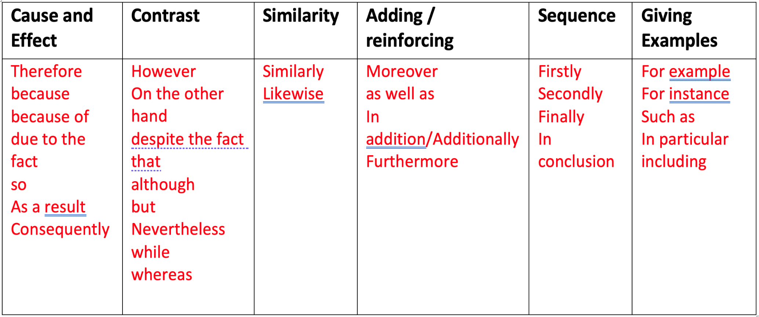
Activity 2 Answers

Slide 9
How to use cohesive devices in your own writing
If you can’t find any places in your writing where you think you could use cohesive devices, ask yourself if your paragraph needs more detail.
Could you…
Add another piece of evidence to support your point? (using ‘Moreover’, ‘Furthermore’, ‘In addition…’)
Give an example? (using ‘such as’, ‘For example’, ‘For instance’…)
Organise your ideas more clearly? (using ‘Firstly’, ‘Secondly’, ‘Finally’…)
Explain why something is important or significant? (using ‘Consequently’, ‘For this reason’…)

Slide 10
Your Turn
Look at the TEEL paragraph about time management you wrote at the end of the last Powerpoint presentation. Do you think it’s both coherent and cohesive?
Consider what improvements you could make to your paragraph to make it more coherent and cohesive and take 10 minutes to make these changes. You should make sure that another person/reader could clearly see and understand these changes.

