Slide 1

BA Business Management
Managing People
Presentation Name:
Talent acquisition management for KFC
Name of the student: Maricela Broasca
Student No: 2125147
Lecturer Name: Mushfiqur Rahman

Slide 2

Table of content
Introduction
Talent management
About the organization
Different types of talent acquisition
Short-term acquisition
Long-term acquisition
Different incentive methods – monetary
Different incentive methods – non monetary
Conclusion
References

Slide 3

Introduction
Talent management plays an important role within any business sector as it directly impacts the creation of future leaders as well as leverages competitive advantage for a business (Kravariti and Johnston, 2020, p. 75-95).
In this case, a brief study will be prepared on KFC regarding the conduction of talent management activities within the organisation. The study will assess the different monetary and non-monetary methods used by the business to handle employees and maintain talent acquisition.

Slide 4

Talent management
The process of locating, luring, and employing qualified persons to fill unfilled positions inside a company is referred to as talent acquisition management.
It consists of creating and putting into action a thorough recruiting strategy to locate the finest applicants for a certain post.
The process of managing talent acquisition usually starts with determining the organisation's personnel needs and writing a job description that describes the requisite education, training, and experience needed for the position (Ansar and Baloch, 2018).
Efficient talent acquisition management is crucial for an organisation's success because it ensures that the right people are hired for the proper tasks, which may have a big influence on overall performance, efficiency, and profit.

Slide 5
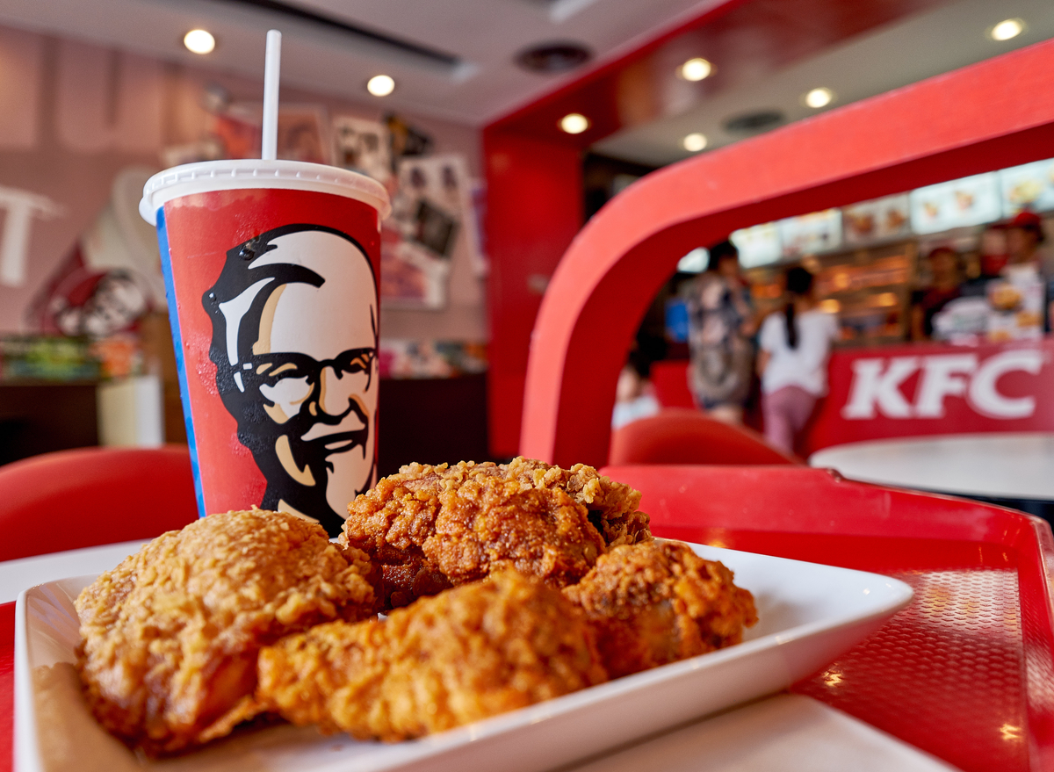
About the organisation
In the realm of the fast food restaurant sector, KFC is a notable business organisation.
The company is known for its signature product which is fried chicken.
The company was formed in 1952 in Kentucky, U.S. by Harland Sanders and Pete Harman.
As of the current day and age, the company possesses a total of 25,000 KFC restaurants in more than 145 countries (KFC, 2023).
KFC is a Quick Service Restaurant business that operates on a combination of equity and franchised models.
KFC made its debut in the UK in 1965, with the opening of its first restaurant in Preston.
Today, there are approximately 890 KFC restaurants in the UK and Ireland, with over 24,000 team members employed by both KFC and its franchisees (KFC UK, 2023).

Slide 6
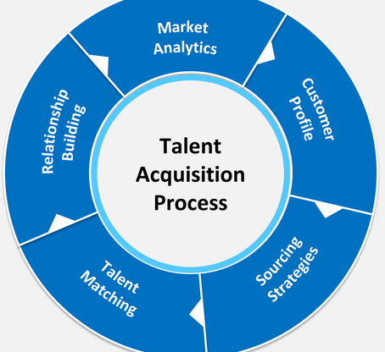
Different types of talent acquisition
There are various types of talent acquisition tactics used by the HR division of business organisations. It can be seen as follows:
Internal talent acquisition: It is a talent acquisition strategy which involves prompting or giving opportunities to the existing employees within the organisation. Such strategies help in reducing excess costs and improve employee morale and motivation (Albert, 2019 p. 215-221).
External talent acquisition: To fill open positions, individuals must be recruited from outside the company. This method of hiring people might assist companies in bringing in new viewpoints and innovative ideas.
Global talent acquisition: To fill vacant jobs in an organisation, this entails recruiting applicants from other nations. The capacity to successfully communicate and work with distant teams is necessary for this sort of talent acquisition, as is a thorough awareness of local customs, laws, and languages.
Diversity and inclusion talent acquisition: To develop an inclusive workplace culture, involves hiring applicants from various backgrounds and marginalised groups. This kind of talent acquisition may assist businesses in keeping top personnel, as well as enhancing employee engagement.

Slide 7

Short term acquisition
Short-term acquisition refers to the policy where employees are hired for specific roles or a fixed period (Edmans, Fang and Huang, 2022 p. 1007-1046). The three examples are:
Seasoned employees: Restaurants generally hire additional staff during summer, or holidays like Christmas to handle high rush and provide extra services.
Interns: Several restaurants provide internships to culinary students or those who want to work in the restaurant and hospitality industries.
Part-time staff: To fill in for missed shifts or to lend extra assistance during busy times, restaurants may engage part-time staff.

Slide 8

Long-term acquisition
Long-term acquisition involves the hiring of employees for permanent or long-term business objectives (Edmans, Fang and Huang, 2022 p. 1007-1046). The examples can be seen as follows:
Full-time staff: Employing full-time personnel may aid in establishing stability and consistency in restaurant operations for jobs such as chefs, kitchen managers, and front-of-house managers.
Employee development programs: Creating and executing initiatives like training provides staff members chances to grow their careers inside the restaurant, which may aid in attracting top talent.
Employee branding: Fostering the establishment of a strong employer brand that showcases the advantages of working there.

Slide 9

Different incentive methods - monetary
The different monetary incentives offered by KFC can be seen as follows:
Performance-based monetary rewards.
Upon providing quality services employees receive tips from the customers.

Slide 10

Different incentive non-monetary
The non-monetary incentives provided by KFC are:
KFC endorse maintaining a work-life balance for employees
KFC can offer flexible work arrangements
KFC adheres to workplace policies regarding health and safety within the organisation.

Slide 11

Conclusion
The study conducted on KFC addressed the various forms of talent management practices conducted by the business. It addressed the importance of talent acquisition and the various types associated with the organisational structure as well.
Lastly, the report addressed the different monetary and non-monetary incentive activities conducted by KFC as a whole.

Slide 12

Thank You

Slide 13
References
Albert, E. T. (2019). AI in talent acquisition: a review of AI-applications used in recruitment and selection. Strategic HR Review, 18(5), 215-221.
Ansar, N., and Baloch, A. (2018). Talent and talent management: definition and issues. IBT Journal of Business Studies (JBS), 1(2).
Edmans, A., Fang, V. W., and Huang, A. H. (2022). The Long‐Term Consequences of Short‐Term Incentives. Journal of Accounting Research, 60(3), 1007-1046.
KFC (2023). Our Locations. [online] Kfc.com. Available at: https://global.kfc.com/our-locations/. [Accessed On:14th March 2023].
KFC UK (2023). KFC Company Information. [online]. Available at: https://info.kfc.co.uk/company-information/. [Accessed On:14th March 2023].
Kravariti, F., and Johnston, K. (2020). Talent management: a critical literature review and research agenda for public sector human resource management. Public Management Review, 22(1), 75-95.

