Slide 1
Hackers, forces of nature and other terms
By Danny, Charlie and Daniel

Slide 2
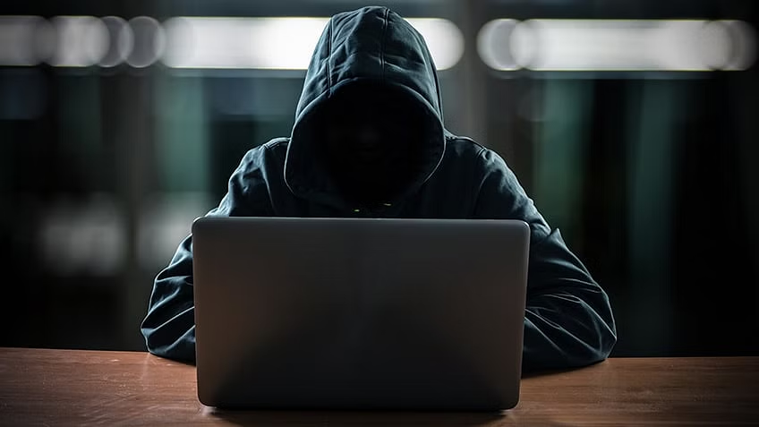
Crackers and Phreakers
Cracker:
Unauthorized computer hacker.
Breaches systems for malicious purposes.
Often motivated by personal gain.
Engages in illegal activities.
Phreaker:
Manipulates telephone systems.
Explores phone network vulnerabilities.
Often for free long-distance calls.
Operated in the past, mainly with analogue systems.

Slide 3
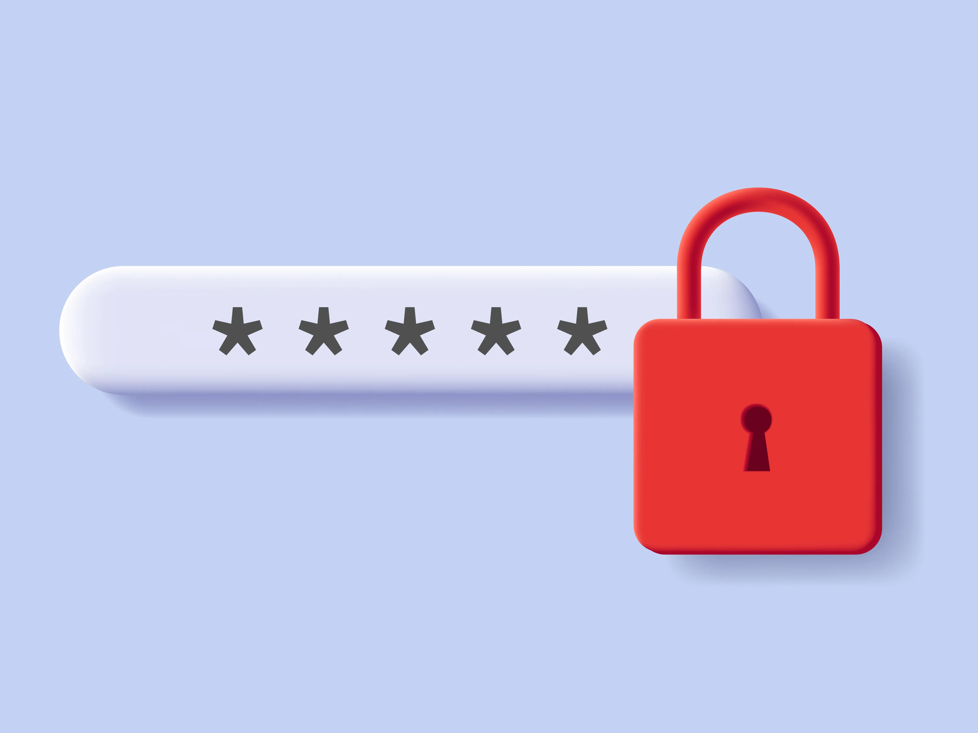
Password Cracking
Brute force
Dictionary attacks
Rainbow tables
Social engineering password attacks

Slide 4
Forces of nature and their threats
  Fire
  Flood
  Earthquake
  Lightning
  Landslides or mudslides
  Tornados or severe windstorms
  Tsunamis
  Electrostatic discharge (ESD)
  Dust contamination
  Solar activity

