Slide 1

Presentation
Recruitment and Selection for Director of Organisational Transformation – BBC
Student: Mr. Amir M Avesta
Student No: 2335138
Lecturer: Master. Toyin Adisa
Date: 14/11/2025
Module code: LCLM5002- UWTSD

Slide 2
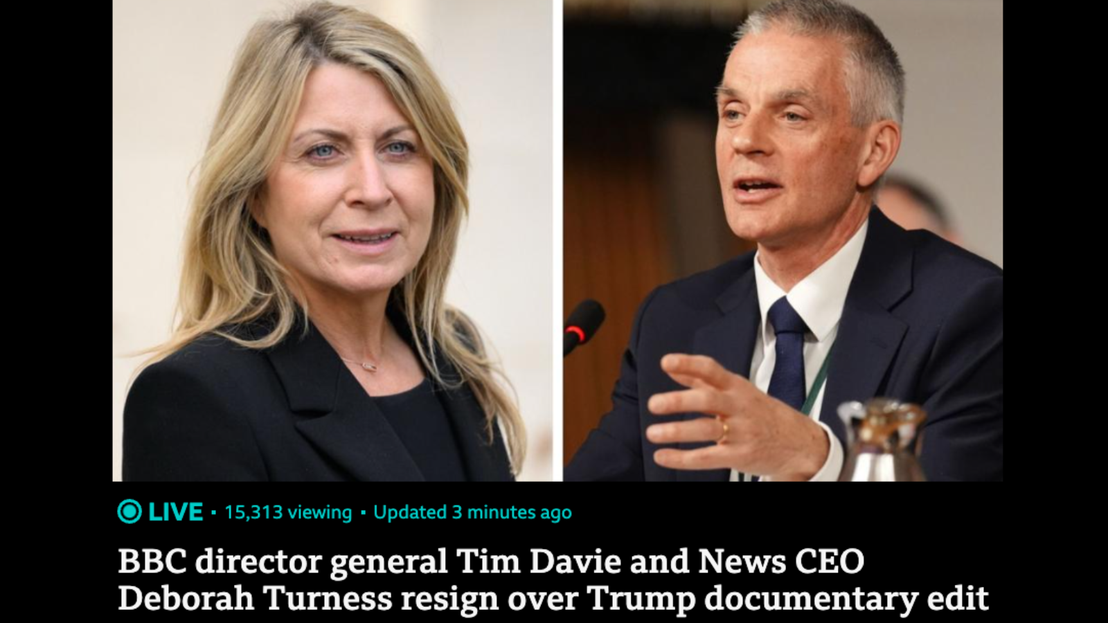
Agenda
The BBC should by leaving the former managers behind, effectively recruit the right persons for the Director of Organizational Transformation role — a position that requires not only strong management skills but also a deep belief in the organization's public values.

Slide 3

Table of Contents
Introduction
BBC Overview
Recruitment Process
Job Analysis, Description & Person Specification
Types of Interviews (3 slides)
Questioning Techniques
Face-to-Face vs Online Interview
Conclusion
References

Slide 4

Introduction
1- Simon Sinek:
“If you hire people who believe what you believe, they’ll work for you with blood, sweat, and tears.”
2- BBC faces leadership changes due to editorial crises.
3- Objective: to ensure that recruitment aligns with BBC’s values of trust, integrity, and public service.
4- The role: Director of Organizational Transformation.

Slide 5

BBC Overview
1- Founded in 1922, London-based global broadcaster.
2- Mission: “To inform, educate and entertain.”
3- Recent challenge: loss of public trust due to editorial issues.
4- BBC now aims to rebuild credibility through organizational transformation.

Slide 6
Recruitment Process
1- Job Analysis
2- Job Description
4- Attraction & Advertising
3- Person Specificatio
5- Shortlisting
6- Interviewing
7- Selection & Job Offer

Slide 7
Job Analysis, Description & Person Specification
Example (BBC Role) | Definition | Stage
Lead BBC’s internal restructuring & digital adaptation | Identifying key needs and outcomes | Job Analysis
Reporting to Director-General; managing transformation strategy | Main duties and reporting lines | Job Description
Leadership, communication, ethics, public service mindset | Qualifications, skills, values | Person Specification

Slide 8

Interview Type
1: Structured Interview

Slide 9

Interview Type
2: Competency-Based Interview
Uses the STAR model (Situation, Task, Action, Result).
Example Question: “Tell us about a situation where you had to rebuild team trust after a crisis?”
Focuses on past performance and specific skills.

Slide 10

Interview Type
3: Panel Interview
Conducted by multiple BBC executives (e.g., HR Director, Head of News, Director-General).
Reduces personal bias.
Allows evaluation from different professional perspectives.
Example Question:
“How would you ensure transparency and accountability across all editorial levels?”

Slide 11

Questioning Techniques
Example | Purpose | Technique
“Can you elaborate on how you managed stakeholder resistance?” | Gain deeper insights | Probing
“What motivates you to lead organizational change?” | Encourage discussion | Open-ended
“Why do you think transparency is critical for media leadership?” | Assess analytical thinking | Socratic
“So, you believe that communication drives trust — could you expand on that?” | Show understanding | Reflective

Slide 12

Face-to-Face vs Online Interview
Online | Face-to-Face | Criteria
Limited, camera-based | Strong non-verbal cues | Communication
Efficient, flexible | Expensive, time-consuming | Cost & Time
Global reach | Restricted to local candidates | Accessibility
Formal, sometimes distant | Personal, human connection | Experience

Slide 13
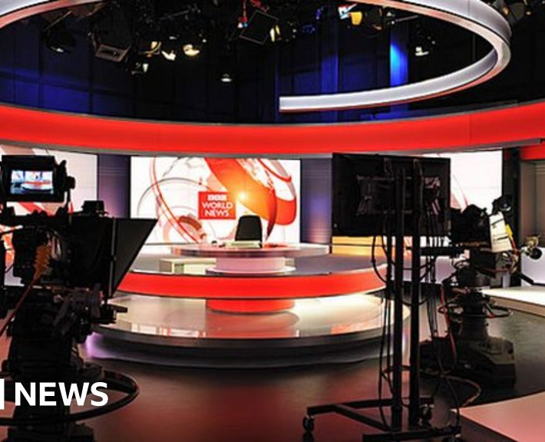
Conclusion
Effective recruitment ensures the right person joins at the right time.
The BBC must look beyond technical skills — values alignment is key.
Structured and competency-based interviews best identify candidates who believe in BBC’s mission.

Slide 14

References
Sinek, S. (2009) Start with Why: How Great Leaders Inspire Everyone to Take Action. Penguin.
Armstrong, M. (2023) Armstrong’s Handbook of Human Resource Management Practice. Kogan Page.
BBC (2025) About the BBC. [Online] Available at: https://www.bbc.co.uk/aboutthebbc
CIPD (2024) Recruitment Overview. [Online] Available at: https://www.cipd.org
Indeed (2024) Interview Techniques for Managers. [Online] Available at: https://www.indeed.com

