Slide 1




Cybersecurity Essentials
(ACCA4029)
Threats, Vulnerabilities, Attacks

Slide 2
From our previous class… (recap)
Welcoming to the cyber world…
Good Guys Vs Bad Guys...
Threats...
Mitigating Threats...
Nitheesh Murugan Kaliyamurthy | n.Kaliyamurthy@uwtsd.ac.uk

Slide 3
From our previous class… (recap)
The Cybersecurity Cube the three dimensions of the McCumber Cube.
CIA TRIAD confidentiality, integrity, and availability.
States of Data the three states of data.
Cybersecurity Countermeasures the types of cybersecurity countermeasures.
IT Security Management Framework the ISO Cybersecurity Model
Nitheesh Murugan Kaliyamurthy | n.Kaliyamurthy@uwtsd.ac.uk

Slide 4
Chat…
Write on the chatbox…
How many of you know about
#kevin mitnick
#have you watched takedown?
----
Nitheesh Murugan Kaliyamurthy | n.Kaliyamurthy@uwtsd.ac.uk

Slide 5
Objectives and Discussions
Malware and Malicious Code the types of malware & malicious code.
Deception the tactics, techniques and procedures used by cyber criminals.
Attacks the different methods used in social engineering and types of cyberattacks.
Nitheesh Murugan Kaliyamurthy | n.Kaliyamurthy@uwtsd.ac.uk

Slide 6
Objectives and Discussions
Threat, Vulnerabilities and Attack vector
Malwares
Methods
Attacks
Nitheesh Murugan Kaliyamurthy | n.Kaliyamurthy@uwtsd.ac.uk

Slide 7
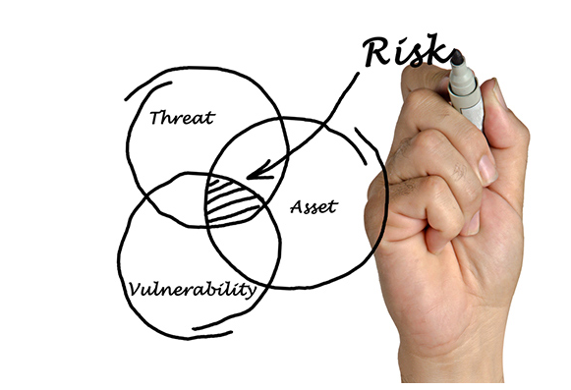
Threats, Vulnerability and Risks
A potential danger to an asset such as data or the network itself.
A weakness in a system or its design that could be exploited by a threat.
The likelihood that a particular threat will exploit a particular vulnerability of an asset and result in an undesirable consequence.
Nitheesh Murugan Kaliyamurthy | n.Kaliyamurthy@uwtsd.ac.uk

Slide 8
Threats, Vulnerability and Risks
Attack Surface
An attack surface is the total sum of the vulnerabilities in a given system that are accessible to an attacker.
The attack surface describes different points where an attacker could get into a system, and where they could get data out of the system.
Nitheesh Murugan Kaliyamurthy | n.Kaliyamurthy@uwtsd.ac.uk

Slide 9
Threats, Vulnerability and Risks
Exploit
The mechanism that is used to leverage a vulnerability to compromise an asset.
Exploits may be remote or local.
A remote exploit is one that works over the network without any prior access to the target system.
In a local exploit, the threat actor has some type of user or administrative access to the end system.
It does not necessarily mean that the attacker has physical access to the end system.
Nitheesh Murugan Kaliyamurthy | n.Kaliyamurthy@uwtsd.ac.uk

Slide 10
Malwares
Malware is a code or software designed to damage, disrupt, steal, or inflict some other ‘bad’ or illegitimate action on data, hosts, or networks.
The three most common types of malware are Virus, Worm, and Trojan horse.
Notes:
12 – Network Security Infrastructure
12.1 – Network Topologies
12.1.7 – Common Security Architectures

Slide 11
Malwares: Virus
A virus is a type of malware that spreads by inserting a copy of itself into another program.
After the program is run, viruses spread from one computer to another, thus infecting the computers.
Most viruses spread by USB memory drives, CDs, DVDs, network shares, and email. Email viruses are a common type of virus.
Notes:
12 – Network Security Infrastructure
12.1 – Network Topologies
12.1.7 – Common Security Architectures

Slide 12
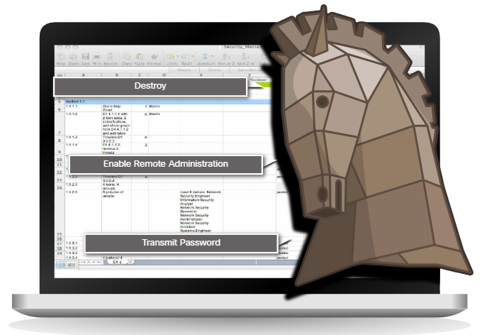
Malwares: Trojans
Trojan horse malware is a software that appears to be legitimate, but it contains malicious code which exploits the privileges of the user that runs it.
Trojans are found attached to online games.
Users are commonly tricked into loading and executing the Trojan horse on their systems
The Trojan horse concept is flexible.
It can cause immediate damage, provide remote access to the system, or access through a back door.
Custom-written Trojan horses with a specific target are difficult to detect.
Notes:
12 – Network Security Infrastructure
12.1 – Network Topologies
12.1.7 – Common Security Architectures

Slide 13
Malwares: Trojans
Type of Trojan Horse | Description
Remote-access | Enables unauthorized remote access.
Data-sending | Provides the threat actor with sensitive data, such as passwords.
Destructive | Corrupts or deletes files.
Proxy | Uses the victim's computer as the source device to launch attacks and perform other illegal activities.
FTP | Enables unauthorized file transfer services on end devices.
Security software disabler | Stops antivirus programs or firewalls from functioning.
Denial of Service (DoS) | Slows or halts network activity.
Keylogger | Actively attempts to steal confidential information, such as credit card numbers, by recording keystrokes entered into a web form.
Notes:
12 – Network Security Infrastructure
12.1 – Network Topologies
12.1.7 – Common Security Architectures

Slide 14
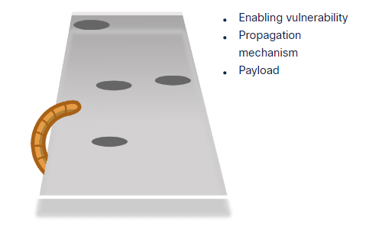
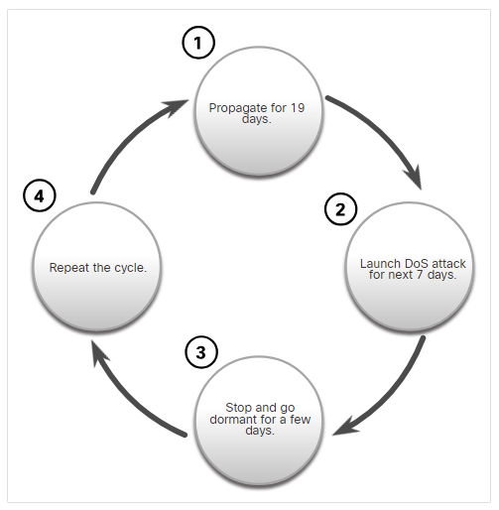
Malwares: Worms
Enabling vulnerability - A worm installs itself using an exploit mechanism, such as an email attachment, an executable file, or a Trojan horse, on a vulnerable system.
Propagation mechanism - After gaining access to a device, the worm replicates itself and locates new targets.
Payload - Any malicious code that results in some action is a payload. Most often this is used to create a backdoor that allows a threat actor to access the infected host or to create a DoS attack.
Notes:
12 – Network Security Infrastructure
12.1 – Network Topologies
12.1.7 – Common Security Architectures

Slide 15
Malwares: Ransomware
Ransomware is a malware that denies access to the infected computer system or its data.
Ransomware frequently uses an encryption algorithm to encrypt system files and data.
Email and malicious advertising, also known as malvertising, are vectors for ransomware campaigns.
Social engineering is also used, when cybercriminals pretending to be security technicians make random calls at homes and persuade users to connect to a website that downloads ransomware to the user’s computer.
Notes:
12 – Network Security Infrastructure
12.1 – Network Topologies
12.1.7 – Common Security Architectures

Slide 16
Malwares
Type of Malware | Description
Scareware | Includes scam software which uses social engineering to shock or induce anxiety by creating the perception of a threat. It is generally directed at an unsuspecting user and attempts to persuade the user to infect a computer by taking action to address the bogus threat.
Phishing | Attempts to convince people to divulge sensitive information. Examples include receiving an email from their bank asking users to divulge their account and PIN numbers.
Backdoors and Rootkits | Installed on a compromised system. After it is installed, it continues to hide its intrusion and provide privileged access to the threat actor.
Spam and Spyware | Used to gather information about a user and send the information to another entity without the user’s consent. Spyware can be a system monitor, Trojan horse, Adware, tracking cookies, and key loggers.
Adware | Displays annoying pop-ups to generate revenue for its author. The malware may analyze user interests by tracking the websites visited. It can then send pop-up advertising pertinent to those sites.
Notes:
12 – Network Security Infrastructure
12.1 – Network Topologies
12.1.7 – Common Security Architectures

Slide 17
Malwares
Type of Malware | Description
Vishing | Vishing is phishing using voice communication technology. Criminals can spoof calls from legitimate sources using voice over IP (VoIP) technology. Victims may also receive a recorded message that appears legitimate.
Pharming | Pharming is the impersonation of a legitimate website in an effort to deceive users into entering their credentials
Whaling | Whaling is a phishing attack that targets high profile targets within an organization such as senior executives.
Plugins | The Flash and Shockwave plugins from Adobe enable the development of interesting graphic and cartoon animations that greatly enhance the look and feel of a web page. Plugins display the content developed using the appropriate software.
SEO poisoning | SEO, short for Search Engine Optimization, is a set of techniques used to improve a website’s ranking by a search engine. While many legitimate companies specialize in optimizing websites to better position them, SEO poisoning uses SEO to make a malicious website appear higher in search results.
Browser hijacker | A browser hijacker is malware that alters a computer's browser settings to redirect the user to websites paid for by the cyber criminals' customers. Browser hijackers usually install without the user's permission and is usually part of a drive-by download.
Notes:
12 – Network Security Infrastructure
12.1 – Network Topologies
12.1.7 – Common Security Architectures

Slide 18
Malwares: What happens?
Computers infected with malware often exhibit one or more of the following symptoms:
  Appearance of strange files, programs, or desktop icons
  Antivirus and firewall programs are turning off or reconfiguring settings
  Computer screen is freezing or system is crashing
  Emails are spontaneously being sent without your knowledge to your contact list
  Files have been modified or deleted
  Increased CPU and/or memory usage
  Problems connecting to networks
  Slow computer or web browser speeds
  Unknown processes or services running
  Unknown TCP or UDP ports open
  Connections are made to hosts on the Internet without user action
  Strange computer behavior
Note: Malware behavior is not limited to the above list.
Notes:
12 – Network Security Infrastructure
12.1 – Network Topologies
12.1.7 – Common Security Architectures

Slide 19
Deception “the misleading factor”
Social Engineering
Social engineering is a completely non-technical means for a criminal to gather information on a target. Social engineering is an attack that attempts to manipulate individuals into performing actions or divulging confidential information.
Social engineers often rely on people’s willingness to be helpful but also prey on people’s weaknesses. These are some types of social engineering attacks
Nitheesh Murugan Kaliyamurthy | n.Kaliyamurthy@uwtsd.ac.uk

Slide 20
Deception “the misleading factor”
Pretexting
This is when an attacker calls an individual and lies to them in an attempt to gain access to privileged data. An example involves an attacker who pretends to need personal or financial data in order to confirm the identity of the recipient.
Something for Something (Quid pro quo)
This is when an attacker requests personal information from a party in exchange for something, like a gift.
Nitheesh Murugan Kaliyamurthy | n.Kaliyamurthy@uwtsd.ac.uk

Slide 21
Deception “the misleading factor”
Shoulder Surfing and Dumpster Diving
refers to picking up PINs, access codes or credit card numbers. An attacker can be in close proximity to his victim or the attacker can use binoculars or closed circuit cameras to shoulder surf.
Impersonation and Hoaxes
Impersonation is the action of pretending to be someone else. For example, a recent phone scam targeted taxpayers. A criminal, posing as an IRS employee, told the victims that they owed money to the IRS.
Nitheesh Murugan Kaliyamurthy | n.Kaliyamurthy@uwtsd.ac.uk

Slide 22
Deception “the misleading factor”
Piggybacking and Tailgating
Piggybacking occurs when a criminal tags along with an authorized person to gain entry into a secure location or a restricted area. Tailgating is another term that describes the same practice.
Online, Email, and Web-based Trickery
Forwarding hoax emails and other jokes, funny movies, and non-work-related emails at work may violate the company's acceptable use policy and result in disciplinary actions.
Nitheesh Murugan Kaliyamurthy | n.Kaliyamurthy@uwtsd.ac.uk

Slide 23
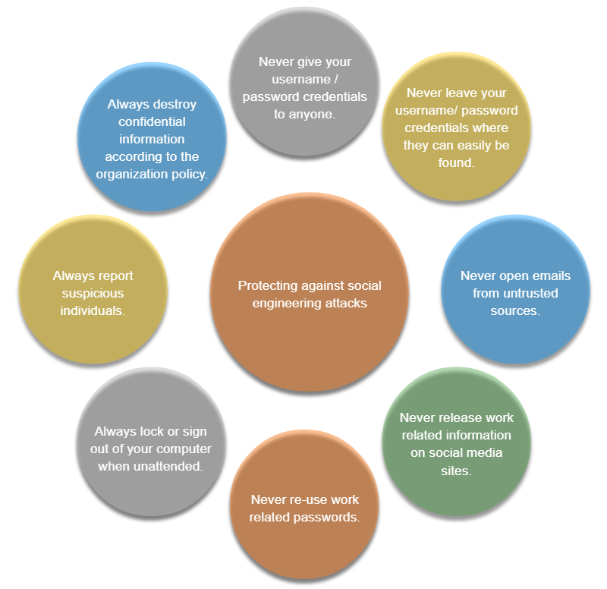
Deception “the misleading factor”
Nitheesh Murugan Kaliyamurthy | n.Kaliyamurthy@uwtsd.ac.uk

Slide 24
Attacks
Denial-of-Service (DoS) Attacks
A DoS attack results in some sort of interruption of network services to users, devices, or applications. DoS attacks are a major risk because they can easily interrupt communication and cause significant loss of time and money. These attacks are relatively simple to conduct, even by an unskilled attacker.
Sniffing
Sniffing is similar to eavesdropping on someone. It occurs when attackers examine all network traffic as it passes through their NIC, independent of whether or not the traffic is addressed to them or not. Criminals accomplish network sniffing with a software application, hardware device, or a combination of the two.
Nitheesh Murugan Kaliyamurthy | n.Kaliyamurthy@uwtsd.ac.uk

Slide 25
Attacks
Spoofing
Spoofing is an impersonation attack, and it takes advantage of a trusted relationship between two systems. If two systems accept the authentication accomplished by each other, an individual logged onto one system might not go through an authentication process again to access the other system.
Man-in-the-middle
A criminal performs a man-in-the-middle (MitM) attack by intercepting communications between computers to steal information crossing the network. The criminal can also choose to manipulate messages and relay false information between hosts since the hosts are unaware that a modification to the messages occurred. MitM allows the criminal to take control over a device without the user’s knowledge.
Nitheesh Murugan Kaliyamurthy | n.Kaliyamurthy@uwtsd.ac.uk

Slide 26
Attacks
Zero-Day Attacks
A zero-day attack, sometimes referred to as a zero-day threat, is a computer attack that tries to exploit software vulnerabilities that are unknown or undisclosed by the software vendor. The term zero hour describes the moment when someone discovers the exploit.
Keyboard Logging
Keyboard logging is a software program that records or logs the keystrokes of the user of the system. Criminals can implement keystroke loggers through software installed on a computer system or through hardware physically attached to a computer. The criminal configures the key logger software to email the log file. The keystrokes captured in the log file can reveal usernames, passwords, websites visited, and other sensitive information.
Nitheesh Murugan Kaliyamurthy | n.Kaliyamurthy@uwtsd.ac.uk

Slide 27
Attacks
Component | Description
zombies | A group of compromised hosts. These hosts run malicious code.
bots | Bots are malware that is designed to infect a host and communicate with a handler system.
botnet | A group of zombies that have been infected using self-propagating malware and are controlled by handlers.
handlers | A master command-and-control (CnC or C2) server controlling groups of zombies.
botmaster | Enables unauthorized file transfer services on end devices.
Nitheesh Murugan Kaliyamurthy | n.Kaliyamurthy@uwtsd.ac.uk

Slide 28
Attacks (Mobile)
Grayware includes applications that behave in an annoying or undesirable manner. Grayware may not have recognizable malware concealed within, but it still may pose a risk to the user. Grayware is becoming a problem area in mobile security with the popularity of smartphones.
SMiShing is short for SMS phishing. It uses Short Message Service (SMS) to send fake text messages. The criminals trick the user into visiting a website or calling a phone number. Unsuspecting victims may then provide sensitive information such as credit card information. Visiting a website might result in the user unknowingly downloading malware that infects the device.
Nitheesh Murugan Kaliyamurthy | n.Kaliyamurthy@uwtsd.ac.uk

Slide 29
Attacks (Mobile)
Rogue Access Points
A rogue access point is a wireless access point installed on a secure network without explicit authorization. A rogue access point can be set up in two ways.
RF Jamming
Wireless signals are susceptible to electromagnetic interference (EMI), radio-frequency interference (RFI), and may even be susceptible to lightning strikes or noise from fluorescent lights. Wireless signals are also susceptible to deliberate jamming. Radio frequency (RF) jamming disrupts the transmission of a radio or satellite station so that the signal does not reach the receiving station.
Nitheesh Murugan Kaliyamurthy | n.Kaliyamurthy@uwtsd.ac.uk

Slide 30
Attacks (Mobile)
Bluejacking and Bluesnarfing
Bluejacking is the term used for sending unauthorized messages to another Bluetooth device. Bluesnarfing occurs when the attacker copies the victim's information from his device. This information can include emails and contact lists.
Nitheesh Murugan Kaliyamurthy | n.Kaliyamurthy@uwtsd.ac.uk

Slide 31
Attacks (Mobile)
Wired Equivalent Privacy (WEP) is a security protocol that attempted to provide a wireless local area network (WLAN) with the same level of security as a wired LAN. Since physical security measures help to protect a wired LAN, WEP seeks to provide similar protection for data transmitted over the WLAN with encryption.
WEP uses a key for encryption.
There is no provision for key management with WEP, so the number of people sharing the key will continually grow.
Nitheesh Murugan Kaliyamurthy | n.Kaliyamurthy@uwtsd.ac.uk

Slide 32
Attacks (Mobile)
Wi-Fi Protected Access (WPA) and then WPA2 came out as improved protocols to replace WEP. WPA2 does not have the same encryption problems because an attacker cannot recover the key by observing traffic.
WPA2 is susceptible to attack because cyber criminals can analyze the packets going between the access point and a legitimate user.
Cyber criminals use a packet sniffer and then run attacks offline on the passphrase.
Nitheesh Murugan Kaliyamurthy | n.Kaliyamurthy@uwtsd.ac.uk

Slide 33
Attacks (Application)
Cross-site scripting (XSS) - is a vulnerability found in web applications. XSS allows criminals to inject scripts into the web pages viewed by users. This script can contain malicious code. Cross-site scripting has three participants: the criminal, the victim, and the website. The cyber-criminal does not target a victim directly. The criminal exploits vulnerability within a website or web application. Criminals inject client-side scripts into web pages viewed by users, the victims.
Nitheesh Murugan Kaliyamurthy | n.Kaliyamurthy@uwtsd.ac.uk

Slide 34
Attacks (Application)
Code Injections Attacks - One way to store data at a website is to use a database. There are several different types of databases such as a Structured Query Language (SQL) database or an Extensible Markup Language (XML) database. Both XML and SQL injection attacks exploit weaknesses in the program such as not validating database queries properly.
Buffer Overflow - A buffer overflow occurs when data goes beyond the limits of a buffer. Buffers are memory areas allocated to an application. By changing data beyond the boundaries of a buffer, the application accesses memory allocated to other processes. This can lead to a system crash, data compromise, or provide escalation of privileges.
Nitheesh Murugan Kaliyamurthy | n.Kaliyamurthy@uwtsd.ac.uk

Slide 35
Defend yourselves!!!
Defending Against Wireless and Mobile Device Attacks
Most WLAN products use default settings
Restrict access point placement
WLAN tools such as NetStumbler may discover rogue access points or unauthorized workstations. Develop a guest policy to address the need when legitimate guests need to connect to the Internet while visiting.
Nitheesh Murugan Kaliyamurthy | n.Kaliyamurthy@uwtsd.ac.uk

Slide 36
Defend yourselves!!!
Defending Against Application Attacks
write solid code.
Regardless of the language used, or the source of outside input, prudent programming practice is to treat all input from outside a function as hostile.
Validate all inputs as if they were hostile.
Keep all software including operating systems and applications up to date, and do not ignore update prompts.
Not all programs update automatically, so at the very least, always select the manual update option.
Nitheesh Murugan Kaliyamurthy | n.Kaliyamurthy@uwtsd.ac.uk

Slide 37


Contents/ References/ Images used in this Presentation:
Contents & Selective Images : Cisco Networking Academy Course – Network Essentials | Selective images from Bing Internet Search |

Slide 38
Further References:
http://www.whoishostingthis.com/blog/2015/06/01/8-worst-viruses/
http://www.howtogeek.com/228828/7-ways-to-secure-your-web-browser-against-attacks/
https://www.consumer.ftc.gov/scam-alerts
https://www.consumer.ftc.gov/articles/0038-spam
http://www.exterminate-it.com/malpedia/ransomware-category
http://www.informit.com/articles/article.aspx?p=1350956

