Slide 1

Charley Stephens (2306714)
Demonstrate how learning theories can support effective teaching and learning.

Slide 2
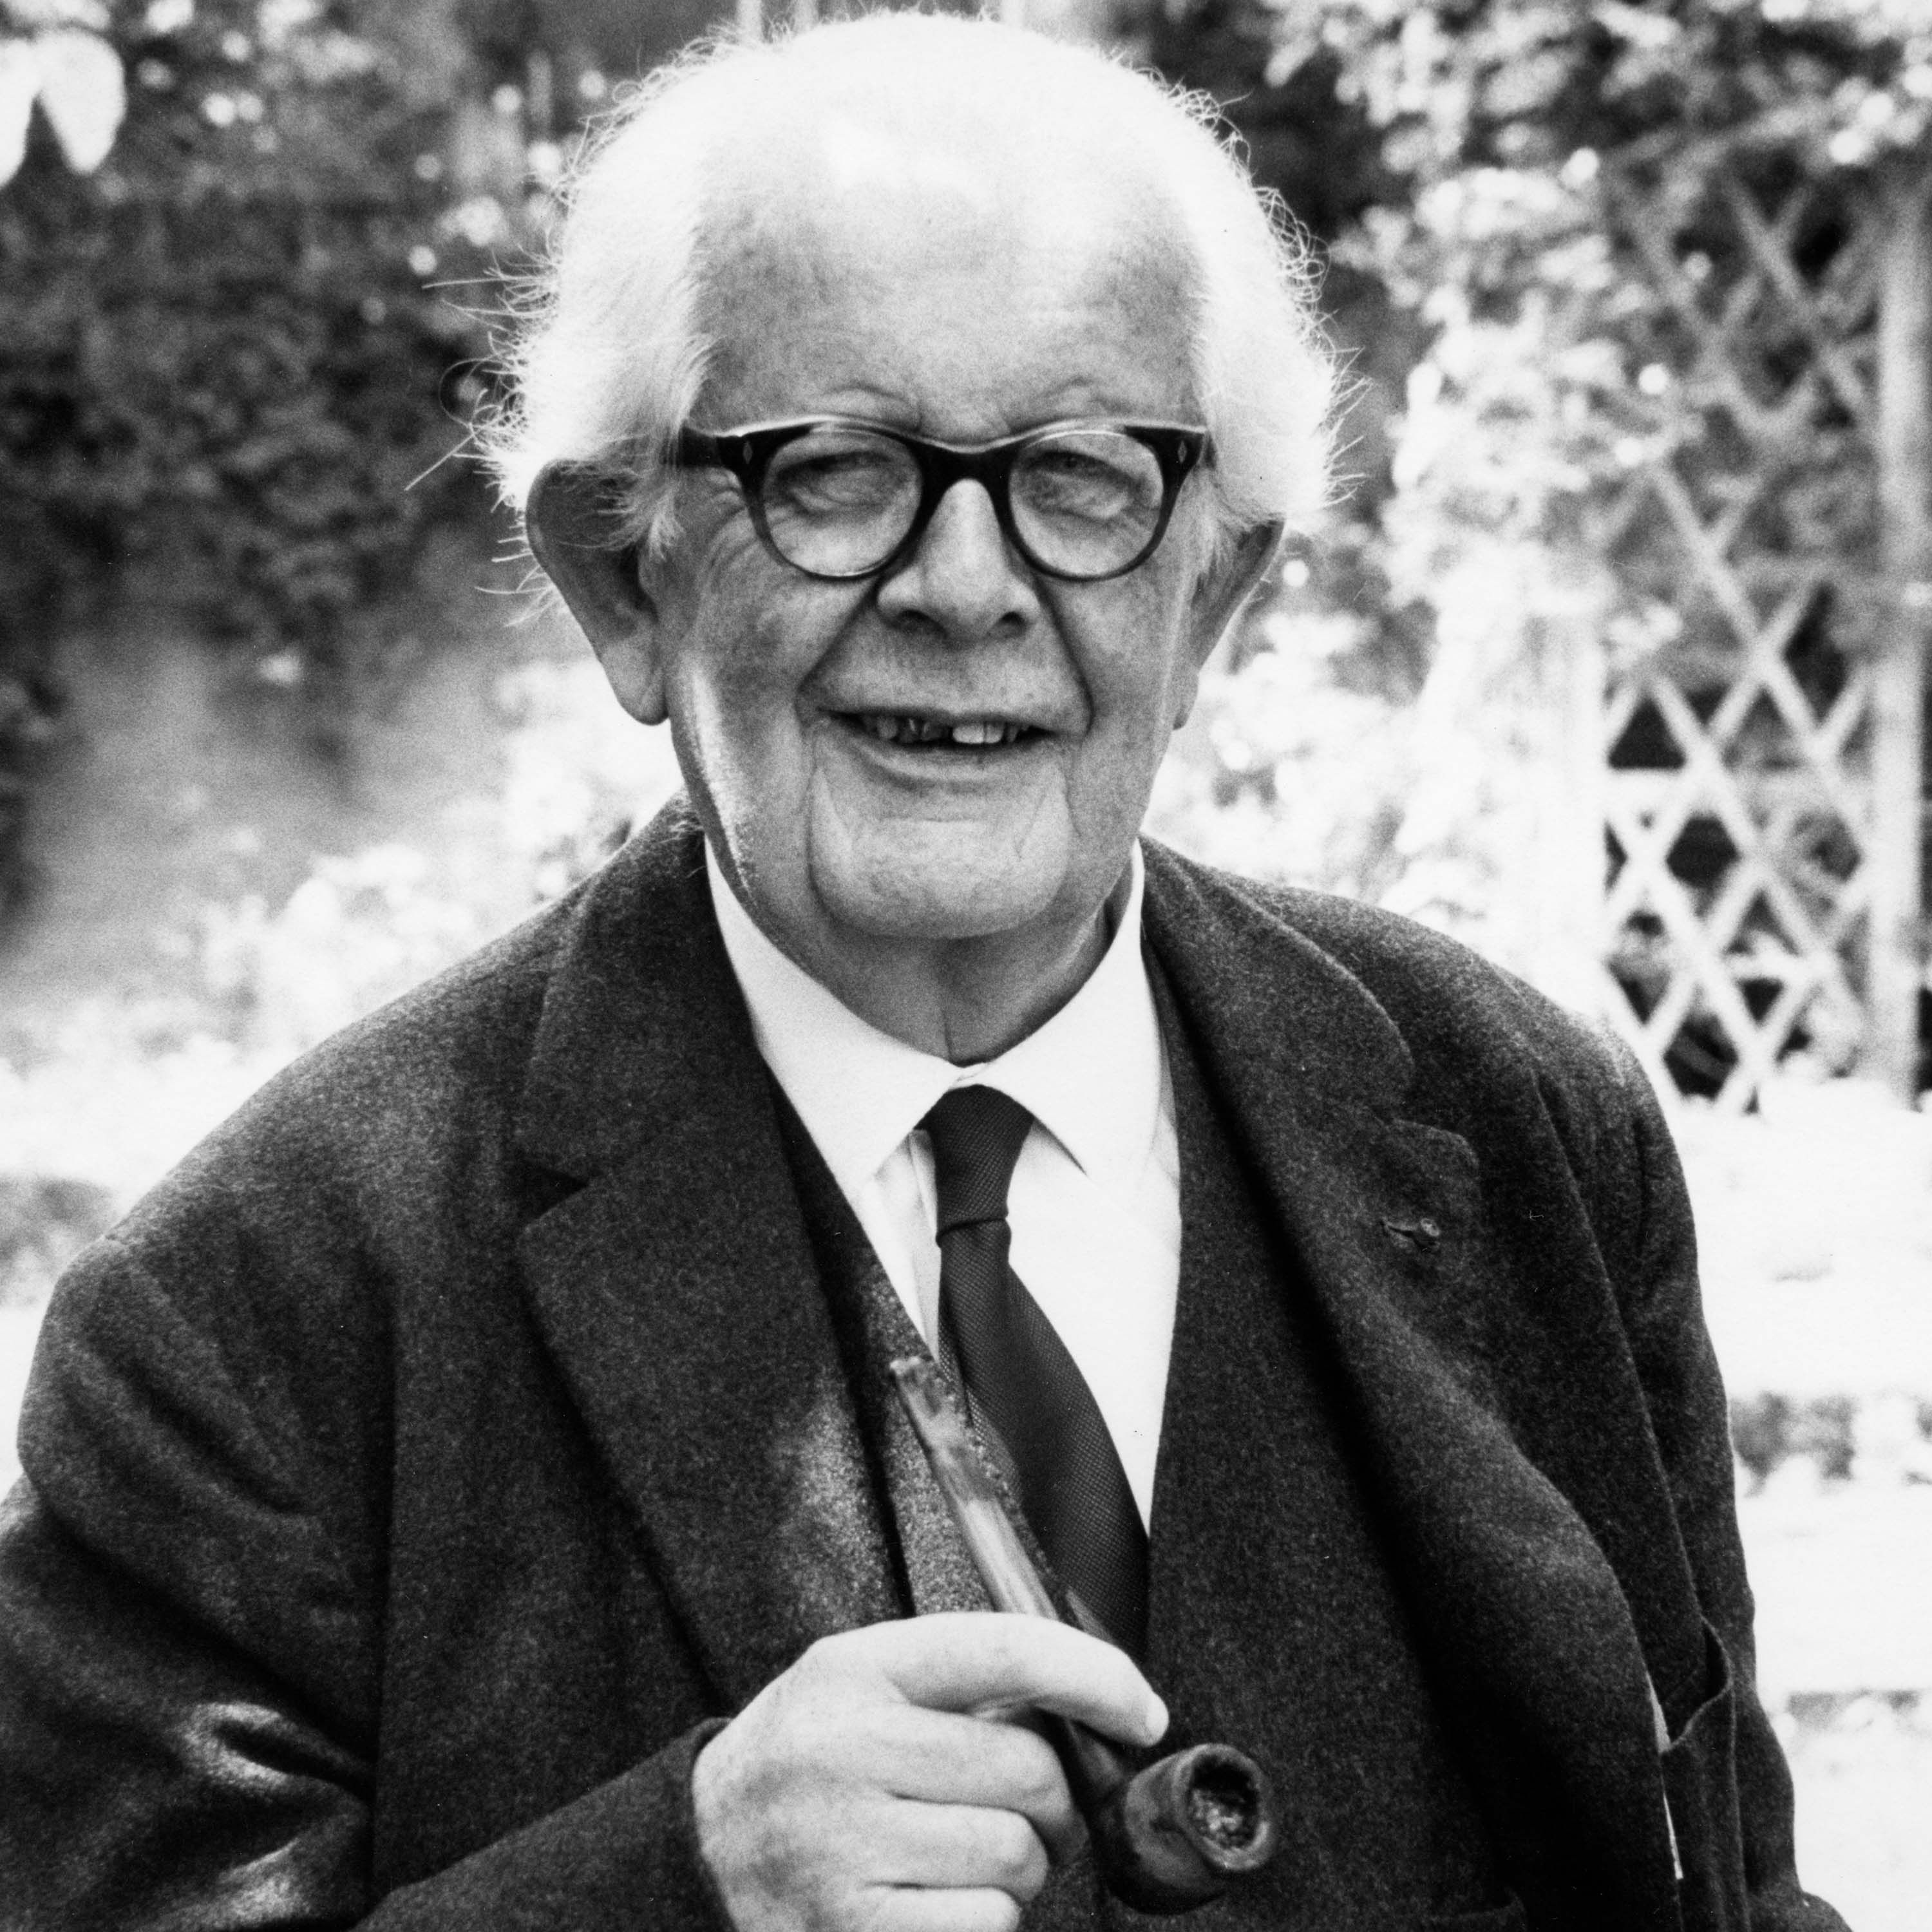
Jean Piaget
Swiss scientist and genetic epistemologist
Born 1896 in Switzerland
Major educational psychology
Alfred Binet Laboratory School
Work past 30 years
One of the first to study
In 1955, Piaget established the International Centre for Genetic Epistemology. He died in 1980 and was buried in Geneva. (Mooney, 2013)

Slide 3
What is Jean Piaget?
A 2002 American Psychological Society poll of 1,725 people Member, Some people rank Piaget as the second-most important psychologist of the twentieth century. Additionally, Piaget is known for possessing invented Constructivist theory, which argues that children actively expand their knowledge of the world by combining their ideas and experiences. (Cherry, 2022)
Piaget persisted in his studies of the natural sciences, earning his doctorate in 1918 graduated in zoology from the University of Neuchâtel. Piaget's observations of his own children served as the basis for many of his subsequent theories. (Cherry, 2022)
He worked in the scientific sciences for the majority of his early career, but in the 1920s he began to concentrate more on his goal of becoming a psychologist.(Cherry, 2022)
The interplay of intrinsic factors (nature) and external factors (nurture) leads to cognitive development.

Slide 4
Influence on education
Piaget's theories still have an effect on instruction. He endorsed the subsequent concepts, which are still widely utilised in educational settings:
Learning through discovery: this approach highlights the notion that kids ought to be allowed the liberty to investigate and find out new things on their own. Courses in dance, music, and art should also be offered in a learning atmosphere.(Cherry, 2022)
Problem-solving: According to Piaget, teachers should observe how students arrive at the right solution while also guiding them through problem-solving exercises. (Cherry, 2022)
Stage-based education: According to Piaget, it's critical that the learning environment corresponds with the stage of cognitive development that each kid is in, as each child develops cognitively at a distinct rate and moves through the stages at their own pace. (Cherry, 2022)

Slide 5
According to Piaget's thesis, children actively participate in their own cognitive development.
Piaget has some of the credit for the 1960s change as well as for the comparatively enjoyable and cost-free school days.(McLeod, 2022)
Piaget observed the development by using his own three children as a starting point but much of his observation work was not scientific research. (Mooney, 2013)
Piaget believed that children intellectual is based partly on physical development (Mooney, 2013)

Slide 6
Piaget’s stages of development
Sensorimotor stage: A person goes through their first stage of development from birth to about age two. During this developmental stage, children primarily learn about the world through their senses and their movements. (Cherry, 2022)
Preoperational stage: The emergence of symbolic play and the growth of language characterise the second developmental stage, which spans the ages of two to seven. (Cherry, 2022)
Stage of concrete operation: from age 7 to age 11, there is a third stage of cognitive development. Children start to reason rationally at this age, but they still struggle with abstract and theoretical ideas. (Cherry, 2022)
Formal operational stage: From twelve years of age to adulthood, children go through the fourth and final stage of cognitive development, they greatly enhance their capacity for deductive and abstract thought at this time.. (Cherry, 2022)

Slide 7
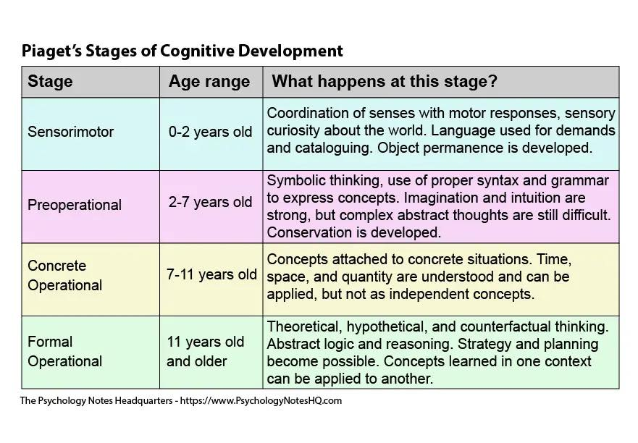
By the end of sensorimotor object permanence occurs
Preoperational- children are eco centric
Concrete operational- think logically about objects and events
Formal operational- child’s ability to think abstractly.
(McLeod, 2022)

Slide 8

Piaget says that children learn through play this is because children need learning environment, curriculum and lessons which provide opportunities for hand on experiences.

Slide 9
Planning learning experiences
In line with Piaget's theory a curriculum that aids kids in gaining concepts and logical progressions is essential to support their cognitive development. Piaget makes the argument that specific knowledge can only be learned by children at different stages in the development of cognition. Piaget believed that when pupils actively interact with the content they are being taught, learning takes place. Because of this, educators need to make sure that pupils engage fully in the lessons they are learning and fully understand.

Slide 10
when working in the early years setting children would have a lollipop stick with their face on and every morning when they came in the would express how they were feeling and were given the opportunity to explain why they felt happy, excited or sad.

Slide 11
References
Gallo, A. (2021). What are the stages of play? Jean Piaget’s Theory of Play! [online] Play. Learn. Thrive. Available at: https://playlearnthrive.com/stages-of-play-jean-piagets-theory/.
Cherry, K. (2022). Jean Piaget Biography (1896-1980). [online] Verywell Mind. Available at: https://www.verywellmind.com/jean-piaget-biography-1896-1980-2795549.
McLeod, S. (2022). Jean Piaget’s theory of cognitive development: 4 stages. [online] Simplypsychology. Available at: https://www.simplypsychology.org/piaget.html#Applications-to-Education [Accessed 24 Jan. 2024].
Mooney, C.G. (2013). Theories of Childhood : An Introduction to Dewey, Montessori, Erikson, Piaget, and Vygotsky. 2nd ed. St. Paul, MN: Redleaf Press. P.62.

