Slide 1

COMPONENT 2: POSTER ASSESSMENT
NHS Health Check Plus App: Improving Uptake and Reducing Digital Health Inequality Among Men Aged 40–74 in Deprived Urban Areas of North East England
Module: LCHS7009 – Population Health and Digital Health Promotion | Contribution: 25%
STUDENT DETAILS
Student Name: Muhammed Atif Sajid Banglawala
Student ID Number: 2514910
Programme: MSc Public Health and Social Care in Practice
Module Code & Title: LCHS7009 – Population Health and Digital Health Promotion
Lecturer: Dr Raheela Shaikh
Assignment Title: Component 2 – Poster
Submission Date: 3rd July
Notes:
1

Slide 2
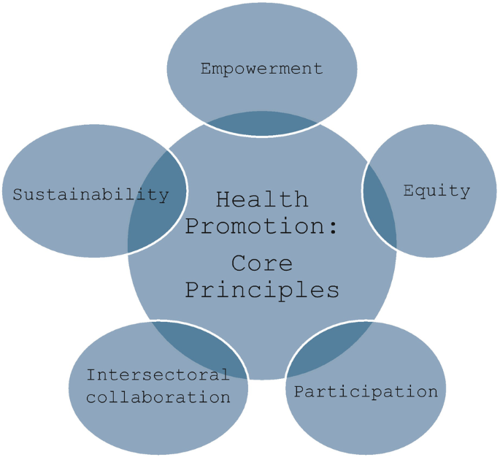
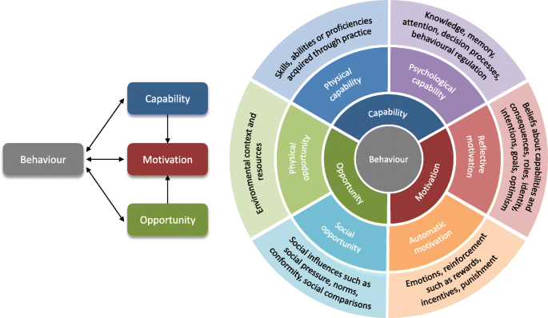


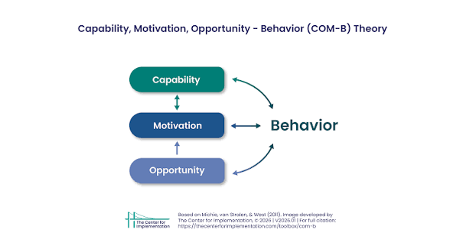

BACKGROUND
HEALTH PROMOTION VALUES AND PRINCIPLES
EXPECTED OUTCOMES
Cardiovascular disease (CVD) continues to be one of the major causes of early mortality and health disparities in England. In the North East region, CVD is responsible for contributing considerably to the gap in life expectancy in the most and least deprived communities (North East and North Cumbria Integrated Care Board, 2025). The uptake of the NHS Health Check service on a national scale continues to be inadequate at 45-52% of eligible individuals, with men and residents from deprived areas showing significantly lower participation rates (Department of Health and Social Care, 2021; Eberhardt et al., 2025).
Prior intervention strategies have used invitation letters, GP reminder systems, and community-based methods, but their effectiveness in terms of reaching underserved individuals has been limited (Eberhardt et al., 2025). The digital health check service has proven more effective with an uptake rate of 21% compared to the traditional 11%, while completing physical measurements and issues of digital exclusion persisted (Salway et al., 2024).
The NHS Health Check Plus App is an intervention tool that uses relevant theories to improve the uptake and follow-up of the NHS Health Check services among males aged 40-74 living in deprived urban communities in North East England. This app provides risk evaluation, personalized support, appointment scheduling, and low literacy features (voice navigation, big text, etc.) to tackle digital inequalities.
Health promotion is based on values such as equity, empowerment, participation, and social justice (World Health Organization, 2020). Principles of the Ottawa Charter are focused on creating supportive environment, enhancing community actions, and fostering development of personal skills.
The proposed intervention (NHS Health Check Plus App) corresponds to the principles of health promotion perfectly since it focuses on equity due to its targeted nature, empowering patients due to health data ownership and personalized action plans, and promoting patient participation because of feedback mechanism and community services integration. Being aimed at reducing digital health divide, the intervention does not promote but prevents health disparities by taking into account low digital literacy among the target audience (Western et al., 2025; Badr et al., 2024; Health Equity Evidence Centre, 2024).
The use of the COM-B model is likely to result in considerably higher uptake and follow-up than conventional approaches. There is evidence that suggests that digital interventions may yield increased initial uptake (Salway et al., 2024). Using the framework of COM-B, the app will be able to improve the rates of completion of NHS Health Checks among the target population by 15-25 percentage points.
However, the success of the project will hinge upon effective community involvement in its co-design as well as continuous assistance with the development of digital literacy skills among individuals. In the absence of this, there is a threat of widening the existing gap in digital exclusion (Zhang et al., 2023; Western et al., 2025). An equity-focused implementation of the intervention has high potential to decrease CVD-related health inequalities in North East England.
BEHAVIOURAL CHANGE THEORY: COM-B MODEL
The COM-B Model (Capability, Opportunity, Motivation - Behaviour) is a comprehensive framework that has the potential to develop efficient digital health solutions (Koulouvari et al., 2025).
Capability is improved through the easy-to-use interface, clear language, assistance with voice navigation and instructions in steps that specifically deal with the issue of poor digital literacy. Opportunity is increased through constant accessibility from mobile devices 24/7, automated reminders, and linking with the local NHS services, bypassing conventional obstacles, such as inconvenient visits and travelling. Motivation can be increased through personalised risk assessment, goals setting, tracking progress, and culturally appropriate materials for men living in deprived areas.
COM-B Model has been used successfully in digital health promotion interventions (Koulouvari et al., 2025). Through the deliberate impact on all three elements, NHS Health Check Plus App goes further than simply providing information.
CONCLUSION
NHS Health Check Plus App provides an innovative, evidence-based solution that addresses low uptake of health check-ups among populations with limited access to them while addressing digital exclusion. As far as policy is concerned, the intervention aligns with the national agenda for digitalizing NHS Health Check program and the emphasis on prevention in the NHS Long Term Plan. In terms of education, this intervention draws attention to the necessity of providing comprehensive education about digital literacy and health literacy in impoverished communities. More research is needed to evaluate the sustainability of behavior change, cost-effectiveness, and generalizability of the intervention. Interventions like this one are an essential step towards equitable public health in the digital era.
Notes:
2

Slide 3
REFERENCES
Badr, J., Motulsky, A. and Denis, J.L. (2024) 'Digital health technologies and inequalities: A scoping review of potential impacts and policy recommendations', Health Policy, 146, 105122. doi:10.1016/j.healthpol.2024.105122. Available at: https://www.sciencedirect.com/science/article/pii/S0168851024001325 (Accessed: 27 June 2026).
Department of Health and Social Care (2021) Preventing illness and improving health for all: a review of the NHS Health Check programme and recommendations. London: Department of Health and Social Care. Available at: https://www.gov.uk/government/publications/nhs-health-check-programme-review/preventing-illness-and-improving-health-for-all-a-review-of-the-nhs-health-check-programme-and-recommendations (Accessed: 27 June 2026).
Eberhardt, J., Kane, L., Portman, R., Ling, J., Goddard, T., Johnston, M., Robinson, C., Reay, A., Divers, A. and Newbury-Birch, D. (2025) 'Barriers and Facilitators of NHS Health Checks in Socioeconomically Deprived Communities in the North East of England: A Qualitative Study With Peer Researchers', Health Expectations. doi:10.1111/hex.70199. Available at: https://onlinelibrary.wiley.com/doi/pdf/10.1111/hex.70199 (Accessed: 27 June 2026).
Gidlow, C.J., Sams, L., Riley, V., Ellis, N.J., Povey, R., Nolan, A., Walsh, G., Green, H. and Thompson, K. (2025) 'Feasibility study of a digital NHS Health Check', BMC Digital Health, 3, 34. doi:10.1186/s44247-025-00161-9. Available at: https://link.springer.com/content/pdf/10.1186/s44247-025-00161-9.pdf (Accessed: 27 June 2026).
Health Equity Evidence Centre (2024) What works to improve health and digital literacy in disadvantaged groups. Available at: https://www.heec.co.uk/resource/what-works-to-improve-health-and-digital-literacy-in-disadvantaged-groups/ (Accessed: 27 June 2026).
Koulouvari, A.-D., Margariti, A., Sakellari, E., Barbouni, A. and Lagiou, A. (2025) 'Applications of Behavioral Change Theories and Models in Health Promotion Interventions: A Rapid Review', Behavioral Sciences, 15(5), 580. doi:10.3390/bs15050580. Available at: https://www.mdpi.com/2076-328X/15/5/580 (Accessed: 27 June 2026).
Koulouvari, A.-D., Margariti, A., Sakellari, E., Barbouni, A. and Lagiou, A. (2025) 'Applications of Behavioral Change Theories and Models in Health Promotion Interventions: A Rapid Review', Behavioral Sciences, 15(5), 580. doi:10.3390/bs15050580. Available at: https://doi.org/10.3390/bs15050580 (Accessed: 27 June 2026).
Liaqat, M., Mushtaq, M., Jamil, A., Mushtaq, M.M., Ali, H., Anwar, R. and Bakht, D. (2024) 'Mobile Health Interventions: A Frontier for Mitigating the Global Burden of Cardiovascular Disease', Cureus, 16(6), e62157. doi:10.7759/cureus.62157. Available at: https://www.cureus.com/articles/260402-mobile-health-interventions-a-frontier-for-mitigating-the-global-burden-of-cardiovascular-disease.pdf (Accessed: 27 June 2026).
Milne-Ives, M., Lam, C., De Cock, C., Van Velthoven, M.H. and Meinert, E. (2020) 'Mobile Health Interventions for the Primary Prevention of Cardiovascular Disease and Type 2 Diabetes: A Systematic Literature Review', Journal of Medical Internet Research, 22(10), e21159. doi:10.2196/21159. Available at: https://www.jmir.org/2020/10/e21159/ (Accessed: 27 June 2026).
North East and North Cumbria Integrated Care Board (2025) Health and Healthcare Inequalities Report 2024-2025. Newcastle upon Tyne: North East and North Cumbria Integrated Care Board. Available at: https://northeastnorthcumbria.nhs.uk/media/xrncif3m/health-and-healthcare-inequalities-report-2024-25.pdf (Accessed: 27 June 2026).
Salway, R., Sillero-Rejon, C., Forte, C., Grey, E., Jessiman, P., McLeod, H., Harkes, R., Stokes, P., De Vocht, F., Campbell, R. and Jago, R. (2024) 'A service evaluation of the uptake and effectiveness of a digital delivery of the NHS health check service', BMJ Open, 14(11), e091417. doi:10.1136/bmjopen-2024-091417. Available at: https://bmjopen.bmj.com/content/bmjopen/14/11/e091417.full.pdf (Accessed: 27 June 2026).
Western, M.J., Smit, E.S., Gültzow, T., Neter, E., Sniehotta, F.F., Malkowski, O.S., Wright, C., Busse, H., Peuters, C., Rehackova, L., Oteșanu, A.G., Ainsworth, B., Jones, C.M., Kilb, M., Rodrigues, A.M., Perski, O., Wright, A. and König, L.M. (2025) 'Bridging the digital health divide: a narrative review of the causes, implications, and solutions for digital health inequalities', Health Psychology and Behavioral Medicine, 13, 2493139. doi:10.1080/21642850.2025.2493139. Available at: https://www.tandfonline.com/doi/pdf/10.1080/21642850.2025.2493139 (Accessed: 27 June 2026).
World Health Organization (2020) Global strategy on digital health 2020-2025. Geneva: World Health Organization. Available at: https://www.who.int/docs/default-source/documents/gs4dhdaa2a9f352b0445bafbc79ca799dce4d.pdf (Accessed: 27 June 2026).
Zhang, J., Gallifant, J., Pierce, R.L., Ashrafian, H., Darzi, A. and Neves, A.L. (2023) 'Quantifying digital health inequality across a national healthcare system', BMJ Health and Care Informatics, 30, e100809. doi:10.1136/bmjhci-2023-100809. Available at: https://pmc.ncbi.nlm.nih.gov/articles/PMC10680008/ (Accessed: 27 June 2026).
Zhang, J., Gallifant, J., Pierce, R.L., Fordham, A., Teo, J., Celi, L. and Ashrafian, H., 2023. Quantifying digital health inequality across a national healthcare system. BMJ health & care informatics, 30(1), p.e100809. Available at: https://pmc.ncbi.nlm.nih.gov/articles/PMC10680008/pdf/bmjhci-2023-100809.pdf (Accessed: 27 June 2026).

