Slide 1
Presentation on
The Impact of Property Purchase on Quality of Life in Hong Kong, a Qualitative Study
Lawrence lui 27 October 2018
University of wales trinity saint David
DBA (spbd 7002) student number: 1715378
Professor: dr. stephanie lee

Slide 2
Abstract
It is commonly seen that quantitative approaches are much more popular than qualitative approaches in researches of housing.
This paper uses qualitative approaches with the aim to provide contextual information which unfolds subjective facts from the buyers that can serve as a good instrument for solving the doubts of buying a home property or not.
Conclusions from questionnaires and a focus group interview show that Hong Kong people who own a home property recognize that their quality of life has improved.

Slide 3
Research Questions
Readers may be interested in knowing whether there is any relationship between property purchase and quality of life.
Has the quality of life changed after purchasing the home property?
Is the change enhancing or inhibiting the quality of life?
Research Gap:
There are very few qualitative studies which link quality of life to the purchase of a home property (and subsequent properties). This paper fills in the gap and proves such correlation exists in our real life.

Slide 4
Objectives of the Study
To provide a guide for those people who have not owned a home property and to address that the quality of life will be improved after the purchase of a property.
To address to the readers in what ways the quality of life is affected after the purchase of a property.
To explore people’s psychological changes after the purchase of a property.
To find out how important a home property is to a family or an individual, in terms of achieving a better quality of life.
To figure out whether the number of properties held by a family or an individual is positively correlated to the quality of life index.

Slide 5
Research Philosophy
Inductive research approach – the essence is associated with Hong Kong citizens who commonly ascribe to a social problem – high property prices. It is important to lead an emerging approach to find out whether Hong Kong citizens are still worth to buy a home property to improve their quality of life.
Research strategy – Explanatory and Analytical
Epistemological position - Interpretivism
Ontological position - Constructivism

Slide 6
Literature Review
It was not until the 1960s that people widely discussed “quality of life” academically. It evolved into a major interest of the general public and the government (Andrews & Herzong, 1986;
Diener E. & Rahtz, D.R. 2004).
In the first place, for the conceptualization of ‘personal satisfaction’, there is no standard method for building up the coverage of ‘life’.
Second, opinions on how ‘quality’ ought to be evaluated are somewhat wide and assorted.

Slide 7
Literature Review
Quality infers esteem judgments and ranking, therefore quality of life is positioned from high to low.
In 1980, Bubolz et al (1980) advocated quality of life on the human ecological side, emphasizing on the relationship between people and surrounding resources that include human constructed and human behavioral environments.”

Slide 8
Literature Review
The research on quality of life has long been concerned with individual physical and emotional well-being, housing, family, work, social relations, political and social lives, social morals and others (Chan et al, 2005).
According to a New York Times author who has covered travel, real estate and consumer news for more than a decade, spending money on properties do not necessarily equal to happiness (Higgens, 2013).

Slide 9
Literature Review
House or Home? What are people chasing for?
“The home is a space of ontological security” The house itself and the inhabitant are internally and externally inscribed with all kinds of symbolic meanings. (Scase and Saunders, 1991; Mallett, 2004; Dapuis and Thorns, 1998).

Slide 10
The Participants of the Questionnaire and Interview
Number of Participants (Questionnaire): 20
Number of Participants (Focus group interview): 5
Age: 26 – 53
Average age: 41
15 male respondents, 10 female respondents
Different industry background

Slide 11
Data Collection Steps
Literature Review
A thorough set of questions prepared for data collection purpose.
Structured, in-depth questionnaire
+ a focus group interview

Slide 12
The Questionnaire
1. Do you have better quality of life after purchasing your own home in Hong Kong?
Full Name:
Gender:
Age:
Marital Status:
Occupation/ Position:
Number of properties held at present:
What was the total price of the property you purchased as your own home in Hong Kong? What was the net floor area (square feet)? When did you purchase it?
Total price:
Net floor area:
Year purchased:
Can you provide us with the name of the estate or building please? Which district in Hong Kong is the property located? What is the current valuation price of the property?
Name of estate or building:
District:
Current valuation price:

Slide 13
The Questionnaire
Total price:
Net floor area:
Year purchased:
2. Can you provide us with the name of the estate or building please? Which district in Hong Kong is the property located? What is the current valuation price of the property?
Name of estate or building:
District:
Current valuation price:

Slide 14
The Questionnaire
3. [To be answered by those who have a mortgage] Thinking about your total monthly mortgage payment, in terms of percentage how much does it take up your total monthly household income?
4. What were the primary reasons for purchasing a property for use as your own home?
5. Different people seem to have different definitions towards the term “quality of life”. Below please find a few aspects which some people might consider to be essential for having quality of life.

Slide 15
The Questionnaire
Skimming through the list, would you please select five items that you think are important to your personal definition of “quality of life”? Please feel free to list any other items which have not been included in the list.
Thinking about the five items that you selected, can you please rank them, in the order of importance, as to how they can help you attain quality of life? Please use 1 to indicate the most important item, 2 for the next important item, etc.

Slide 16
The Questionnaire
.
(Randomize the list) | a. | b.
 | Top 5 items (Circle) | Ranking of top 5 items (1=most important)
Have a high-pay job | 1
Have prominent career prospects | 2
Own your primary residence | 3
Own at least one property for investment purposes, on top of your primary residence | 4
Own a car | 5
Have work-life balance | 6
Be physically fit | 7
Be able to enjoy a sense of freedom | 8
In good terms with family | 9
Be able to start a family | 10
Other, please specify: _________________ | 11
Other, please specify: _________________ | 12

Slide 17
The Questionnaire
6. With respect to quality of life, do you feel it had improved at different intervals after you purchased the property for your own home? (Please answer Yes/ No/ Not Applicable)
One year after purchase:
Five years after purchase:
Ten years after purchase:
7. If you answered any “yes” to Question #6, please kindly state your reason(s).
8. If you answered any “no” to Question #6, please explain your reason(s).
9. Supposed that your quality of life was rated at 100 at the time you purchased your home, what would you say is the index now?

Slide 18
The Questionnaire
10. Did you experience any psychological changes after you purchased your own home?
11. In your opinion, were there any advantages/ disadvantages at work after the purchase of your own home?
12. After purchasing the home property, have you found it easier to communicate with your colleagues or relatives? Why is that please?
13. Has your self confidence been enhanced after the purchase of your home property?
14. Do you think that your self confidence can be further enhanced if you purchase more properties on top of your primary residence?

Slide 19
The Questionnaire
15. Do you feel that the purchase of your home is meaningful to you and your family members? Please explain in what ways the purchase is meaningful.
16. Did you (for those who are married) / Do you plan to (for those who are not yet married) buy a property as your own home before getting married? If yes, do you associate property ownership with having better quality of life?
17. Did you ever regret purchasing the home property? Please explain reasons.
18. Do you agree that property purchase is the best investment tool?

Slide 20
Preliminary Findings
1. 18 respondents (72%) associate property ownership with having better quality of life.
2. Assuming the quality of life index of each respondent was 100 at the time of purchase of property:
12 respondents consider their existing quality of life is 200 or higher.
Another 12 respondents consider their existing quality of life is 101-199.
One respondent gives lower than 100.
Male respondents have an existing quality of life index of 161.
Female respondents have an existing quality of life index of 203.

Slide 21
Preliminary Findings
3. Results show that respondents from the accounting and finance field consider that buying of home property (and subsequent properties) is an extremely important element to improve the quality of life.
4. Respondents’ top five most important elements of quality of life:
- Be in good terms with family
- Own your primary residence
- Be physically fit
- Have work-life balance
- Have a high-pay job

Slide 22
Preliminary Findings
5. 13 respondents (52%) said that the purchase of property results in:
- a more stable life
- a feeling of success
- increase in wealth
- good boosters and lead to greater concentration at work
4 respondents are afraid of losing their job.
6. 14 respondents (56%) agree that their self-confidence after they purchase the home property.
16 respondents (64%) agree that their self-confidence will further be enhanced if they purchase properties on top of the primary residence.

Slide 23
Preliminary Findings
7. 23 respondents (92%) gave positive responses with respect to the meaningfulness of the purchase of home property to the respondents as well as their family members.
8. No respondent regretted purchasing the home property.
9. 19 respondents (76%) agree that property purchase is the best investment tool.

Slide 24
Limitations and Challenges
Questionnaire respondents like to give short answers. People in the focus group interview give more insights.
Industry background of participants can further be expanded.
The design of questionnaire and the managing of data analysis took longer time than expected.

Slide 25
THE CODING TREE

Slide 26
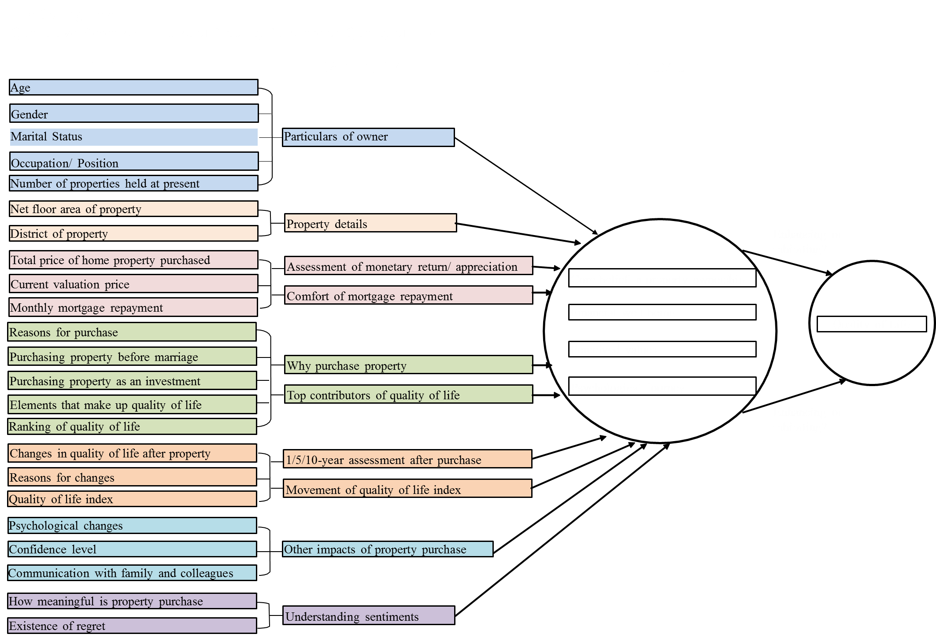

Slide 27
Discussion and Conclusion
Findings are encouraging – proven that this qualitative approach allows for a broader study and enhances the generalization of the results.
This study achieves the purpose of obtaining data and providing a summary that supports generalizations about the home purchase and quality of life.
Helps to fill in the research gap. Research objectives are achieved.
Serves as good reference materials to those who have not bought a home yet.
This study carries out that core belief in property, ownership, financial well-being, perceived values and psychological journey are the THEMES to enhance or inhibit the quality of life.

Slide 28
Personal Reflections
The significance in this paper is recognized in the inductive process of comprehending the characteristics, application and implication of qualitative approach as the means of data analysis under the topic about purchase of property and quality of life.
A fruitful experience which brings much satisfaction to learning QR.
84% respondents rank “in good terms with family” No.1 and No.2 in their elements that help attain quality of life. I think I should focus more on family instead of being a workaholic.

Slide 29
REFERENCES
Bubolz, M., Eicher, J., Evers, S. and Sontag, M. (1980). A human ecological approach to quality of life: Conceptual framework and results of a preliminary study. Social Indicators Research, 7(1-4), pp.103-136.
Chan, Y., Kwan, C. and Shek, T. (2005). Quality of Life in Hong Kong: The CUHK Hong Kong Quality of Life Index. [online] Cuhk.edu.hk. Available at: https://www.cuhk.edu.hk/hkiaps/qol/sources/articlesNbooks/2005Mar1.pdf [Accessed 3 Oct. 2018].
Higgins, M. (2013). Homeownership, the Key to Happiness?. [online] Nytimes.com. Available at: https://www.nytimes.com/2013/07/14/realestate/homeownership-the-key-to-happiness.html [Accessed 5 Oct. 2018].
Scase, R. and Saunders, P. (1991). A Nation of Home Owners. The British Journal of Sociology, 42(4), p.637.

