Slide 1

Welcome!
JW MARRIOTT

Slide 2

Table of Contents
Introduction
A summary of JW Marriott Hotel
Customer Engagement of JW Marriott Hotel
Prominent Guests Services of JW Marriott Hotel
Roles of Guest Services and hospitality in the Hotel industry
Necessary Skills for Accomplishing Customer Expectations
Strategies for Accomplishing Customer's Expectations
Conclusion
Reference

Slide 3

Jw Marriott pRezentation
I chose to talk to you about one of the most luxurious hotel brands in the world and this is the JW Marriott Marquis. When we say Marriott, we mean luxury and high-quality service. JW Marriott Marquis is a luxury hotel brand that is part of Marriott International, one of the largest hotel companies in the world. They have hotels that are known for high-quality service, and luxury accommodation. They are in large cities and popular holiday destinations around the world.

Slide 4

Customer services in hotel
Guest services play a crucial role in the hotel industry as they contribute to the overall guest experience and satisfaction. The offer of quality services can be a decisive factor in the choice of a hotel by the guests and can influence the decision whether or not to return to the same hotel in the future. Also, guest services can influence the reputation of the hotel and have a positive or negative impact on the hotel business through the recommendations and reviews of guests. Therefore, it is important to consider the role and function of guest services in general to ensure a pleasant experience for guests and to support the success of the hotel in the long term.

Slide 5


Consumers of the marriott brand.
JW Marriott is known for its quality service and attention to detail. They want to exceed the expectations of guests by providing an excellent service and by creating a comfortable and clean environment. Definitely, this is one of the best choices for someone looking for a quality hotel with excellent service and impeccable hospitality. JW Marriott is a luxury hotel brand and there is no specific list of its customers. In general, customers are businessmen, luxury tourists, participants in corporate events and tourists looking for a higher level of comfort and service in the hotel.

Slide 6
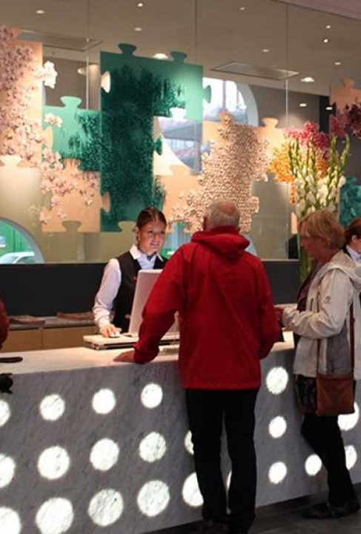
Consumers of the hotel brand
Business people are one of the largest categories of customers for the JW Marriott. This is because the brand offers complete business facilities such as conference rooms, presentation equipment and secretarial services. Also, the JW Marriott is known for its spacious and comfortable rooms, as well as for the high-quality services offered by its staff. These are essential values for business people, who spend a lot of time on the go and need a comfortable and productive environment to carry out their activities. Luxury guests are also an important category of customers for the JW Marriott. The brand offers a wide range of accommodation services and facilities, such as spas, top restaurants and swimming pools, which attract waiters in search of a luxury experience. Also, the JW Marriott is known for the personalized services offered by its staff, which ensures that every customer feels special and pampered. In addition, the JW Marriott is also popular among families and couples looking for a luxury holiday. The brand offers facilities for children, as well as childcare services, so that parents can relax and enjoy the holiday.

Slide 7
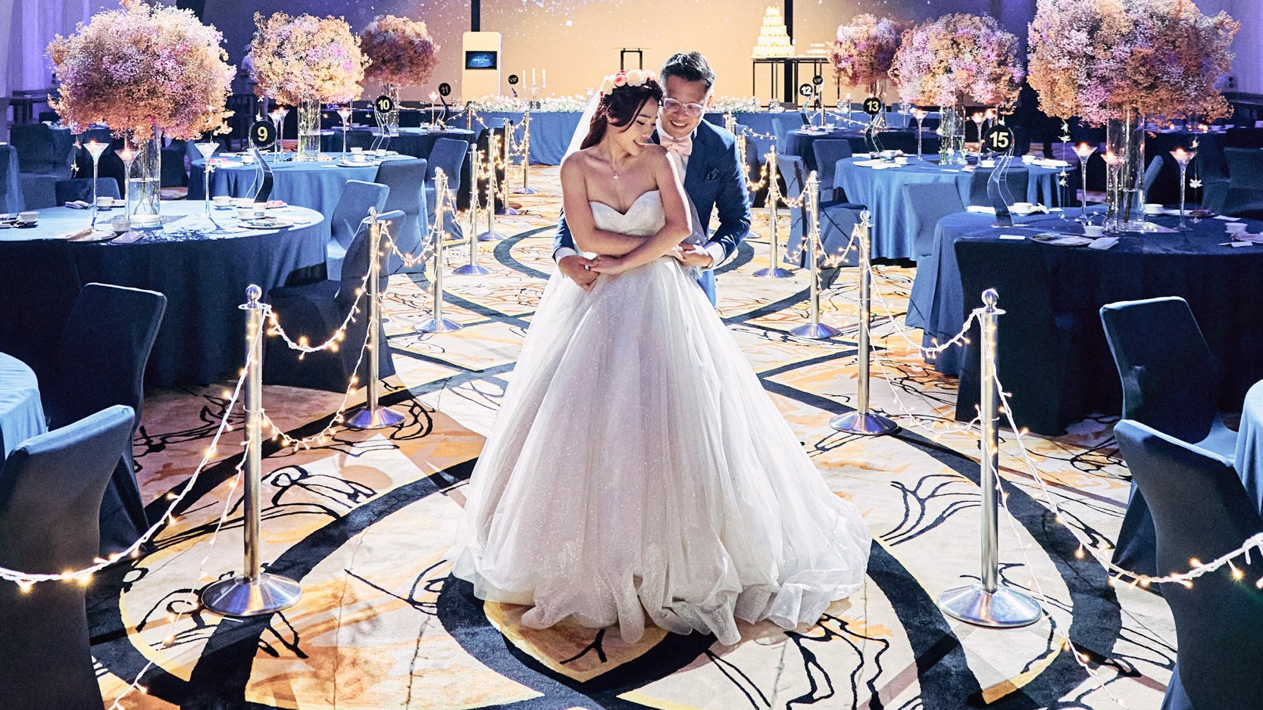
The JW Marriott is also a popular choice for wedding and social events due to its beautiful locations and high-quality services offered. In conclusion, JW Marriott is a luxury hotel brand that attracts a wide range of customers, including businessmen, luxury guests, families and couples. The nature of the guest services and facilities offered by the JW Marriott hotel brand is to provide a luxurious and comfortable accommodation experience for guests. The scope of these services and facilities includes accommodation rooms, conference spaces, restaurants, swimming pools and fitness services.

Slide 8
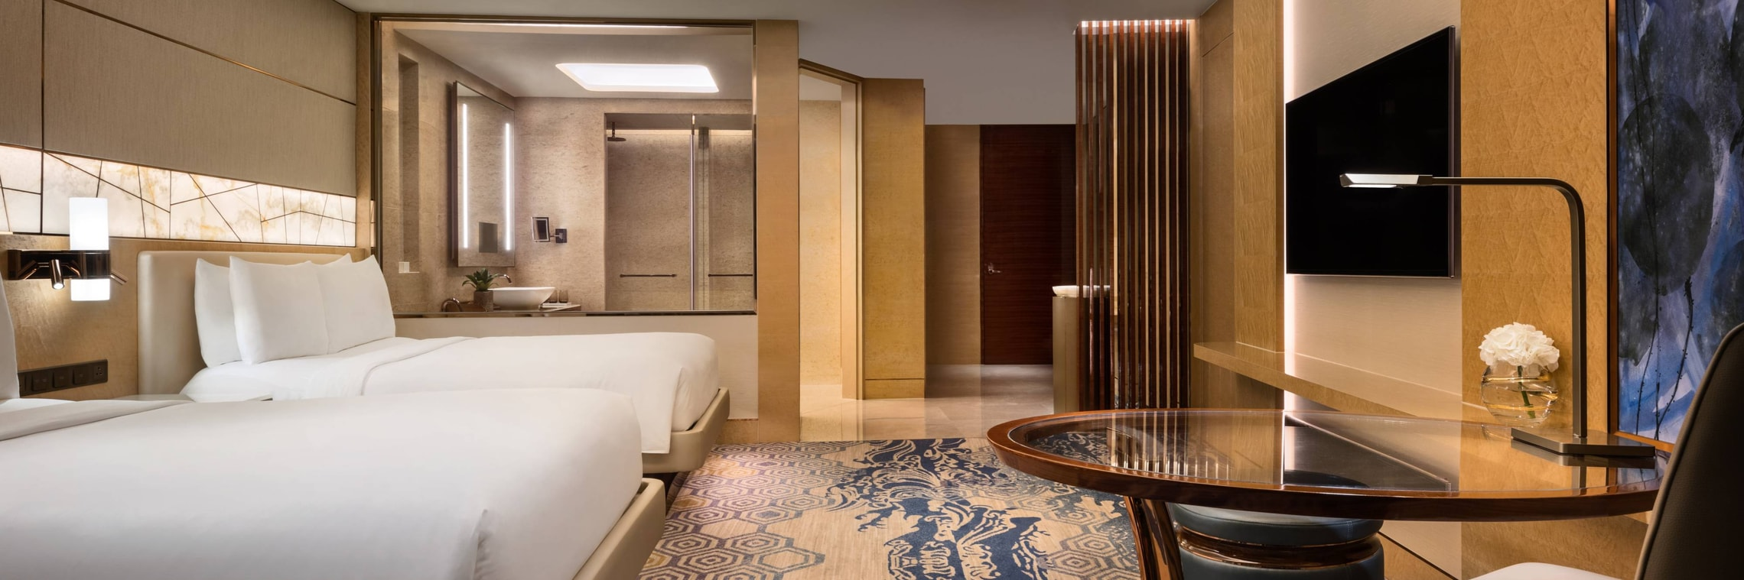
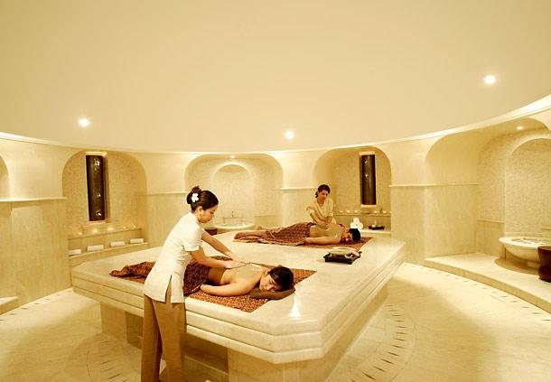
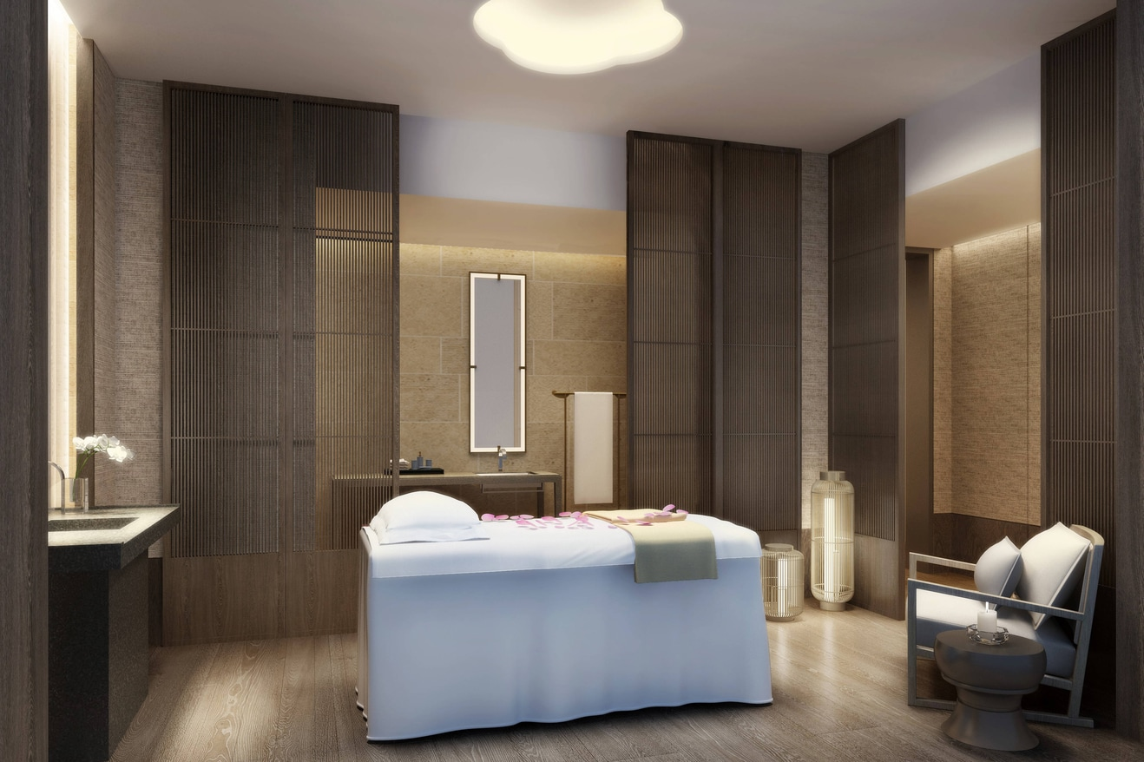
personalized services

Slide 9
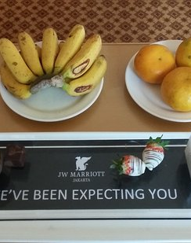
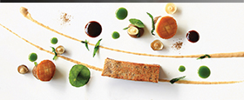
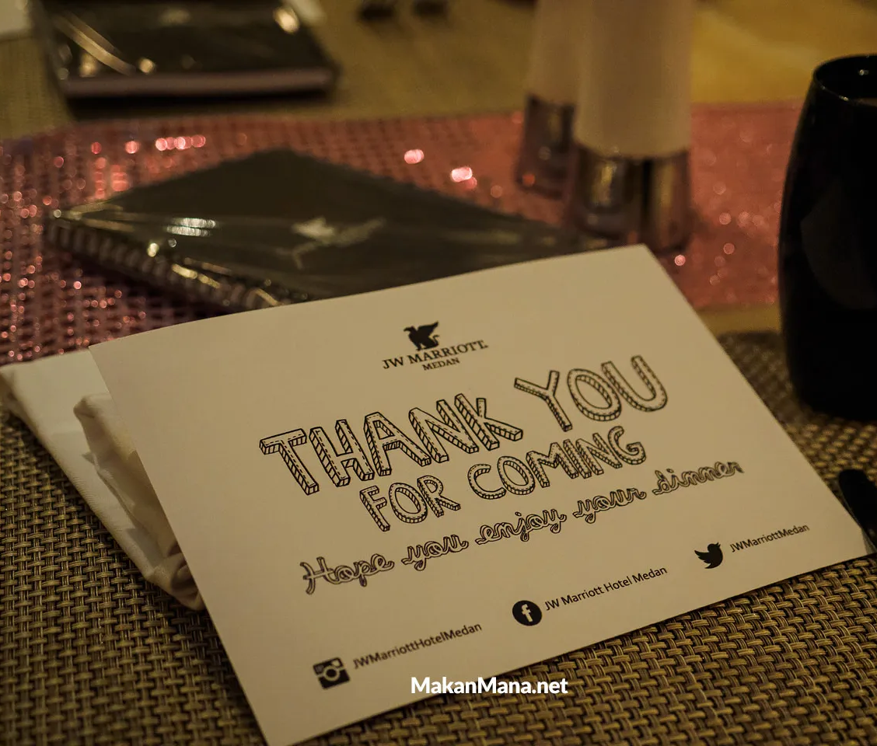

Hotel hospitality
Therefore, given the role and function of the JW Marriott guest services is essential for maintaining a high level of customer satisfaction and increasing brand loyalty. Hospitality is an essential concept in the service industry, and hotels are one of the most important industries that rely on it. Hospitality means being welcoming and making guests feel comfortable and welcome. It is important that guests feel at home when staying at a hotel, and this can be achieved by providing a quality service, a clean and comfortable environment and preventing any problems.

Slide 10
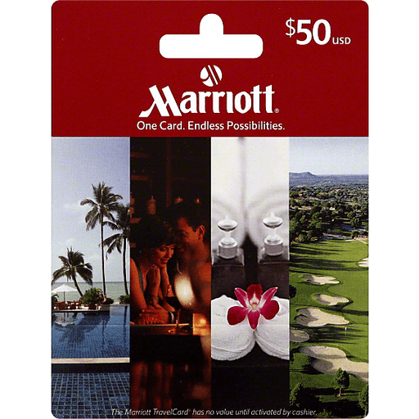
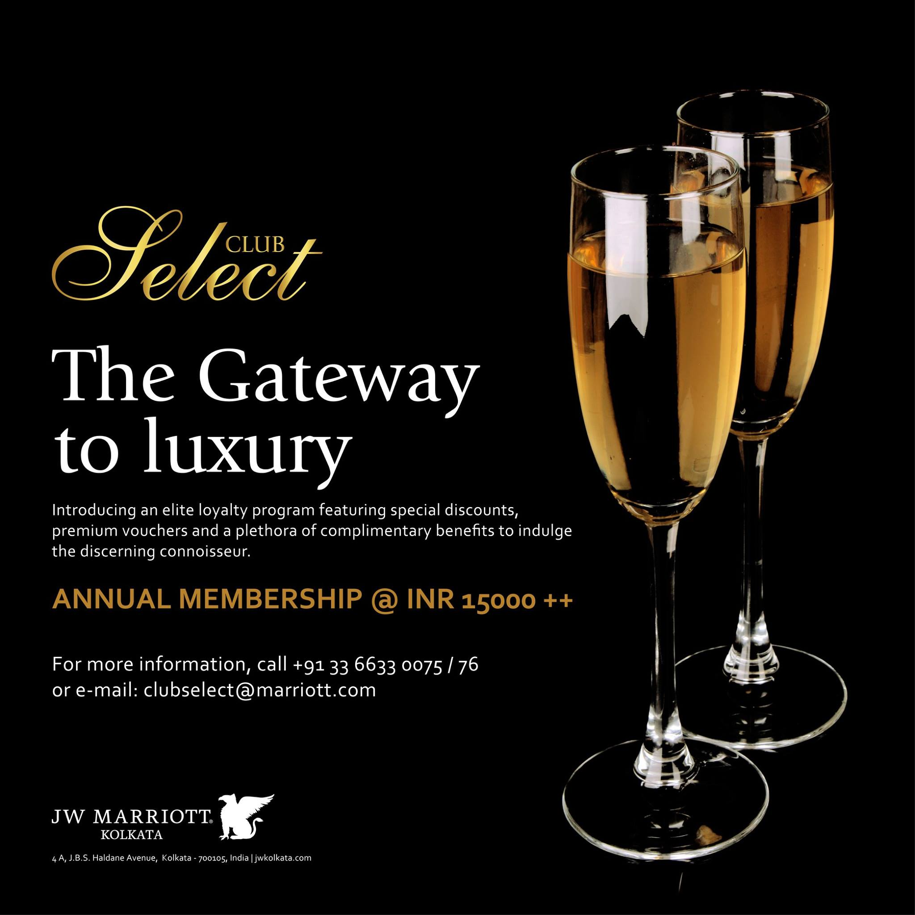
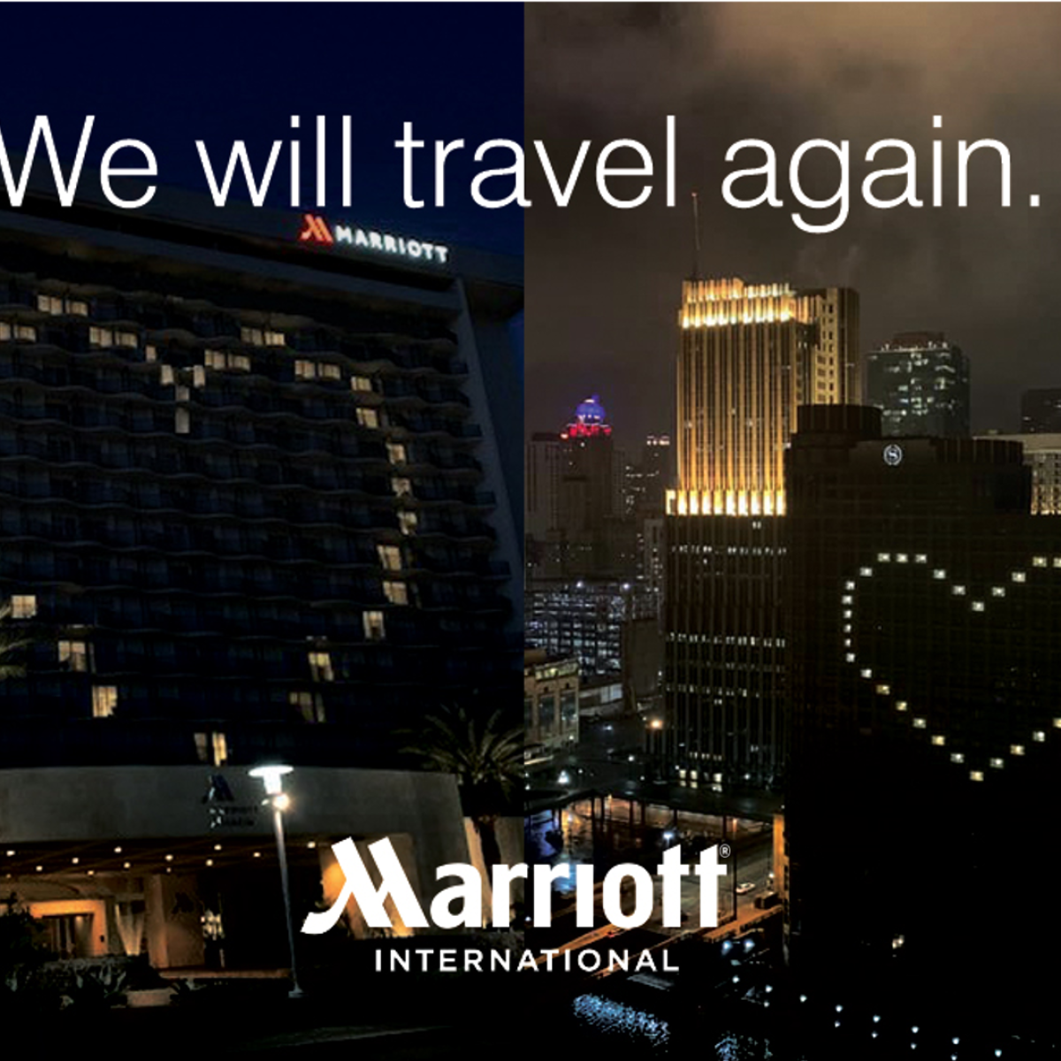
GUEST LOYALTY
The JW Marriot should make a strategic plan for utilizing its resources properly. The hotel should arrange a training program for their hotel staff to provide quality services. Ensuring personal service for the customers. The hotel should implement and develop in-room technology. Optimizing their websites and offering multiple channels of communication to attract customers. Give discounts to their loyal customers.

Slide 11
Conclusion
Customer satisfaction is the ultimate goal of the hospitality industry that comes from fulfilling the expectations of the customers. The customers are willing to get quality and value-for-money services from the hotel. Satisfied customers are rating the services of the hotel and promoting their brands to the surrounding. The JW Marriot hotel should implement the above-mentioned strategy to get an appreciation of the customers as well as customer engagement Understanding the needs and preferences of the customers and operating services to fulfil the needs of customers help to achieve the goal of the hotel.

Slide 12
Reference
Andreani, F. (2016) “The influence of Customer Relationship Management (CRM) on customer loyalty in JW Marriott Hotel Surabaya,” Jurnal Manajemen dan Kewirausahaan, 14(2). Available at: https://doi.org/10.9744/jmk.14.2.156-163.
Hara, T. (2016) “Introduction to tourism as an industry,” Quantitative Tourism Industry Analysis, pp. 1–21. Available at: https://doi.org/10.4324/9780080887999-1.
Joseph, S. (2019) “Quality Management in Hospitality,” Hospitality Experience, pp. 214–248. Available at: https://doi.org/10.4324/9781003023814-8.
Kasemsap, K. (2015) “The role of marketing strategies in the Tourism Industry,” Emerging Innovative Marketing Strategies in the Tourism Industry, pp. 174–194. Available at: https://doi.org/10.4018/978-1-4666-8699-1.ch010.
Moroney, A. (2014) “139th SMPTE technical conference and exhibit marriott marquis hotel • New York, N.Y. November 21 to 24, 1997,” SMPTE Journal, 106(9), pp. 629–631. Available at: https://doi.org/10.5594/j04536.
O'Mahony, G.B. (2015) “Service quality in Hospitality,” Key Concepts in Hospitality Management, pp. 145–148. Available at: https://doi.org/10.4135/9781526435606.n33.

