Slide 1
Digital skills and research methods
Lecturer: koushik modak
Module code: Bmsw4003
Stacey sugarova 2120140
Papadie Marian Christian 2125133
Ivana balogova 1916775
Rudolf Balog 21194
Milan gaspar

Slide 2
Introduction
The presentation helps in analyzing how Tesla facilitates modern technology in its business to improve its efficiency in the workplace and employability. It also points out the challenges of introducing modern technology into the organization as well as its impacts. Lastly, the outcome or the lessons that can be drawn from this case study is also discussed among the learners.

Slide 3
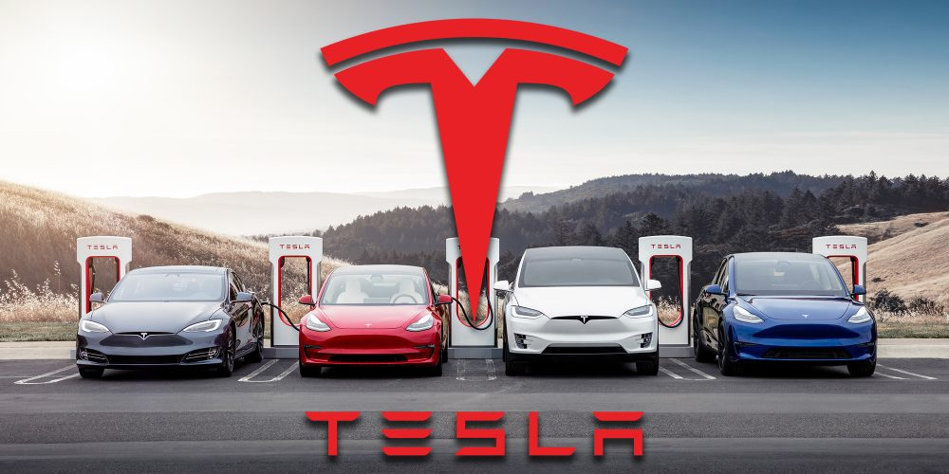
Background of the organization
American electric vehicle company
Clean energy company
Wide sale of a battery-operated vehicle
Market value
Pioneers of sustainable transport
Notes:
Tesla is an American electric vehicle company based in Texas. It is a clean energy company that designs electric operated cars, solar panels, solar roof tiles and many more. Tesla has the widest sale of battery-operated vehicles and plugs in electric vehicles around the world(Lin et al., 2018). Tesla has been way forward in the automotive industry due to its innovations in electric vehicles and technology is in its manufacturing units.
The company puts efforts into the overall advancement of society towards a new era of tech-savvy consumers (Goh and Sandars, 2020). The company runs its business with a market value of US$1 trillion. Tesla is a company that is said to be the pioneer in creating sustainable transport and energy through electric vehicles and solar power.

Slide 4
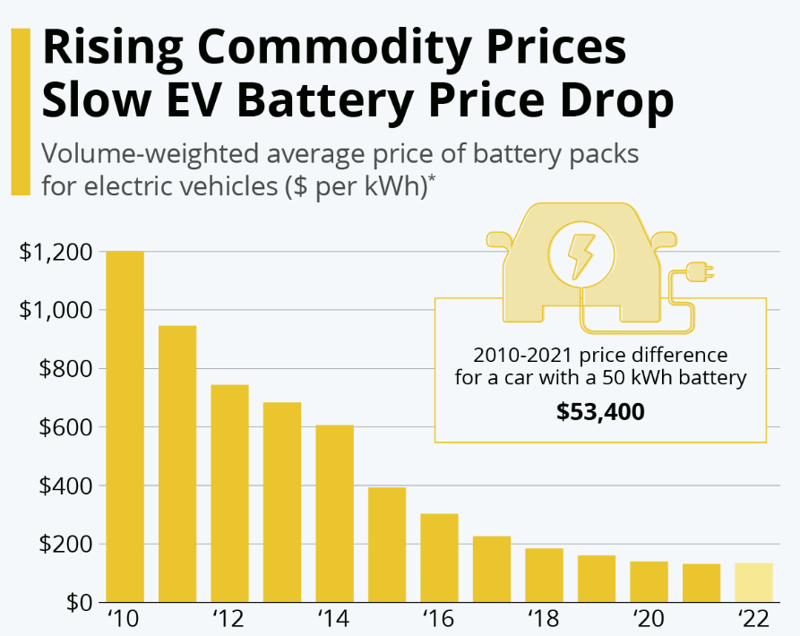
Challenges before the introduction of modern technology
Importance of adaptability
Speed of change
Semi-automated production
Notes:
As advanced as Tesla is, it was important for the company to consider the factor of adaptability of their consumers before launching hi-tech products as the consumers need time to accept the changes that the company brought about in the automotive industry. Their speed of evolution is therefore higher than the demand in the market which causes their strategies to follow a setback(Kemp et al., 2019). Their semi-automated production unit makes several errors in production due to the implementation of changes in the end product which the machine learning technology is not yet adapted.

Slide 5
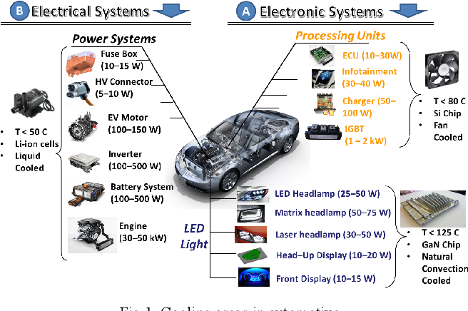
Challenges before the introduction of modern technology.
Dealing with investors and lawsuits
Establishing trust
Becoming profitable
Sales and service
Concerns about the demand in the market
Notes:
There have been various petitions against Tesla due to which the company needs to get decisions in their favour. The market has been showing deep investor doubts because of the tragic changes that the company wants to bring. To become profitable the people have to be made aware of the products and the specifications that the company is offering. There are various challenges that the company has faced in the past because of its technological advancements in its products including the inadequate charging infrastructures for its battery-operated cars (Rimmer, 2018). Also, it faces challenges in smart and flexible charging positions as well as energy management for effective load management for its products. Another concern that the company has is monitoring its batteries, its analytics as well as recycling functions.
Despite being such a big company Tesla has not been very up to the mark in terms of its after purchase services which can be proved to be a major setback for the company. All the innovations that the company is going to make might not be accepted by the consumer base and their food proper marketing strategies are required so that the demand in the market can be grown (Alghalith, 2018). The company has faced manufacturing complications several times due to its semi-automated productions. There is also financial uncertainty that is linked with the services that the company provides because of the purchasing power of its consumers. Also, there may be complications with the shortage of batteries.

Slide 6
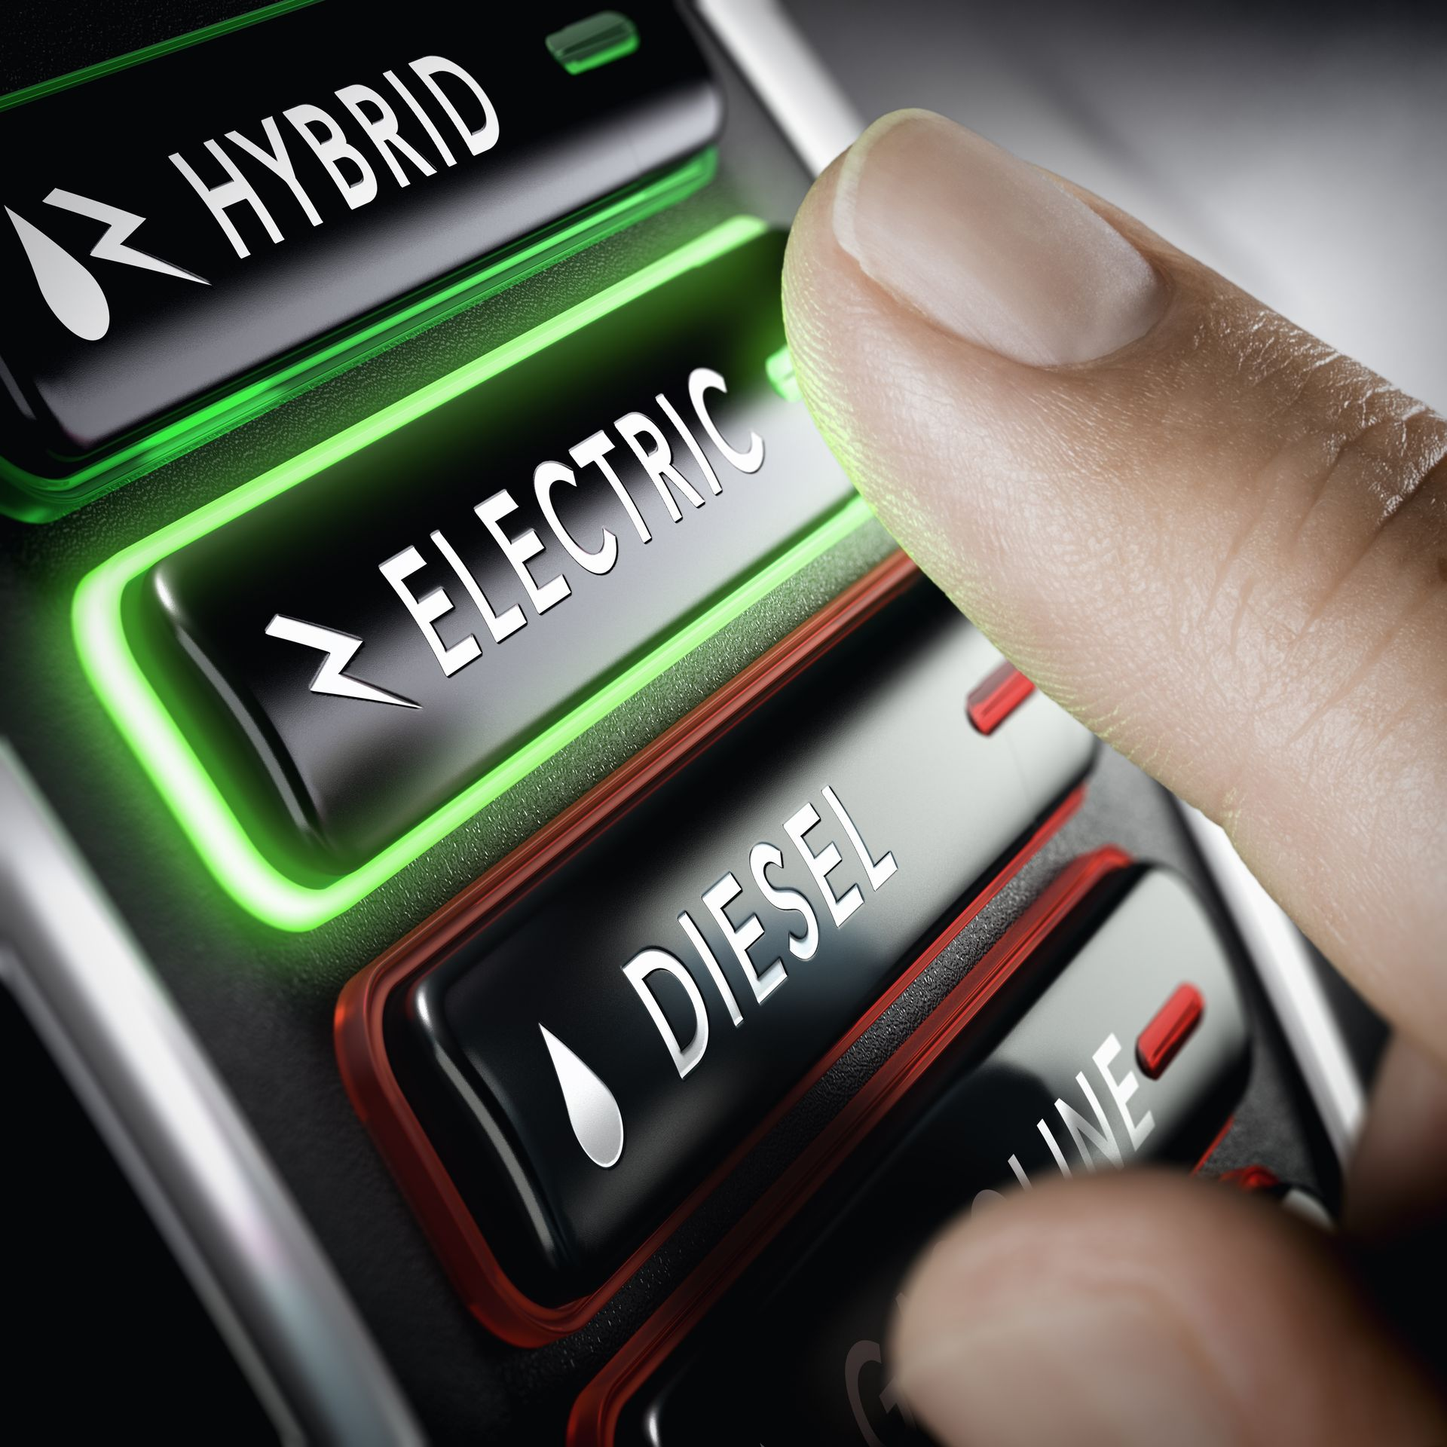
Insights of the modern technology used
The advanced driver assistance system
Level 2 vehicle automation
Reduced accidents
Reduced fatigue
Notes:
Lane centring, traffic-aware control, automatic lane changes, self-parking and the ability to summon the car from a parking spot or garage are some of the features that the advanced driver assistant system provides. It is said to be a level 2 vehicle automation for the company however the car still names constant supervision from the driver. The features like auto-steering and traffic-aware cruise control allow the car to match the speed of its surrounding traffic and also the driver in steering the car according to the markings in the lane (Alghalith, 2018). The feature also allows parking the car in parallel to or perpendicularly with an automated function. Navigations are also provided in autopilot functions as well as usage of mobile functions to summon the car is also made available by the company.
This autopilot feature from Tesla claims to be advanced enough to reduce the number of accidents by providing constant support to the drivers so that negligence can be eradicated. Since the driver does not have to be so conscious about driving all the time therefore it is also said to be able to reduce fatigue that is caused due to long driving periods. On the plus side, Autopilot is an advanced system that assists drivers and enhances their safety while driving. If used properly according to the manual the feature can reduce the overall load of the driver(Ajibade, 2018). However, this feature is only applicable to drivers who are attentive and prepared to take control of the vehicle at any given point in time. The enhanced autopilot and full self-driving capabilities allow the vehicle to be semi-automated.

Slide 7
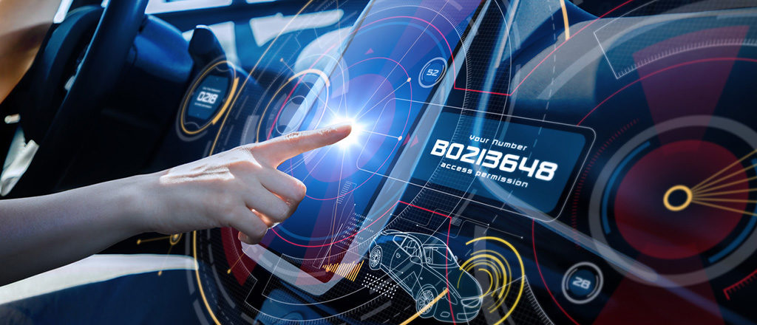
The impact of the technology introduced
Defects in autopilot
Software errors
Augmented safety
Multi-sensor fusion
Processing power
Incorporation of machine learning
Reliable cars
Notes:
The autopilot has reflexes that are fast as lightning but being a machine and software-based system, it does fail in spotting hazards in its path. This feature has caused various fatalities after its introduction. There are certain errors with the software which the drivers could not deal with in tragic situations and thus end up in the face of a tragic accident. The manual with the software instructs the driver to always be conscious even when the car is on autopilot however people take it lightly and entirely depend on the software for driving the car which proves to be hazardous at times.
Tesla has received the highest safety rating of five stars after introducing its automated autopilot function. Being an electric motor and battery-based automobile it takes up less space and does more crumple zones to help observe the energy during crashes. Introducing more sensors into its motors and self-driving cars allows the car to completely picture its environment and allow a range of vision in all kinds of weather for object detection using radars. They have also focused on incorporating more processing power which is 40 times faster than their old ones so that their ADAS can better process information and act accordingly keeping in mind the situations and surrounding(Calic and Ghasemaghaei, 2021)s. The features have various safety measures that include emergency brakes, collision warnings and obstacle aware acceleration as well as blind-spot monitoring that makes the car safe for its users and the surroundings.
With the help of machine learning, Tesla as a company is providing more information about how to react appropriately in strange situations so that the car nose went to slow down and solve the random problems faced on the road. Tesla has been making safe cars for the environment but introducing the autopilot system has made them more reliable(Kemp et al., 2019). If known how to use this feature properly the fatalities caused during driving would be reduced to a level that will have more trust in the company.
As an impact of the introduction of the autopilot in Tesla, the world would see a drastic change in its transport and automobile industries because people would someday or the other shift towards transport facilities that are less harmful to the environment considering the adverse effects that normal automobile industry puts into the environment(Tenhundfeld et al., 2020). Also, the natural resources are soon going to be extinct due to which people would have no choice but to shift to battery-operated cars and automobiles. Tesla as a company is running well above its time and predicting the future for the way humans travel in today's world. Once the entire automobile industry ships from using petroleum and diesel to other renewable sources of energy the features that Tesla has been providing would become the bare necessity for the industry.

Slide 8
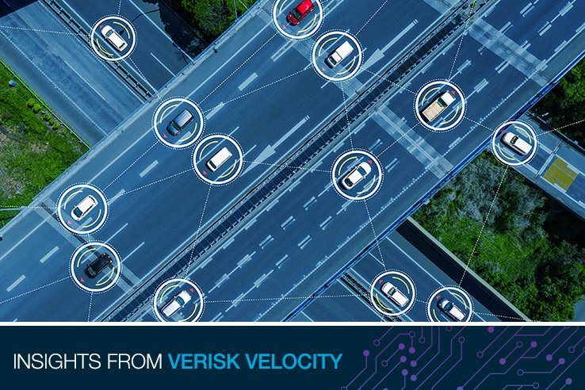
Lessons are drawn from the case study
Building market share by incorporating trends
Following the demands in the market
Technological advancements in Tesla
Focusing on environmental safety and well being
Differentiating products for involvement
The onset of robotics for future demand
Notes:
With the help of this case study, we can better understand how a company focuses on building its market share by incorporating various trends that are going on in the market. In this case, Tesla is an organization that builds the standards for the automotive industry(Giampietri and Trestini, 2020). It is very important for it to consider the market demand and before incorporating any such feature that the market may not understand the consumer base may not be familiar with, to put thoughts well in advance about the feature and its need in the society.
Therefore from the above discussion, it can be said that it is essential for any organization to adapt to its changing surroundings and reinvent or innovate ideas that support the company in the long run and allow it to survive in the era of changes. Incorporating technology into business to make sure that the consumers receive services that are of high quality and assurance is the new normal for the industries that serve people(Matikiti et al., 2018). It is high time that organizations accept automation to a level that allows them to function properly according to the demand in the market and allows them to keep their brand value intact.
It can also be said that by incorporating the autopilot feature into their automobiles they have taken a big step toward technological advancement and automated services in terms of the automobile industry. People are very much drawn to technology due to digitalization in the various segments of the market. Tesla is making sure that it is advancing keeping in mind the safety of the environment as well as incorporating modern technology into its products so that its brand has a significant brand value and image in the market(De et al., 2018). However, they need to make sure that whatever technology they are installing in their products the consumer should be able to handle it and be able to make full use of it.
There are various challenges that the company has previously faced because of its distinctive features that are very much differentiating from its competitors who don't stand a chance because of the company's huge market share and brand value. With the help of this case study, we understand that automation for humans is the new normal and the future is yet to see robotics installed in every possible field of the world. The autopilot feature in automobiles allows the drivers to be less conscious about their driving and allows them to travel freely(Koskinen et al., 2019). However, the driver should never be fully dependent on the feature and should be aware of his surroundings so that there is cooperation between the two.

Slide 9
Conclusion
Following the events of the case study, it can be concluded that to improve a company's presence in the market and brand value it must go parallel with the trends in the market. It is also important for the company to consider the factors of technological advancements in society. Any feature that an organization introduces into its products or implements into its services, comes with various challenges as well as impacts that are at times adverse in nature and simultaneously beneficial for the company’s growth as well. Using the changing market trends to a company’s benefit by changing the narrative of the event is what makes a company successful.

Slide 10
Reference List
Ajibade, P., 2018. Technology acceptance model limitations and criticisms: Exploring the practical applications and use in technology-related studies, mixed-method, and qualitative research. Library Philosophy & Practice, 1941.
Alghalith, N., 2018. Tesla: innovation with information technology. International Journal of Business Research and Information Technology, 5(1), pp.37-51.
Calic, G. and Ghasemaghaei, M., 2021. Big data for social benefits: Innovation as a mediator of the relationship between big data and corporate social performance. Journal of Business Research, 131, pp.391-401.
De Backer, K., DeStefano, T., Menon, C. and Suh, J.R., 2018. Industrial robotics and the global organisation of production.
Giampietri, E. and Trestini, S., 2020. Analysing farmers’ intention to adopt web marketing under a technology-organisation-environment perspective: A case study in Italy. Agricultural Economics, 66(5), pp.226-233.
Goh, P.S. and Sandars, J., 2020. A vision of the use of technology in medical education after the COVID-19 pandemic. MedEdPublish, 9(49), p.49.
Ijab, M.T., Wahab, S.M.A., Salleh, M.A.M. and Bakar, A.A., 2019, December. Investigating big data analytics readiness in higher education using the technology-organisation-environment (TOE) framework. In 2019 6th International Conference on Research and Innovation in Information Systems (ICRIIS) (pp. 1-7). IEEE.
Kemp, A., Palmer, E. and Strelan, P., 2019. A taxonomy of factors affecting attitudes towards educational technologies for use with technology acceptance models. British Journal of Educational Technology, 50(5), pp.2394-2413.
Koskinen, K.M., Lyyra, A., Mallat, N. and Tuunainen, V., 2019, January. Trust and risky technologies: Aligning and coping with Tesla Autopilot. In Proceedings of the 52nd Hawaii International Conference on System Sciences.
Lin, R., Ma, L. and Zhang, W., 2018. An interview study exploring Tesla drivers' behavioural adaptation. Applied ergonomics, 72, pp.37-47.
Matikiti, R., Mpinganjira, M. and Roberts-Lombard, M., 2018. Application of the Technology Acceptance Model and the Technology–Organisation–Environment Model to examine social media marketing use in the South African tourism industry. South African Journal of Information Management, 20(1), pp.1-12.
Rimmer, M., 2018. Elon Musk’s open innovation: Tesla, intellectual property, and climate change. In Intellectual Property and Clean Energy (pp. 515-551). Springer, Singapore.
Tenhundfeld, N.L., de Visser, E.J., Ries, A.J., Finomore, V.S. and Tossell, C.C., 2020. Trust and distrust of automated parking in a Tesla Model X. Human factors, 62(2), pp.194-210.

