Slide 1
Module Name : Electronics II
Module Code : ACDA6001
Topic : VHDL- Brauns Multiplier
Lecture : 6
Lecture By,
Mrs. Jenifer Prince Devaraj,
Lecturer - Embedded Electronics,
Faculty of Applied Computing,
UWTSD
Email:j.prince-devaraj@uwtsd.ac.uk

Slide 2
Introduction to VHDL
VHDL :4X4 Braun’s Multiplier: Exercise
5. Write a VHDL Code for implementing 4X4 unsigned Braun’s Multiplier using a parallel binary multiplier.
  The above multiplier should generate 16 partial products by multiplying each bit of A with each bit of B and then add these partial products to get the 8-bit result.
UWTSD Lectures / ACDA6001 – Electronics 2

Slide 3
Introduction to VHDL
VHDL :4X4 Braun’s Multiplier: Exercise
Steps
Develop the Structure of Braun’s Multiplier.
Name all the input , output Ports, Signal
Add Half Adder and Full Adder programs to your Project
Create and Write a program for Brauns Multiplier.
Utilise all the ports and signals mentioned in the structure.
Port map the Full adder and half adder into it.
Run the File for simulation.
UWTSD Lectures / ACDA6001 – Electronics 2

Slide 4
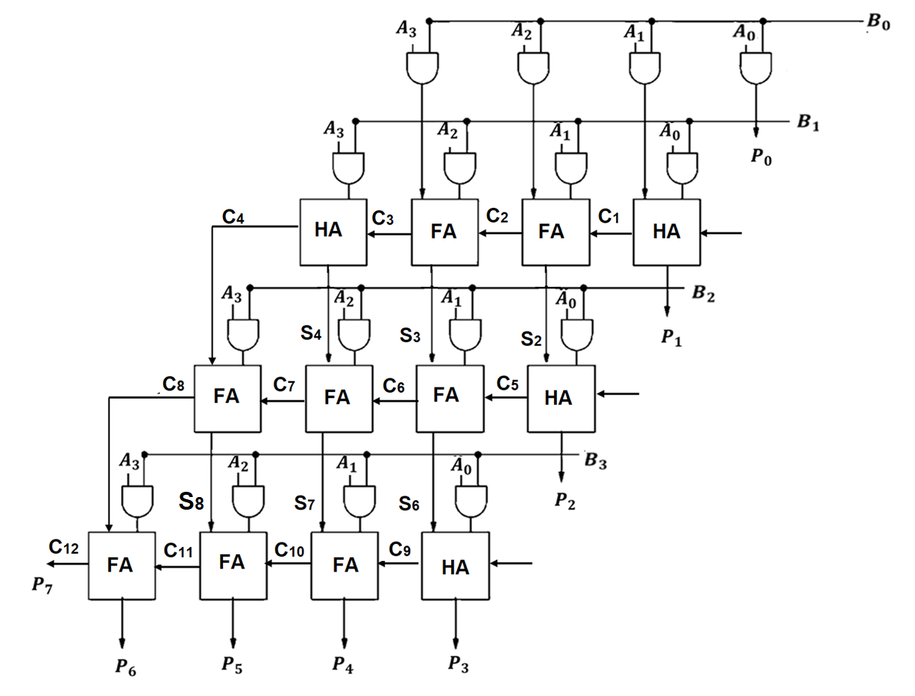
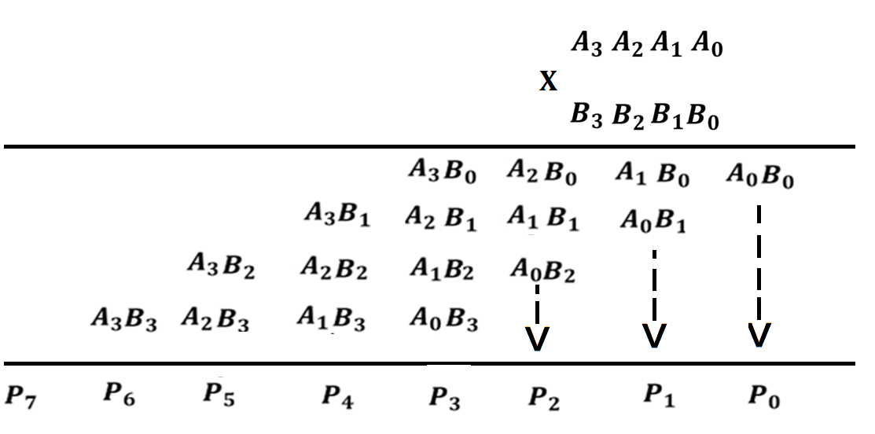
Introduction to VHDL
VHDL :4X4 Braun’s Multiplier: Exercise
Name all the input , output Ports, Signal
UWTSD Lectures / ACDA6001 – Electronics 2

Slide 5
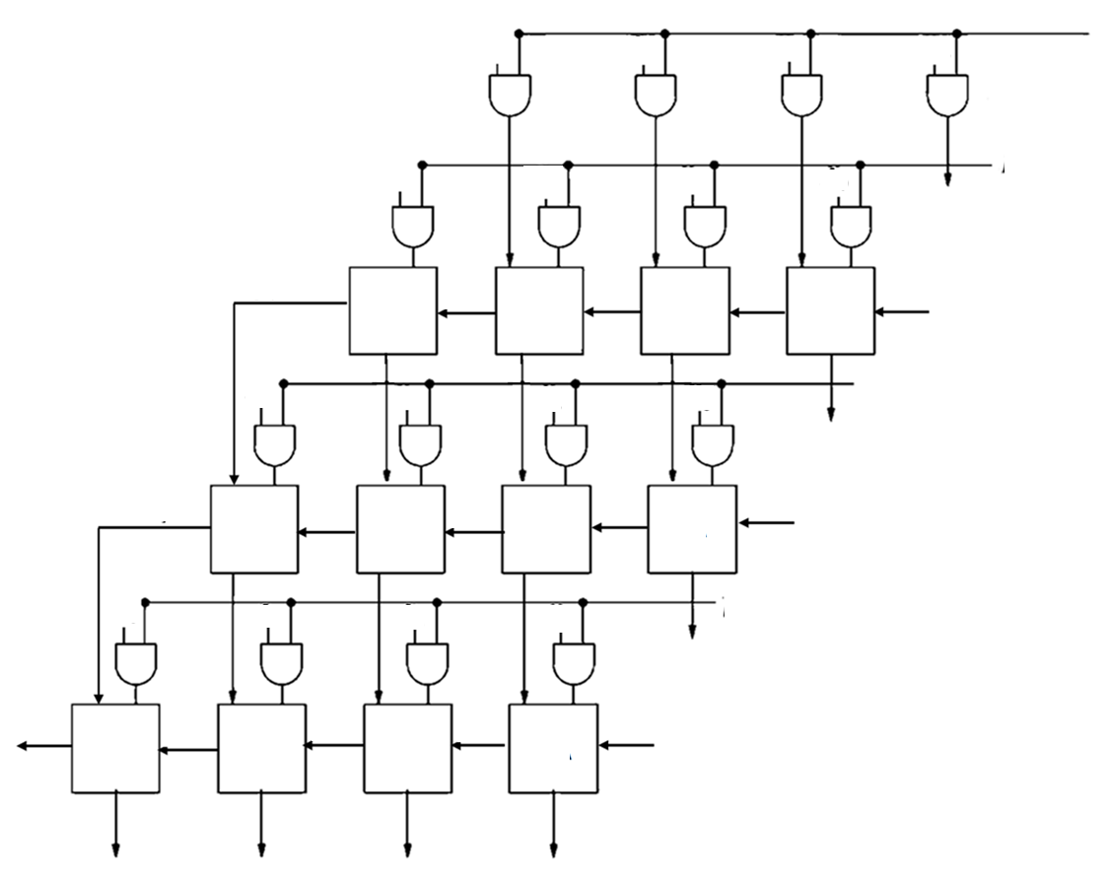
Introduction to VHDL
VHDL :4X4 Braun’s Multiplier: Exercise
Develop the Structure of Braun’s Multiplier.
UWTSD Lectures / ACDA6001 – Electronics 2

Slide 6
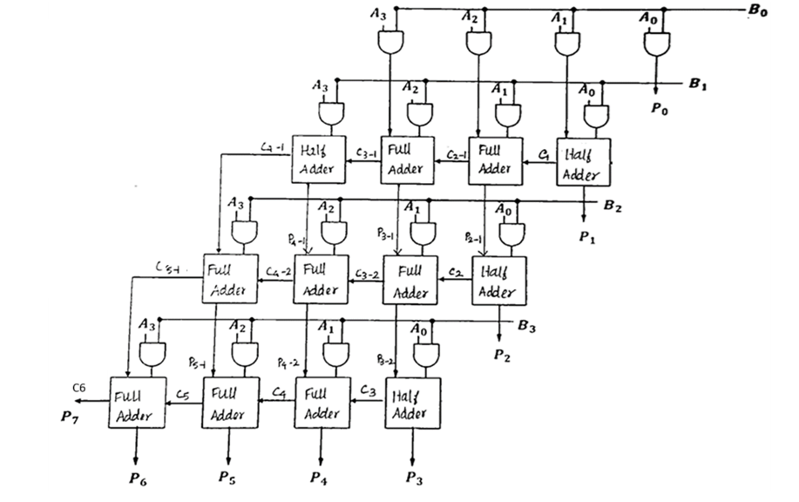
Introduction to VHDL
VHDL :4X4 Braun’s Multiplier: Exercise
Develop the Structure of Braun’s Multiplier.
UWTSD Lectures / ACDA6001 – Electronics 2

Slide 7
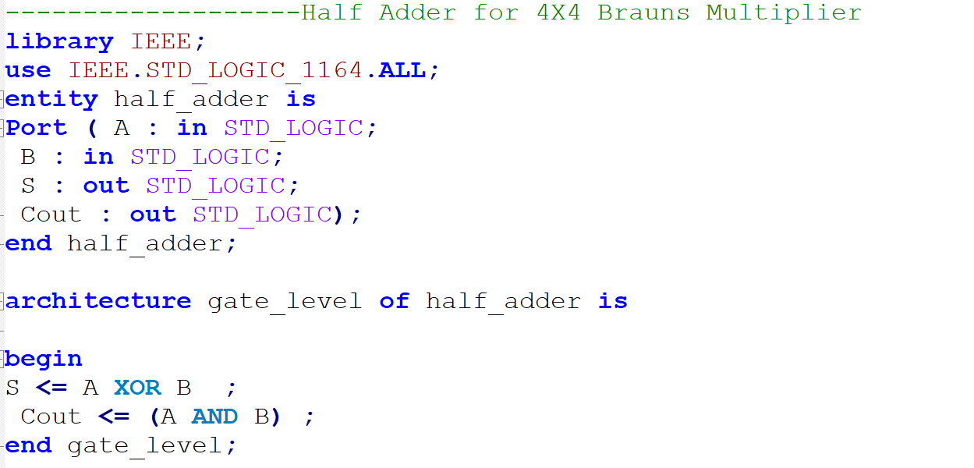
Introduction to VHDL
VHDL :4X4 Braun’s Multiplier: Exercise
Add Half Adder and Full Adder programs to your Project
UWTSD Lectures / ACDA6001 – Electronics 2

Slide 8
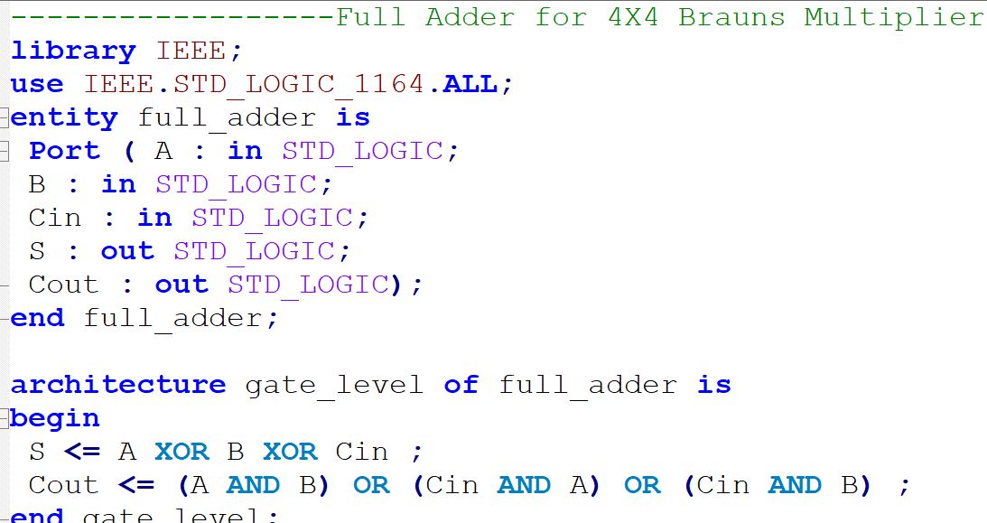
Introduction to VHDL
VHDL :4X4 Braun’s Multiplier: Exercise
Add Half Adder and Full Adder programs to your Project
UWTSD Lectures / ACDA6001 – Electronics 2

Slide 9
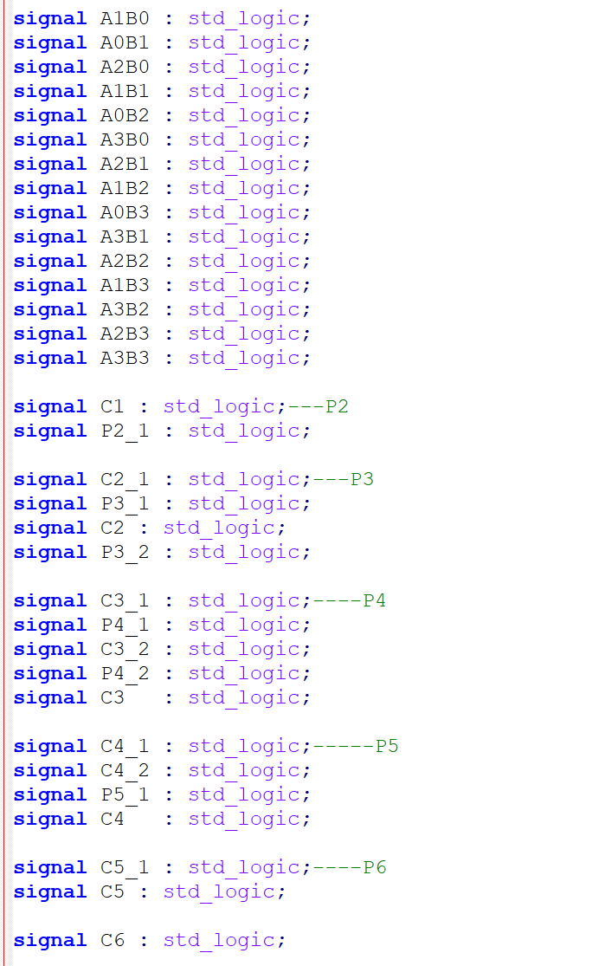
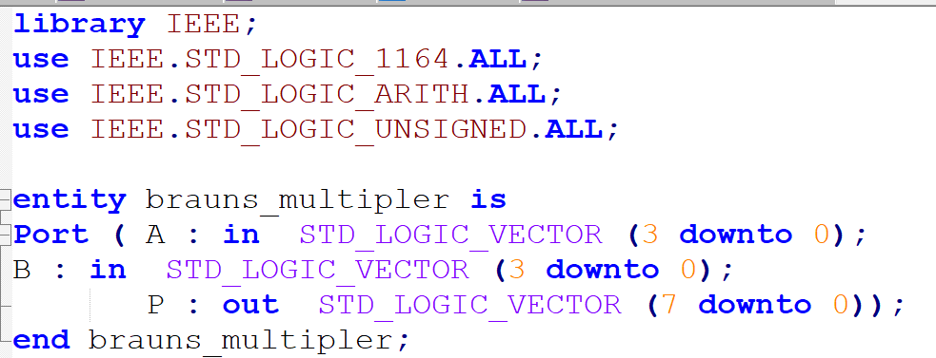
Introduction to VHDL
Create and Write a program for Brauns Multiplier.
UWTSD Lectures / ACDA6001 – Electronics 2

Slide 10
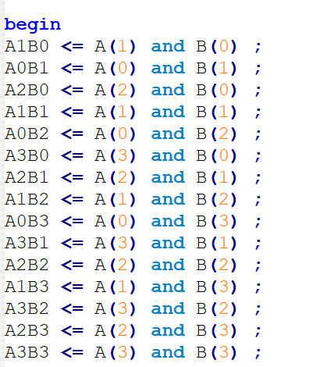
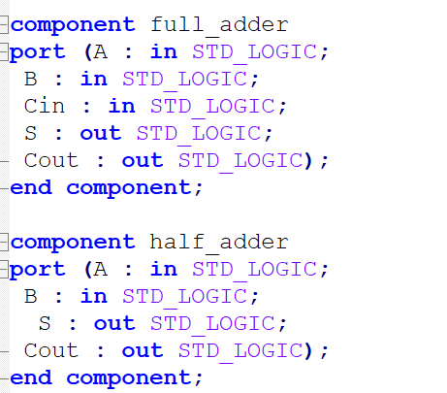
Introduction to VHDL
UWTSD Lectures / ACDA6001 – Electronics 2

Slide 11
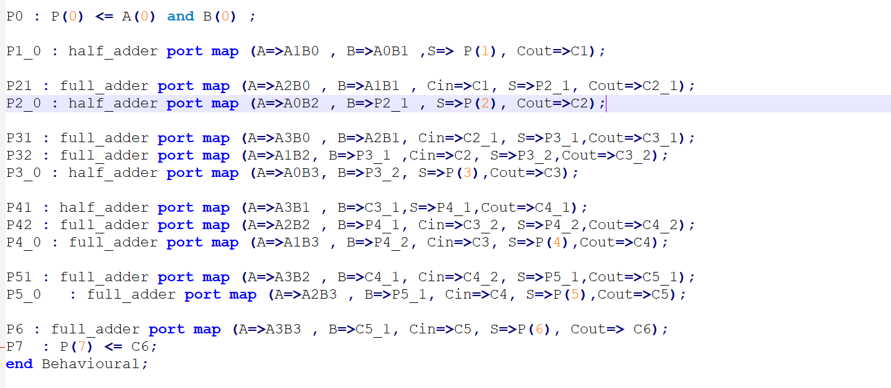
Introduction to VHDL
Run the File for simulation.
UWTSD Lectures / ACDA6001 – Electronics 2

Slide 12
Thank you

