Slide 1

Student name: Monalene Anne Ho
Student ID: 2311680
Module name: Empowering the Older Person
Module code: BMHP6027
Lecturer’s name: Laila Saurani

Slide 2
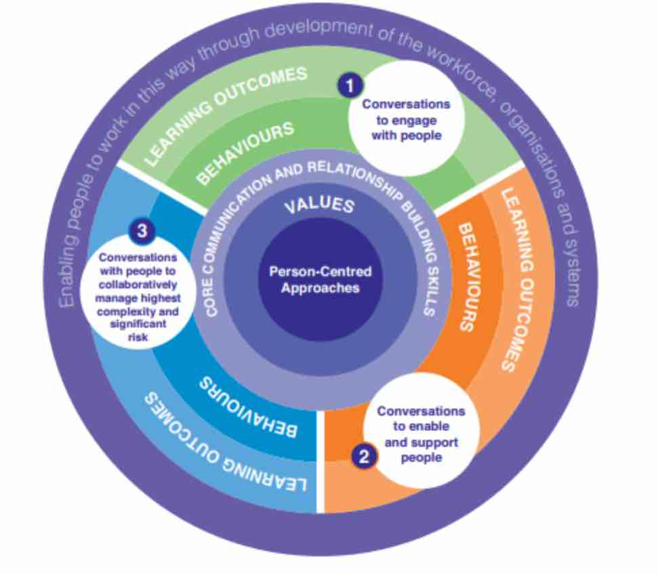

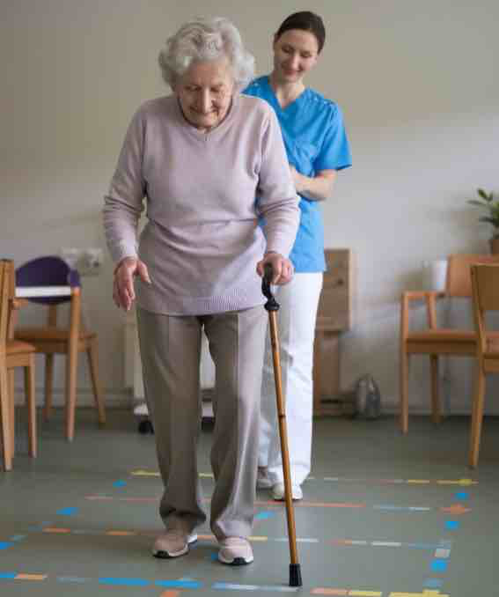
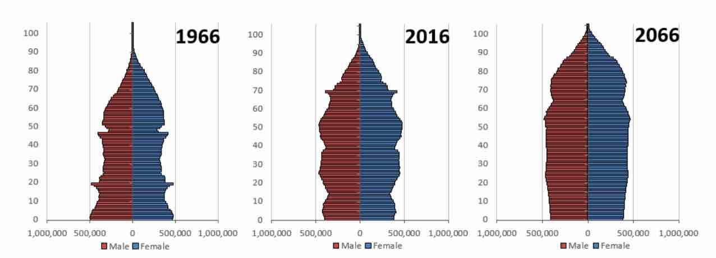
Care, Empowerment and Support Needs
• Functional ability supports independent living, yet sustaining it often depends on coordinated health and social care support (WHO, 2020).
• Participation in decision-making promotes dignity and autonomy, although organisational routines may limit meaningful involvement (McCormack and McCance, 2017).
• Increasing multimorbidity requires integrated services to maintain independence and quality of life in later life (Sun et al., 2023).
Challenges in Maintaining Independence
• Frailty and multimorbidity increase care complexity and may reduce functional ability in later life (Kingston et al., 2018).
• Loneliness and social isolation negatively affect mental wellbeing and participation in community life (Age UK, 2024).
• Workforce shortages and rising demand create gaps between policy commitments and everyday care provision (Humphries et al., 2021).
Empowering the Older Adults
Recommendations and Conclusion
• Expand community-based preventative services to maintain functional ability and delay avoidable care dependency (WHO, 2020).
•Strengthening integration between health and social care services is essential for supporting older adults with complex needs (Humphries et al., 2021; NHS England, 2022).
• Sustaining independence in later life requires legislation, coordinated services and adequate workforce capacity (Age UK, 2024; Skills for Care, 2023).
(Anon, 2017)
Introduction
• England’s population is ageing, with over 11 million people aged 65+, increasing pressure on health and social care services (ONS, 2023).
• Around 940,000 older adults experience chronic loneliness, which is associated with poorer physical and mental health outcomes (Age UK, 2024).
• Promoting independence, dignity and wellbeing is therefore a central objective of adult social care policy in England (DHSC, 2014).
Effectiveness of Approaches and Interventions
• Person-centred care promotes dignity and wellbeing by recognising individual preferences and life histories (Edvardsson et al., 2017).
• Empowerment theory emphasises involvement in decisions affecting care, though organisational constraints may restrict genuine autonomy (Tengland, 2008).
•Policies such as the Care Act 2014 and Mental Capacity Act 2005 aim to protect wellbeing and support individuals’ rights to make decisions about their care (Department of Health and Social Care, 2014; Department for Constitutional Affairs, 2005).
(ONS, 2018)

Slide 3
References
Age UK (2024) Later life in the United Kingdom 2024. London: Age UK. Available at: https://www.ageuk.org.uk(Accessed: 10 March 2026).
Barnett, K., Mercer, S., Norbury, M., Watt, G., Wyke, S. and Guthrie, B. (2012) ‘Epidemiology of multimorbidity and implications for health care, research, and medical education’, The Lancet, 380(9836), pp. 37–43.
Department for Constitutional Affairs (2005) Mental Capacity Act 2005. London: The Stationery Office.
Department of Health and Social Care (2014) Care Act 2014. London: The Stationery Office.
Edvardsson, D., Winblad, B. and Sandman, P.O. (2017) ‘Person-centred care of people with severe Alzheimer’s disease: current status and ways forward’, The Lancet Neurology, 7(4), pp. 362–367.
Humphries, R., Thorlby, R., Holder, H., Hall, P. and Charles, A. (2021) Social care funding and workforce challenges in England. London: The King’s Fund.
Kingston, A., Robinson, L., Booth, H., Knapp, M. and Jagger, C. (2018) ‘Projections of multi-morbidity in the older population in England’, The Lancet Public Health, 3(9), pp. e447–e455.
McCormack, B. and McCance, T. (2017) Person-Centred Practice in Nursing and Health Care: Theory and Practice. 2nd edn. Oxford: Wiley-Blackwell.
Marmot, M., Allen, J., Boyce, T., Goldblatt, P. and Morrison, J. (2020) Health Equity in England: The Marmot Review 10 Years On. London: Institute of Health Equity.
NHS England (2022) Integrated Care Systems: Design Framework. London: NHS England. Available at: https://www.england.nhs.uk (Accessed: 10 March 2026).
Office for National Statistics (2023) Living longer: ageing population in the UK. London: ONS. Available at: https://www.ons.gov.uk (Accessed: 10 March 2026).
Skills for Care (2023) The state of the adult social care sector and workforce in England. Leeds: Skills for Care. Available at: https://www.skillsforcare.org.uk (Accessed: 10 March 2026).
Sun, X., Smith, L., Brown, K. and Taylor, R. (2023) ‘Multimorbidity and integrated care for older adults: implications for health and social care systems’, Journal of Ageing and Health, 35(4), pp. 456–468.
Tengland, P.A. (2008) ‘Empowerment: a conceptual discussion’, Health Care Analysis, 16(2), pp. 77–96.
The King’s Fund (2021) Integrated care systems explained. London: The King’s Fund. Available at: https://www.kingsfund.org.uk (Accessed: 10 March 2026).
World Health Organization (2020) Decade of Healthy Ageing 2020–2030. Geneva: WHO.
World Health Organization (2021) Global report on ageism. Geneva: WHO.
World Health Organization (2022) Integrated care for older people: guidelines. Geneva: WHO.

