Slide 1
This presentation is set to 600 pixels by 400 pixels, the ideal size for a tile image in Moodle. The next slide shows an example of a Moodle tile image – it fills the slide and is high resolution, clear and related to the tile’s content.
Remember, the image will often be cropped depending on the device used to access Moodle, potentially hiding parts of the image around the edge, so avoid using text.

Slide 2
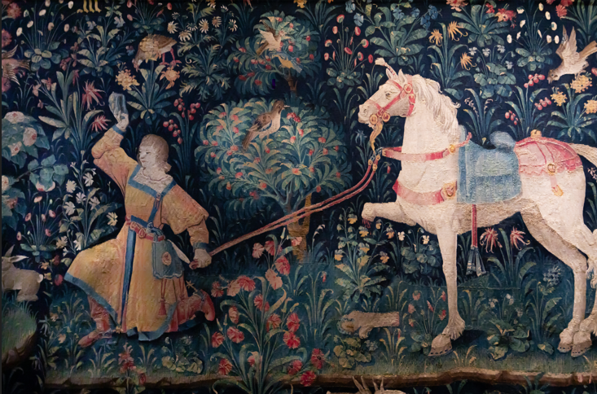

Slide 3
If you have a large number of very different-looking images for your tiles, it can appear a bit disjointed. One technique to avoid this is to place a coloured 50% transparent box over your images before exporting them.
You can do this by drawing a rectangle over the image, selecting a new fill colour, then right-clicking on the box and selecting Format Shape… from the pop-up menu. Then enter 50 in the Transparency option on the Format Shape panel.

Slide 5
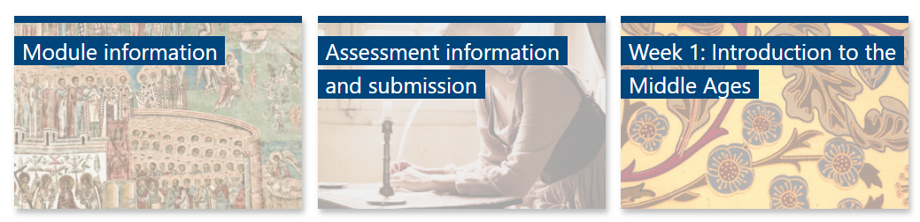
Remember, the tiles will have their own title clearly and prominently displayed automatically on them, so there is really no need to add text on to your tile image. Adding text to the tile image will make things less clear, not more!

Slide 6
Finding images online
It is safest to find good quality, high resolution images from reputable sources, rather than from random sites or a web search. Two good sources are:
Adobe Stock (using your UWTSD credentials): https://stock.adobe.com
Pexels (no account necessary): https://www.pexels.com

Slide 7
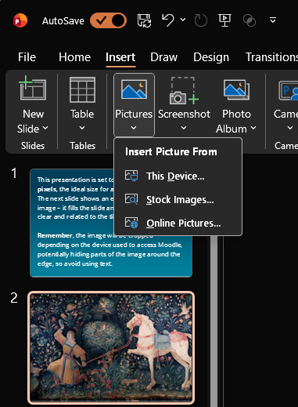
Inserting an image
into this template
When you’ve downloaded an image you’d like to use, insert it into the template by selecting Insert > Pictures > This Device, as shown here on the right.

Slide 8

Resizing the image
Your image will need to fit the full width and height of the slide to work correctly. If when you are resizing your image the aspect ratio changes, you can hold down the Shift key on your computer to keep the aspect ratio the same, otherwise your image will look squished.

Slide 9
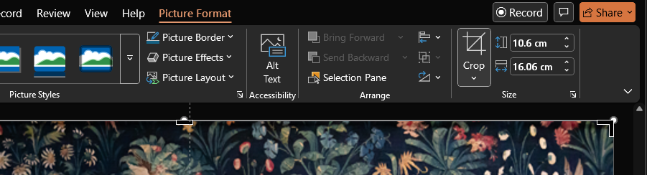
Cropping the image
You don’t have to crop the image for the export to work correctly, but cropping can help you visualise the final tile. Select the image and use the Crop tool in the Picture Format tab, as shown here.

Slide 10
Exporting your image
Go to the slide containing your image, then choose File > Export > Change File Type > PNG Portable Network Graphic.
Next, select Save As…, choose a location and filename, and select Save. When prompted, select Just This One to export only the current slide.
You are now ready to use the image in Moodle!

