Slide 1

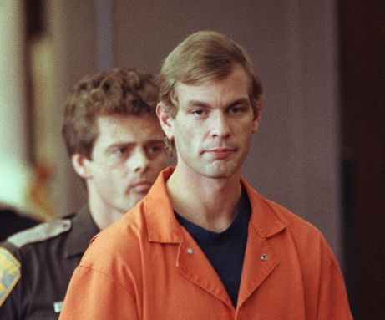
Nature vs Nurture – Jeffery Dahmer
Ieuan Bessant. Cameron Grant, Richard Kwame Agyei.

Slide 2
Nature vs Nurture in Psychology
The nature vs nurture argument is a very common debate held by psychologists, criminologist and sociologist and is a very important debate amongst the social sciences.
They aim to answer the question of whether humans are born with innate predispositions to certain behavior such, including criminality, or whether we are all born as a blank slate and are made into who we are by our life events or through conditioning and social learning theories.

Slide 3
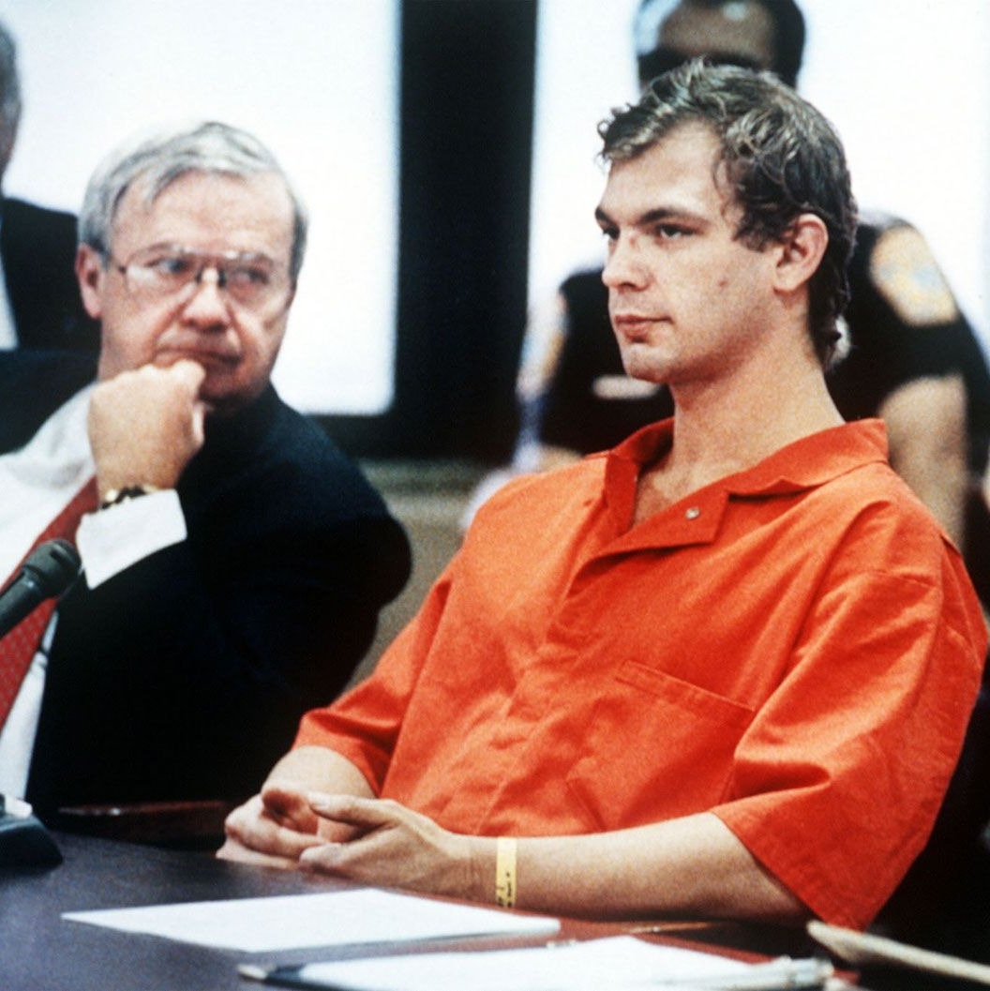
Jeffery Dahmer
We aim to answer the question of whether criminality is a biological predisposition from birth or as a result of biological conditions or if criminals are shaped by things like their adverse life events, using the case of famous serial killer, Jeffery Dahmer.

Slide 4
Maternal Deprivation
The first theory that could be looked at is the theory proposed by Bowlby in (1953) that proposed that children seek to form attachments as early as possible in order to survive and that maternal deprivation was a key factor that led children on to becoming criminals in their later life.
Bowlby conducted a study on children in a juvenile center and found that 40% of the children in the study that were sent to this center experienced prolonged separation from their mothers or experienced some form of negligence or depravation, physically or emotionally, from their maternal mothers compared to just 5% of the control subjects and proved a link between maternal deprivation and criminality or deviance.
Bowlby created what was known as the 'affectionless psychopath' trait, a disorder in which the individual feels no guilt or shame and lacks a social conscience that would be correlated with the maternal deprivation experienced by these deviant children and their criminal behavior.
Bowlby (1944)

Slide 5
Jeffery Dahmer's early life
Dahmer had a very tough childhood; he grew up being regularly left to fend for himself due to his mother's severe battle with addiction, mental health and suicidal ideation as well as his father's great absences due to work (Martens and Willhelm 2011)
His father, Lionel Dahmer also confirmed in his own book, 'A Fathers Story' (1994) that Jeffery was often exposed to infighting and verbal arguments between his parents and resulted in a harsh divorce when Dahmer turned 18.
This is great evidence that Jeffery suffered from severe negligence and maternal as well as paternal depravation that prevented Jeffery from ever forming a strong, loving bond between him and his mother and could be attributed to his propensity to commit the crimes he did in his later life.
He showed many attributes of the 'affectionless psychopath' that arose from this theory to be correlated with maternal deprivation such as a lack of guilt, shame and the lack of Dahmer's social conscience.

Slide 6
Social Learning Theory
Another theory of cognitive and behavioral psychology that links the nurture side of this argument with inclinations towards criminal behavior and being made into criminals rather than born.
This theory was first popularized by Albert Bandura in in 70s and 80s and proposed that children are born a 'tabula rasa', or a blank late and that behavior and language is learned via a process of social learning. Behavior of socialization agents, mainly parental, will be observed by their children, process in their brain and will then attempt to recreate the language or behavior presented to them.
This was backed up by a study done by Bandura himself. He found in his study that children who were presented with violent behaviors and language to a bobo doll by older human figures would then recreate that behavior themselves on the bobo doll when left alone. This then proved his theory that children learn through a combination of observational learning and cognitive learning processes.
Bandura (1977)

Slide 7
SLT and Dahmer
It has been heavily theorized that Dahmer's 'fascination with death and gore' is a result of behavior he observed and learnt via observational, social learning of events he experienced with his Dad in his early life.
It is confirmed by McEvoy (2023) that Dahmer's behavior in dismembering his victims and keeping parts of their bodies as souvenirs is likely an escalation of his fascination with dismembering the insides of roadkill animals, a behavior he observed via his father in his early life.
This idea could help explain Jeffrey Dahmer's violent actions because it's highly possible that the things he saw, learnt, and utilized to dismember animals as a model for dismembering humans in his adult life are what led to his murders.

Slide 8
The Strain Theory
This theory Depicts that individuals are involved in criminal acts as a way of satisfying frustrations that come from the pressures from society that result in an inability to meet their aims in the acceptable way
Gorst-Unsworth and Fox, 2013
Jeffery Dahmer's Background proves that he had a shattered upbringing and was constantly exposed to violent behavior, the divorce of his parents, inadequacy in opportunities, and countless verbal arguments and constant tensions resulted in Dahmer's withdrawal from society and resulted in the social strain he experienced in his adult life and contributed to his criminal behavior, as a way to satisfy this strain.

Slide 9
The Psychological Theory
This theory proposes that some predispositions to things like a lack of empathy, severe emotional distress and psychopathy can contribute to an individual indulging in criminal behavior.
(Conklin 2007)
Jeffery Dahmer's acts, which shows many levels of lack of empathy on behalf of his victims are psychopathic traits.
(Ferguson et al., 2013)
From this, it can be realized that the untreated, psychopathic condition of Jeffery Dahmer led him to develop his inability to empathize and his distant relationship with his parents in early childhood contributed to his predisposition for committing criminal behavior.

Slide 10
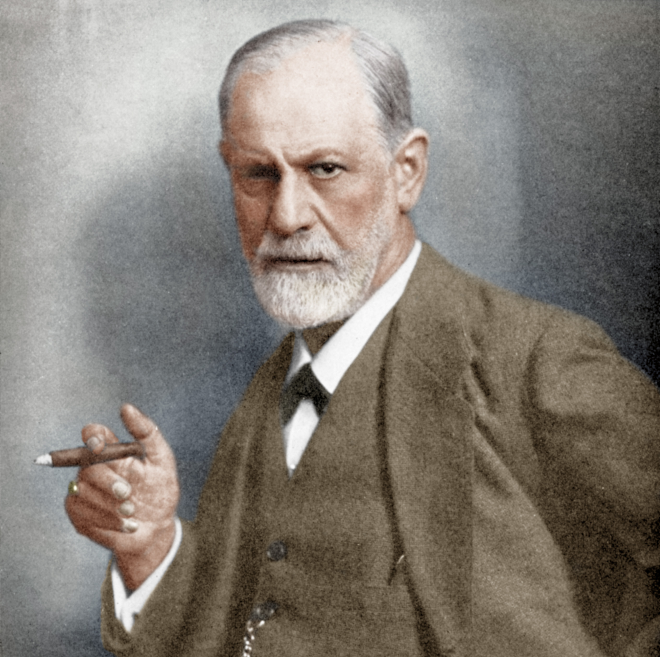
Sigmund Freud

Slide 11
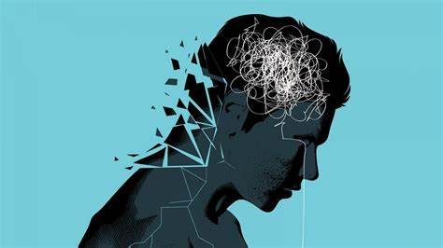
Early life and Mental Health

Slide 12
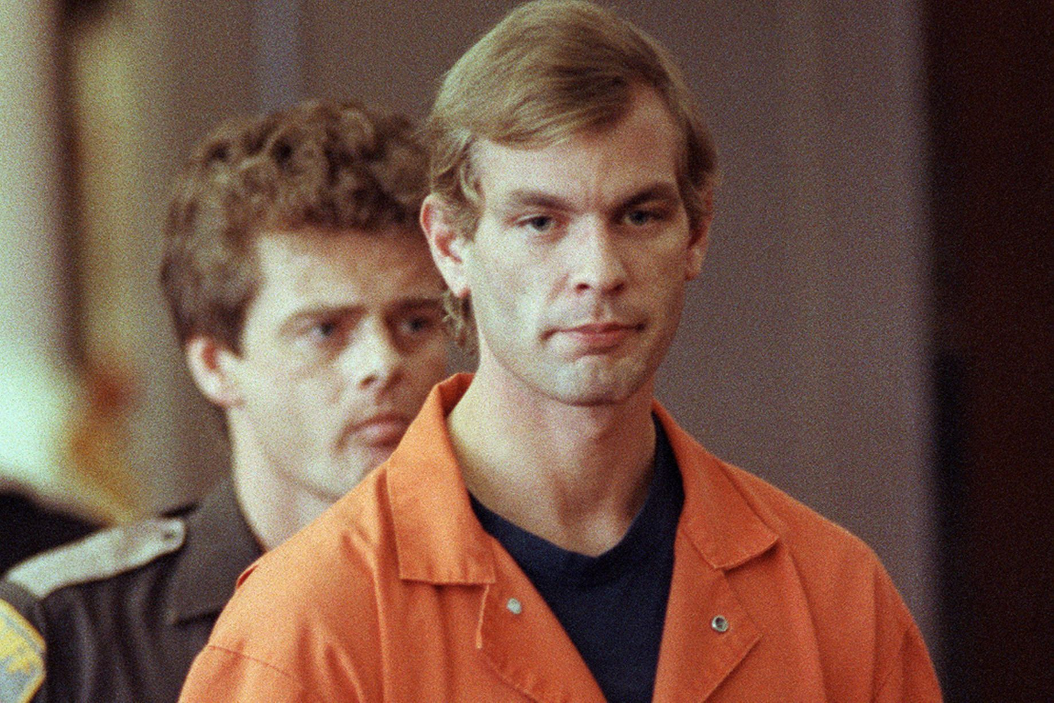
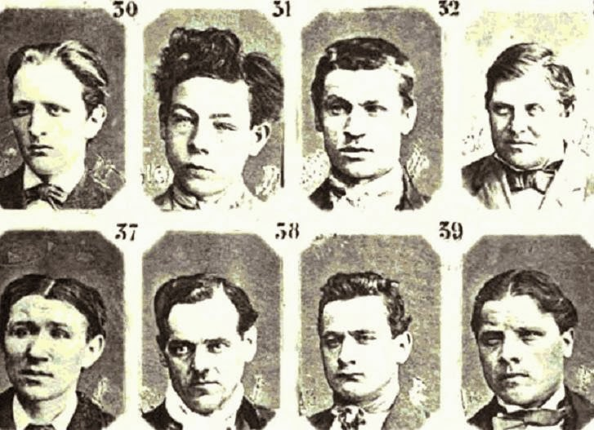
Lombroso's Theory

Slide 13
Reference List
Bowlby, J (1944). Forty-Four Juvenile Thieves Their Characters and Home-Life. Available at: https://www.demenzemedicinagenerale.net/images/mens-sana/Bowlby_44_thieves.pdf (Accessed 27th February 2024).
Conklin (2007) Working memory performance in typically developing children and adolescents: behavioral evidence of protracted frontal lobe development. Available at: https://pubmed.ncbi.nlm.nih.gov/17305440/ (Accessed 9th March 2024)
Dahmer, L (1994). “A FATHER’S STORY” (1994) Kirkus Reviews. Austin: Kirkus Media LLC.
Ferguson et al (2013) The physical environment and child development: an international review. Available at: https://pubmed.ncbi.nlm.nih.gov/23808797/ (Accessed 9th March 2024)
Martens, W (2011). Sadism Linked to Loneliness: Psychodynamic Dimensions of the Sadistic Serial Killer Jeffrey Dahmer,” The Psychoanalytic review (1963), 98(4), pp. 493–514. Available at: https://doi.org/10.1521/prev.2011.98.4.493. (Accessed 27th February 2024).
McEvoy, C. Convicted serial killer and sex offender Jeffrey Dahmer murdered 17 men and boys between 1978 and 1991. He was killed in 1994 by a fellow prison inmate. Available at: https://www.biography.com/crime/jeffrey-dahmer (Accessed 9th March 2024)

