Slide 1

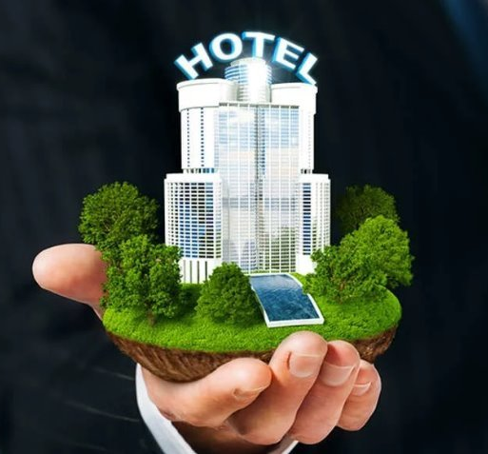

Cert. HE. Hospitality and Hotel Management
BMIH4011: Sustainable Hospitality
Student Name: Lavinia Branescu
Student ID: 2408946
(Source: Chernova, 2023)

Slide 2
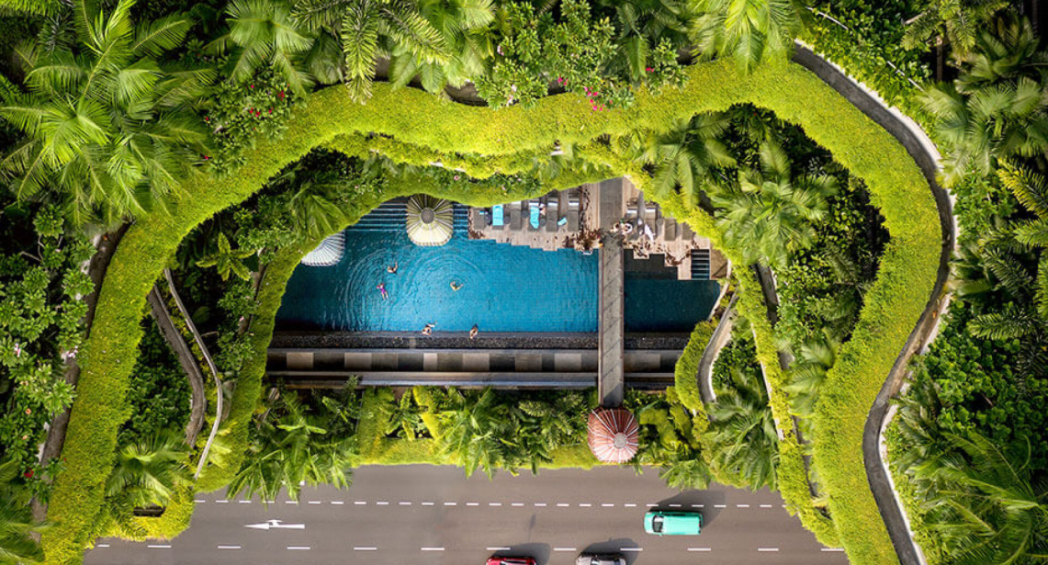
Introduction
(Source: Chernova, 2023)
Topaz Mansion can become a more sustainable hospitality company by aligning its operations with sustainable principles.
Sustainability improved guest experiences and satisfaction in the present environment.
Notes:
This presentation will assess a detailed overview of Topaz Mansion along with its target market. Sustainability strategies for this company will be suggested in this paper supported by examples. Finally, this presentation will present different creative elements and visuals related to the topic in detail.

Slide 3

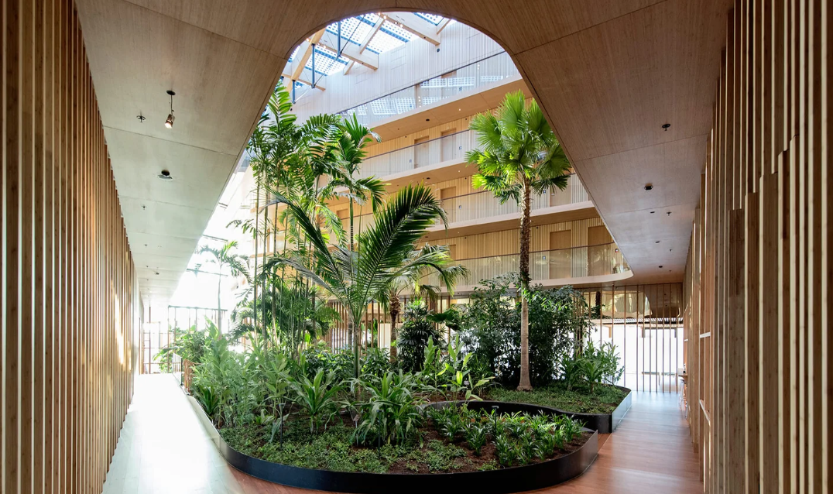
Overview of Topaz Mansion
(Source: Chernova, 2023)
Topaz Mansion is going to be launched in the UK within the next few months as a new five-star hospitality organisation.
It will be located in London and it is going to showcase the rich heritage values of Britain.
Royal and sustainable accommodations will be the main characteristics of the selected hotel (Elphick, 2024).
Notes:
Topaz Mansion will be an eco-friendly and sustainable hospitality organisation. It is going to serve regional and British cuisine for its potential customers (Elphick, 2024). It will include over 100 rooms which will lead this company to serve a large number of customers at a single time. This organisation will use renewable energy, reduce waste reduction and boost water conservation to become more sustainable (Elphick, 2024).

Slide 4
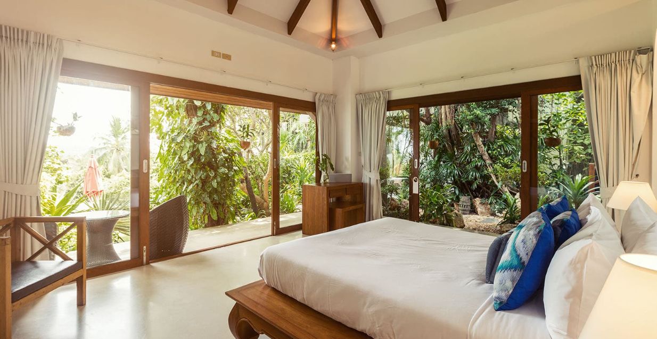
Sustainability Strategies
(Source: Chernova, 2023)
Topaz Mansion needs to implement sustainable practices and operations to become a greener accommodation organisation.
Energy efficiency, water conservation, waste management as well as food and beverage management can make this company sustainable.
It will become capable of attracting environment-friendly customers and enhancing the overall brand reputation through sustainable actions (Fredericks, 2025).
Notes:
Hotels can easily improve their energy efficiency by reducing the use of high-energy consumption devices. They have the suitability of utilising renewable energy sources to become more sustainable. They can implement windmills, solar panels and geothermal energy to avoid the use of fossil-fuelled energy (Green Business Benchmark, 2024). Topaz Mansion has efficient lighting to decrease the overall energy consumption. The installation of smart systems and energy-efficient appliances will surely lead this company to boost its emergency efficiency. Topaz Mansion may install a living wall as a vital environmental and sustainable feature. It will enable this business to plant around thousands of trees to reduce the overall emissions and provide habitat to wildlife (Green Business Benchmark, 2024). This technique is essential for balancing the indoor temperature of this hospitality business. The application of water conservation initiatives makes the selected business to become greener. It assists hotels in reducing the wastage of water and enhancing conservation activities. Low-flow fixtures and rainwater harvesting are two effective techniques for improving the water conservation activities of this business. Topaz Mansion can install responsible irrigation systems for the living wall to manage the conservation of water properly (Fredericks, 2025).

Slide 5
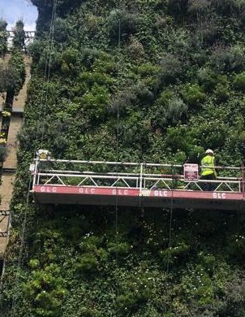
Contd…
(Source: Chernova, 2023)
The proper management of waste will be essential for Topaz Mansion to become more sustainable.
It will also need to manage food and beverages strategically to reduce waste creation as well as promote local sourcing (Elphick, 2024).
Topaz Mansion can attract a large number of environment and healthy food-conscious customers through these strategies.
Notes:
Recycling programs, composting and the reduction of single-use plastics can enhance the waste management practices in hotels. They may also use sustainable and eco-friendly materials to reduce the creation of waste. Topaz Mansion can try to remove single-use plastic bottles as soon as possible. It has developed a partnership with sustainable companies to offer glass-bottled spring water to its guests (Green Business Benchmark, 2024). The removal of plastic plates and straws can reduce the creation of waste in the Topaz Mansion. Food and beverage waste reduces the profitability as well as environment-focused activities of companies. Reusable amenities like coffee cups, water bottles and cutleries can improve the management of food as well as beverages in hotels (Green Business Benchmark, 2024). Topaz Mansion may purchase food and beverages from local markets including Borough Market to support the local community. It also delivers organic and plant-based food to showcase itself as a health-conscious hotel to its customers (Elphick, 2024).

Slide 6
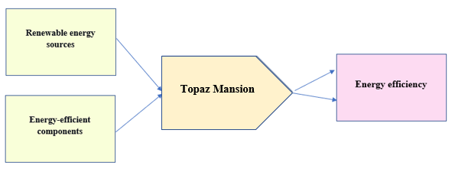
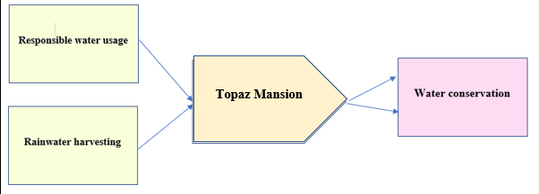
Visual and Creative Elements
The use of renewable energy sources and energy-efficient components will assist Topaz Mansion in reducing overall energy consumption.
Responsible water usage and rainwater harvesting are two suitable options for the selected hotel to improve its water conservation actions.
(Source: Chernova, 2023)
Notes:
The utilisation of energy efficient options will lead Topaz Mansion to reduce expenses behind energy consumption. It will be able to safeguard water and reduce the wastage of this component through its responsible water utilisation activities (Chernova, 2023).

Slide 7
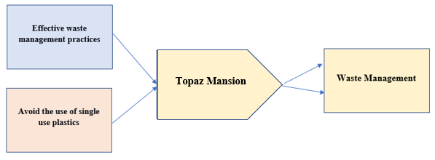
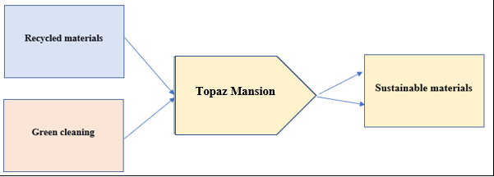
Contd…
(Source: Chernova, 2023)
Topaz Mansion can implement effective waste management practices and avoid the use of single use plastics to reduce waste generation.
It needs to use recycled materials and green cleaning products to become a more sustainable organisation.
Notes:
The application of waste management strategies can support Rubens Hotel in reducing its footprint in soil and water pollution. It will be able to reduce the use of single-use plastics through its waste management practices. Recycled and green materials are essential for Topaz Mansion to showcase itself as a green organisation (Zeigermann, 2021).

Slide 8
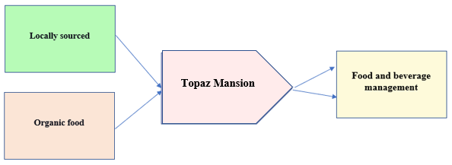
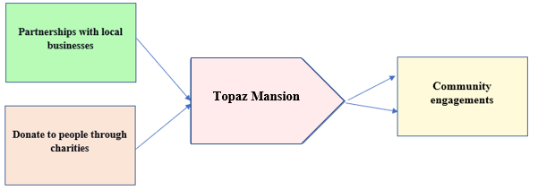
Contd…
Topaz Mansion may apply locally sourced and organic food as well as beverages to deliver healthy eating options to guests.
It can develop partnerships with local businesses and donate to people through charities to boost community engagement.
(Source: Chernova, 2023)
Notes:
Organic food options can improve the guest satisfaction and locally sourced items will improve the social contribution of Topaz Mansion. The enhanced community engagements are capable of boosting the social image and brand reputation of the selected hotel (Chernova, 2023).

Slide 9
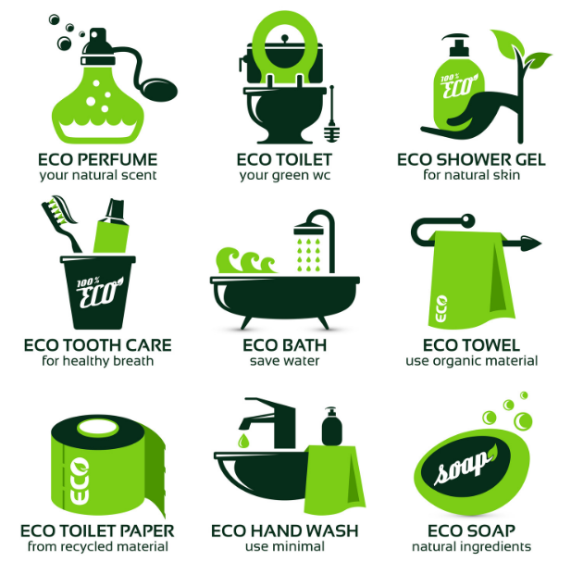
Conclusion
(Source: Chernova, 2023)
Hotels can become environment and community-focused by applying sustainable practices.
They become capable of attracting environment-conscious customers easily with the help of their green actions.
Topaz Mansion will also be capable of moving towards becoming a more sustainable hospitality company to enhance the overall guest experiences and brand image.
Notes:
This presentation has presented a detailed background and target market of Topaz Mansion. The implementation of sustainable strategies can make this company greener and environment-friendly. This study will recommend sustainability stages for the proposed hotel. Finally, visual and creative components related to the topic have been analysed in this presentation in an effective way.

Slide 10
References
(Source: Chernova, 2023)
Chernova, N., (2023). “Drinks in HEL” Food tourism route across distilled beverage experiences in Helsinki.
Elphick. D., (2024). Hotel sustainability: A full guide for hotel owners. Available at https://www.siteminder.com/r/hotel-sustainability/ [Accessed 06 May 2025]
Elphick. D., (2024). How to start a hotel business plan? Available at https://www.siteminder.com/r/hotel-business-plan/ [Accessed 05 May 2025]
Fredericks. L., (2025). Sustainable Hotel Ideas: 25 Ways to Go Green. Available at https://www.cvent.com/en/blog/hospitality/eco-friendly-hotel-ideas [Accessed 06 May 2025]
Green Business Benchmark, (2024). Sustainable Hospitality: How to Create a Sustainability Plan for Hotels. Available at https://greenbusinessbureau.com/industries/hospitality/sustainable-hospitality-how-to-create-a-sustainability-plan-for-hotels/ [Accessed 06 May 2025]
Zeigermann, U., (2021). Scientific knowledge integration and the implementation of the SDGs: comparing strategies of sustainability networks. Politics and Governance, 9(1), pp.164-175.
Notes:
Chernova, N., (2023). “Drinks in HEL” Food tourism route across distilled beverage experiences in Helsinki.
Elphick. D., (2024). Hotel sustainability: A full guide for hotel owners. Available at https://www.siteminder.com/r/hotel-sustainability/ [Accessed 06 May 2025]
Elphick. D., (2024). How to start a hotel business plan? Available at https://www.siteminder.com/r/hotel-business-plan/ [Accessed 05 May 2025]
Fredericks. L., (2025). Sustainable Hotel Ideas: 25 Ways to Go Green. Available at https://www.cvent.com/en/blog/hospitality/eco-friendly-hotel-ideas [Accessed 06 May 2025]
Green Business Benchmark, (2024). Sustainable Hospitality: How to Create a Sustainability Plan for Hotels. Available at https://greenbusinessbureau.com/industries/hospitality/sustainable-hospitality-how-to-create-a-sustainability-plan-for-hotels/ [Accessed 06 May 2025]
Zeigermann, U., (2021). Scientific knowledge integration and the implementation of the SDGs: comparing strategies of sustainability networks. Politics and Governance, 9(1), pp.164-175.

Slide 11
I confirm that I have not used any AI tools in the research and creation of this assignment. I confirm that I have not presented any AI generated materials as my own work. I confirm I have copies of my drafts, notes, and other resources I used, which I may be asked to provide in evidence.

