Slide 1
Dance in Context
Week 1
Claire Mackerras

Slide 2
Aims of the session
Discuss the importance of structure of Analysis
Discuss the importance of and create definitions for a variety of key words.
Discuss the importance of chronological order/ timelines
Introduction to bibliography – Ref Works

Slide 3
TIMELINES
Key Events
Inventions
Leaders which had a major impact on world’s history.
Create your own timeline of your dance career to date./ (Chronological order)

Slide 4
Analysis
The process of breaking a complex topic or substance into smaller parts to gain a better understanding of it.
Think of 10 words directly linked with Analysis.

Slide 5
Analysis
Breakdown
Inquiry
Study
Division
Scrutiny
Dissection
Examination
Search
Reasoning
Subdivision
Partition
Resolution
Test
Resolve
Consider
Estimate
Evaluate

Slide 6
A structure for Analysis
A time and a Place for Dance Analysis
The Arts: the need for analysis
The nature of Dance Analysis
The uses of Dance Analysis
Language and Dance Analysis

Slide 7
A Time and a place for
Dance Analysis
Dance had reached a crucial point in which it needed to be analysed.
1980- signs that dance would be added to the subjects offered in the school leaving examinations in England and Wales, (GCE ‘O’ Level). It would offer a broader course catering more readily for the ordinary school pupils experience of contemporary dance forms.
1986- change to GCSE had produced a number of new dance syllabuses.
1986- GCE ‘A’ Level studying dance to university entrance standard.
Degrees with substantial dance components were in existence but were not necessary linked to teacher education were established in higher education.
Historic association with physical education.
1950’S/ 1960’S framework
1970- Higher educational changes physical education
Dance was taking over/ cuckoo in the nest/ Artistic rationale sharing human body in motion and perhaps aesthetic interest.
Degrees/ other arts two subject degrees
BA (Hons) solely in dance/ graduates late 1970’s- Laban Centre for Movement and Dance
Notes:
General Certificate of Education (GCE)

Slide 8
A Time and a Place for Dance Analysis
Further degrees developed London Contemporary / Surery
While courses developed it showed the shaky theoretical underpinnings of the study of dance.
Outside field of formal education research strengths in dance have long existed in the UK, particularly in dance history, and training strengths in the specialist training of ballet/ contemporary dancers.
Develop dance as a subject to study within a framework/ Difference of Vocational approach/ extensive content structured approach.
Anthropology
History
Psychology
Sociology
Theology
These disciplines have something very useful to contribute to an understanding of the place and purposes of dance in the wider context
Notes:
Anthropology: study of human's, past and present, that draws and builds upon knowledge from the social sciences and biological sciences, as well as the humanities and the natural sciences.
Theology: is the systematic and rational study of concepts of God and the nature of religious truths, or the learned profession acquired by completing specialized training in religious studies.

Slide 9
A time and a Place for Dance Analysis
The examination of dance in its depth, by analysis has been slow to develop. Why??
Transience of dance reason.. How has it changed now?
Not the intention to explain the making of dances in terms of the psychological processes of the choreographers mind but to offer a means of refining the skills of appreciation , skills which are relevant to the choreographer as to the director, historian or teacher.
Notes:
Transience- The state or fact of lasting only for a short time

Slide 10
The Arts: the need for Analysis
Conflicting views of art educators/ choreographers and dancers – Why
The need to engage
When a new dance genre emerges the critic has to be thoroughly familiar with existing forms in order to see how and in what ways the new dance diverges from previous practices and how it draws on them. Being familiar with the varied types of the art allows the spectator to formulate criteria based in interpretative and evaluative principles.
To watch a dance and see and hear its complex interweaving of rhythms and patterns and to perceive the way in which theses contribute to the imaginative significance of the whole construction is, similarly, both the excitement of, and justification for, engaging in analysis.
Scepticism development of new theories since theorists exist to be challenged for their capacity to illuminate the activity that they chant.
What we want is to reinforce the possibility of giving reasons for opinions, of proving evidence to support an interpretation, of ascribing qualities to the art work and offering some means of judging its value. Promoting ones views in the name of criticism without giving reason is simply not good enough.
Notes:
Ascribing: regard something as being due to ( a cause)

Slide 11
The Nature of Dance Analysis
As soon as someone talks about dance this embarks upon analysis, to pick out features of an event and to match them against assumptions about what a dance is.
Characteristics/ distinguishing elements
What is meant by analysing dance works?

Slide 12
The Nature of Dance Analysis
Analysis provides a structure for the knowledge that is needed to frame interpretations and increase the possibility of becoming imaginatively and creatively involved in a work.
Dance does this by taking in account its conceptual structure, of the movements present in the dance, allowing the possibility of a minutely detailed examination of its parts, but it also permits a synthesis of the results of detailed observations with contextual knowledge, when then furthers the process of interpreting and evaluating dance.
Dance Analysis does not remain solely at the level of a description of movement as ‘ movement theory’. The notion of interpretation requires that the character of the dance, its subject matter, the treatment of that subject matter and the qualities that might be ascribed are also understood. This is beyond the scope of theories that simply analyse movement.
Appreciating dance is a complex process which depends on individuals having certain skills.

Slide 13
The Nature of Analysis
Example:
Skills of noting or observing separate movement components of the dance and being able to perceive them as related or unrelated happenings.
Constructing a clear picture of the movements and the way in which they coexist, of the dancers, as individuals and as groups, of the performing environment, costumes and sound, is the basis of analysis.
Spectator/ difficult as rushes by./ Making sense drawing on them what they know about dances/ subject matter and engaging imaginatively with it in order to ascribe certain qualities and attribute meaning to the dance.

Slide 14
The Nature of Analysis
Making sense of a dance requires, that an interpretation is made, derived from a rigorous description of the movement and supported by additional knowledge of the context the dance exists. Not just the historical or biographical facts of the world's provenance, nor simply the details of the movement and its structuring but the cumulative effect of acquiring this knowledge and then seeing how these elements are transmuted in the whole. The dance may have a purpose or function, primarily as an art work or as a ritual act of these simultaneously.
Understanding the individual circumstance of each dance is crucial to interpretation.
These factors are relevant in understanding this significance of a dance and it is at this point that contextual knowledge of dance, embodied in studies from dance history, sociology, anthropology and theology becomes valuable
To take an anthropological or historical starting point is to conduct a different type of study based primarily on the interests and methodologies of those disciplines.

Slide 15
The uses of Dance Analysis
The skills of analysis are relevant not only those involved in ‘academic’ studies but also that they are central in making the dance.
Where else does this happen in dance?
Discuss/ Groups

Slide 16
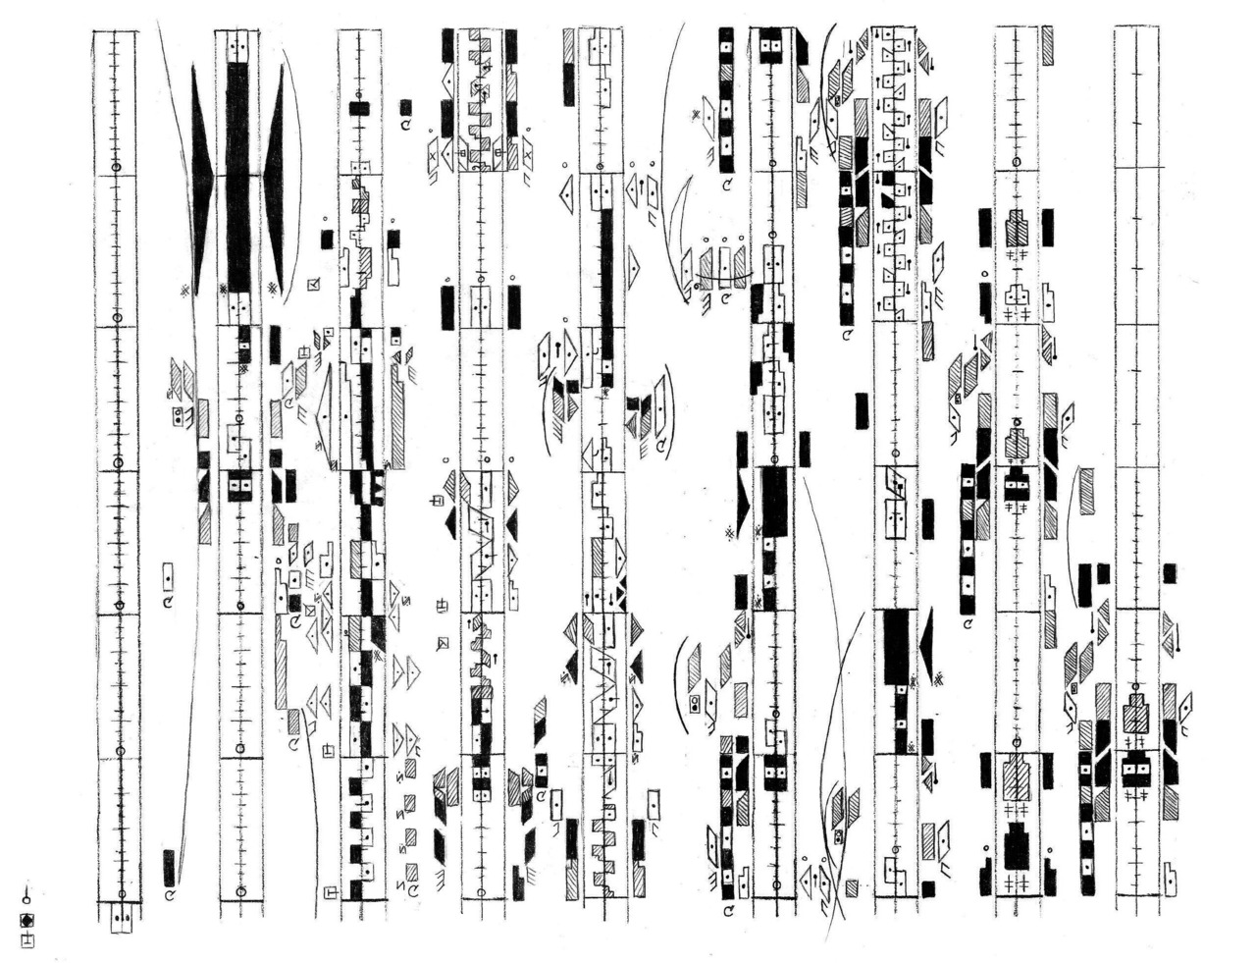
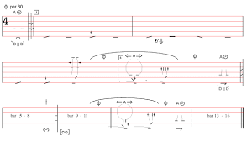
Language and Dance Analysis
Terminology
Notation/ interpretations- dilemma
Dance Notation Journal Becker and Roberts (1983) debate the problem of recapturing the quality ( a matter of aesthetic ascription)
Bissell (1983) same journal.
Rich sources of information/ anthropological research/ dance making history. Augment analysis and provide certain kinds of insight which do not result solely from a viewing a performance.
Greater clarity of language and terminology is an essential precursor to the valid use of this range of important sources in the analysis of dances.

Slide 17
Read Copeland (in carter, 1998, pp.98-107) and summarise the anti- analysis arguments. Consider whether you agree/ disagree with any of these, and ask yourself why.

