Slide 1
Dr. Millissa Cheung
*Some of sources are adopted from McGraw Hill
BMMB 7007 HRM
How to build & maintain Employee
Relationship

Slide 2
The Labor Relations Framework 1 of 2
Dunlop, Industrial Relations Systems - a successful industrial relations system
  An environmental context
  Participants
  A “web of rules”
  Ideology
It does not eliminate conflict.
  Collective bargaining, mediation, arbitration, participation in decision making
  LO 14-1

Slide 3
The Labor Relations Framework 2 of 2
Katz and Kochan – three types of decisions
  Strategic level
  Functional level
  Workplace level

Slide 4
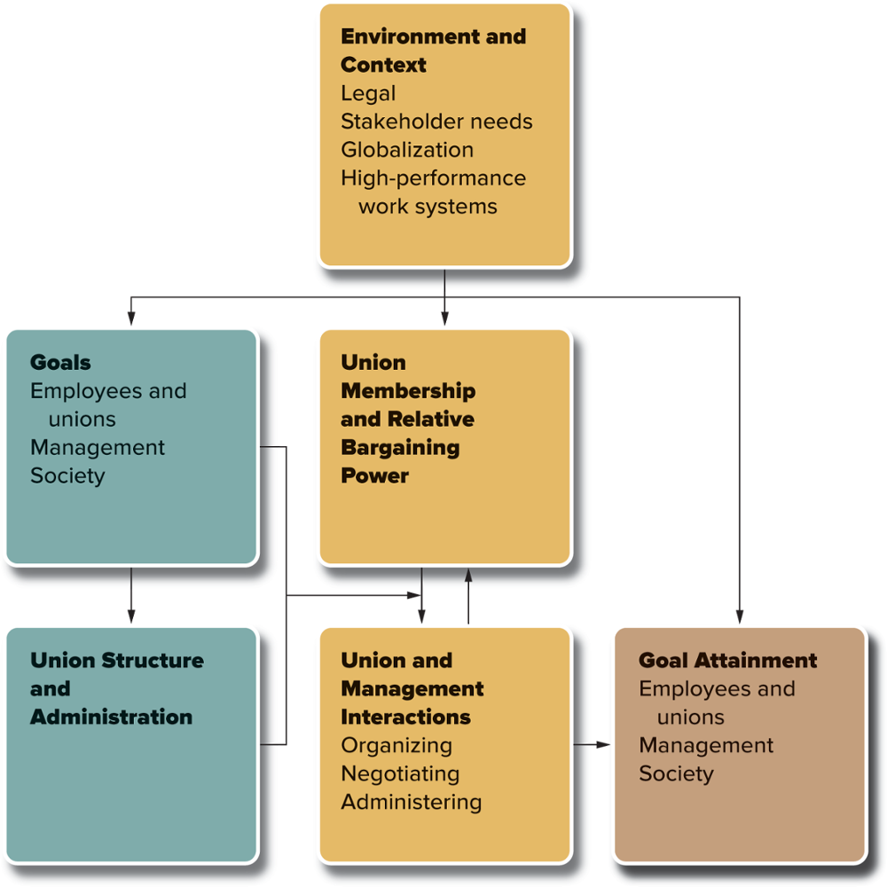
Figure 14.1 A Labor Relations Framework
Jump to long description in appendix
SOURCE: AFL-CIO, http://afl-cio.org/About/What-the-AFL-CIO-Does, accessed April 29, 2017.

Slide 5
Goals and Strategies 1 of 3
Society
  Labor unions’ major benefit to society is the institutionalization of industrial conflict.
  Unilateral control by management sacrifices workers’ rights.
  LO 14-2

Slide 6
Goals and Strategies 2 of 3
Management
  Discourage or encourage unions?
  Shifts focus from dealing with individuals to dealing with a group

Slide 7
Goals and Strategies 3 of 3
Labor Unions
  Give workers a formal and independent voice in setting the terms and conditions of their work
    Wages and safety and welfare

Slide 8
Table 14.1 Typical Provisions in Collective Bargaining Contracts 1 of 8
Establishment and administration of the agreement
  Bargaining unit and plant supplements
  Contract duration and reopening and renegotiation provisions
  Union security and the checkoff
  Special bargaining committees
  Grievance procedures
  Arbitration and mediation
  Strikes and lockouts
  Contract enforcement

Slide 9
Methods
-Collective bargaining contracts
Functions, rights, & responsibilities
Provision of incentives and leaves
Training & development
Labor unions/Assocations
-social contracts
Mentoring
Recognition
Social gathering
Employee participation

Slide 10
Table 14.1 Typical Provisions in Collective Bargaining Contracts 2 of 8
Functions, rights, and responsibilities
  Management rights clauses
  Plant removal
  Subcontracting
  Union activities on company time and premises
  Union–management cooperation
  Regulation of technological change
  Advance notice and consultation

Slide 11
Table 14.1 Typical Provisions in Collective Bargaining Contracts 3 of 8
Wage determination and administration
  General provisions
  Rate structure and wage differentials
  Allowances
  Incentive systems and production bonus plans
  Production standards and time studies
  Job classification and job evaluation
  Individual wage adjustments
  General wage adjustments during the contract period

Slide 12
Table 14.1 Typical Provisions in Collective Bargaining Contracts 4 of 8
Job or income security
  Hiring and transfer arrangements
  Employment and income guarantees
  Reporting and call-in pay
  Supplemental unemployment benefit plans
  Regulation of overtime, shift work, etc.
  Reduction of hours to forestall layoffs
  Layoff procedures; seniority; recall
  Work sharing in lieu of layoff
  Attrition and promotion arrangements
  Training and retraining
  Relocation allowances
  Severance pay and layoff benefit plans
  Special funds and study committees

Slide 13
Union Structure, Administration, and Membership 1 of 8
National and International Unions
  American Federation of Labor and Congress of Industrial Organizations (AFL-CIO)
  Unions are craft or industrial

Slide 14
How to file a grievance ?

Slide 15
Table 14.11 Steps in a Typical Grievance Procedure 1 of 3
Employee-initiated grievance
  Step 1
    Employee discusses grievance or problem orally with supervisor.
    Union steward and employee may discuss problem orally with supervisor.
    Union steward and employee decide (1) whether problem has been resolved or (2) if not resolved, whether a contract violation has occurred.

Slide 16
Table 14.11 Steps in a Typical Grievance Procedure 2 of 3
Employee-initiated grievance continued
  Step 2
    Grievance is put in writing and submitted to production superintendent or other designated line manager.
    Steward and management representative meet and discuss grievance. Management’s response is put in writing. A member of the industrial relations staff may be consulted at this stage.
  Step 3
    Grievance is appealed to top line management and industrial relations staff representatives. Additional local or international union officers may become involved in discussions. Decision is put in writing.

Slide 17
Table 14.11 Steps in a Typical Grievance Procedure 3 of 3
Employee-initiated grievance continued
  Step 4
    Union decides on whether to appeal unresolved grievance to arbitration according to procedures specified in its constitution and/or bylaws.
    Grievance is appealed to arbitration for binding decision.
  Discharge grievance
    Procedure may begin at step 2 or step 3.
    Time limits between steps may be shorter to expedite the process.
  Union or group grievance
    Union representative initiates grievance at step 1 or step 2 on behalf of affected class of workers or union representatives.
SOURCE: From H. C. Katz, T. A. Kochan, and A. J. S. Colvin, An Introduction to Collective Bargaining and Industrial Relations, 4e, 2008. Reprinted with permission of The McGraw-Hill Companies, Inc.

Slide 18
Labor Relations Outcomes 1 of 2
Strikes
  Most recent strikes have involved white-collar employees
  Strikes are the exception
Wages and Benefits
    Unions influence pay, benefits, and promotions
    Although wages and benefits are higher for union members, job satisfaction is lower, on average.

Slide 19
Labor Relations Outcomes 2 of 2
Productivity
  Unions both help and hurt productivity.
  Union workers are generally believed to be more productive than nonunion workers overall.
Profits and Stock Performance
  A company’s profits and stock performance may suffer if unions raise costs

