Slide 1




Task 2 - Individual academic presentation
Module name: Knowledge and Information Management Skills for the Workplace
Module code: BMSW5106
Assignment title: Academic Presentation
Student name: Luigi – Stefan Butoi
Student number: 1816330
Link to the video recording of the presentation:
https://web.microsoftstream.com/video/32689904-15c0-4c35-8d40-3b11cafad1d5

Slide 2

Information Systems
There are multiple information systems that can help business expand and proceed towards a successful path in a specific market.
In my report I have covered a few examples, but there is a second type of systems that was not covered in the report which is the Manual Information System where data is collected, processed and stored in the old fashioned way without the help of computers, on paper inside the business archive. This method is outdated but still effective as it can be stored safer than online data where hackers can steal important information about the business. However, manual information system is a slow process which requires more human interaction than the computer based information system which is not cost effective and such physical stored information can still be lost or misplaced due to human error.

Slide 3

Computer based information system (CBIS)
There are a couple of components of CBIS that were not mentioned in the report, the following components are:
Hardware
Software
Database
People
Telecommunication
Procedures
These components make this information system a very reliable and productive method of collection, storing and processing data into information.

Slide 4

CBIS Limitation and Disadvantages
There are multiple limitations and disadvantages of using CBIS which have not been covered in the report, these limitations cand occur because technology is still a developing process and it has not reached the “perfect” stage therefore this type of system can cause issues or disruption within the business.
Some of the limitations are:
Judgement/experience – Artificial intelligence is not experienced like humans
Improvisation and flexibility – No reaction to unpredicted events
Innovation – Lack of creativity
Intuition – Human intuition can help interact with certain people and understand them better.

Slide 5
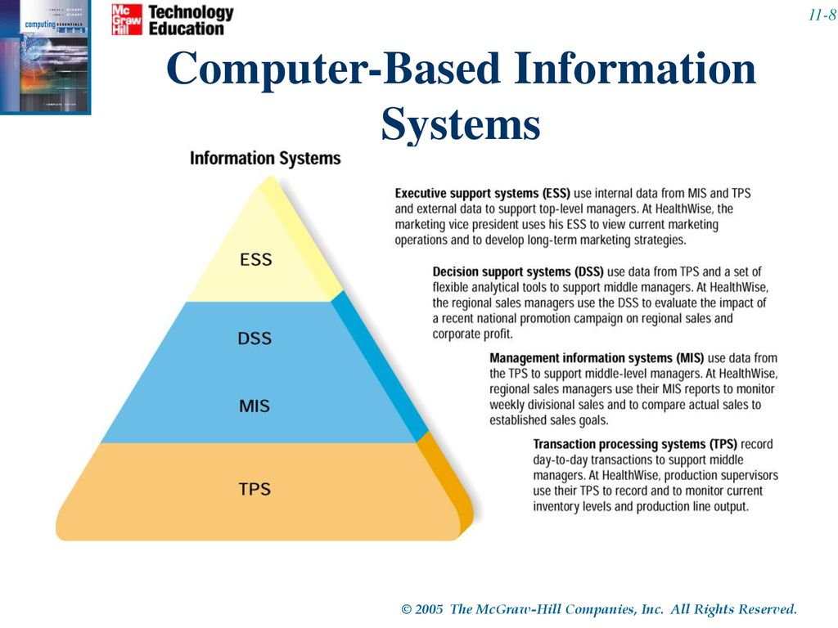
Types of Computer Information Systems (CIS)

