Slide 1
LEVEL 4 ASSESSMENT SPECIFICATION .
Student: 2433717 Dwayne Myers
Cert he business skills for the work place.
Lclm4003
Effective team work and communication.
Tutor:???
ASSIGNMENT TITLE: solo PRESENTATION – FLIGHT FOODS LTD
NARUTRE OF BUSINESS: THE MANUFACTURE & SALES OF READY MEALS TO AIR LINES

Slide 2
back GROUND OF PRESENTATION
  This is a company that makes and supply's Airline flights food, they have been recently been providing poor services which we will cover in the slide to come. The plan is get the company flight for food back on track after carefully examining the company's issues .
  The communication barriers presented in this case study are:
Slide 1: introduction page
Slide 2: Background of presentation
Slide 3: Environmental noise
Slide 4: Language/Communication/Body language
Slide 5: Age/Generational
Slide 6: Cultural (standards and practices)
Slide 7: Emotional
Slide 8: My suggestions pf ways to over come barriers
Slide 9: Berlo method
Slide 10: Diagram of Berlo method
Slide 11: Communication Barriers improvement skills

Slide 3
Environmental noise :
The Consultancy firm hired to investigate the problems stated that the building has good space plus ventilation which is downside by being overwhelmed with outdated machinery .
Gary pointed out to the factory area that was to noisy for communication because of the clinking & banging caused by machinery.

Slide 4
Language/Communication/Body language:
The floor manager, Gary, an Englishman from London’s East End.
Signs stating that workers must: “Keep your hairnets on at all times/Wash your hands regularly/Do not chat when operating the machinery/ Keep fresh meat chilled”. Workers aren’t following instructions.
Noisy atmosphere which is affecting communication between the work force.
Gary pointing out to the noisy machinery would show he is annoyed in body language
Gary the floor manager from London(east end) stated that “ I tried my best, but the staff aren’t trained in food hygiene”.{ Gary is qualified in food and hygiene} also they speak their own language.

Slide 5
Age/Generational:
As it states that a Consultancy firm was hired to investigate the problems which states the workforce is made up of 40 staff members aging from 16 years of age to 60 years of age from 5 culture back groups.
Some of thee Common Barriers across all age groups 16-60 in a work place can be:
Generational: approach on how tasks are completed. Communication differences as some may prefer calls rather that to text message.
Barriers between employees aged 16 to 60 in the workplace largely stem from generational differences in technology adoption, communication styles, and deeply rooted, often inaccurate, stereotypes. As workplaces become more age-diverse, with up to four or five generations working together, these gaps can lead to misalignment in work expectations, reduced collaboration, and, in some cases, ageism that impacts both younger and older employees.
Forbes +3 https://www.google.com/search?q=what+are+the+barriers+between+age+groups+from+16-60+in+a+work+place&client=tablet-android-samsung-ss&hs=eOQp&sca_esv=db2351f46a6aa745&biw=1204&bih=538&ei=EaugacC1EdulhbIPpaSciQQ&ved=0ahUKEwiAgqLS_feSAxXbUkEAHSUSJ0EQ4dUDCBE&oq=what+are+the+barriers+between+age+groups+from+16-60+in+a+work+place&gs_lp=Egxnd3Mtd2l6LXNlcnAiQ3doYXQgYXJlIHRoZSBiYXJyaWVycyBiZXR3ZWVuIGFnZSBncm91cHMgZnJvbSAxNi02MCBpbiBhIHdvcmsgcGxhY2VI7qACUPUQWJSXAnACeACQAQCYAbIDoAGCPKoBCjMuMjcuNy40LjG4AQzIAQD4AQGYAg-gAoQVwgILEAAYsAMYogQYiQXCAggQABiwAxjvBcICCBAAGKIEGIkFwgIFEAAY7wXCAgQQIRgKmAMA4gMFEgExIECIBgGQBgOSBwgxLjEwLjMuMaAHiYMBsgcIMC4xMC4zLjG4B_sUwgcIMC4yLjEyLjHIB0mACAA&sclient=gws-wiz-serp

Slide 6
Cultural (standards and practices):
Cultural (standards and practices) its first of all a good practice for the leader to set the standards by example. As Gary states that he had went out with friends the night before, to find out meat had been let out on the kitchen sides which had gone off. Wasting commodities and bad hygiene practices.
Standards and practices in the workplace encompass the policies, procedures, and ethical guidelines implemented to ensure a safe, efficient, legal, and respectful working environment. These are generally split into regulatory compliance (legal requirements) and internal best practices (company-specific rules).
Flight food have been loosing business due to complaints from the air line department that food was at poor standards, from being under cooked.
Packaging being poorly prepared.
To meat been found in vegetarian meals.
Poor standards set by Gary. The head of food hygiene although he is a qualified in this position.
Gary state that he went to bed at 2 o’clock & woke at 6 o'clock which is sleep depravation, a loss of 6hrs sleep. Setting poor standards as the leader, also Gary states that he had coffee spills on his shirt.

Slide 7
Emotional:
Empathy in the workplace is the ability to understand, relate to, and share the feelings, perspectives, and experiences of colleagues, serving as a crucial component of emotional intelligence. It improves employee engagement, fosters innovation, and strengthens relationships by promoting active listening and compassionate, supportive responses, rather than merely offering sympathy.
Gary states that he try's his best but the staff arnt trained in food and hygiene before they start work because management wants them to start working right away. Gary also goes on to say that he has to do what he can to teach the staff on the job as he is qualified in food hygiene and safety. This show empathy as he cares about the proactiveness of the staff.

Slide 8
My Suggestion off the ways in which these barriers could be overcome are:
Key solutions would be integrational mentoring for younger and older team member's to share skills for example the swiftness of a youthful mind with the experience from the older team.
Reducing workplace barriers involves fostering inclusive communication, leveraging technology, and promoting a supportive culture. Key actions include adopting an open-door policy, implementing mental health training, and using diverse, accessible communication methods (e.g., visual aids). Key steps also include reducing physical and social barriers, using data for personalization, and eliminating unfair hierarchies.

Slide 9
In this regard, Berlo understands his model as "a model of the ingredients of communication". He identifies four basic components: source, message, channel, and receiver. The source is the party that wants to communicate an idea. They have to encode this idea in the form of a message.
Gary:
I try my best, but the staff are not trained in food hygiene before they start working because Management wants them to start working right away and I have to do what I can to teach them on the job as I am qualified in Food Hygiene and Safety. Most of them speak their own language with a few English words thrown in. So, in an average day I am running around in this madhouse, trying to explain to them what they had to do. (He pointed to the factory floor with all the machines clanking and banging)It is not easy. The older ones seem to understand, but the problem seems to be with the younger ones. It doesn’t matter what I tell them, they seem to do something else. So, since they couldn’t understand me, I plastered the walls with signs, as you can see:
“Keep your hairnets on at all times/Wash your hands regularly/Do not chat when operating the machinery/ Keep fresh meat chilled”.
They’re not a bad lot really, but they just don’t seem to understand.
In this text above it shows that the staff have difficulty in understanding the Berlo model by failing to clearly understand the source Garry, the message he was trying to deliver which was teaching food and hygiene safety the channel he used which was communication amongst noisy old machinery, then the receivers which were the 40 staff from 5 different cultural groups.

Slide 10
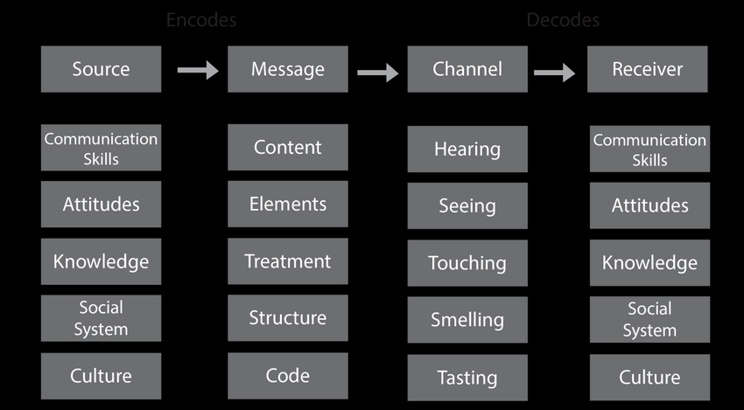

Slide 11
Communication Barriers improvement skills i would offer the company are:
Encourage Transparency: Implement an open-door policy, encourage direct communication, and maintain transparency from leadership to all levels.
Active Listening: Train employees in active listening to ensure they process information before responding.
Diverse Communication Methods: Use varied methods like newsletters, chat tools, and visual aids (diagrams/photographs) to ensure understanding.
Simplify Messaging: Avoid jargon, keep messages concise, and ensure communication is tailored to the recipient.
Language Support: Provide training or resources for language barriers to assist a diverse workforce.
ECI Software Solutions +6
Reference: https://www.ecisolutions.com/en-gb/blog/7-easy-tips-to-overcome-communication-barriers-in-your-workplace/

