Slide 1
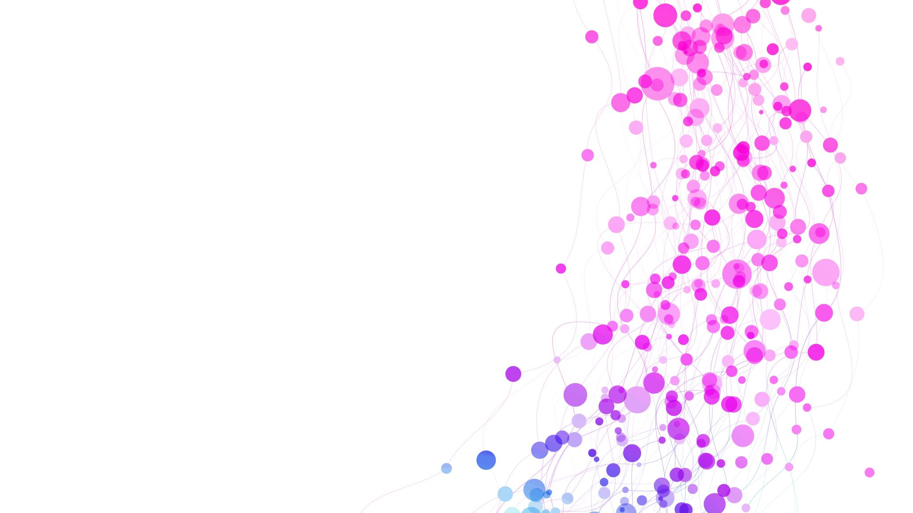
HIT Training - Case Study
By Cathryn Morgan
Student No. 2100313
BMSS6011: Evidence Based Practice in Exercise Science

Slide 2
What is HIT Training
High-Intensity Interval Training (HIT) is one of the most effective forms of training to improve physical performance (Bruchheit and Laursen, 2013).
The training consists of repeated long or short interval of high intensity exercise with recovery periods between (Foster et al., 2015). It is recommended that the athlete should spend several minutes in the ‘red zone’ above 90% of their V02max during HIT sessions for the optimum beneficial adaptations (Bruchheit and Laursen, 2013).
HIT can be used to improve sprint performance and/or endurance performance by adjusting the work to rest time for specific training (Kelly et al., 2021).

Slide 3
Why is HIT Training Important
Various studies show beneficial effects of HIT training to both aerobic and anaerobic capacity (Foster et al., 2015).
Reduced time of HIIT workouts is attractive (Foster et al., 2015).
Higher exercise intensities may be superior to moderate intensity for maximizing health outcomes (Karlsen et al., 2017).
According to Girard, Feng and Chapman, (2018) HIT training can improve a variety of performance variables in multiple sports:
  3k and 5k track times.
  Improvements in cycling time trial times.
  Evidence of improvements to peak velocity in some sports.

Slide 4

Client Information
Gender: Male
Age: 22
Height: 172.7
Weight: 67.6kg
Recreational Athlete that engages in physical activity regularly.
Goal: To improve cardiovascular ability for endurance running.

Slide 5
Pre-Training Testing
To measure whether the cardiovascular system has improved through HIT Training a VO2max test was taken before beginning the training programme and after completing training.
For a V02max test, the client cycled on a Wattbike (Wattbike, Nottingham, Uk) continuously as the test increased in power gradually until the client was cycling at maximum power and intensity that they could no longer continue the test, the final minute of breathing is collected to measure the clients V02max.
Test Results
Weight | Power | HR | Atmos O2 | Atmos CO2 | Sample Time | C02 | 02 | Bag Volume | VO2max
67.6kg | 190w | 214bpm | 20.8 | 0.02 | 58sec | 2.86 | 18.5 | 130.7L | 38.7

Slide 6
Workout Plan
As well as measuring the VO2max, the test revealed the maximum power and heart rate of the client to set a target power to aim for and to measure the heart rate during training sessions.
Work Time = 95% of 190watts = 180.5
Rest Time = 45% of 190watts = 85.5
Day | Monday | Tuesday | Wednesday | Thursday | Friday | Saturday | Sunday
Week 1 | Rest Day | Train | Rest Day | Train | Rest Day | Train | Rest Day
Week 2 | Rest Day | Train | Rest Day | Train | Rest Day | Train | Rest Day
Week 3 | Rest Day | Train | Rest Day | Train | Rest Day | Train | Rest Day
Week 4 | Rest Day | Train | Rest Day | Train | Rest Day | Train | Rest Day
Week 5 | Rest Day | Train | Rest Day | Train | Rest Day | Train | Rest Day
Training Days
Warm up:
Pedal comfortable pace for 5 minutes on the bike, 2 mins of dynamic stretches.
Main session:
4 minutes of pedaling at 180.5 Watts
2 mins of recovery pedaling at 85.5 Watts
Cool down:
Pedal at comfortable recovery pace, 2 mins of static stretching.

Slide 7
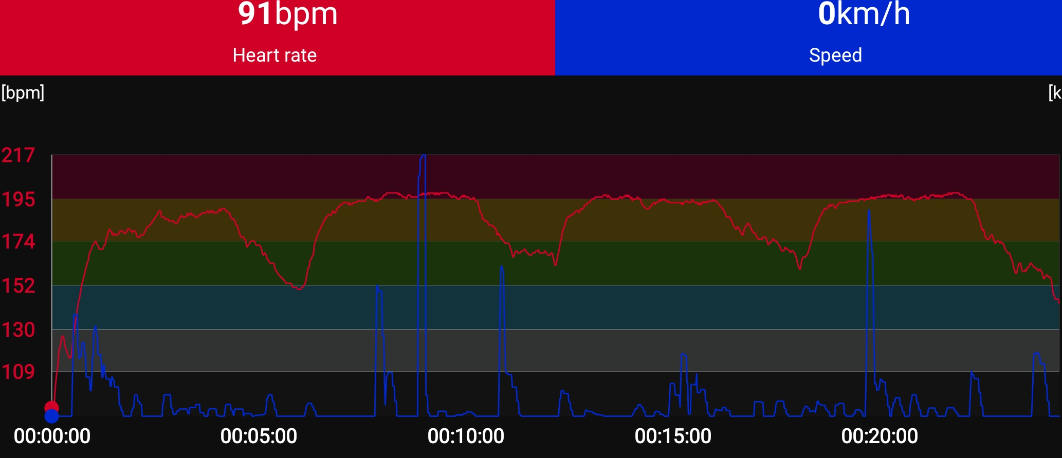
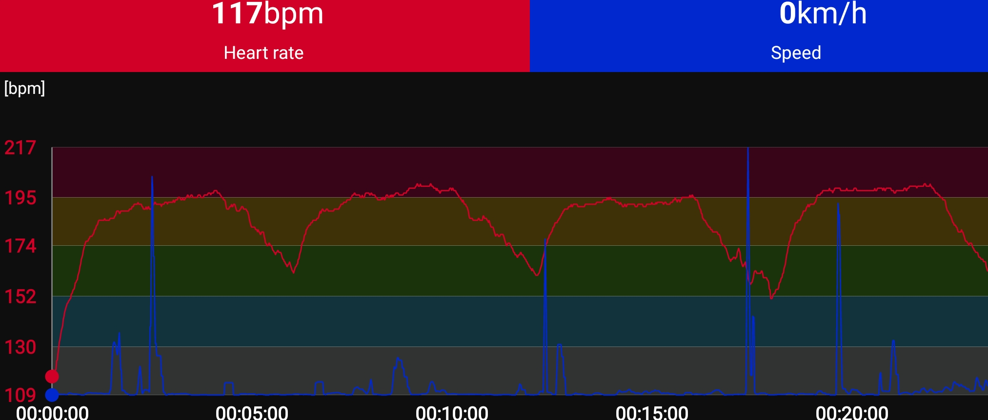



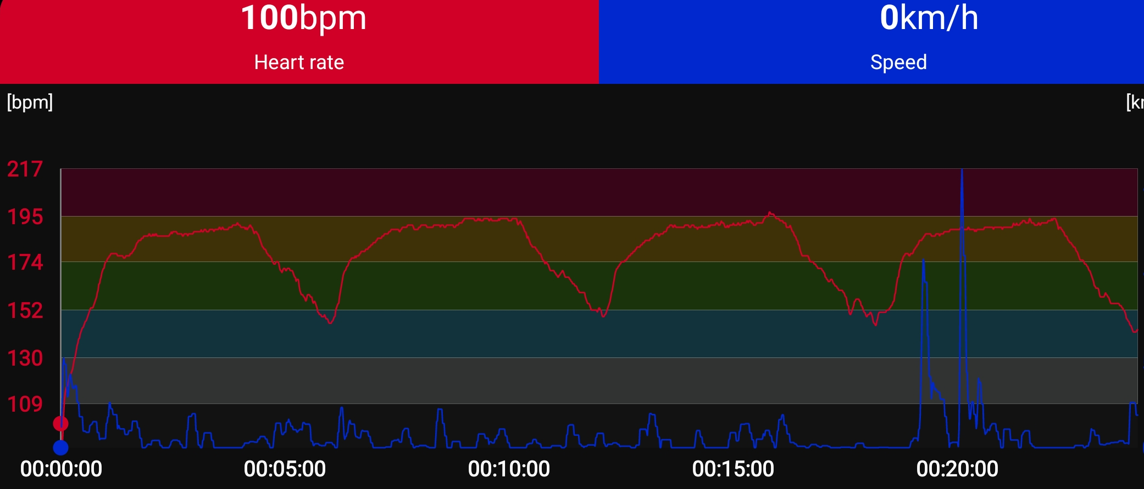
Training Progression
The Heart Rate was recorded during the exercise session
Session 1
Session 3
Session 5
Session 2
Session 4
Session 6

Slide 8
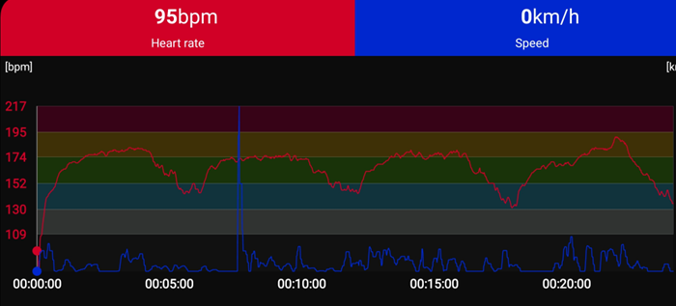
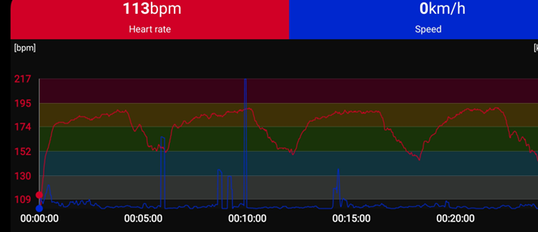
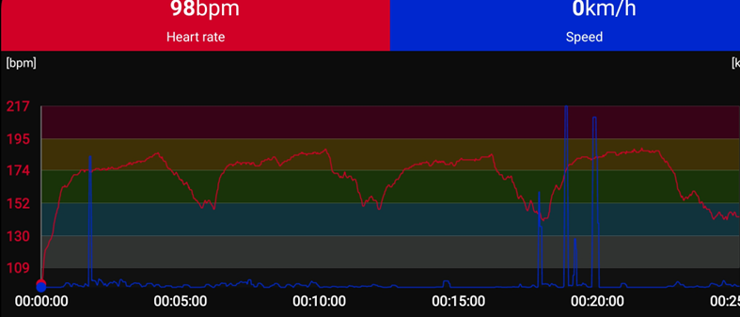
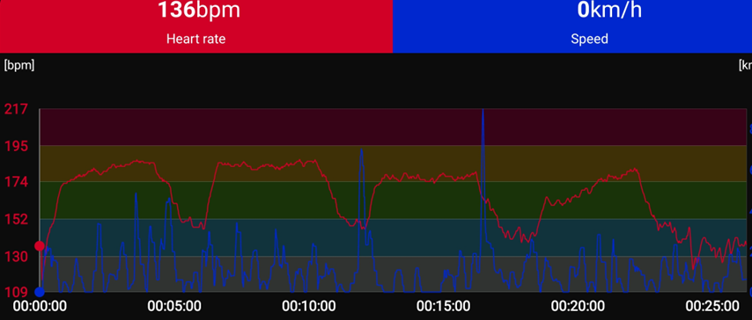
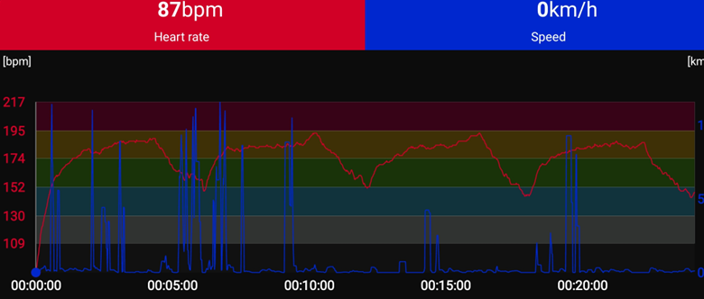
Session 7
Session 9
Session 11
Session 8
Session 10
The last 2 weeks of sessions did not reach a heart rate as high as the first 3 weeks. There could be multiple reasons for this, but it shows that the body is not working as hard as it was when the client started training.

Slide 9
Post-Training Testing
After completing the 5-week training the VO2max test was repeated to see if the client had made improvements throughout the training programme.
Test Results
Weight | Power | HR | Atmos O2 | Atmos CO2 | Sample Time | C02 | 02 | Bag Volume | VO2max
68.4kg | 205w | 213bpm | 20.7 | 0.08 | 60sec | 2.95 | 18.4 | 117.2L | 35.9

Slide 10
Improvements
The client had an improvement in power.
The client did not improve the V02max result, therefor they did not achieve the set goal of improving the cardiovascular system.
 | Before | After
Power | 190 | 205
V02max | 38.7 | 35.9

Slide 11
Is HIT Training Effective?
After 5 weeks of a HIT session programme, the client did not have an improvement in their V02max result. Therefore, the training did not show effective for this athlete.
Many tests are done with untrained athletes showing good results in Vo2Max development over a period of training sessions, this client has experience and is athletic already so these benefits may have gone unnoticed due to this already enhanced capacity.
A more conclusive study would involve multiple clients both trained and untrained to explore whether novice sports people or beginners see more benefit from HIT training.
The timescale of 5 weeks may have been too short to notice any improvements, and a test done over a longer period would help to investigate the aerobic development of already trained athletes.

Slide 12
References
Buchheit, M. and Laursen, P.B. (2013). High-intensity interval training, solutions to the programming puzzle: Part I: cardiopulmonary emphasis. Sports medicine, 43(5), pp.313-338.
Foster, C., Farland, C.V., Guidotti, F., Harbin, M., Roberts, B., Schuette, J., Tuuri, A., Doberstein, S.T. and Porcari, J.P. (2015). The effects of high intensity interval training vs steady state training on aerobic and anaerobic capacity. Journal of sports science & medicine, 14(4), p.747.
Girard, J., Feng, B. and Chapman, C. (2018). The effects of high-intensity interval training on athletic performance measures: a systematic review. Physical Therapy Reviews, 23(2), pp.151-160.
Karlsen, T., Aamot, I.L., Haykowsky, M. and Rognmo, Ø. (2017). High intensity interval training for maximizing health outcomes. Progress in cardiovascular diseases, 60(1), pp.67-77.
Kelly, D.T., Cregg, C.J., O’Connor, P.L., Cullen, B.D. and Moyna, N.M. (2021). Physiological and performance responses of sprint interval training and endurance training in Gaelic football players. European Journal of Applied Physiology, 121(8), pp.2265-2275.
Wattbike, (2024), Available at: https://www.wattbike.com Accessed: 17th May 2024

