Slide 1
Computer Architecture & OS ACCA4022
Week 4: Session 1 & 2: Number Systems

Slide 2
Learning Outcome
By the end of this session, students should be aware of:
Non-positional Number Systems
Positional Number System
Decimal Number System
Binary Number System
Octal Number System
Hexadecimal Number System
Number Conversion
Shortcut Methods of Number Conversion

Slide 3
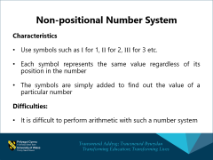
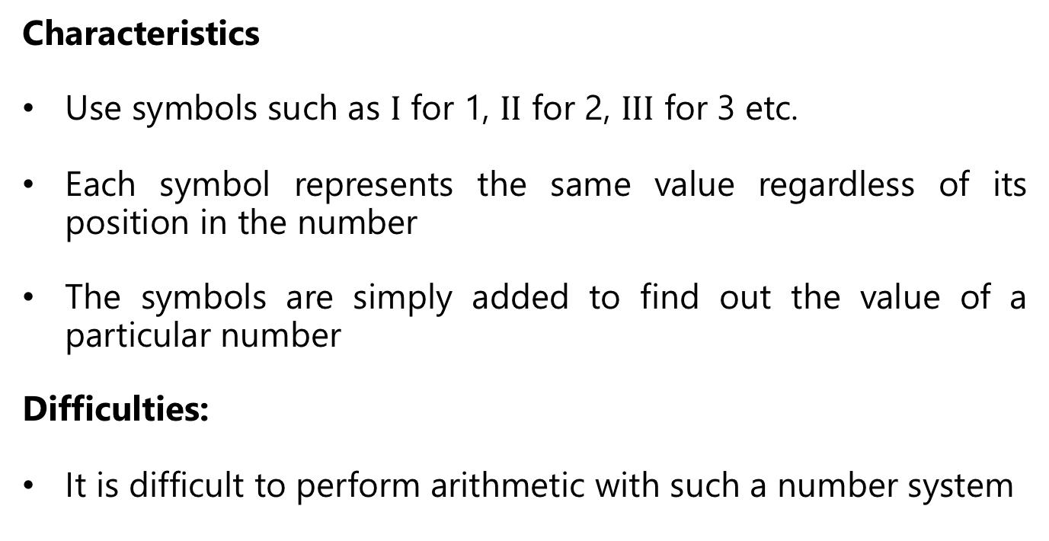

Non-positional Number System
Characteristics
Use symbols such as $Ι$ for 1, $ΙΙ$ for 2, $ΙΙΙ$ for 3 etc.
Each symbol represents the same value regardless of its position in the number
The symbols are simply added to find out the value of a particular number
Difficulties:
It is difficult to perform arithmetic with such a number system

Slide 4
Positional Number System
Characteristics
Use only a few symbols called digits
These symbols represents different values depending on the position they occupy in the number
The value of each digit is determined by:
  The digit itself
  The position of the digit in the number
  The base (total number of digits in the number system) of the number system
The maximum value of a single digit is always equal to one less than the value of the base

Slide 5
Characteristics of Numbering Systems
The digits are consecutive
The number of digits is equal to the size of the base
Zero is always the first digit
The base number is never a digit
When 1 is added to the largest digit, a sum of zero and a carry of one results
Numeric values are determined by the implicit positional values of the digits.

Slide 6
Significant Digits
Binary: 11101101
Most significant digit Least significant digit
Hexadecimal: 1D63A7A
Most significant digit Least significant digit

Slide 7
Decimal Number System
Characteristics
A positional number system
Has 10 symbols or digits (0, 1, 2, 3, 4, 5, 6, 7, 8, 9). Hence, its base is 10
The maximum value of a single digit is 9 (one less than the value of the base)
Each position of a digit represents a specific power of the base (10)
We use this number system in our day to day life
Example: (25)₁₀

Slide 8
Binary Number System
Characteristics
A positional number system
Has only 2 symbols or digits (0 and 1). Hence, its base is 2
The maximum value of a single digit is 1 (one less than the value of the base)
Each position of a digit represents a specific power of the base (2)
This number system is used in computers
Example: (1001)₂

Slide 9
Binary Number System
Base 2 Number | Base 10 Equivalent | Power | Positional Value
000 | 0 | 2⁰ | 1
001 | 1 | 2¹ | 2
010 | 2 | 2² | 4
011 | 3 | 2³ | 8
100 | 4 | 2⁴ | 16
101 | 5 | 2⁵ | 32
110 | 6 | 2⁶ | 64
111 | 7 | 2⁷ | 128

Slide 10
Octal Number System
Characteristics
A positional number system
Has total 8 symbols or digits (0,1, 2, 3, 4, 5, 6, 7). Hence, its base is 8
The maximum value of a single digit is 7 (one less than the value of the base)
Each position of a digit represents a specific power of the base (8)
Since there are only 8 digits, 3 bits (bits stands for binary digits), 2³ = 8 are sufficient to represent any octal number in binary
Example: (2057)₈

Slide 11
Hexadecimal Number System
Characteristics
A positional number system
Has total 16 symbols or digits (0,1, 2, 3, 4, 5, 6, 7, 8, 9, A, B, C, D, E, F). Hence, its base is 16
The symbols A, B, C, D, E, and F represent the decimal values 10, 11, 12, 13, 14, and 15 respectively
The maximum value of a single digit is 15 (one less than the value of the base)
Each position of a digit represents a specific power of the base (16)
Since there are only 16 digits, 4 bits (2⁴ = 16) are sufficient to represent any hexadecimal number in binary
Example: (1AF)₁₆

Slide 12
Number Conversions
Decimal to Binary Conversion:
The easiest way to convert a decimal number to its binary equivalent is to use the Division Algorithm
This method repeatedly divides a decimal number by 2 and records the quotient and remainder
The remainder digits (a sequence of zeros and ones) form the binary equivalent in least significant to most significant digit sequence

Slide 13
Number Conversions
Decimal to Binary Conversion Example
Convert 67 to its binary equivalent:
67₁₀ =( )₂
Step 1:: 67 / 2 = 33 R 1 Divide 67 by 2. Record quotient in next row
Step 2: 33 / 2 = 16 R 1 Again divide by 2; record quotient in next row
Step 3: 16 / 2 = 8 R 0 Repeat again
Step 4: 8 / 2 = 4 R 0 Repeat again
Step 5: 4 / 2 = 2 R 0 Repeat again
Step 6: 2 / 2 = 1 R 0 Repeat again
Step 7: 1 / 2 = 0 R 1 STOP when quotient equals 0
(1 0 0 0 0 1 1)₂

Slide 14
Number Conversions
Decimal to Octal Conversion Example:

Slide 15
Number Conversions
Decimal to Hexadecimal Conversion Example:
Convert 830₁₀ to its hexadecimal equivalent:
830 / 16 = 51 R14
51 / 16 = 3 R3
3 / 16 = 0 R3
= E in Hex
(33E)₁₆

Slide 16
Number Conversions
Binary to Decimal Conversion:
The easiest method for converting a binary number to its decimal equivalent is to use the Multiplication Algorithm
Multiply the binary digits by increasing powers of two, starting from the right
Then, to find the decimal number equivalnt, sum those products

Slide 17
Number Conversions
Binary to Decimal Conversion Example:
Convert (10101101)₂ to its decimal equivalent:
Binary 1 0 1 0 1 1 0 1
Positional Values
x
x
x
x
x
x
x
x
2⁷
2⁶
2⁵
2⁴
2³
2²
2¹
2⁰
Products
128 + 32 + 8 + 4 + 1
(173)₁₀

Slide 18
Number Conversions
Binary to Octal Conversion Example:
Now follow the Decimal to Octal Conversion method to get the answer
Is your answer (226)₈?

Slide 19
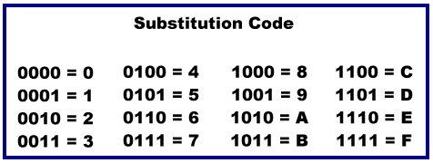
Number Conversions
Binary to Hexadecimal Conversion Example:
The easiest method for converting Binary to Hexadecimal is to use a substitution code
Each Hexadecimal number converts to 4 binary digits

Slide 20
Number Conversions
Binary to Hexadecimal Conversion Example:
Convert (1010101101001)₂ into Hexadecimal number.
Steps:
Take binary numbers
Divide the binary digits into groups of four (starting for right) for integer part and start from left for fraction part
Convert each group of four binary digits to one Hexadecimal digit
(This is simple algorithm where you have to grouped binary number and replace their equivalent Hexadecimal digit)

Slide 21
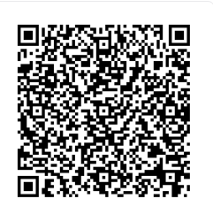
Online Assignment Skills Programme
Referencing Unit 1: Academic Integrity & Avoiding Plagiarism
moodle.uwtsd.ac.uk/mod/scorm/player.php?a=7377&currentorg=articulate_rise&scoid=16124&sesskey=8lTY5SBgOC&display=popup&mode=normal

Slide 22
References
M. M. Mano, Digital Logic and Computer Design, India: Prentice-Hall, 2003
V. Vijayendran, Fundamentals of Microprocessor – 8085, Chennai: S. Viswanathan (Printers & Publishers), PVT. LTD, 2004
W. Stallings, Computer Organisation and Architecture, London: Pearson, 2016
I. Englander, The architecture of Computer Hardware, Systems Software & Networking – An Information Technology Approach, London: John Wiley & Sons, 2014

Slide 23
Any Questions?

