Slide 1
Project Proposal
Ellie Rhodes- 265024
Supervisor- John Williams

Slide 2
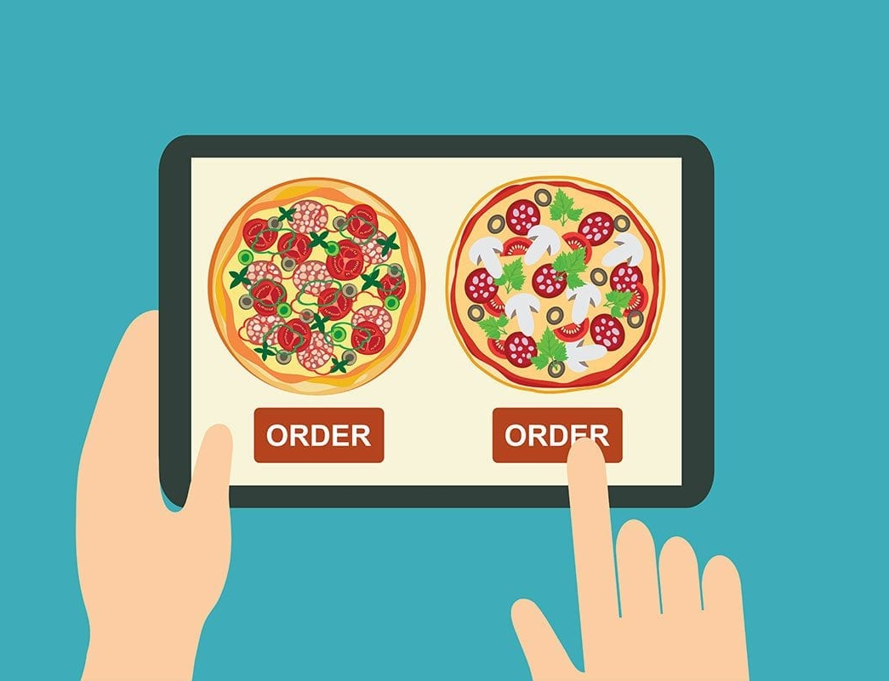
To investigate if bespoke food service applications supersede online food delivery marketplace applications- A case study
Project Title:

Slide 3
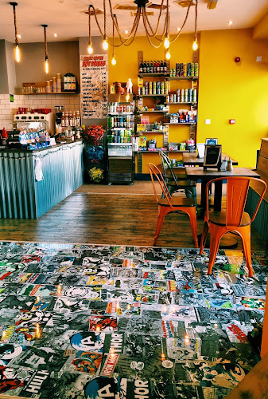
About the Business
The application will be designed for independent business, Comic Café.
The owner has agreed to take part in the case study, sharing experiences and opinions

Slide 4
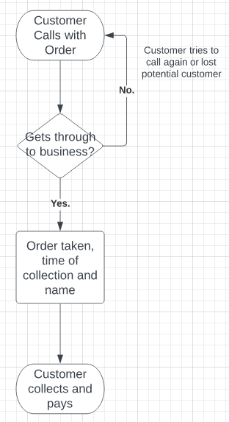
Problem Statement
Current system is manual method, as shown. This has lead to multiple issues;
Misplaced/forgotten orders
Phone lines hard to get through between 12-1pm
Previous attempt with JustEat deemed difficult by owner

Slide 5
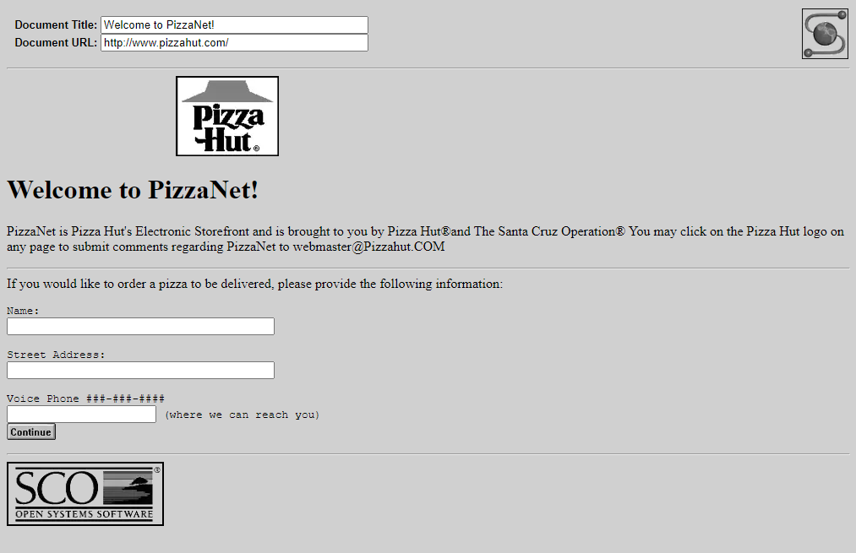
What is a Food Delivery Marketplace?
Das explains (1), food ordering system enables a business to accept and manage online orders for delivery or takeaway.
Collison (2), internet brought Pizza Hut’s ‘PizzaNet’, the original food order website, later Waiter.com with 60 restaurants
2020 pandemic reason for 840% increase in weekly sales
Notes:
Das.J. Customer perception toward food ordering and delivery services. (2019) [accessed Nov 10] Available at: file:///C:/Users/ellie/Downloads/5y1.org_3a0882d005f3184157c3fe6d19f8b170.pdf
Collison.J. The impact of food delivery services: restaurant sales. (2020) [accessed Nov 12] Available at: https://jackcollison.github.io/files/files/thesis.pdf

Slide 6
Application Design
Gardner (3), a “well designed application will help make a strong impression on potential customers”.
IEEE (4) Logical, Effective Navigation, Consistency, Compatibility
Nielson (5), heuristics based on “easier for the user to recognise than remember and perceive than understand design”.
Notes:
(3) Gardner.B. Responsive web design: enriching user experience. (2012) [accessed Nov 20] Available at: https://www.webdesignblog.gr/wp-content/uploads/2012/03/5.pdf#page=15
(4) IEEE. Determinants of a successful website design. (2012) [accessed Nov 26] Available at: https://ieeexplore.ieee.org/abstract/document/772943
(5) Nielson.J. How to conduct a heuristic evaluation. (pub.1994, edit 2018) [accessed Nov 26] Available at: https://www.ingenieriasimple.com/usabilidad/HeuristicEvaluation.pdf

Slide 7
Advantages and Disadvantages of Ordering Services
Advantages (6)
Convenient
Opens market to other businesses
Increase exposure and business revenue
Serve more people than can sit-in
Disadvantages (7)
Isolated disconnect
High demand- time delays, less reliable
Notes:
(6) Reddy.C. Driving forces of food ordering and delivery. (2020) [accessed Dec 4] Available at: https://papers.ssrn.com/sol3/papers.cfm?abstract_id=3589059
(7) Abishek.R. Customer attitude and behaviour toward online food delivery. (2019) [accessed Dec 8] Available at: https://www.pramanaresearch.org/gallery/prj-p549.pdf

Slide 8
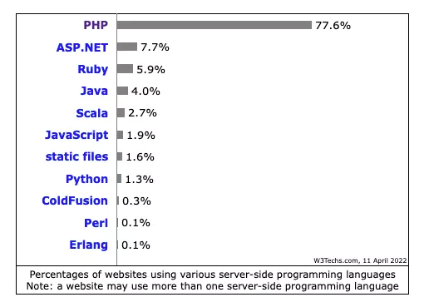
Technology Stacks
With recent technology, it’s never been easier to join the online marketplace or make predesigned solo website such as Wix or Squarespace.
Can use different technology stacks to create web applications:
MEAN
WAMP
XAMPP
Notes:
(8) IEEE. Component Stacks for applications. (2014) [accessed Dec 12] Available at: https://ieeexplore.ieee.org/abstract/document/7420497

Slide 9
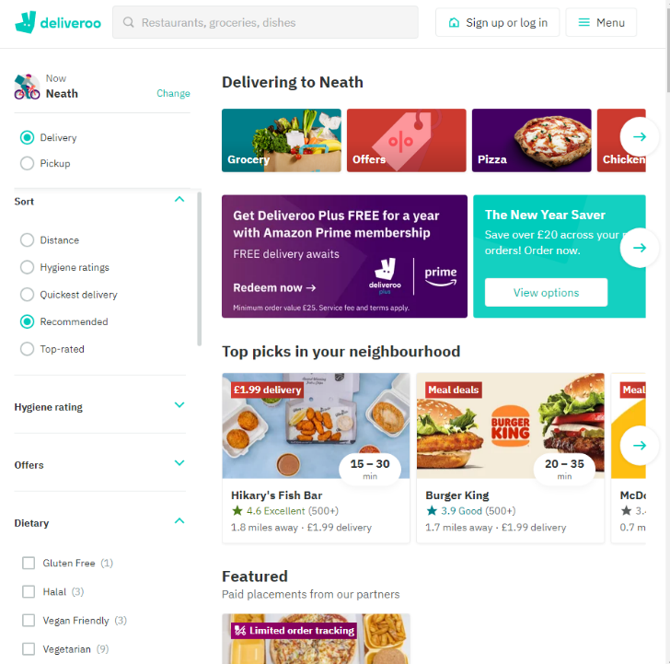
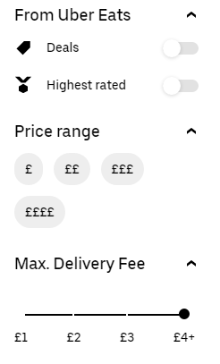
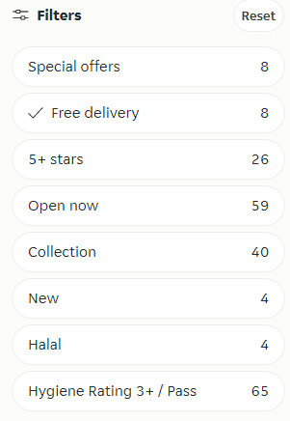
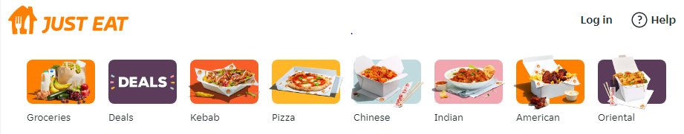
Available Applications & Independent Examples
Notes:
(9) Dominos. Webpage. (2022) [accessed Nov 30] Available at:https://www.dominos.co.uk/
(10) Love Munch Kitchen. Webpage. (2022) [accessed Nov 30] Available at: https://www.lovemunchkitchen.com/
(11) Pizza Factory. Webpage. (2022) [accessed Nov 30] Available at: https://pizzafactoryonline.co.uk/
(12) Just Eat. Webpage. (2022) [accessed Nov 16] Available at: https://www.just-eat.co.uk/
(13) Deliveroo. Webpage. (2022) [accessed Nov 16] Available at:https://deliveroo.co.uk/
(14) Uber Eats. Webpage. (2022) [accessed Nov 16] Available at: https://www.ubereats.com/gb/feed?diningMode=DELIVERY&pl=%3D%3D
(15) Shaeeali.N. Customer review analytics. (2020) [accessed Nov 20] Available at: https://www.proquest.com/openview/de3fba00c76b2a04181beda22203ea08/1?pq-origsite=gscholar&cbl=1686339

Slide 10
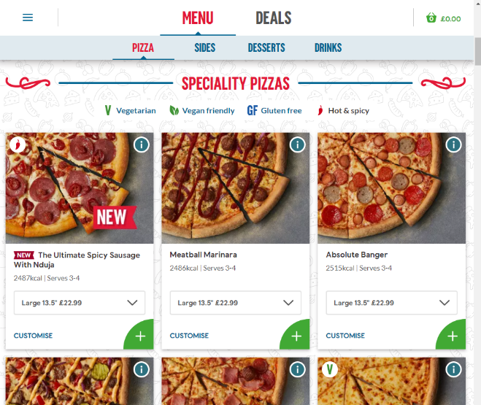
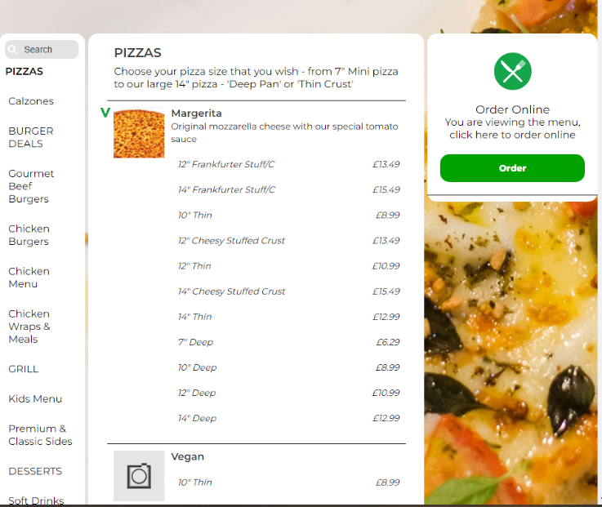
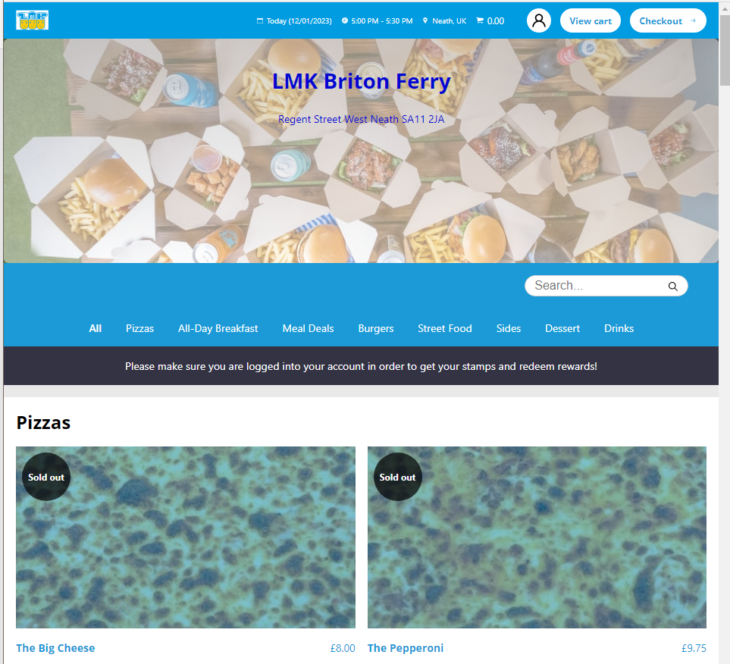
Available Applications & Independent Examples
Notes:
(9) Dominos. Webpage. (2022) [accessed Nov 30] Available at:https://www.dominos.co.uk/
(10) Love Munch Kitchen. Webpage. (2022) [accessed Nov 30] Available at: https://www.lovemunchkitchen.com/
(11) Pizza Factory. Webpage. (2022) [accessed Nov 30] Available at: https://pizzafactoryonline.co.uk/
(12) Just Eat. Webpage. (2022) [accessed Nov 16] Available at: https://www.just-eat.co.uk/
(13) Deliveroo. Webpage. (2022) [accessed Nov 16] Available at:https://deliveroo.co.uk/
(14) Uber Eats. Webpage. (2022) [accessed Nov 16] Available at: https://www.ubereats.com/gb/feed?diningMode=DELIVERY&pl=%3D%3D
(15) Shaeeali.N. Customer review analytics. (2020) [accessed Nov 20] Available at: https://www.proquest.com/openview/de3fba00c76b2a04181beda22203ea08/1?pq-origsite=gscholar&cbl=1686339

Slide 11
Acknowledging Legislation
A company that requests data has the responsibility to protect it within their ability, Aseri (19).
General Data Protection Act
Catering License (business)
Notes:
(16) Aseri.A. Security issues for online shoppers. (2021) [accessed Dec 19] Available at: https://www.ijstr.org/final-print/mar2021/Security-Issues-For-Online-Shoppers.pdf
(17) GDPR. General data protection Act (2022) [accessed Dec 20] Available at: https://gdpr-info.eu/art-13-gdpr/

Slide 12
Conclusion
Online food ordering services are being used and created at a rapid pace increasing market size
01
The chosen solution is a web based online application that can be used to order exclusively from Comic Café, with a focus on user-friendly interface
02
Designed using PHP, XAMPP, MySQL interfaces made for customer and business use
03

Slide 13
Aims and Objectives
Aim-
To design and develop a food ordering application for an independent café
Objectives-
To research current food applications and identify improvements
Highlight how the proposed application would benefit the client
Discover and set requirements needed within the application
Research and decipher a suited platform and language to carry out project
Create designs of the application to be approved or edited by client
Develop the website application using spiral method
Coherently test the application with intended users
Review project outcome
Reflection of possible improvements or refinement

Slide 14
Phenomenology Methodology
Stumpfegger (21), illustrates phenomenal research is a quantitative method that aims to understand and interpret the universal nature of the phenomenon
Gathers natural data by interpreting what it is like to experience a specific situation, more likely to create a genuine response
Good alternative to discover personal experiences (owner) especially in observation
Notes:
(18) Stumpfegger.E. Phenomenological Approach. (2013) [accessed Dec 30] Available at: https://link.springer.com/chapter/10.1007/978-3-319-17978-0_3#:~:text=The%20underlying%20research%20philosophy%20is,activity%E2%80%9D%20(Smith%202011)

Slide 15
Inductive Research
Dudovskiy (22) begins with detailed observations and moves toward abstract generalisations and ideas and supports the generation of new theories
In this instance, the problem has been observed and the project is a test theory to solve it
Notes:
(19) BRM. Inductive Approach. (2015) [accessed Jan 4] Available at: https://research-methodology.net/research-methodology/research-approach/inductive-approach-2/

Slide 16
Data Collection
Mixed method approach applied with both quantitative and qualitative data
Applies to primary and secondary research data
Baker (25), observation is used to gather data from watching events/people in a natural setting
Nielsen (10), Heuristic review is an evaluation using a set of guidelines that aims to reduce users’ cognitive load and memory capacity
Notes:
(20) Baker.L. Observation: a complex research method. (2006) [accessed Jan 9] Available at: https://muse.jhu.edu/article/202353/summary
(5) Nielson.J. How to conduct a heuristic evaluation. (pub.1994, edit 2018) [accessed Nov 26] Available at: https://www.ingenieriasimple.com/usabilidad/HeuristicEvaluation.pdf

Slide 17
Time Horizons
Armstrong (24), cross sectional is data captured at one time, for one instance
Due to project time limitations
Can be used to show results compared to other variables, like age against general opinion.
Spiral SDLC to accommodate changes and incorporate client feedback.
Notes:
(20) Armstrong.J. Extrapolation of time series and cross-sectional data. (2001) [accessed Jan 5] Available at: (https://link.springer.com/chapter/10.1007/978-0-306-47630-3_11
(21) Alsharmrani.G. Comparison of SDLC models. (2011) [accessed Dec 12] Available at: https://d1wqtxts1xzle7.cloudfront.net/36637147/SDLC-libre.pdf?1423940228=&response-content-disposition=inline%3B+filename%3DA_Comparison_Between_Three_SDLC_Models_W.pdf&Expires=1673522971&Signature=di~9IENX4vzFYpoB5Wr5nBFkFKovZ3dyrfypEFG6AC~rY2KAVNQXt-4~Hg6piif-zQbt6ty0eGlMR~y3~6d-lpbLfaPWGEDKW7Poru6sxD~2qVDhsfdwAjbcL8x9dx6Bi~Gfce3K-6x2ZfI4CeVHVZkbc8e2GFhn5eKCGtHGB6Y8KjkaDf3yFH3hI9JwhcfAKUOBycbs94~ATvtefymENqsfLoLY0479txGqQnyb0jYYG4tXyyNZfxAeM32iFN5rWSXrAdROsXFy3zfGPlRyK1DIuMdCcEWD6P~ysSqWa362rl9aH7V55wwsPuOupkWy3C2iKvn7i5NqiABi8QeeYQ__&Key-Pair-Id=APKAJLOHF5GGSLRBV4ZA

Slide 18
Resources
Hardware
PC, configured with Intel Core i5 or newer processor, 16GB RAM, 1TB storage and running Windows 10/11 operating system, peripherals
Software
VS code, MySQL, XAMPP

Slide 19
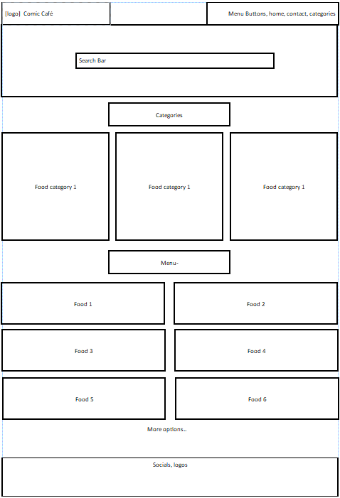
Draft Website
Designs- Main Page

Slide 20
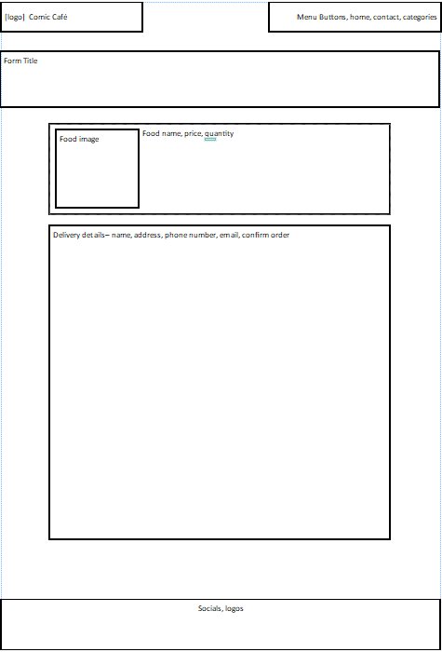
Draft Website
Designs- Order Form

Slide 21
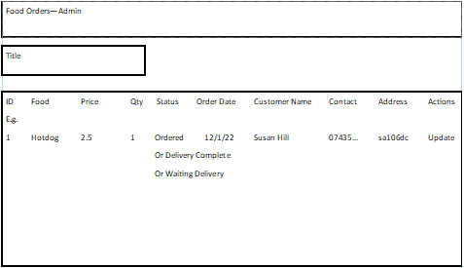
Draft Website
Designs- Admin Order Panel

Slide 22
Ethic Considerations
Main concern is the details taken by the website, bank details, addresses, names.
Within development process, fictional data will be used and research into security needed carried out.
Case study will include consensual observation and heuristic reviews of the application

Slide 23
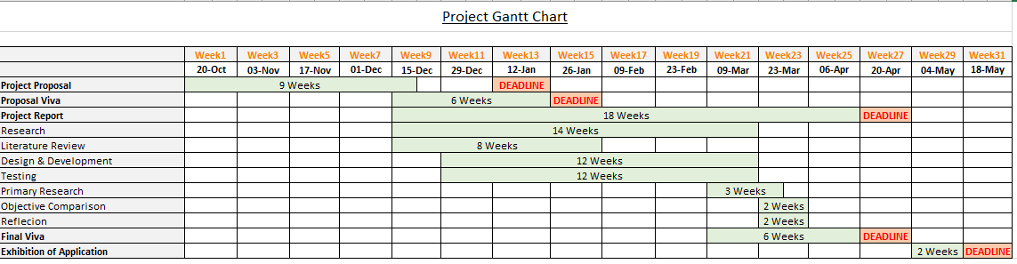
Gantt Chart for Project

Slide 24

That concludes the presentation..
Any questions?

Slide 25
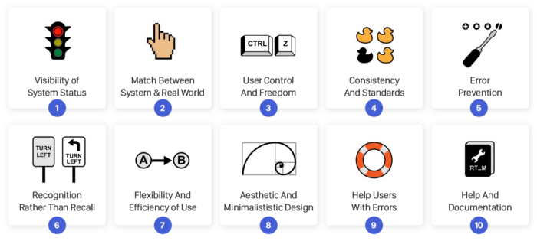
Additional Slides
Notes:
(5) Nielson.J. How to conduct a heuristic evaluation. (pub.1994, edit 2018) [accessed Nov 26] Available at: https://www.ingenieriasimple.com/usabilidad/HeuristicEvaluation.pdf

