Slide 1
BMMB7010
Leading and Managing Projects
University of Wales Trinity Saint David
Dr Antje Cockrill

Slide 2

Day 3 & 4
Day 3 10.00 am – 12.30 pm:
Design thinking in project management
Day 3 1.15 pm – 4 pm (w.break)
Introduction to Business Research
Qualitative methods
Business research ethics
Case study: Focus groups
Day 4 10.00 am – 12.30 pm
Quantitative methods
Day 4 1.15 pm – 4 pm (w.break)
Questionnaire design
Decisions on projects

Slide 3
Moving on
We looked at Qualitative Methodologies, now we are moving on to Quantitative Methodologies

Slide 4

Quantitative Data Collection Methods
Time and effort required to produce useful data before data is collected (changes difficult to make once data collection starts)
Good conceptual knowledge of the area under investigation needed
Knowledge of the subjects to be questioned
Clear idea of the objectives of the research instrument
Questionnaire and Experiments

Slide 5
What is a questionnaire?
 A series of questions.
 Gathers information from lots of people.
 Focussed around a single topic or area of interest.
Notes:
Simple explanation is that it is an instrument consisting of a series of questions.
The purpose of a questionnaire is to gather information from a series of respondents.
Does it gather any random information?
No, a questionnaire is designed to gather enough information on a specific topic or area of interest.

Slide 6

Why is the Questionnaire necessary?
One overall aim (e.g. customer satisfaction)
No more than three objectives (e.g. intention to revisit, customer experience, overall satisfaction)
Too many aims/objectives = poor survey

Slide 7




An effective questionnaire…
Asks relevant questions
Questions that will provide the answers to the research topic in question
Gets valid responses
Responses given reflect the respondent’s actual opinions
Gets a representative response
Makes it more reliable to infer the findings to wider population
Food
Question 1
Question 2
Question 3


Survey report

Slide 8
Stages in the
Development of a Questionnaire
Planning stage
Design stage
Pilot stage

Slide 9
Stages in the
Development of a Questionnaire
Definition of the research
aims and objectives
Exploratory research
Planning stage
Design stage
Information required
Definition of population
Target groups
Access method
Type of questionnaire (online, face to face, Interview style)
Pilot stage

Slide 10
Types of questionnaire
Self-completed
Postal
Electronic
Interviewer-led
Face to face
Telephone
No method consistently outperforms others
Notes:
The way questionnaires are used can be broadly divided into two groups;
Self-completed questionnaires; where respondents provide their answers themselves without any other input, and
Interviewer-lead; where the questions are read out to the respondent by the interviewer and their responses are noted.
Self-completed questionnaires commonly include paper-based postal surveys and those delivered electronically such as internet surveys or other electronic device such as kiosks or hand-held computers.
Interviewer lead questionnaires commonly includes face-to-face approaches or questionnaires conducted over the telephone.
Additional info:
There are pros and cons to using each method
According to the HTA review, no one mode of administration consistently outperforms all others.

Slide 11
Considerations
Better response rates from interviewer-led surveys than from self-response surveys.
Self-response surveys are usually cheaper.
Interviewer-led surveys can produce richer information.
Self-response surveys can reach more people.
Online surveys are faster but have lower response rate
The quality of online surveys is more difficult to control
Notes:
Its generally held that the larger your sample size, the more reliable your information. However, you also need to consider your response rates and quality of information that you’ll get.
Interview-led surveys have that element of human interaction which means they usually result in better response rates, however they are more costly because of the training and staff time to administer them.
Richer information: can prompt for more information or can clarify any ambiguities in the questions, and have greater scope for open-ended questions.
Sample size: for clinical audit you’re looking to get at least 40 data sets to get a good sample, for research you’re probably looking for a statistically significant sample.
Additional info
Refer to page 3 of the ‘Guidance for writing effective questionnaires’ for pros and con’s of each method’

Slide 12
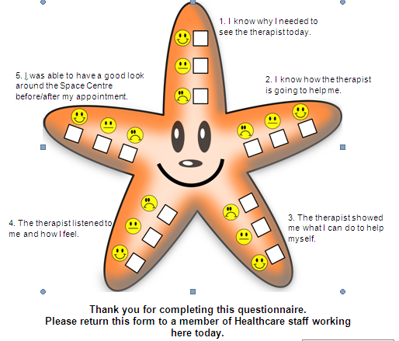
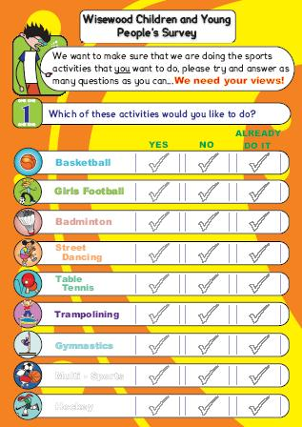
Who Are your respondents?
Is it pitched at the right age group?
http://www.sheffkids.co.uk/adultssite/documents/Wisewood%20questionnaire.pdf
Notes:
Are you pitching it at the right age group? Are you asking too much?
Will it really be the child or the parents answering it?
Not just about children; the average reading age for Leicester is between 7-10 years old. Need to ensure your questions are

Slide 13
More considerations
Will it be completed right after the event, or sometime after?
Will it be completed in front of other people or in private?
Many people are poor at estimating numerical info about their lives.
The more common the event the shorter a person’s window of recall is.
People’s behaviour does not necessarily reflect what they say in a questionnaire
Notes:
If asking people to complete a questionnaire when they have ‘gate-fever’ i.e. after a training session, after a clinic, then you need to make sure it is short enough and to the point. Asking someone to complete 6 sides of A4 questions when they are worrying about whether their car-parking money has run out, or whether their clinic is over-running just isn’t going to happen.
Asking a teenager about their sexual health when they are with their friends may give you one set of answers, with their parents a completely different set of answers and in private a third set.
However you also need to consider that the more common an event the less people are likely to be able to remember it accurately, for example: if you were to ask a heavy smoker exactly how many cigarettes they had smoked yesterday it is unlikely they would be able to tell you.
If you are asking an evaluation question then you also need to consider is the timescale you are asking in appropriate. You might ask someone coming out of a clinic – how friendly did you find the clinic staff today? while it is fresh in their minds this is an appropriate timescale to ask within. However if you are also asking them how useful they have found information they have been given in the clinic they may not be able to evaluate this effectively having not had a chance to put it into practice.

Slide 14
Stages in the
Development of a Questionnaire
Planning stage
Type of question
Wording and instructions
Layout
Ordering of Topics
Scaling
Probes and prompts
Coding
Design stage
Pilot stage

Slide 15
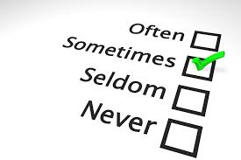
Type of questions
The type of question determines your analysis – you cannot go back!
Categorical questions – the answers are distinct categories that do not overlap (colours, gender, nationality etc)
Ordinal questions – the answers are categories that have an inherent order but uneven intervals (e.g. 1 week, 1 month, 1 year)
Interval questions – the answer categories have an order with a specific interval (e.g. Strongly Agree, Agree, Neutral, Disagree and Strongly Disagree) Sometimes that even interval is assumed!
Ratio questions – the same as Interval questions but with a true (meaningful) zero (e.g. money)
In practice, categorical and ordinal questions are often treated the same; and interval and ratio questions are often treated the same

Slide 16
Mid-point / neutral opinions
Use mid-points in questions on attitude.
Historically controversial as it was thought that respondents chose a neutral option to avoid thinking about a question.
Now shown that including a mid-point increases reliability and validity
But: scales without mid-point can be useful in international research to reduce response bias
Strongly disagree
    
Strongly agree
Notes:
Some controversy exists as to whether a neutral point should be offered. If this option is removed, this forces the respondent to choose a response, which may lead to respondent irritation and increase non-response bias
Additional info:
This desirability of having a neutral middle point to increase the reliability and validity of response scales has also been confirmed by a meta-analysis of 87 experiments of question design reported by Saris and Gallhofer (2007)

Slide 17
Question wording
Keep questions as short as possible
  Max 16 words.
Consider providing medium length (30 word) introductions to groups of related questions (context is vital!)
Use open-ended questions sparingly
Notes:
Keep questions as short as possible:
The longer a question, the harder it is to understand.
A rough guide is a maximum of 16 words, though you’re looking to keep your questions shorter than this.
If you have several questions on the same topic, then consider grouping them together with a short introduction at the top. This will achieve two things:
First, it clarifies the topic for the respondent (so they’re clear about what you’re after),
Secondly, it likely means you can cut down the length of the questions underneath it (making them easier to understand). Doing this has been shown to improve the data quality.(1)
Open-ended questions are great because they give a lot of quality information, and I would recommend that you have at least one of these in your questionnaire. However, they take time to answer and are seen as a more burdensome than a multiple choice option.
If you’re using a lot of open-ended questions, then perhaps you should consider a more appropriate method of data collection such as interviews or focus groups.

Slide 18
Double questions
Is space and storage adequate?
☐ Yes ☐ No
Was the consent of the patient obtained and recorded?
☐ Yes ☐ No
Was the consent of the patient:
☐ Obtained?
☐ Recorded?
If a question can be broken down into parts then it should be?
Notes:
Avoid double-questions.
This question is taken from our DSE Self-Assessment form and is an example of a double question.
How do I answer this if I have plenty of space but no storage, or I’ve got plenty of storage (filing cabinets) but almost no space to work?
<click>
Here’s another example.
We’ve used this question several times over the years in clinical audits on record keeping, but kept finding the results came back as poorer than we expected despite us reminding staff about obtaining consent. We eventually cottoned on, and replaced it with these two questions:
<click>
It then became clear that staff were obtaining consent, and the issue was with the recording. We looked further into this and found that the templates they were using to record patient activity didn’t have space to record consent. Until this was broken down it wasn’t clear where the issue lay or how to resolve it.
The message from this is that, if a question can be broken down into parts then do so.

Slide 19
Double negatives
Do you think that it is an unwise policy to continue sending food aid to Africa.
☐ Yes ☐ No
If the respondent has to tick ‘No’ to give a positive response then this can be considered a double negative.
Try and phrase questions with a positive slant so that the positive response is ‘Yes’ rather than ‘No’.
Notes:
Hand in hand with double questions, are double negatives.
The problem with these is that they are very hard to understand and respond to.
In this example…

Slide 20

Design
For hard copy questionnaires, use booklet format with double-sided printing
  A4 folded to A5, or, A3 folded to A4
Front cover:
  The title of the questionnaire
  Identity of the organisation carrying it out
  Clearly explain the purpose of the questionnaire
  Ask for consent
  Keep graphics neutral
No more than 4 pages
Image from: https://non-perfectdad.co.uk/end-of-season-parents-questionnaire/
Notes:
These are a general guide based on expert opinion and theories of cognition.

Slide 21
Ordering your questionnaire
Place easy, non-challenging questions first
Key filter questions should go in early.
Use a funnel structure
  Go from basic to more in depth.
  General questions before specific questions.
  Go from the least sensitive to the most sensitive questions.
  But – try and put important questions in before the end.
Notes:
There is good evidence that the order of your questions can influence the responses you receive. So, here is some advice on how you can get the best information from your questionnaire:
Easy, non-challenging questions should come first. It makes your questionnaire appear inviting to your respondents.
Key filter questions should go in early. We’ll look at filters a bit later on.
Use a funnel structure to your questions (basic to in-depth, general to specific). Placing general questions before specific questions topic reduces bias. For example, if you’re interested in levels of happiness, then ask about the respondents general happiness before moving onto specifics such as happiness at work.
Least to most sensitive questions. What are the most commonly asked sensitive questions in NHS questionnaires?
> Demographics, (age, gender, religion, sexuality, disability).
These are very sensitive questions and should be left to the end.
However, remember to put your important questions in before the end. As Annette discussed earlier, if the respondent decides to cut the questionnaire short because of time constraints, then at least you have some useable data.
----------------------------------
General / specific questions
The order in which you place questions has been shown to affect the way people respond to them.
Placing general questions before specific questions on the same topic reduces bias from respondents wanting to be consistent with their previous responses.
E.g. asking about general happiness before moving onto specifics such as happiness at work.
Go from the least sensitive to the most sensitive questions to prevent turning respondents off straight away. If it feels too personal too quickly it can be a bit of a jolt – you need to warm respondents up.
e.g. Demographic questions
such as age, gender, disability and sexual orientation, are often required as part of health services research and evaluations to demonstrate equality of services, or to cross-match against the other questions to see if there is variation in response by groups, such as gender, or age, for example.
However, they do come across as threatening / an invasion of the respondent’s privacy, and if they’re placed first in the survey will affect how the respondent answers the rest of the questions or whether they complete the questionnaire at all.
But – try and put important questions in before the end - as that way if people are turned off you may still have collected a reasonable amount of important data before they abandon it.

Slide 22
Ordering your questions
Ask for suggestions for improvement at the end.
Check for leading questions.
Add prompts where required.
Order of questions can impact heavily on the amount of time it takes for the respondent to complete the questionnaire.
Notes:
Same as with the more in-depth questions you need to get the respondent warmed up. Once you have got the respondent thinking about the topic then ask for any suggestions – they will be a lot more responsive as their mind will be on the topic.
Check for leading questions – consider whether your questions and the order in which you ask them are likely to influence the answers given. (More on this on p8. of the handout)
Design your questionnaire so it logically follows from the respondent’s perspective, not what’s easiest for your data analysis. If one topic naturally leads onto another then keep those questions together on the questionnaire. Once all the data is back in you can always rearrange it to make your analysis easier.

Slide 23
Filtering
Filtering (or routing) helps identify which respondents should answer a detailed set of questions about a certain aspect of the topic.
Can be difficult to achieve – should be VERY CLEARLY signposted

Slide 24
Filtering Example
About our new website | Yes | No
1. Did you visit our website today? (If yes please answer questions 2-4, if no go to question 5)
2. Did you like the new look?
3. Did you find it easy to navigate?
4. Would you recommend the site to others?
5. Did you pick up a copy of our latest leaflet?
✓
✓
✓
✓
✓
Notes:
Here’s a questionnaire asking people what they thought of our new website. You can see that we’ve used a funnel structure, moving from general questions to more specific questions, and that we’ve given a little note to say that if you’ve not been to the website, then go to question 5.
So how can this go wrong?
The answer is that respondents can sometimes get a bit carried away and want to answer all questions without stopping to read the guidance.
This can make routing questions difficult, and invalidate the answers given.
For example if a respondent answers like so (click to next slide)
(Click)
In this case do you assume that they had visited our website but mistakenly ticked NO for Q1 (when they meant YES) and have provided accurate answers for Q2 – Q4
OR
Do you assume they answered Q1 correctly – they hadn’t visited our website and failed to see our instructions, but they tried to be helpful and give responses to questions 2, 3 and 4 even though they didn’t apply?
This is the danger with filter questions. So how do we get around this?

Slide 25
Filtering Example
About our new website |  | Yes | No
1. Did you visit our website today? |  | Please continue with Q1a | Please go to Q2
 | 1a. Did you like the new look?
 | 1b. Did you find it easy to navigate?
 | 1c. Would you recommend the site to others?
2. Did you pick up a copy of our latest leaflet?
Notes:
It doesn’t always work – but a bit of formatting using colour and shape can help to make navigating routing forms easier.
Alternatively, if you need to use a lot of filter questions, then many electronic systems such as the hand-held computers, and web surveys make routing easier because the filtering happens behind the scenes – so a well designed survey should only show you questions that are relevant to you.
Using an interviewer who understands the form will also help avoid these issues.
ALSO : Beware that Filtering can put people off answering honestly (Particularly in long questionnaires). If they can see that ticking yes means they need to answer the next 10 questions and answering no allows them to skip then a number of people will go for ‘No’.

Slide 26
Other elements to remember
Make it look professional.
Give an estimated completion time.
Put the deadline for return at the beginning and end of the questionnaire.
Provide a return address – on the questionnaire.
Say ‘Thank you’.

Slide 27
Common Issues
What was the first drink you had today?
Tea
Coffee
Water
Juice
Haven’t had a drink today
What might be wrong with this question?
Notes:
What might be wrong with this closed question?
When writing closed questions ensure you cover all options or it could bias the analysis. – if unsure whether you have covered everything add an Other option to capture that data.
The answers from closed questions are easier to analyse BUT you are not leaving it open to allow respondents to raise unexpected, or missed, issues. OR to explain their answers.
Other tip for closed questions is :
Research has shown that in self completion questionnaires the first options on a list are chosen most often – whereas in interview situations the latter options are chosen most often.
Additional information
* There is evidence that openin

Slide 28
Common Issues
What is your age group?
0-18 | 18-30 | 30-45 | 45+
Notes:
Sometimes it can be better to appear pedantic than to risk skewing the responses.

Slide 29
Common Issues
What did you think about the waiting time?
Excellent | Very good | Good | Average | Poor
Notes:
You’re giving many more good options than poor ones – this is unbalanced.
Number of points used:
Recommend to use either five or seven point scales.
Generally, three-point scales are too narrow to be effective, and there is no evidence that nine points gives greater precision than a seven point scale.
Stick to using the same range of options for all questions where possible.
Or at least for each section
If necessary re-phrase your questions so that they work with the ratings.

Slide 30

Common Issues
How do you rate the student experience and teaching at your university?
Very poor | Poor | Satisfactory | Good | Very good

Slide 31
Common Issues
Great CRM leads to great WOM. How true is this in your experience?
Very untrue | Untrue | Don’t know | True | Very true

Slide 32
Common Issues
Do you have any problems with your line manager?
Very untrue | Untrue | Don’t know | True | Very true

Slide 33
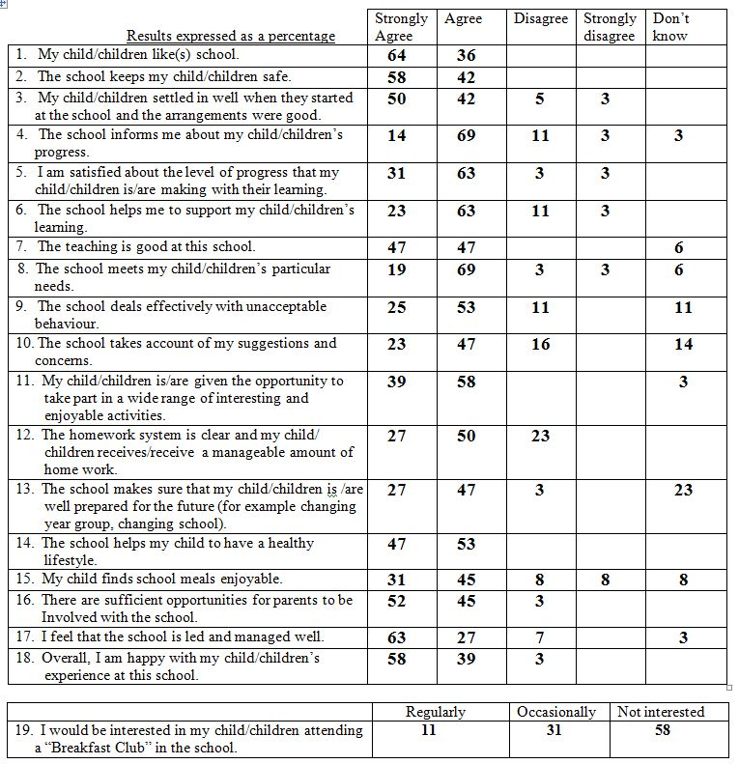
Is this a well designed survey?

Slide 34
Stages in the
Development of a Questionnaire
Planning stage
Always pretest !!!!
Design stage
Pilot testing
Redesign
Pilot stage
Final questionnaire

Slide 35
Pilot your tool
This is the MOST IMPORTANT part.
If a range of respondents from different backgrounds will be using the questionnaire make sure you use as many of these different groups as possible in the trial.
Go back to your objectives – does the data help you fulfil your objectives and measure against the standards you set?
Notes:
At the end of the day people don’t read tool guidance and questions properly - no matter how much effort you put in there will almost always be Issues and returns that are invalidated, but if you have managed to keep these to a minimum then you’ve done a good job.
If your tool is being used to collect data from patient records trial it against 5 different records – can you collect all the data easily, do you need to re-order the questions, is the guidance on where to find it clear and unambiguous.
You might be surprised to learn just how many people loose sight of their initial objectives when creating and tweaking their audit tool. Go back and ensure that it answers your objectives and you have questions set for each standard you are measuring. It’s not good to learn this after you’ve collected your data.

Slide 36
Summary: Stages in the Development of a Questionnaire
Definition of the
research problem
Exploratory research
Information required
Definition of population
Target groups
Survey method
Planning
Stage
Ordering of topics
Type of question
Wording and instructions
Layout / Scaling
Probes and prompts
Coding
Planning
Pilot testing
Redesign
Final questionnaire
Pilot
Stage

Slide 37
Acknowledgement
I gratefully acknowledge the work of Craig Parylo and Annette Lee who have given permission to use/adapt some of their slides as part of this session.
Their full set of slides can be found at http://www.leicspart.nhs.uk/library/clinicalaudit_questionnaireslides.pptx

Slide 38
Design your own customer satisfaction survey for an online retailer of your choice - practical

