Slide 1
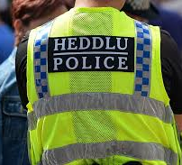
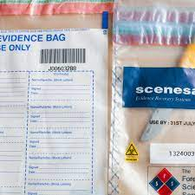
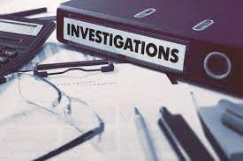
BMCP6003
Conducting Investigations
Sadie France
s.france@uwtsd.ac.uk

Slide 2

Warning!!!
The module will include some sensitive content.

Slide 3
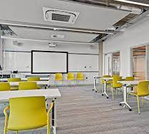
Contact Time
Thursday
12:00hrs – 16:00hrs

Slide 4
Scheme of work
Week commencing: | Content:
Week 1: 30/09/24 | Introduction to module
Week 2: 07/10/24 | Initial Investigation - Guest speaker (David Thomas) SWP
Week 3: 14/10/24 | Crime scenes and arrest
Week 4: 21/10/24 | Criminal Offences
Week 5 :28/10/24 | Role play revision –Immersive room IQ
WEEK 6: 07/11/24 | ROLE PLAY ASSESSMENT (Immersive room- IQ building)
11/11/24 | PROGRESS WEEK
Week 7: 18/11/24 | Crimes
Week 8: 25/11/24 | Interviews
Week 9: 02/12/24 | Information and intelligence
Week 10: 09/12/24 | Exam revision
JANUARY 2025 (Date/time TBC) | EXAM (2 HOURS)

Slide 5
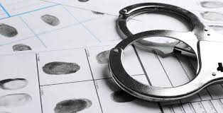
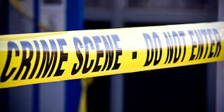
Module Aim
To critically examine the fundamental principles of conducting investigations from initial contact to post trial.

Slide 6




How is this module assessed?
Component 1: 50%
Role Play
Component 2: 50%
Exam (2 hours)

Slide 7
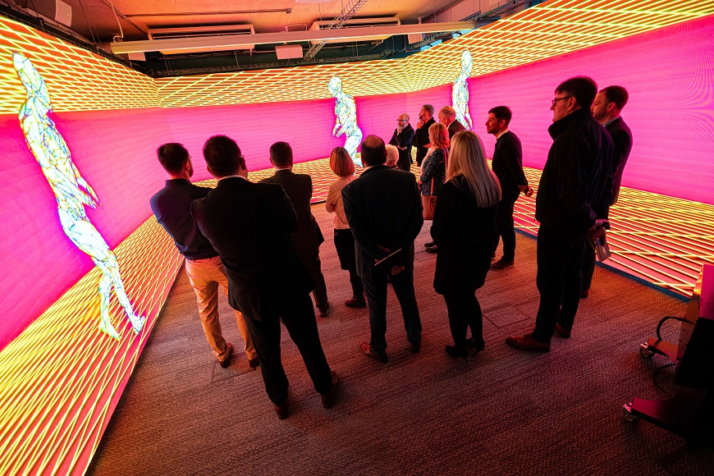
Role Play assessment
Role Play assessment
7th November (9:30am-4:30pm) Timetable on Moodle
IQ campus
Immersive Room https://youtu.be/z0KdbuKTHec

Slide 8
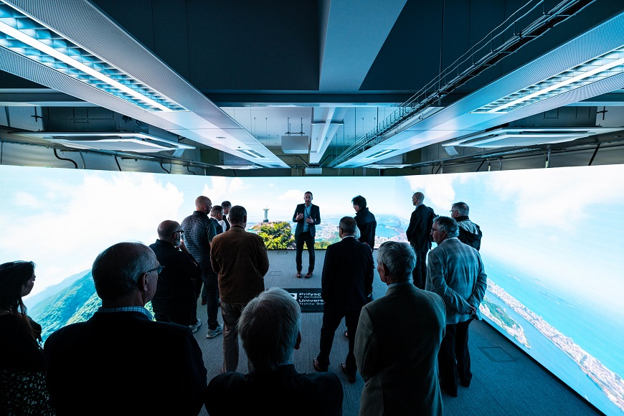

Slide 9
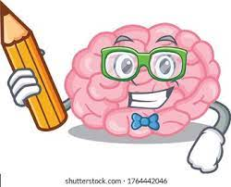

Exam
Exam
2 Hour Exam
Date and time tbc by Exam office
Keep an eye on MyTSD for update
IQ campus (room tbc)
Please don’t panic!
Revision session- 12th December 2024

Slide 10

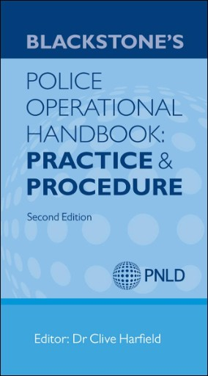
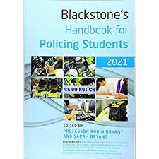
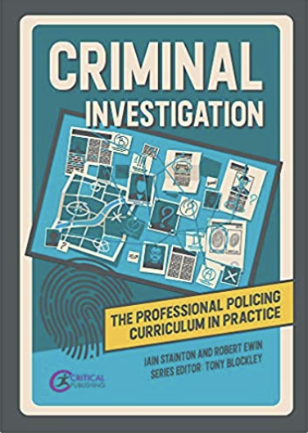

Recommended Resources
Go to the library – reading list available on Moodle
A number of resources available electronically
The COP website is one of the best!
Free!!

Slide 11
Component 1: Role Play
Weighting: 50%
Length: 15-20mins
Date: 7th November 2024 (Immersive room (IQ campus)
(More information on assessment briefs on Moodle)

Slide 12
Let’s book you in 7th November IQ campus….
11:30am-Harvey
12pm- Leo
12:30pm- Sadie
1pm-Harrison
2pm- Jemima
2:30pm- Lucy
3pm- Hannah
3:30pm-Brad
4pm-Olivia
4:30pm- Patrick

Slide 13
Component 2: Exam
Length: 2 hours
Weighting: 50%
Date: TBC – JAN 2025
Don’t Panic!
- There will be plenty of opportunities to practice/reflect/recap within the workshops = attendance is key!

Slide 14

Needs…
Concerns…
Expectations….

Slide 15





Remember ....

Slide 16







Speak to me!
Help
Support
Guidance
Email: s.france@uwtsd.ac.uk
Hwb: hwb@uwtsd.ac.uk

Slide 17
Areas of Study…
Conducting Investigations
Investigation processes
Managing investigations
Forensics
Working with suspects, victims and witnesses
Interviewing
Investigative strategies

Slide 18
Today’s aim and learning outcomes:
To explore what the term ‘Conducting Investigations’ mean (overview)
To examine fundamental principles, legislation and powers related to conducting investigations
To understand definitions such as 'criminal investigations' and 'investigator'
To explore Human Rights act 1998

Slide 19

What do you think of?....
“…Conducting Investigations…”
what is a criminal investigation - Google Search

Slide 20

PACE Codes of Practice
Provide guidelines on how investigative processes should be conducted
Further reading on PACE codes of Practice click here
Code | General areas covered
A | Stop and Search
B | Search of premises
C | Detention, treatment, and questioning of suspects
D | ID of suspects
E | Audio-only recording of interviews
F | Audio-visual recording of interviews
G | Power of arrest
H | Detention, treatment, and questioning of terrorist suspects

Slide 21
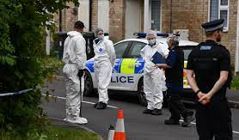
The Code of Practice to the Criminal Procedure and Investigations Act 1996 (CPIA) defines a criminal investigation as:
‘An investigation conducted by police officers with a view to it being ascertained whether a person should be charged with an offence, or whether a person charged with an offence is guilty of it.’

Slide 22
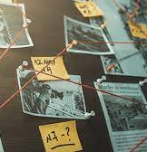
Investigations may be carried out in relation to:
Crimes that have been committed
Identifying whether a crime has actually been committed, with a view to commencing criminal proceedings
Crimes that the police believe may be committed, for example, when premises or individuals are kept under observation for a period of time, with a view to the possible institution of criminal proceedings
(College of Policing, 2021)

Slide 23

Methods of Investigation
There are two methods of criminal investigation
Reactive
This starts with the discovery of a crime & seeks to bring offenders to justice by uncovering material that identifies suspects & provides sufficient evidence to enable a court to determine their guilt
Proactive
This usually starts with an intelligence analysis that a particular individual or group is involved in criminal enterprise
Notes:
Reactive: This starts with the discovery of a crime and seeks to bring offenders to justice by uncovering material that identifies suspects and provides sufficient evidence to enable a court to determine their guilt. The technique of reactive investigations focuses on interviewing victims, witnesses and suspects, the examination of scenes and the development of forensic links between suspects and the offence.
Proactive : The proactive method usually starts with an intelligence analysis that a particular individual or group is involved in criminal enterprise. This is often organised crime such as drug dealing, fraud or people trafficking. Individual instances of such offending are rarely reported to the police and so generally the techniques of reactive investigation cannot be used. As a result investigators generally use a range of covert surveillance techniques, which are designed to link offenders to the criminal enterprise. These techniques are often complemented by financial investigations and forensic science techniques.
At PIP level 1 It is expected that you will be involved mainly in reactive investigations.

Slide 24
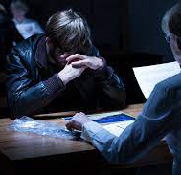
The Code of Practice to the Criminal Procedure and Investigations Act 1996 (CPIA)defines a criminal investigator as:
‘...any police officer involved in the conduct of a criminal investigation. All investigators have a responsibility for carrying out the duties imposed on them under this code including, in particular recording information and retaining records of information and material.’

Slide 25
Investigative Skills
The planning required to conduct an investigation and the investigative process
Decision making and how it can be improved by applying the investigative mindset
Investigative and evidential evaluation (which can assist the investigator to determine the value of material gathered during the investigation)
Creative thinking
Challenging experts
Victim and witness care
Investigators need to be skilled in the following areas:

Slide 26
Policing Perspective: Conducting Investigations
Information obtained from initial call
Information from police systems
Information from officer attending
Information provided by 1st witness
Info provided by victim (1st account)
Evidence collected at scene (exhibits)
Evidence from CSI in attendance
Suspect information & intelligence
Plan to locate & manage suspect
Complete crime report
Consider multi-agency approach
Consider future action- ie searches, interview, file prep

Slide 27
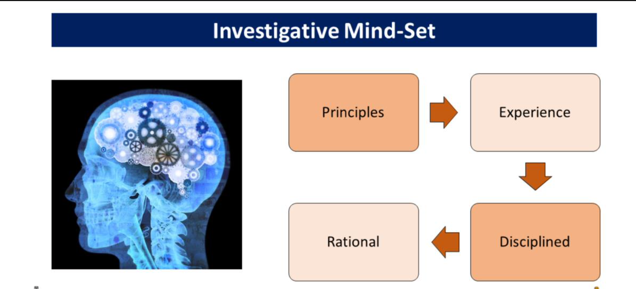
TASK- In groups, discuss what the term ‘investigative mind-set’ means to you?
Notes:
Reference: Core Investigative Doctrine 2005 https://polka.pnn.police.uk/GPDocuments/38/Shared%20Knowledge%20Documents/ 213/ACPO%20Guidance%20and%20Procedures/Core_Investigative_Doctrine.pdf/c7 176a74-879b-46a1-96ab-440ab8c6dad7/Core_Investigative_Doctrine_V1.pdf
There is no formal decision of an Investigative mind-set, so.....
QTs - What does the term ‘investigative mind – set’ it mean to you? Record the student observations
According to the College of Policing the application of an investigative mind-set will bring some order to the way in which investigators examine material and make decisions.
There is no process map that will assist the investigator to develop the mind-set, it involves applying a set of principles to the investigation process.
It is a state of mind or attitude which investigators adopt and which can be developed over time through continued use.
This will enable investigators to develop a disciplined approach which ensures that the decisions they make are appropriate to the case, are
reasonable and can be explained to others.

Slide 28
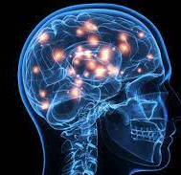
Investigative mind-set
“Term used to describe a systematic approach to gathering and assessing material, underpinning an effective investigation’’
(ACPO Core Investigative Doctrine, 2005, p. 61).
“The application of an investigative mindset will bring some order to the way in which investigators examine material and make decisions’’
(ACPO Core Investigative Doctrine, 2021, p, 84).

Slide 29
Investigative mindset
An investigative mind-set will bring some order to the way in which investigators examine material and make decisions.
There is no process map that will assist the investigator to develop the mind-set, it involves applying a set of principles to the investigation process.
It is a state of mind or attitude which investigators adopt and which can be developed over time through continued use.
This will enable investigators to develop a disciplined approach which ensures that the decisions they make are appropriate to the case, are reasonable and can be explained to others (College of Policing, 2020).

Slide 30


Investigative Mindset
A B C
APPROACH
Five Principles:
Understanding the source of the material
Planning and Preparation
Examination
Recording and collation
Evaluation
We will look at this in more detail over the next few weeks…

Slide 31
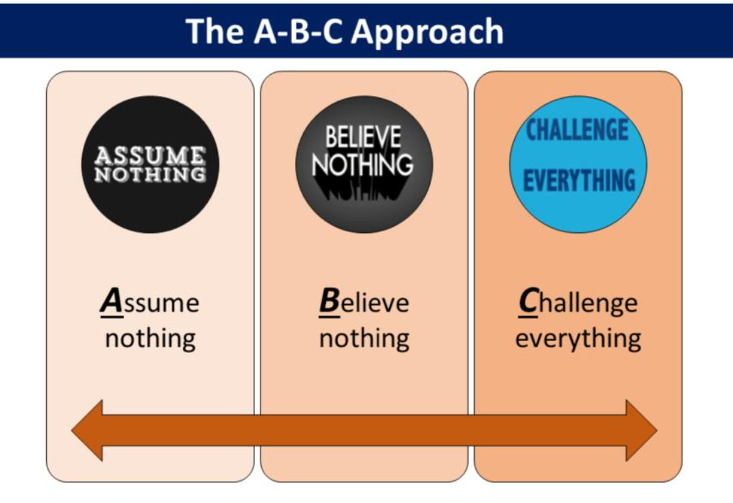

Slide 32
Principles of Investigation
There are several investigative principles which are widely accepted within the police service.
The principles are underpinned by the recognition that policing works best where it has the support and cooperation of the community.
These principles propose that:
The exercise of legal powers should not be oppressive and should be proportionate to the crime under investigation
As far as is operationally practical and having regard to an individual’s right to confidentiality, investigations should be carried out as transparently as possible – victims, witnesses and suspects should be kept up to date with developments in the case
Investigators should take all reasonable steps to understand the particular needs of individuals, including, but not limited to, any protected characteristics they may have, in order to comply with the provisions of the Equality Act 2010
(College of Policing, 2021)

Slide 33
Principles of Investigation
cooperation of the community.
Principles of Investigation
Investigators should have particular regard for vulnerable people and children
Investigators should respect the professional ethics of others. This is particularly important when working with those whose role it is to support suspects
These principles, the investigation process, and an investigative mindset provide a structure to support quality investigations.
(College of Policing, 2021)

Slide 34

TASK
Visit one of the following websites and note the “top news”:-
The Guardian
The Telegraph
The Sun
News of the World

Slide 35
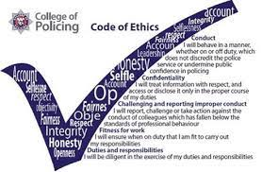

Ethics
The activities and processes of criminal investigation can attract considerable attention, partly due to media coverage of crime and criminal behaviour, but also because of the impact crime has on individuals and communities.

Slide 36
The success of an investigation relies on the goodwill and cooperation of victims, witnesses and the community. Investigators should be aware that:
Investigations should be conducted with integrity, common sense and sound judgement
Heavy-handed, discriminatory or disproportionate actions risk losing cooperation and any future criminal proceedings
Effective investigators maintain a balance that recognises the concerns of all the parties involved
Understanding the response to crime assists investigators to build this relationship
A professional approach to investigations benefits the victim, the public and
the police

Slide 37
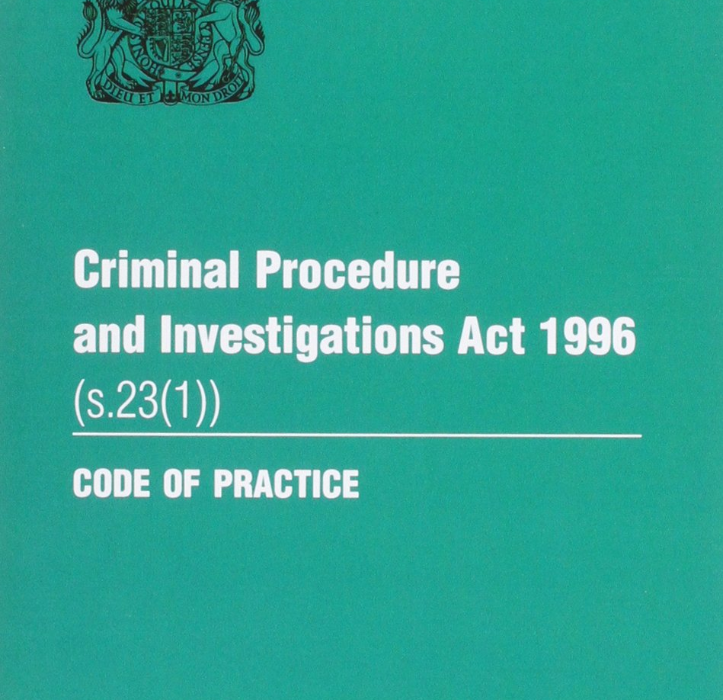
Legal Powers
Investigators have access to a range of legal powers that enable them to conduct effective investigations:
Criminal Procedure and Investigations Act 1996 (CPIA)
Regulation of Investigatory Powers 2000 (RIPA)
Police and Criminal Evidence Act 1984 (PACE)
Human Rights Act 1998 (HRA)
Equality Act 2010
Youth Justice and Criminal Evidence Act 1999 (YJCEA)

Slide 38
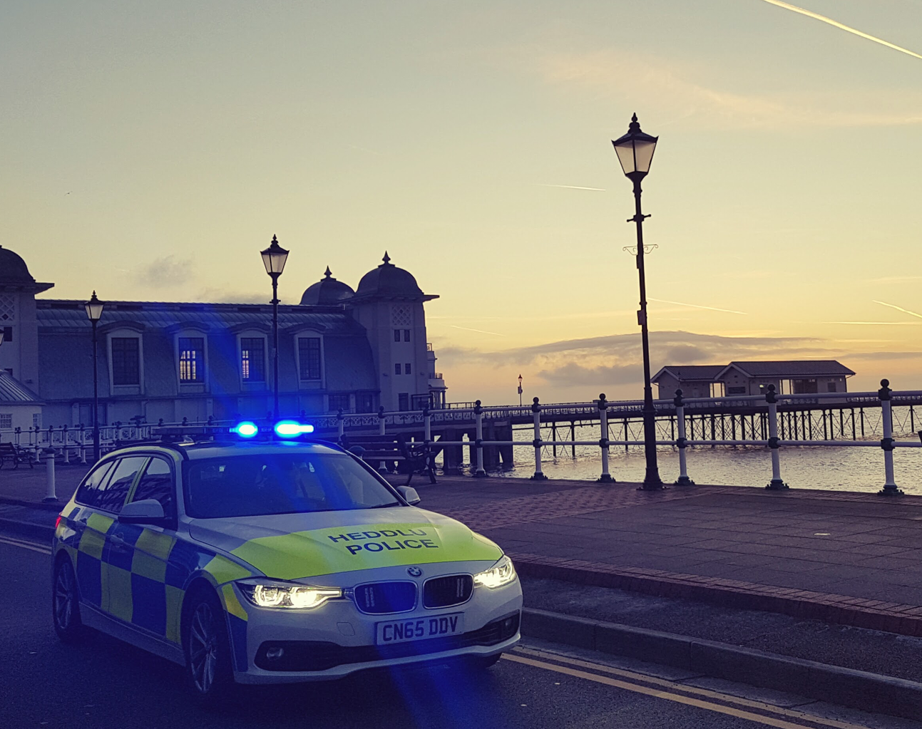
The Use of the
National Decision Model

Slide 39
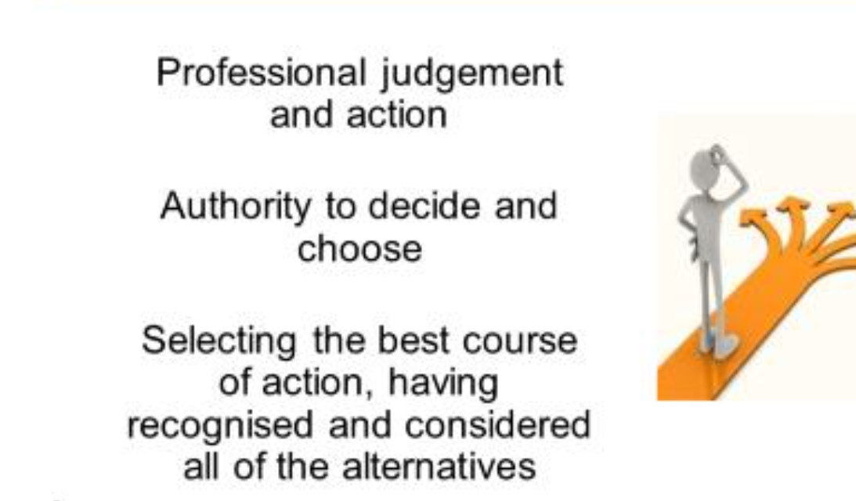
Discretion – what does it mean??
1. What does the word discretion mean to you?
2. Why do the police have discretion in dealing with persons?
(College of Policing, 2021)

Slide 40
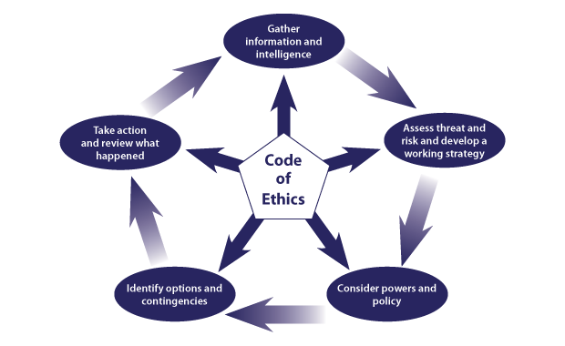
The National Decision Model (NDM)
Helps everyone in policing make decisions
Provides a framework in which decisions can be examined and challenged
Encourages officers and staff to act in accordance with the Code of Ethics and use their discretion where appropriate
Reduces risk aversion and weighs the balance of resourcing against demand, threat and risk

Slide 41

Notes:
The Human Rights Act 1998 (HRA) requires all public authorities, including the police, to act in a way which is compatible with the European Convention on Human Rights (ECHR) unless they are prevented from doing so by primary legislation, or by secondary legislation made under the primary legislation which cannot be interpreted compatibly with the convention

Slide 42

What are Human Rights?
There are 16 basic rights in the Human Rights Act 1998 – all taken from the European Convention on Human Rights
They can be grouped into three broad types:
Absolute rights – such as the right to protection from torture and inhuman and degrading treatment (Article 3). The state can never withhold or take away these rights.
Limited rights – such as the right to liberty (Article 5). These rights may be limited under explicit and finite circumstances.
Qualified rights – rights which require a balance between the rights of the individual and the needs of the wider community or state interest. These include: the right to respect for private and family life (Article 8)

Slide 43
TASK- In groups….
Research the 16 basic Human Rights within the groups:-
GROUP 1- Absolute rights
GROUP 2- Limited rights
GROUP 3- Qualified rights
List a summary of the Human Right along with the article number
Each group is to note these down on a PP and email to:- s.france@uwtsd.ac.uk

Slide 44
Qualified rights
Sadie and Hannah

Slide 45
What are qualified rights?
The right to respect for private and family life, home and correspondence
The right to freedom of thought, conscious and religion
The right to freedom of expression
The right to freedom of assembly and association
The right to protection of property
In summary
Qualified rights are those requiring a balance between the rights of the individual and the needs of another or of the wider community for example when your right to free may have to be restricted to protect someone else’s right to privacy this includes articles 8,9,10 and 11

Slide 46

Limited rights
By jemima and luci

Slide 47
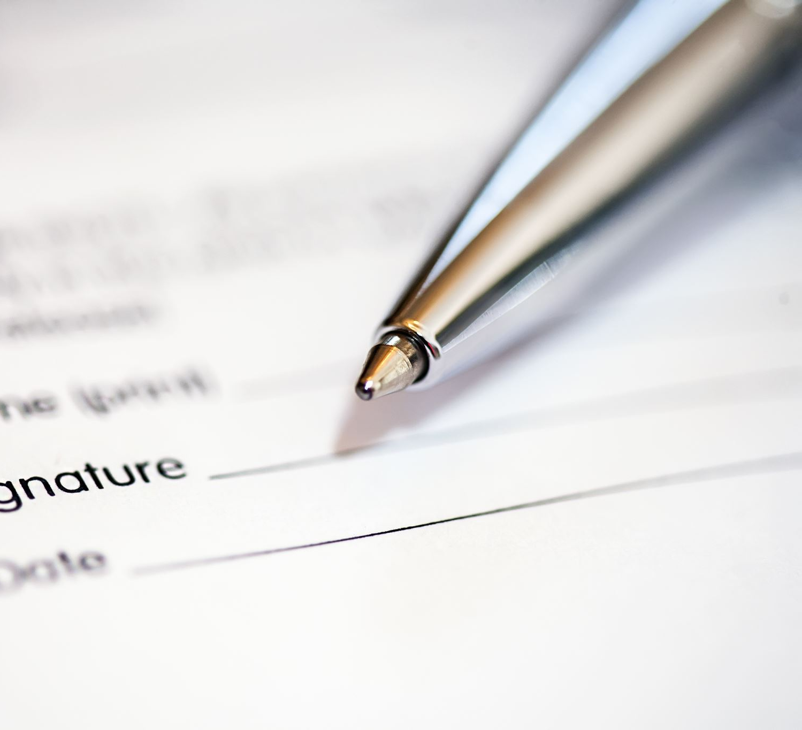
Definition
Limited rights mean that they can only be restricted in specific situations set out in the human right act.

Slide 48
Article 2 – the right to life – which means nobody including the government can try to end your life.
Article 5 – the right to liberty – protects your right not to be deprived of your liberty or freedom unless it's in accordance with the law. This means you mustn’t be imprisoned or detained unless there's a law which allows it, and the correct procedure is followed.

Slide 49
Absolute Rights
By Harrison, Leo and Patrick

Slide 50
Article 2 – Right to Life
Prohibits the intentional deprivation of another's life excepting the execution of a sentence of court where a death penalty is provided by law or where such death results from the use of necessary force in self defence to effect a lawful arrest prevent escape of a person lawfully detained or a quell a riot or insurrection.
The death penalty has been abolished in the UK (13th Protocol Article 1)

Slide 51
Article 3 – Right to freedom
From torture
From inhumane or degrading treatment
Courts have found beating as a form of torture found in the case;
Aydein V Turkey 1997

Slide 52
Article 4 – Right to freedom
From slavery and servitude
From forced labour
Represented by the image of the person bound by chains and caged

Slide 53
Article 6 – Right to a fair trial
Hearing must be fair and free from bias
The accused must have legal representation
The trial can be either public or private due to mitigating circumstances
Right to see documents
Notice
As soon as practicable
Reasons for decision

Slide 54
Just for fun…
Detective Skills Test - CSI Exam - See if You're a Good Detective in 2 Minutes (youtube.com)

Slide 55

Questions

Slide 56
To conclude
Introduction to module
Looked at assignments
What is meant by conducting investigations
Investigative mindset
NDM
Human Rights act 1998
Next week…
Guest speaker
Evidence
Crime scenes

