Slide 1

Communication within Health and Social Care
Halima Bibi
2129612

Slide 2
Aim
Types of Communication
Transactional Model of Communication
Relevance of Effective Communication
Miscommunication
Health Passport

Slide 3

What is communication?
Verbal and non-verbal
Letters/emails
Appointments
Prescriptions
Care plans
Relaying of information from one party to another
(Azam, 2010)

Slide 4
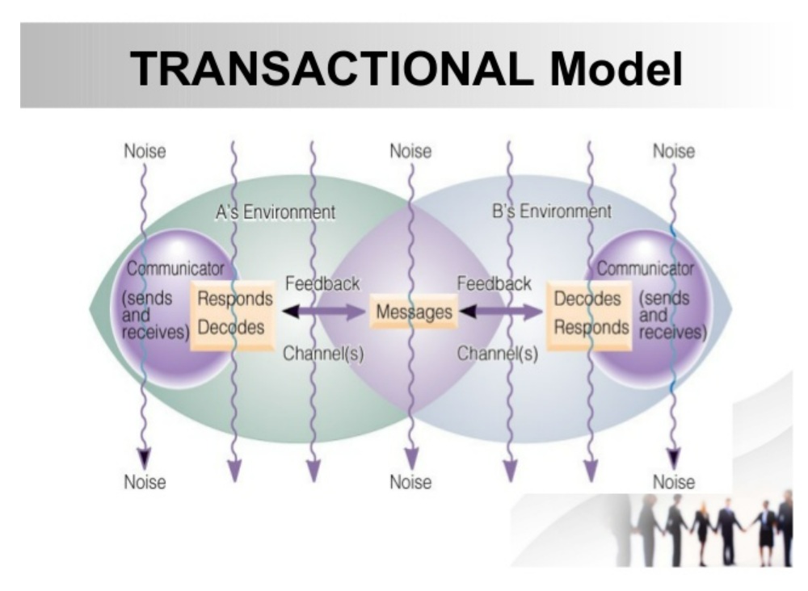
Transactional Model of Communication
Barnlund Transactional Model of Communication (2003), proposes:
Communication is fluid, messages are sent and received continuously and are reciprocal.
Feedback is constant.
Noise are barriers to communication.
(Mims et al.,2019)
(Biznews,2023)

Slide 5

Relevance of Effective Communication
Bridges the gap between care providers and service users
Builds trust between colleagues and service users
Ensures all parties have the relevant information needed to optimize care
Enables the facilitation of the best outcome for the service user
Communicate with empathy, remaining professional
(Portland Community College, 2016)

Slide 6

Misscommunication
When things go wrong…
Use the aacs framework
Acknowledge
Analyse
Consequences
solution
(Frohmon and Lupton,2020)

Slide 7

Health Passport
Ideal for people with multiple health problems
People with Dementia may have several other health issues
As Dementia worsens, they may be unable to communicate their needs
Health Passports may be a solution by:
Providing cohesive care
Ensuring all Health and Social Care providers are aware of the patients needs
Allows for greater autonomy of individuals
(Leavey et al.2020)

Slide 8

Summary
Communication is the backbone that keeps health and social care standing.
I have discussed:
Types of communication and its importance.
Described the transactional model of communication.
What to do when communication fails.
A practical example of communication- Health Passport.

Slide 9
Reference list
Azam, N., (2010) ‘Communication cycle: Definition, process, models and examples’ Academia, Available at: https://d1wqtxts1xzle7.cloudfront.net/56694648/FINANCE-17-with-cover-page-v2.pdf?Expires=1668810469&Signature=EazOcekHYb0uu0eHRFW4kbN5gJunppV4ErAtiyJBDHt1MWkP29n7Tp-MwgA8uUHKGhEKxDvWpmenbvuo7cOgNl6RjBBYTDA2pu9BCRHQwgZUykaDdbluEXZ3zIocXhb1c9PuJivDSwXuARkM4ZZSGOTM-slSHzANg5ykPQWjgv62H4yrTDY-1Wtuiz0j8feGZBqU4FUcuzuzgZzLaM5ooBvbETG6wHUPw4tsfoxEEGLoZnMcewa3lMyYIw-zWm9zzaEwoIIpw8n-Q97Dlc69tv3Fis3izjfvg4eWiUhk65PgtJbIHeB~~Iqx0P08vEZDy167kPz7ArgKiATiHrUEJA__&Key-Pair-Id=APKAJLOHF5GGSLRBV4ZA (Accessed: 28 Jan. 23
Biznews, (2023),Barnlund transactional model of communication, hpd consultants, Available at:https://biznewske.com/barnlund-transactional-model-of-communication/ (Accessed: 22 Feb 2023).
Frohman, R, & Lupton, K (2020), Critical Thinking for Nursing, Health and Social Care, Bloomsbury Publishing Plc, London. Available from: ProQuest Ebook Central. (Accessed:01 February, 2023)
Portland Community College (2016) The 7 Benefits of Effective Communication in Personal and Professional Settings. Available at: http://climb.pcc.edu/blog/the-7-benefits-of-effective-communication-in-personal-and-professional-settings#:~:text=The%207%20Benefits%20of%20Effective%20Communication%20in%20Personal,productivity%20...%207%207.%20Promotes%20team%20building%20 (Accessed:27 January 2023).

Slide 10
Reference list
Mims, B., Simon, W. and Duque, M., 2019. Communications and Information Existing Models Paper for 2019 DUET Megacity Project.
Leavey, G., Curran, E., Fullerton, E., et al. (2020) ‘Patient and service-related barriers and facitators to the acceptance and use of interventions to promote communication in health and social care: a realist review’, BMC health services research, 20(1), pp. 503–503. Available at: https://doi.org/10.1186/s12913-020-05366-4. (Accessed: 27 January 2023).
Portland Community College (2016) The 7 Benefits of Effective Communication in Personal and Professional Settings. Available at: http://climb.pcc.edu/blog/the-7-benefits-of-effective-communication-in-personal-and-professional-settings#:~:text=The%207%20Benefits%20of%20Effective%20Communication%20in%20Personal,productivity%20...%207%207.%20Promotes%20team%20building%20 (Accessed:27 January 2023).

