Slide 1
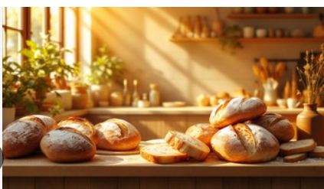
Basil’s Bakery Plus
Problem Solving and Decision Making
Component 1: Individual Presentation
Student Name: Cheick Sheick Raazaq Hussain
Student Number: 2535395
Module Code: LCLM4004
Module: Problem Solving and Decision Making
Lecturer:

Slide 2
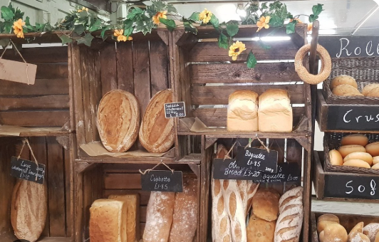
Basil’s Bakery
Bakery operating independently within the Coventry retail park
Founded in 2015
Makes cakes, pastries, and breads
Uses organic quality raw materials for manufacturing products
Was seeing an increase in sales every year
Has seen a decrease in sales because of the pandemic
There has been an increase in sales but lower than the sales in 2019
The projected sales for 2023-2025 are expected to be 25% lower than those in 2019
The footfall within the retail park and consumer demand have changed
Source: Basil’s Bakery case study (LCLM4004, 2026)

Slide 3
NATURE AND SCOPE OF THE PROBLEM
Main issue:
Decreased sales and uncertainty regarding the prospects of the existing business model in the future.
Issues:
1. Reduced customer flow
There is less traffic at the retail park
Some stores have closed down
Vacant stores are unoccupied
2. Customer change of behavior
Working from home becomes increasingly popular
Office employees visit less often
Delivery services are more in demand by customers
3. Limited services
Delivery services are unavailable
Advanced order is difficult
Basil has to be present at the store to prepare the meals
4. Increased expenses
Water and energy expenses
Expenses on rent
Rates for the business
Insurance
Organic ingredients expense
In conclusion:
Less demand + limited accessibility + high expenses = decreased profitability
Source: Basil’s Bakery case study, 2026

Slide 4
WHY PESTEL?
PESTLE analysis is concerned with the outside environment of the business entity:
Factor | Focus
P – Political | Government policy and public support
E – Economic | Costs, income and consumer spending
S – Social | Customer lifestyles and behaviour
T – Technological | Digital systems and new ways of working
E – Environmental | Sustainability, climate and resources
L – Legal | Laws and regulatory requirements
Why to use it?
Opportunities and threats in external environment
Structure of environmental scanning (Sammut-Bonnici and Galea, 2015)
Aids in comprehending factors beyond the organizational control
Strategic decisions making tool (Yüksel, 2012)
Weakness: PESTLE analysis doesn’t provide the information on which factor is more important and creates another one.
Source: Yüksel, 2012; Sammut-Bonnici and Galea, 2015)

Slide 5
PESTEL ANALYSIS: POLITICAL AND ECONOMIC
E - Economic
Higher utility charges
Higher rent and business rates
Expensive insurance bills
Organic produce becomes more expensive
Spendings by customers fall
Implication for Costs and Profit Margins
Evidence
Situation in the UK economy and retail industry remains unstable as per statistics released by the Office of National Statistics (ONS, 2026).
Implication for Basil
The economic difficulties have a two fold impact on business in that costs are increasing while demand is decreasing.
P - Political
Governments’ policy may impact business rates and taxes
Decision by the local government can affect the appeal of the retail park
Government support for small business can be seen as an opportunity
Regulations concerning food and business can be seen as compliance
Implication for Basil
Political and local government decisions can impact costs associated with business as well as appeal of the retail park where Basil works.
Source: Basil’s Bakery case study, 2026; ONS, 2026

Slide 6
PESTEL ANALYSIS: SOCIAL AND TECHNOLOGICAL
T – Technological
Current situation
Phone pre-orders do not work effectively during peak periods
Absence of an online order system
Lack of a digital order/delivery portal
Difficulties with making orders while Basil is baking
Opportunities
Website / Online orders
Click and collect
Digital pre-orders
Marketing via social media
Delivery services cooperation
Implication
Technologies will allow Basil to adapt to the changes in customer behavior without moving the bakery.
S – Social
Changes in lifestyle practices
Hybrid working implies fewer visits to the office
The number of incentives to visit the retail park each day will decline
Inconvenience is losing its importance
Some loyal customers now work/live beyond the bakery's territory
Changing customer demands
Example: 28% of employed people in Great Britain were working in hybrid mode in January-March 2025 (ONS, 2025)
Implication
It is not enough for Basil to rely on walk-in trade only.
Source: ONS, 2025; Basil’s Bakery case study, 2026

Slide 7
PESTEL ANALYSIS: ENVIRONMENTAL AND LEGAL
L - Legal
There are some legal issues that Basil should comply with related to:
Product safety and hygiene standards
Employer responsibilities
Consumer protection laws
Business and trade requirements
Personal data protection if the online ordering system is introduced
Key threat
Introduction of the online ordering and delivery system may cause legal issues.
E - Environment
Use of organic components will give Basil a competitive advantage in terms of sustainability.
Organic products may become vulnerable to crop failure.
The impact of environment disruption will influence farming (Yüksel, 2012).
Availability of ingredients and price variations are possible.
Sustainability will play an important role in branding.
Key threat
Environmental issues present both threats and opportunities.
PESTLE analysis overview
Important factors:
Economic
Social
Technological
Source: Basil’s Bakery case study, 2026; Yüksel, 2012

Slide 8
PESTEL EVALUATION
What does the PESTLE analysis tell us?
External Threats
Lower retail park activity
Fewer office workers as customers
Higher costs
Inconsistent supply of ingredients
New customer expectations
External Opportunities
Online ordering
Pre-ordering
Delivery services
Click and collect services
Digital marketing
More organic positioning of the bakery
Analysis of critical elements
Not just a matter of fewer customers. There have been changes in the external environment which means that Basil’s way of conducting business is now outdated due to changes in customer behavior.
Limitations of the PESTLE analysis
PESTLE:
Analyzes external environment
Structure
Strategic thinking
But,
Cannot determine the root cause alone
Doesn’t rank external factors
Can be subjective
Requires evidence
Source: Yüksel, 2012; Sammut-Bonnici and Galea, 2015)

Slide 9
FISHBONE / CAUSE-AND-EFFECT DIAGRAM
Consequence:
Reduced sales at basil’s bakery
PEOPLE
METHODS
TECHNOLOGY
Customers working from home
Traditional sales model
Limited digital reach
Basil must bake onsite
Limited pre-order system
Telephone limitations
Staff capacity
No delivery service
No online ordering
Organic ingredients
Quieter retail park
Higher utilities
Supply uncertainty
Hybrid working
Higher rent
Rising ingredient costs
Shops closing
Higher business rates
MATERIALS
ENVIRONMENT
COSTS / FINANCE
Source: Cause-and-effect/Fishbone approach: Ishikawa (1986)

Slide 10
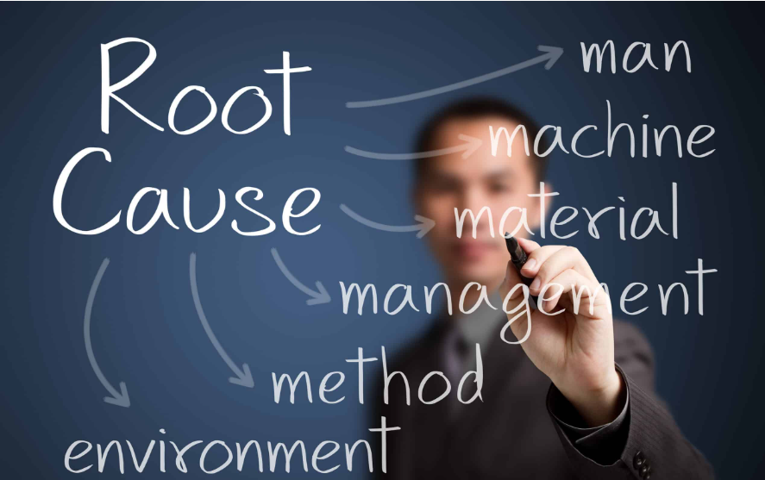
FISHBONE ANALYSIS: ROOT CAUSES
What are the important causes?
1. Accessibility to the customer base: It gets more common that customers work from home and visit the retail park infrequently.
2. Physical presence dependency: There is a high dependency of the bakery on customers who visit the retail park (Ishikawa, 1986).
3. Limited ways of ordering: It gets harder to place an order by phone as it is too busy and Basil does not have the online ordering system.
4. Delivery absence: Basil is unable to deliver orders to their loyal customers because of their relocation.
5. Expensiveness: Expensiveness makes changes less flexible.
6. Riskiness: Ingredients are subject to crop failure which affects their price.
Root cause analysis
The main root cause in this case is the gap between the way Basil operates traditionally and customer environment.
Source: Ishikawa, 1986; Basil’s Bakery case study, 2026)

Slide 11

BENEFITS AND LIMITATIONS OF FISHBONE ANALYSIS
Strengths
Offers visual illustration of a complex problem
Encourages the thinking about many causes
Helps in distinguishing between symptoms and possible causes
Enables systematic brainstorming. (Ishikawa, 1986)
Helps in communicating the relationship between various causes
Points out where more research is needed
Limitations
Does not ensure that all identified causes are significant
Depends greatly on having access to good information
Is subjective (Kumah et al., 2024)
Can lead to having too many causes
Needs additional proof to validate the root cause
Application to Basil
Fishbone identifies causes → Evidence is gathered → Prioritization of causes → Correct course of action can be taken.
Source: Ishikawa, 1986; Kumah et al., 2024

Slide 12

KEY FINDINGS
1. There are various reasons of declining sales
There isn't any one reason for the lowered sales.
2. Changes in the external environment
Retail park shopping behavior, job environment, and work behavior has changed.
3. Changes in customer behavior
The customers want convenience in terms of deliveries and pre-orders.
4. Shortcomings of current model
The current model is constrained by foot traffic and telephone ordering.
5. Increasing cost
There are increasing overheads and variable cost of organic food items.
6. Technology as a solution
Internet orders, pre-orders, click & collect and deliveries can be used to widen the customer reach.
Overall finding
The main problem that Basil has is the need to transform his bakery model.
Source: Ishikawa, 1986; Kumah et al., 2024

Slide 13

CONCLUSION AND DECISION-MAKING IMPLICATION
Conclusion
It seems that Basil needs to reconsider his business model, and he should adopt the digital model.
Areas for further consideration
1. Market demand
Number of customers who require delivery services?
What products do the consumers require?
Which delivery area is feasible?
2. Viability
Cost of delivery and technology
Profit margin
Break-even point
3. Capacity
Will Basil cope with more orders?
Additional staff required?
Increased capacity in production?
4. Customer experience
Online ordering
Pre-ordering
Pick and collect
Delivery
Decision-making guideline
Adaptation of business model based on assumptions.
Collect data → compare alternatives → analyze costs and benefits → implement → evaluate outcomes.

Slide 14
REFERENCES
Basil’s Bakery case study (2026) LCLM4004 Problem Solving and Decision Making: Component 1 Assessment Specification. Birmingham.
Ishikawa, K. (1986) Guide to Quality Control. 2nd revised edn. Tokyo: Asian Productivity Organization.
Kumah, A., Forkuo-Minka, E. and colleagues (2024) ‘Cause-and-Effect (Fishbone) Diagram: A Tool for Generating and Organizing Quality Improvement Ideas’, Global Journal on Quality and Safety in Healthcare, 7(2), pp. 85–92. doi: 10.36401/JQSH-23-42
Office for National Statistics (2025) Who has access to hybrid work in Great Britain? Availabble at: https://www.ons.gov.uk/employmentandlabourmarket/peopleinwork/employmentandemployeetypes/articles/whohasaccesstohybridworkingreatbritain/2025-06-11 (Accessed: 4 Oct 2026).
Office for National Statistics (2026) Economic activity and social change in the UK, real-time indicators. London: Office for National Statistics. Availabble at: https://www.ons.gov.uk/releases/economicactivityandsocialchangeintheukrealtimeindicators20august2026 (Accessed: 4 Oct 2026).
Sammut-Bonnici, T. and Galea, D. (2015) ‘PEST analysis’, Wiley Encyclopedia of Management. Chichester: John Wiley & Sons. Availabble at: https://doi.org/10.1002/9781118785317.weom120113 (Accessed: 4 Oct 2026)
Yüksel, İ. (2012) ‘Developing a multi-criteria decision making model for PESTEL analysis’, International Journal of Business and Management, 7(24), pp. 52–66. doi:10.5539/ijbm.v7n24p52

